Slide 1
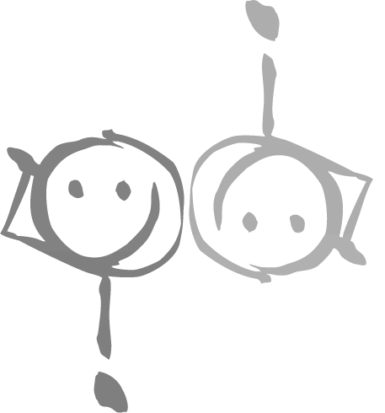
Religious Tourism in Bavaria
Staatliche Wirtschaftsschule an der Bayerischen Landesschule für Körperbehinderte in München
seit 1832

Slide 2
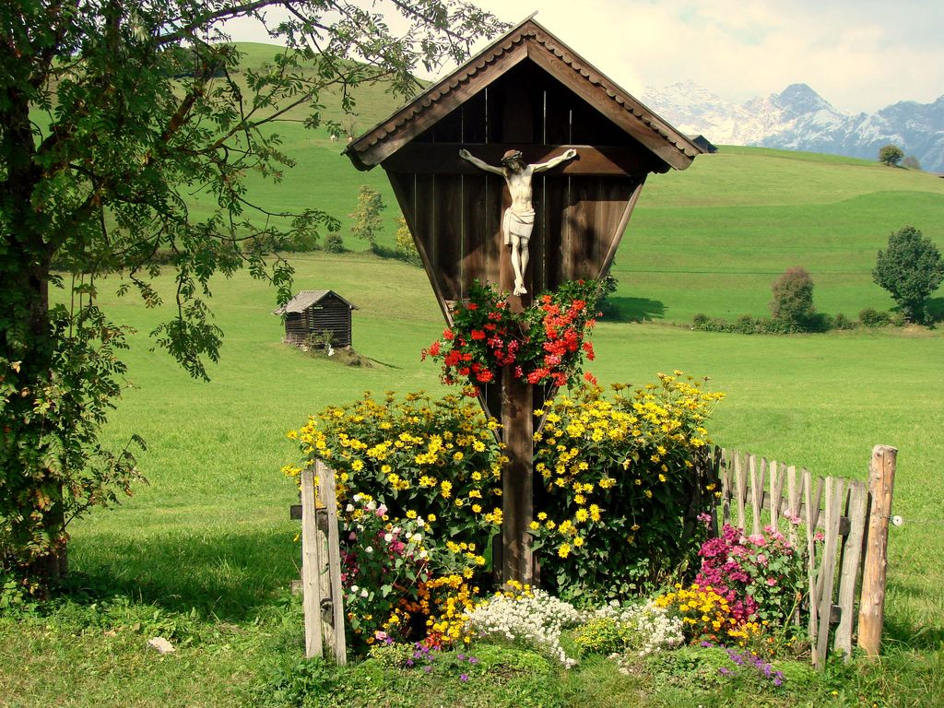
Table of Contents
RELIOUS FACTS ABOUT OUR SCHOOL
THE BAVARIAN POPE
PILGRIMAGES
PROCESSIONS
TOURISTIC PLACES OF RELIGION
MAJOR RELIGOUS FESTIVALS

Slide 3
1. RELIOUS FACTS ABOUT OUR SCHOOL student Survey AT our school

Slide 4
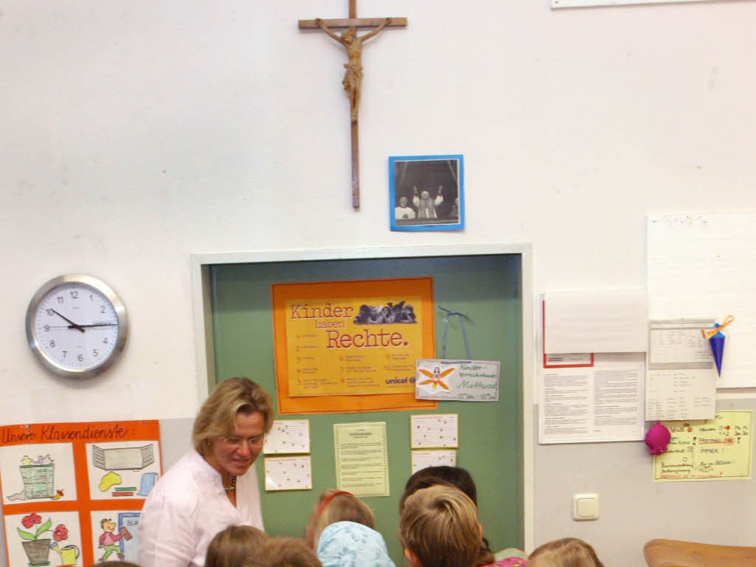
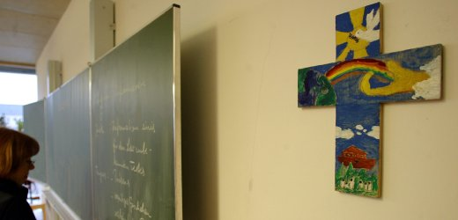
crosses in classrooms
Notes:
it is common that crosses in classrooms or in front of schools suspended as a sign of faith in religion

Slide 5
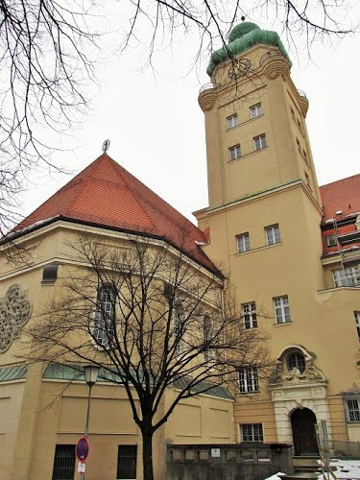
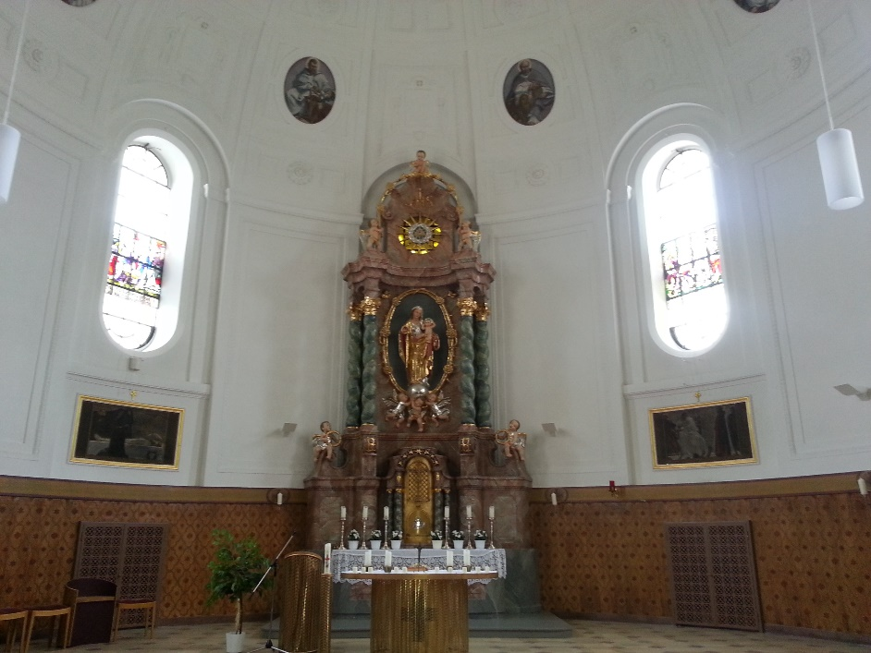
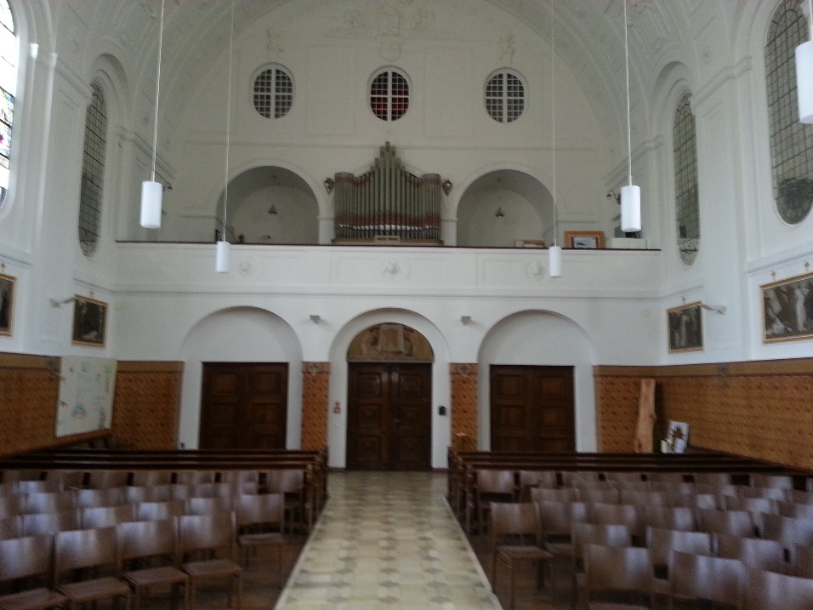
Our own school Church
Notes:
it is common that crosses in classrooms or in front of schools suspended as a sign of faith in religion

Slide 6
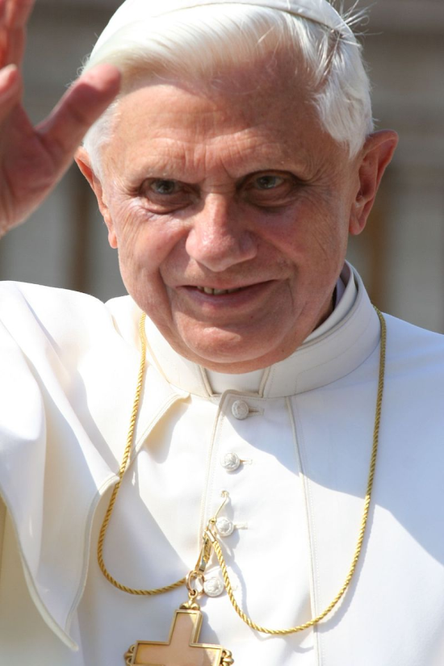
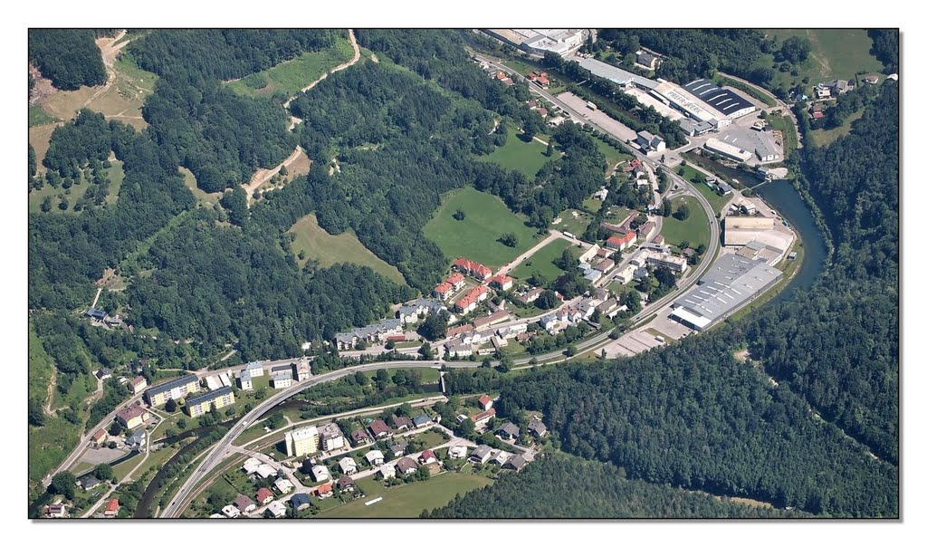
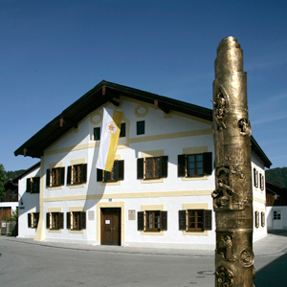
2. The Bavarian Pope
Pope Benedict (Joseph Ratzinger) was born on 16/04/1927 in Marktl am Inn, a small Bavarian town
he was the first German Pope since Adrian VI (1523)
since 28/02/2013 he is still Pope, but you call him now Emeritus Pope or Holy Father
many tourists visit nowadays his birth place
Notes:
he was April 19, 2005 until his resignation on 28 February 2013, the head of the Catholic Church at the Vatican roem.

Slide 7
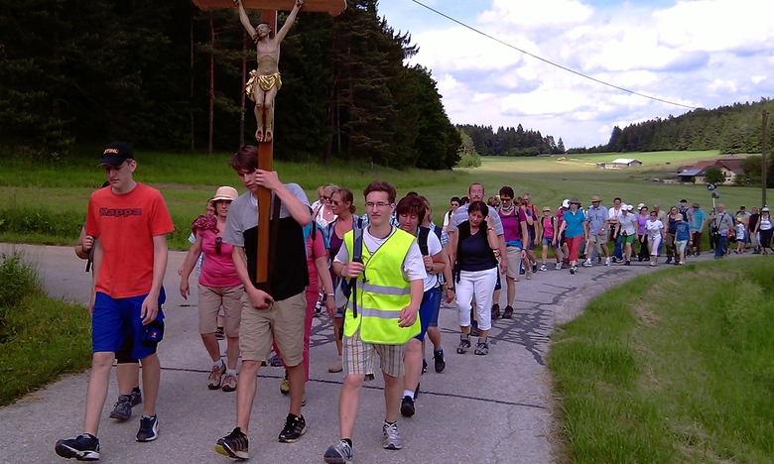
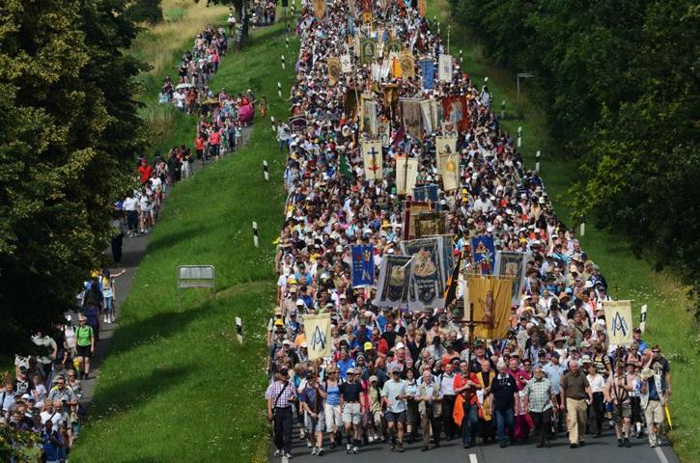
3. Pilgrimages
traditional hiking for one or several days in the group e.g. with the parish church to legally recognize places of pilgrimage

Slide 8
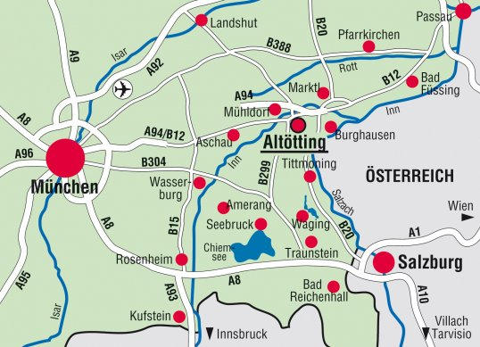
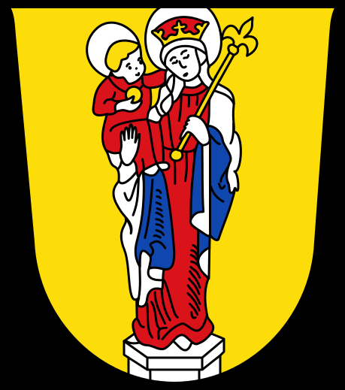
Altötting

Slide 9
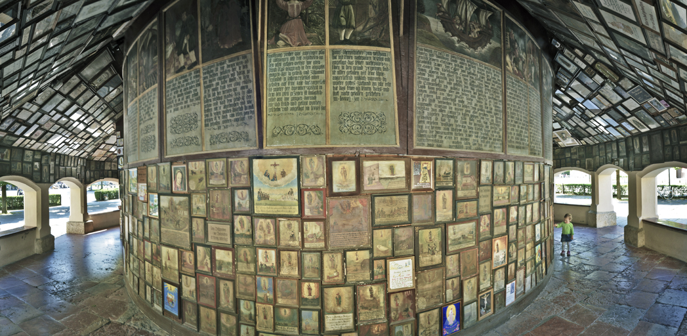
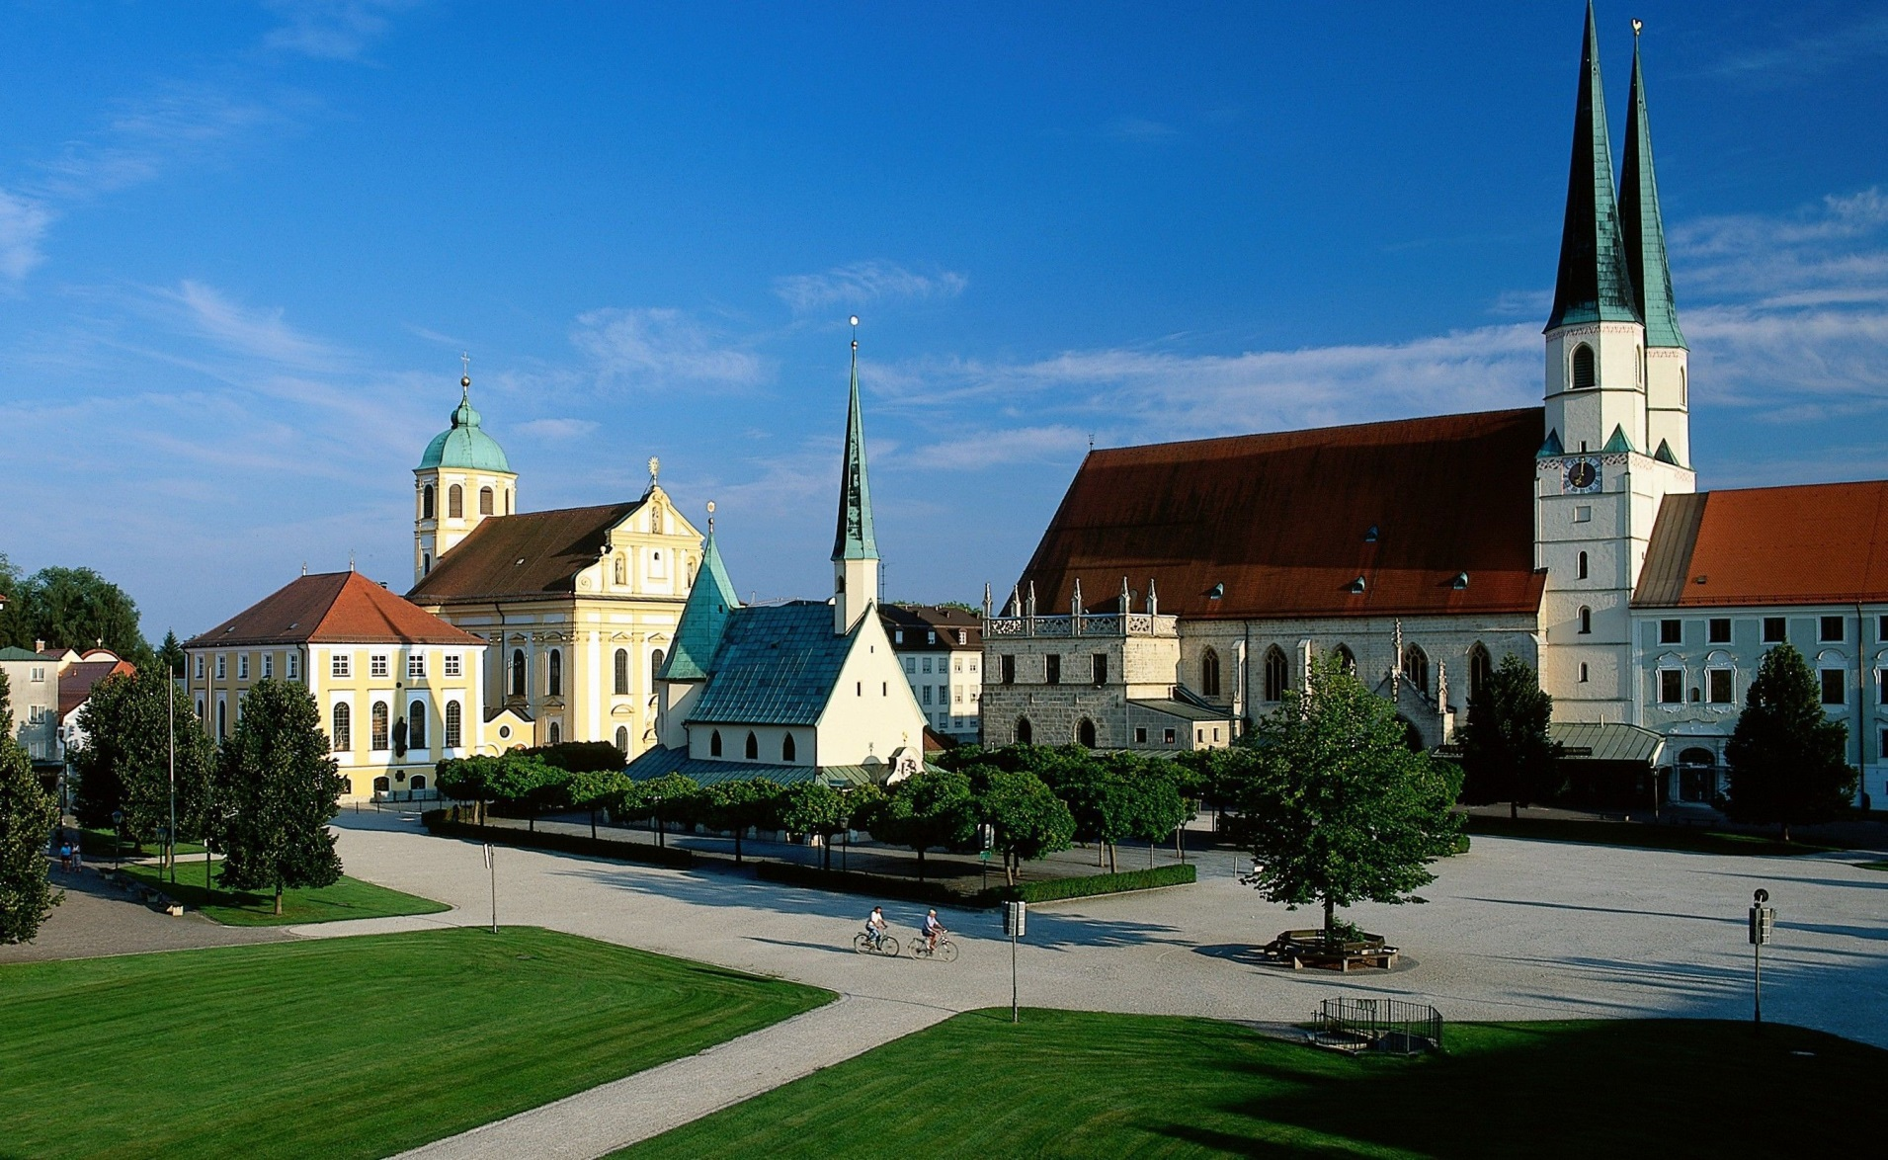
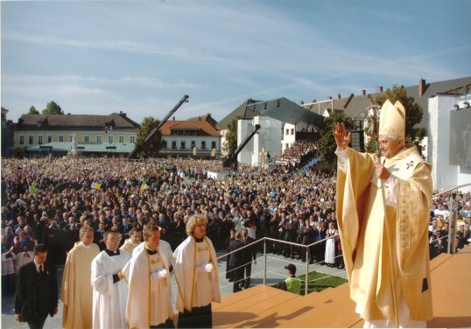
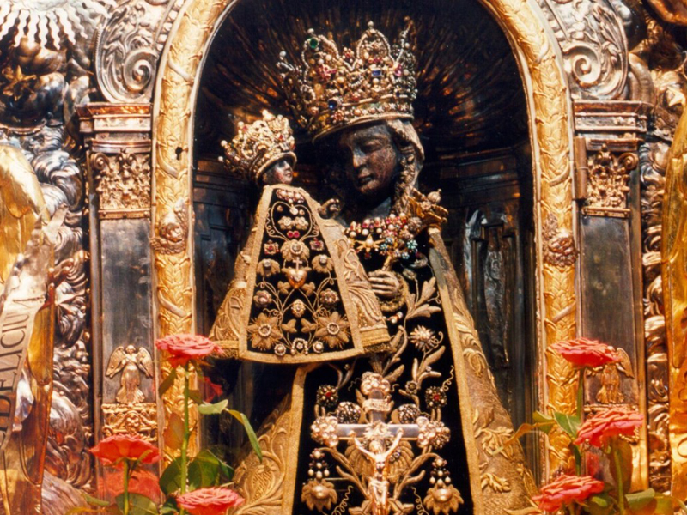
Altötting

Slide 10
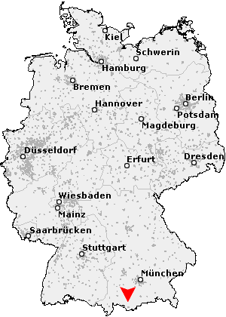
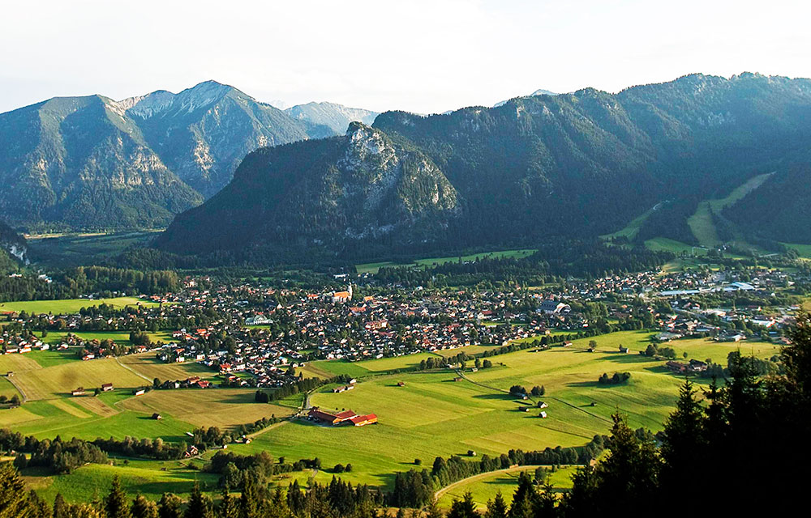
Oberammergau
Notes:
Oberammergau is a municipality in the Upper Bavarian district of Garmisch-Partenkirchen. It is located in the river Ammer Ammer valley.
Oberammergau is known mainly by every ten-yearly Passion Plays, which were listed last year of 2010

Slide 11
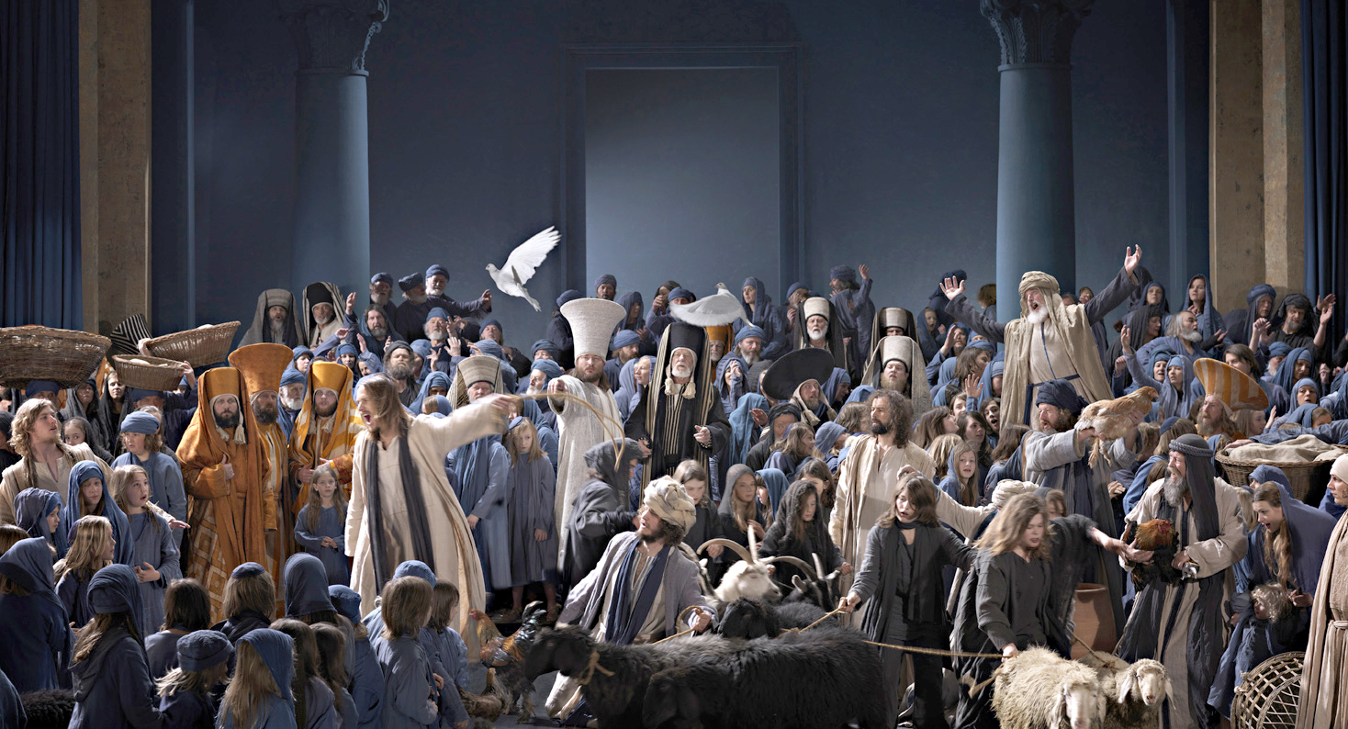
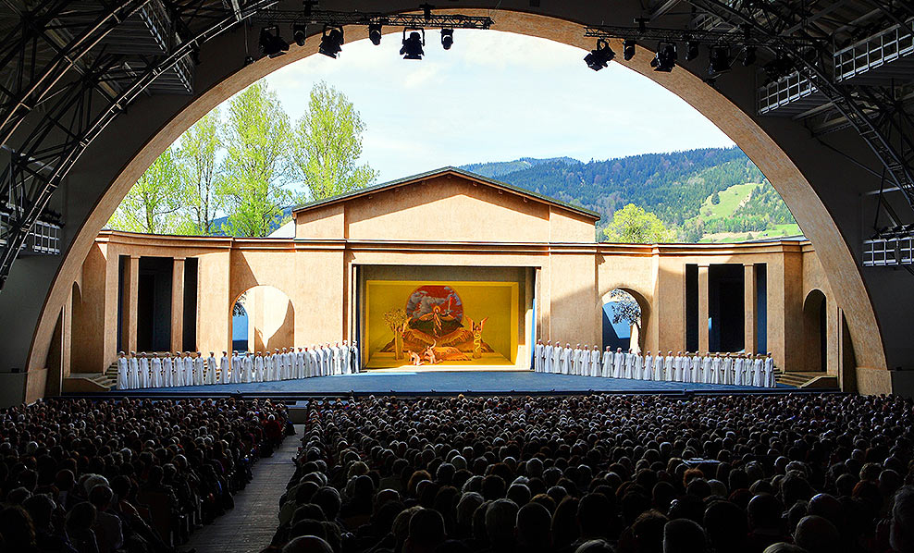
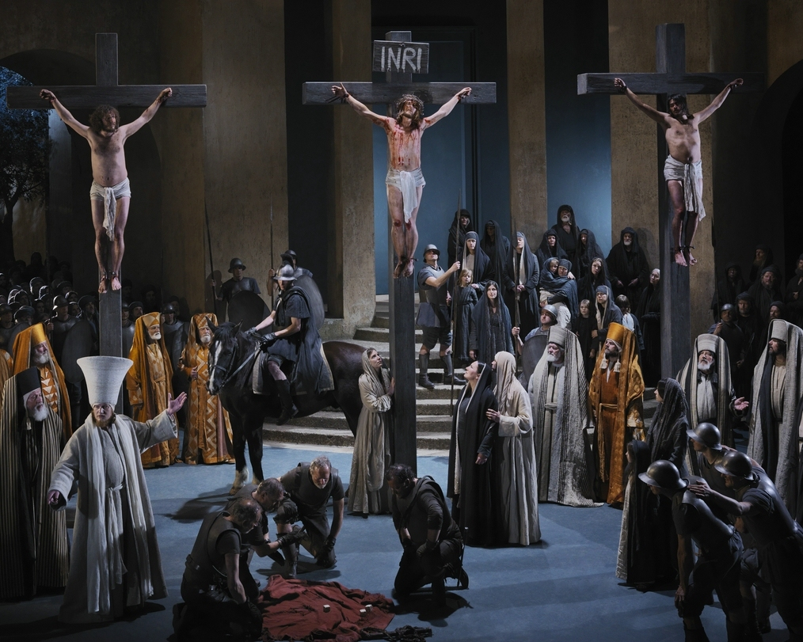
PassionsPLAY
Notes:
The Oberammergau Passion Play is the world's most famous Passion Play, in an hour-long performance make the villagers of Oberammergau the latest five days after the life of Jesus.

Slide 12
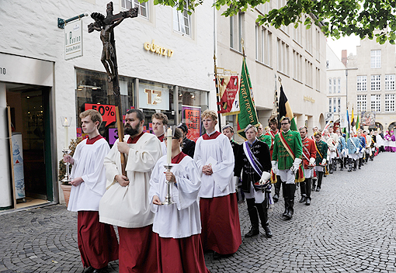
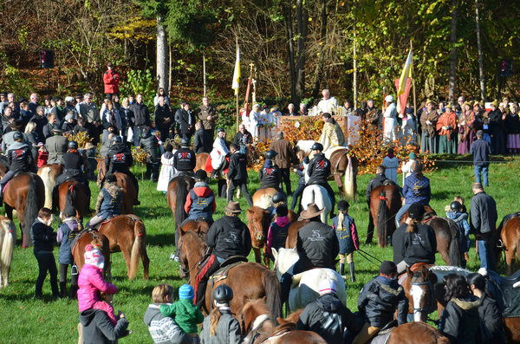
4. Processions
processions to famous places of pilgrimage
Bavarian people have special costumes for the various days of celebration
e.g. Leonhardiritt

Slide 13
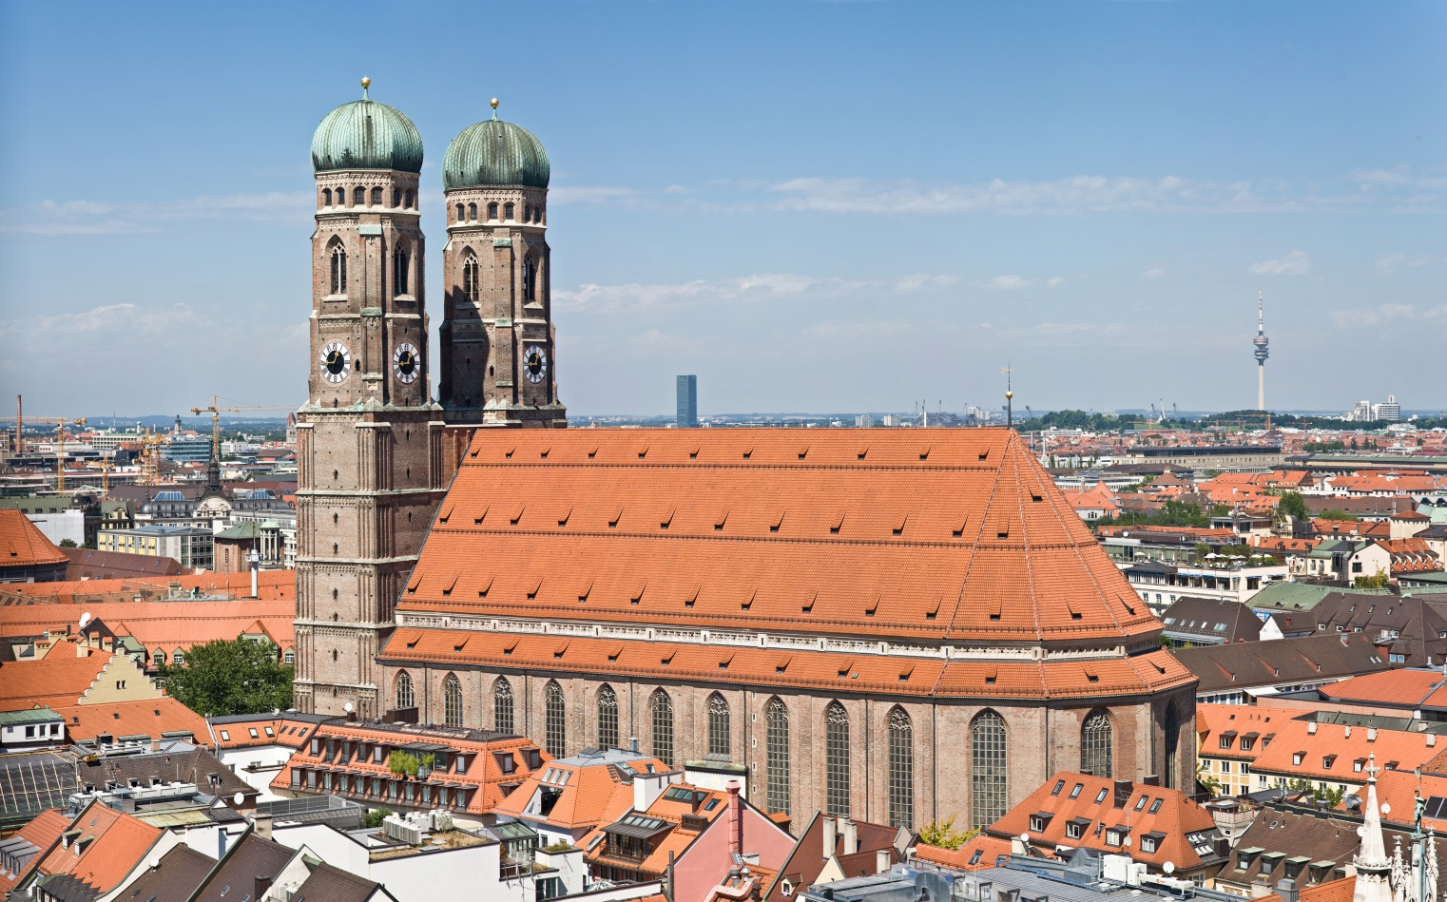
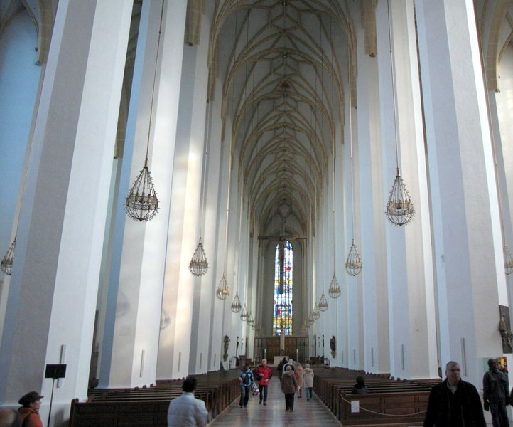
5. TOURISTIC PLACES OF RELIGION Frauenkirche (Munich)
Notes:
is a symbol of the Bavarian capital, Munich
The Church has seating about 20,000 people place

Slide 14
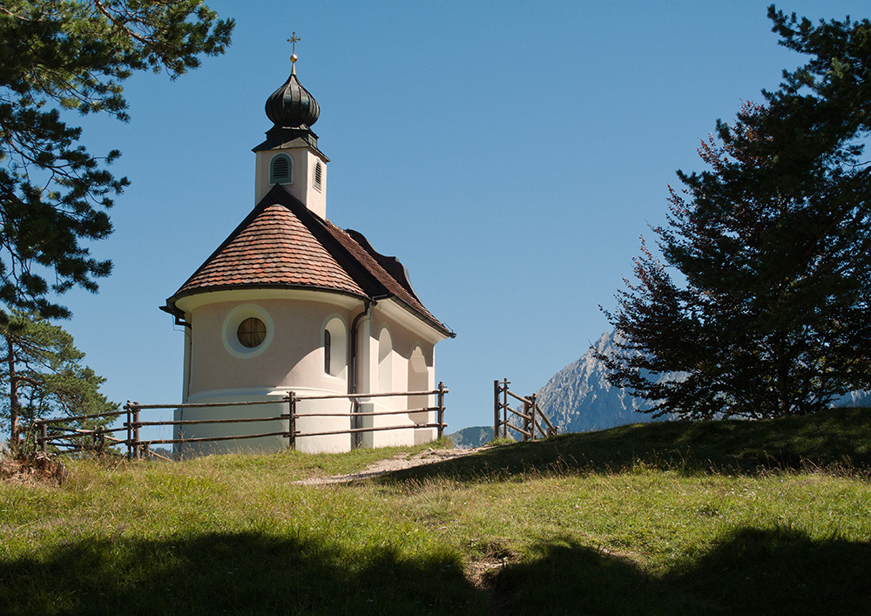
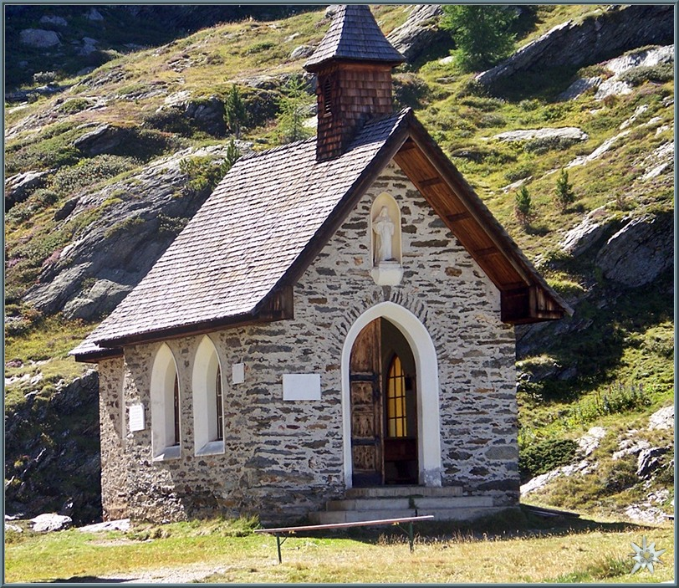
chapels

Slide 15
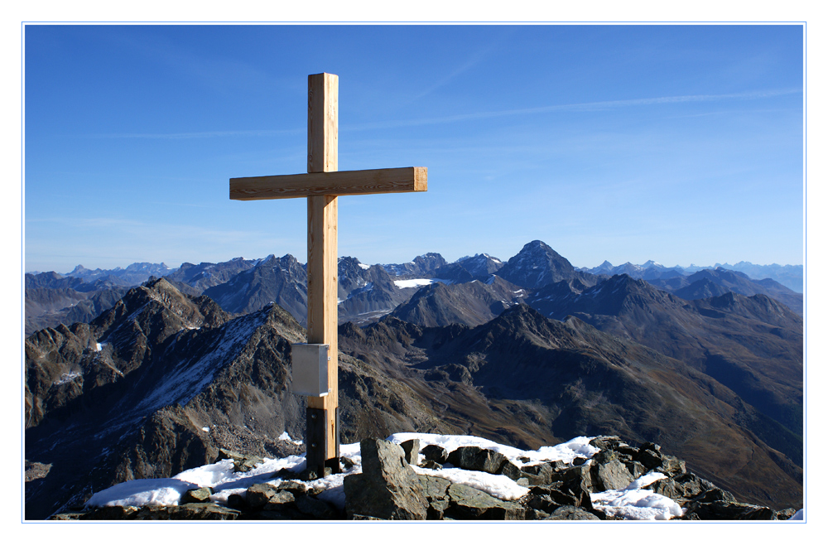
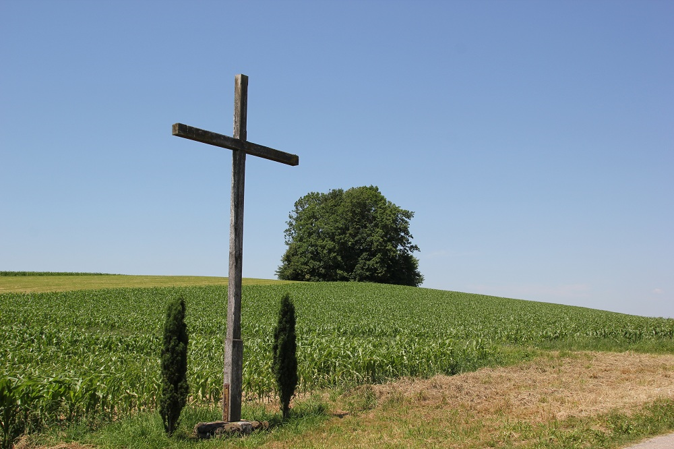
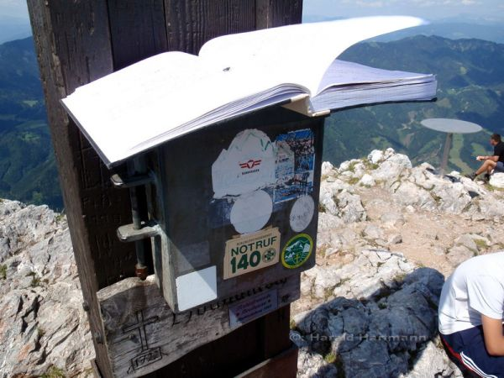
wayside crosses (crucifix)

Slide 16
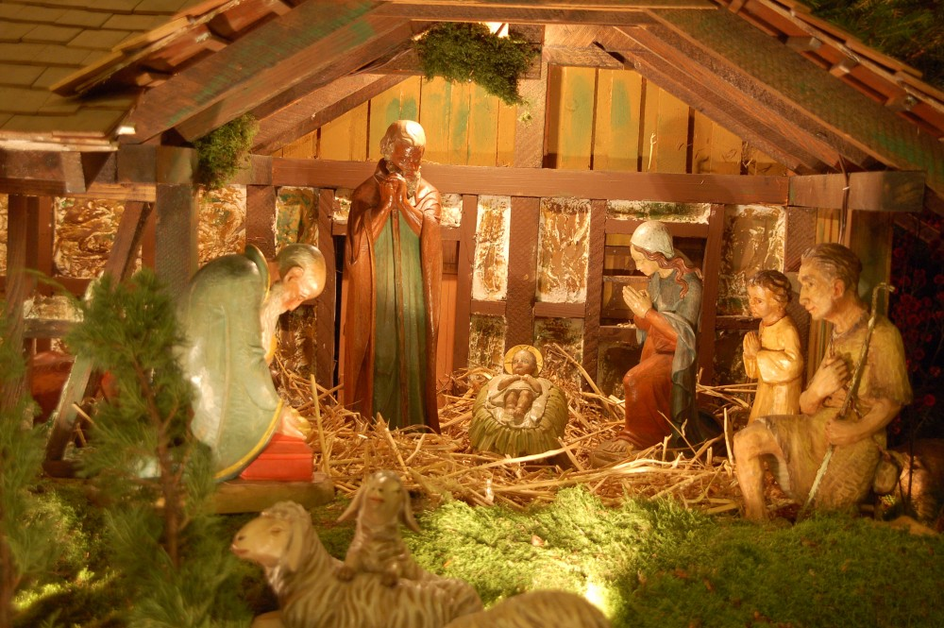
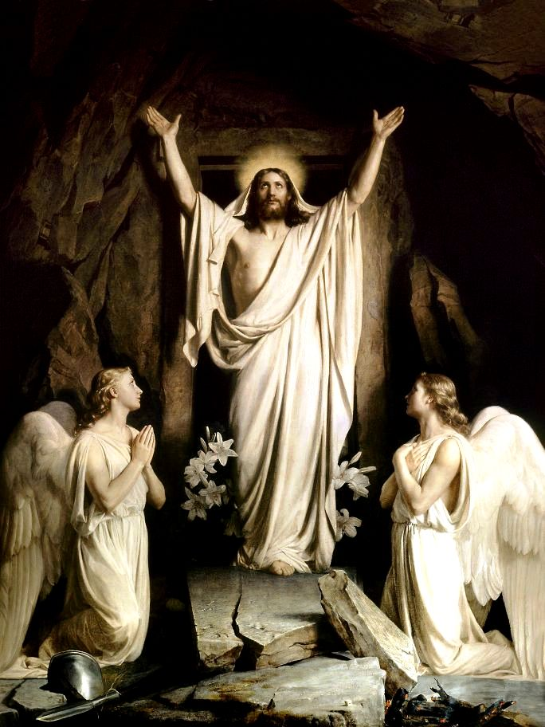
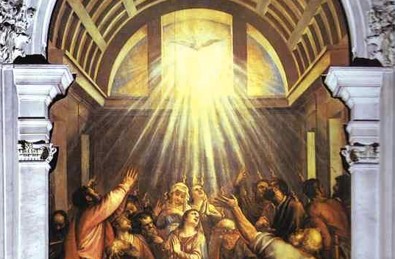
6. major religious festivals
Christmas
Pentecost
Easter

Slide 17
Thank you for your Attention!

