Slide 1
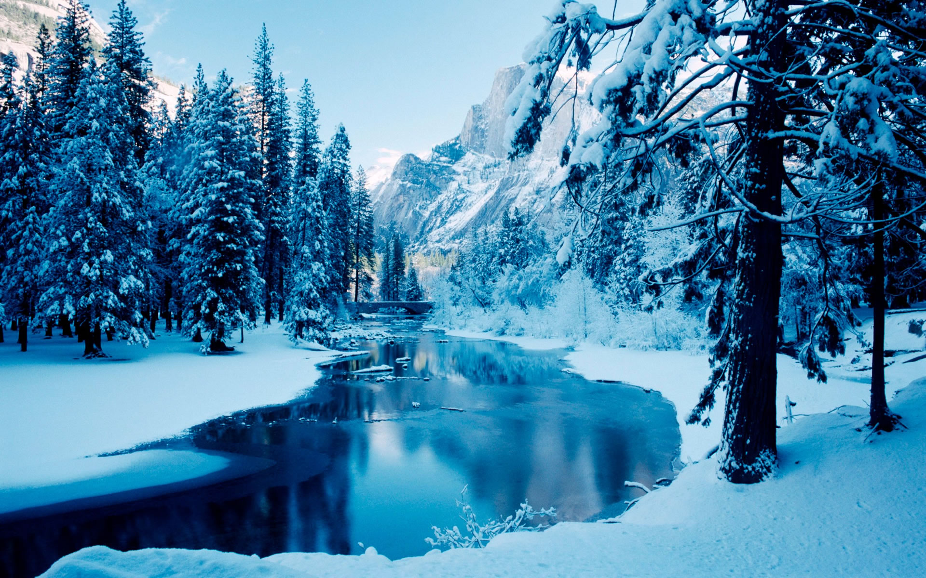
Sustainable Winter Tourism
Staatliche Wirtschaftsschule an der Bayerischen Landesschule für Körperbehinderte in München
seit 1832

Slide 2
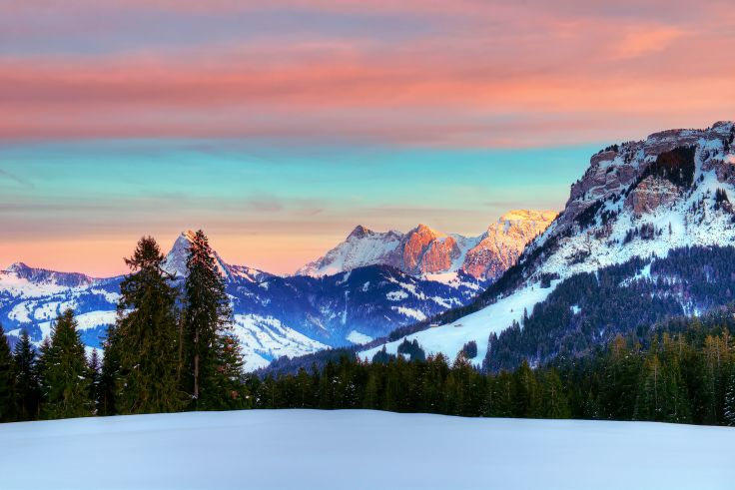
Topics
Bavarian winter sport regions
Bavarian Forest
The Alps
Sustainable winter sport activities
Cross-country skiing
Snowshoeing
Go sledging
Non-sustainable winter sport activities
Downhill-skiing
Snowboarding
Negative impacts of non-sustainable winter sport activities
Possible solutions

Slide 3
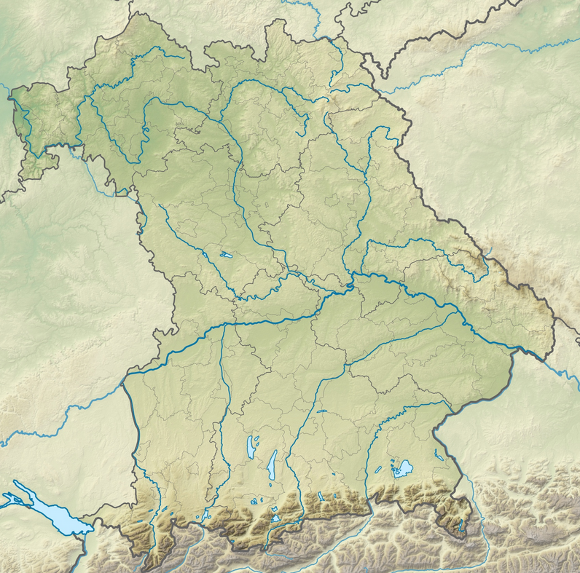
1. Bavarian winter sport regions
Bavaria Forest
MUNICH
The Alps

Slide 4
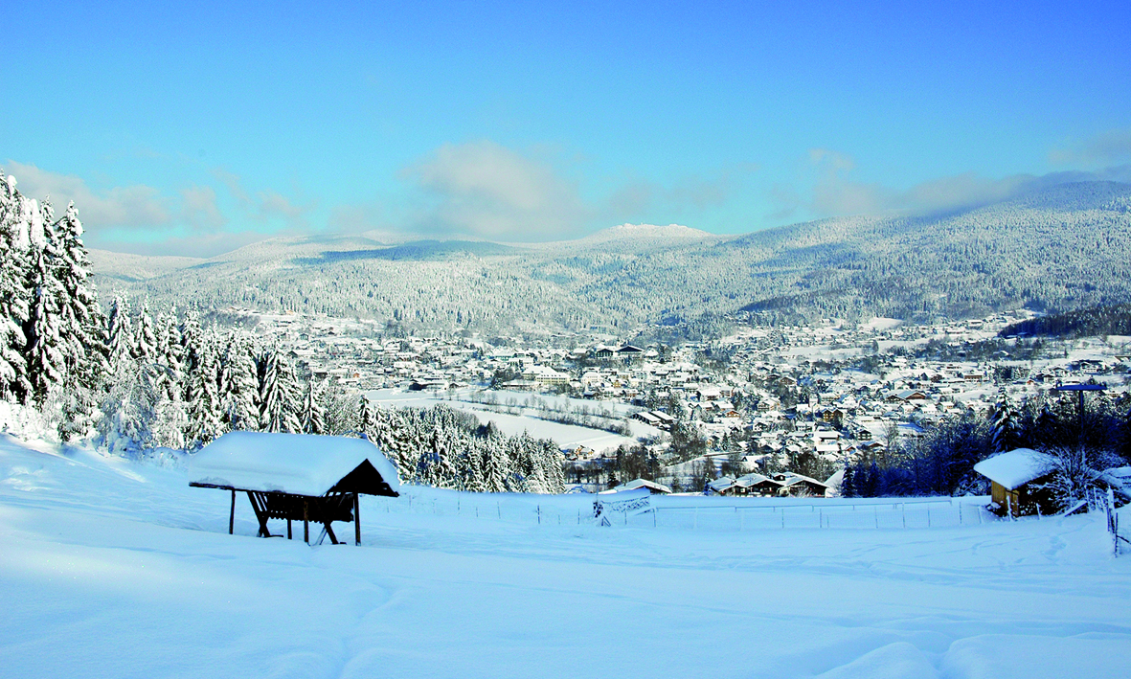
1. Bavarian winter sport regions Bavarian Forest
hilly landscape of the Bavarian Forest
Notes:
The Bavarian Forest is a wooded low-mountain region in Bavaria, Germany. It extends along the Czech border. At The picture you can see the hilly landscape of the Bavarian forest.

Slide 5
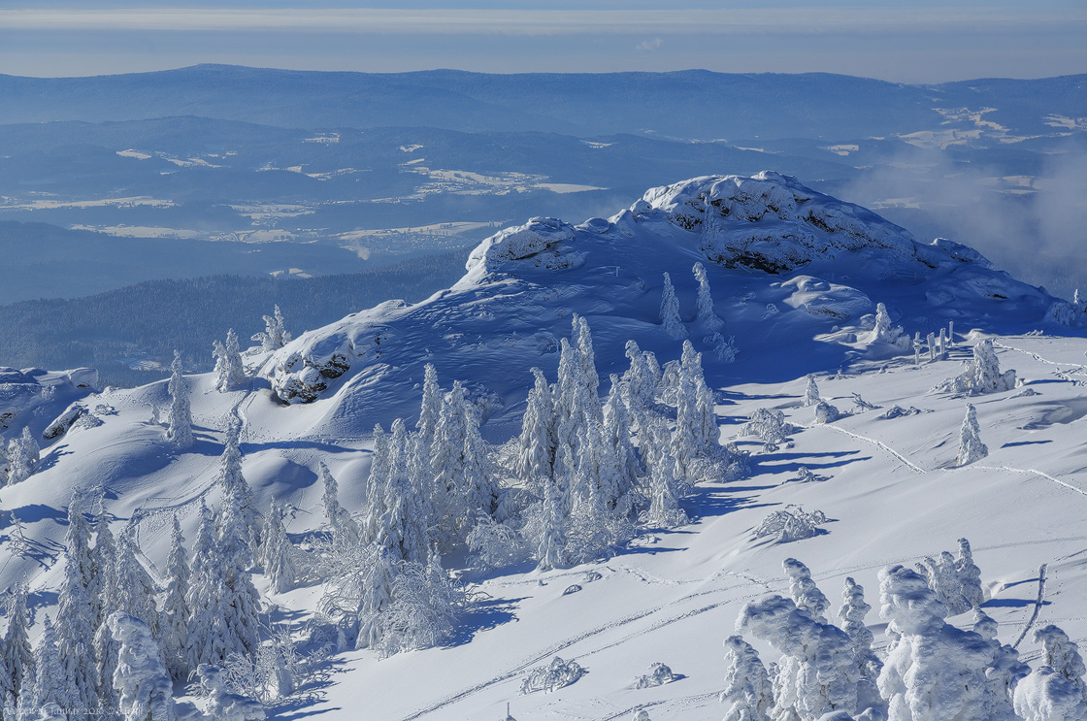
1. Bavarian winter sport regions Bavarian Forest
Summit of the Great Arber
(1.455,5 m on high)
Notes:
This is the summit of the Great Arber. It is with 1.455,5 m. ü. NHN, the largest point of the Bavarian forest.

Slide 6
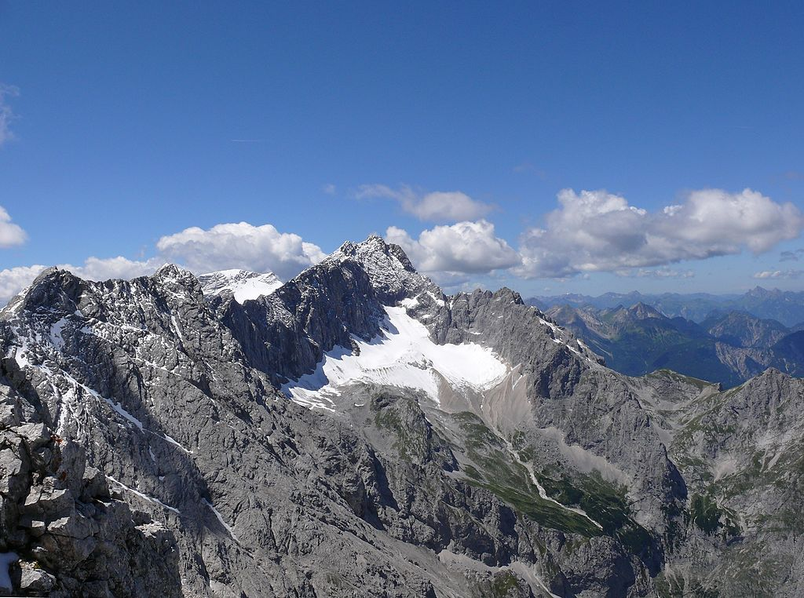
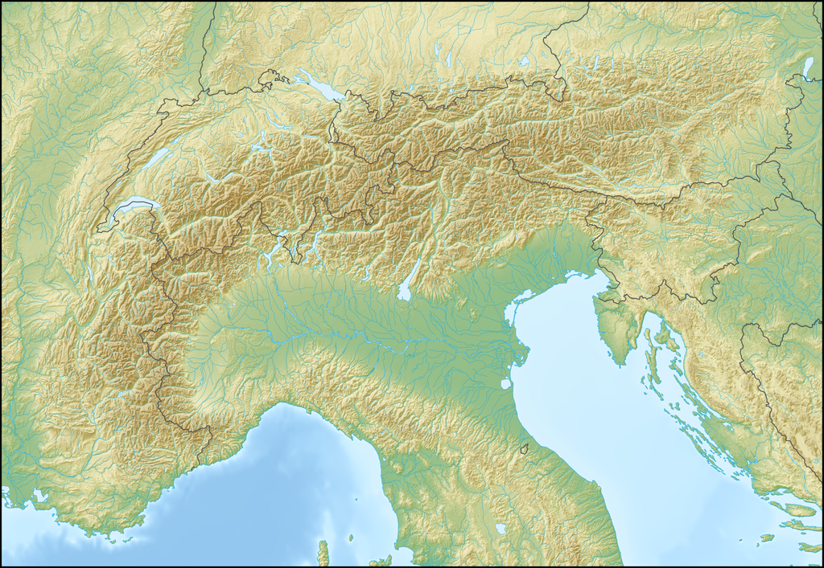
1. Bavarian winter sport regions The Alps
Munich
Zugspitze
highest mountain in Germany
(2.962,02 on high)

Slide 7
2. Sustainable winter sport activities

Slide 8
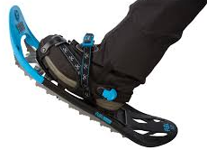
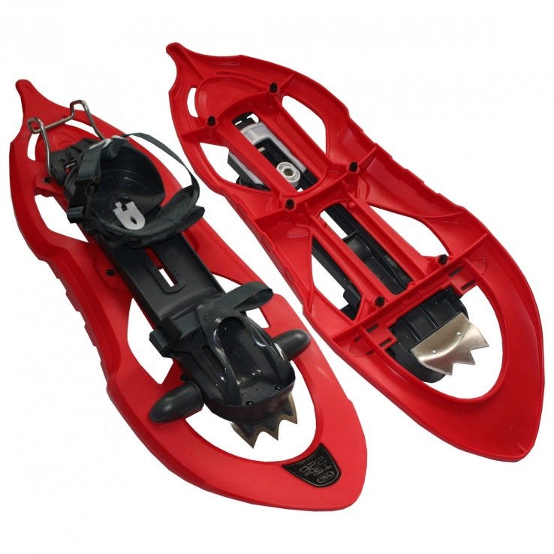
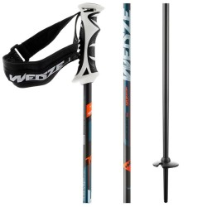
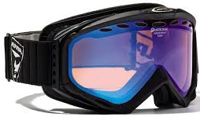
Snowshoeing
Snowshoe frontside
and backside
Snowshoe
Ski sticks
Ski goggle
Notes:
Snowshoes are an help to the movement at Snow conditions, wich were traditionally used in many snowy areas. They distribute the weight of the person carrying them over a larger area so Snowshoeing has now become a popular winter sport as an alternative to ski mountaineering.

Slide 9
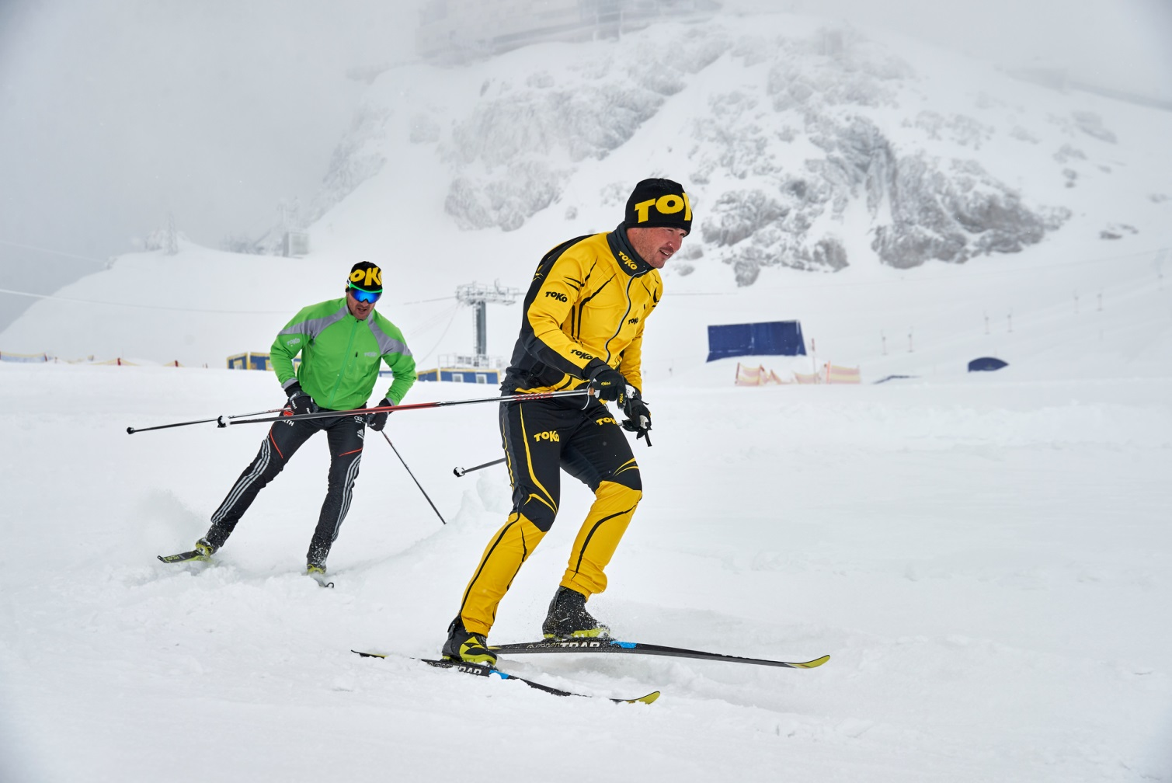
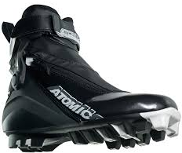
Cross-country skiing
Skishoe
Ski sticks
Ski
Notes:
Cross-country skiing is a Nordic winter sport, where you ski on slopes not only downhill, but also moves horizontally or uphill on the snow. Cross-country skiing is considered a health-friendly sport, as almost all muscle groups are operated.

Slide 10
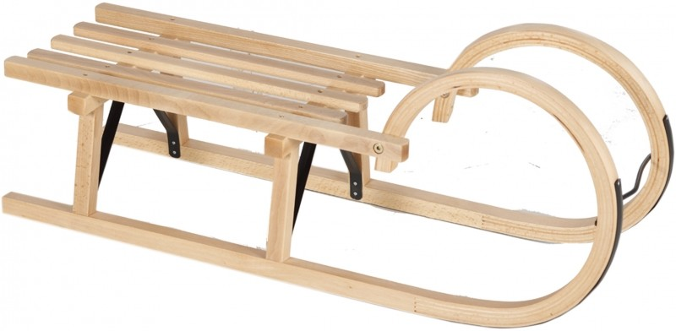
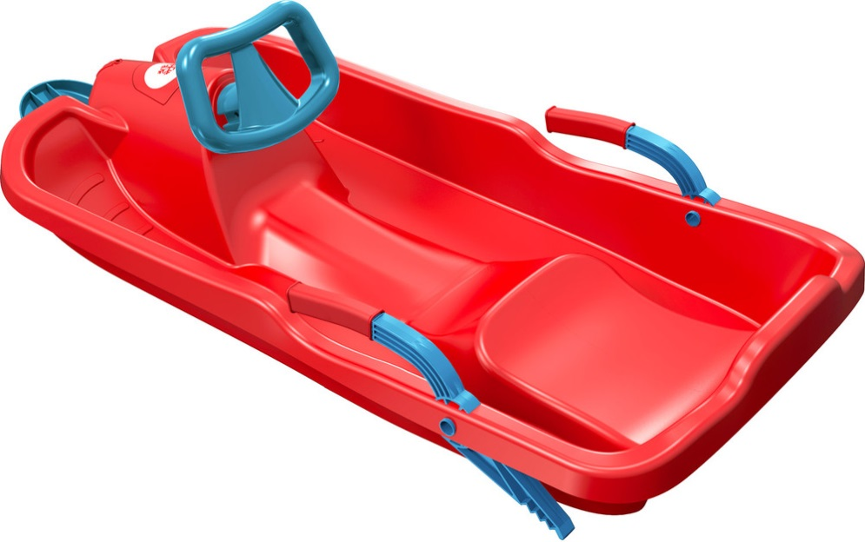
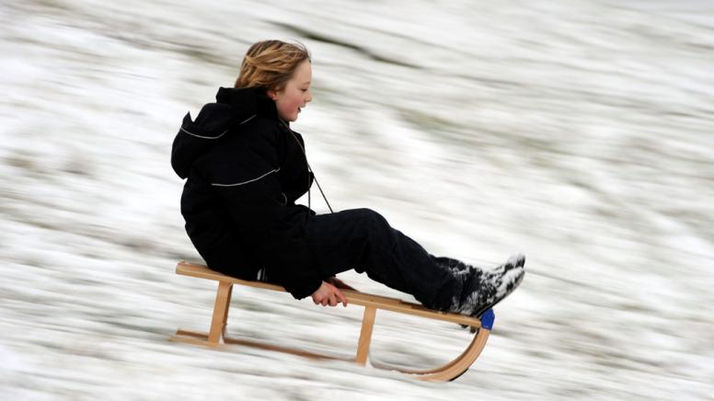
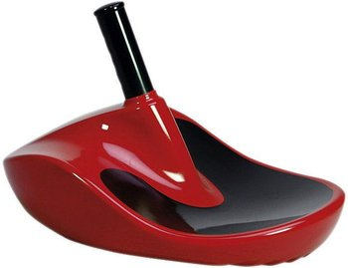
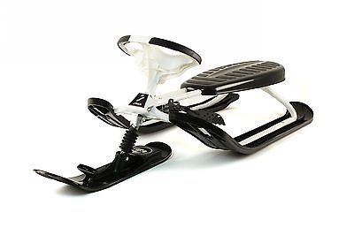
Go sledging
Notes:
Sleding is an original, winterly, way of moving, a mountain with a sled down. Nowdays, the sled is the sporting device that can be steered by weight shifting.

Slide 11
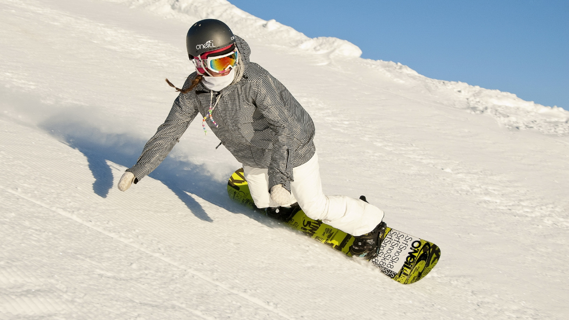
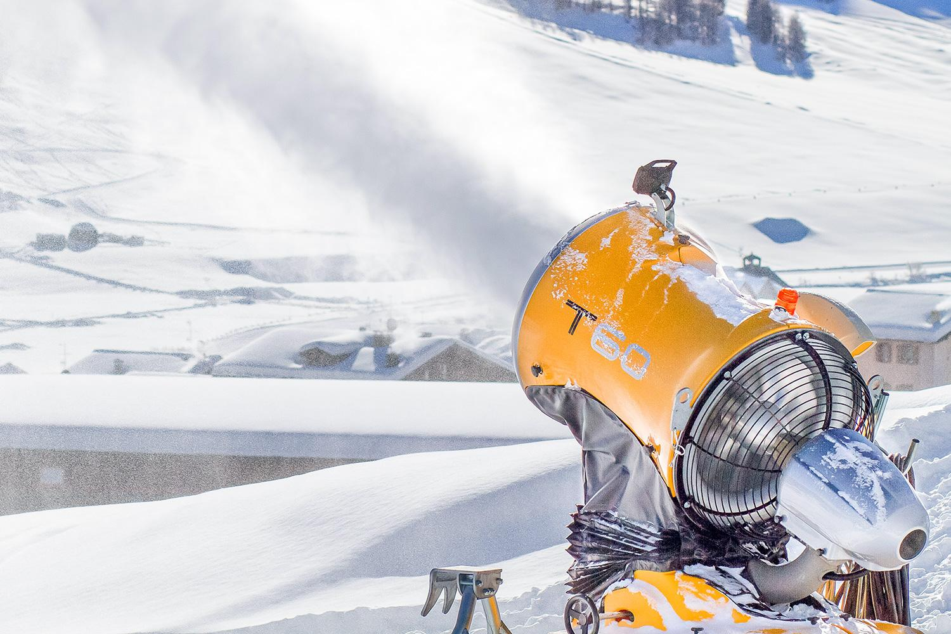
3. Non-sustainable wintersport activities
Notes:
The two most environment harming wintersports are downhill skiing and snowboarding

Slide 12
Snowboarding
damage to the sward so in spring and summer there can´t grow grass

Slide 13
Downhill skiing

Slide 14
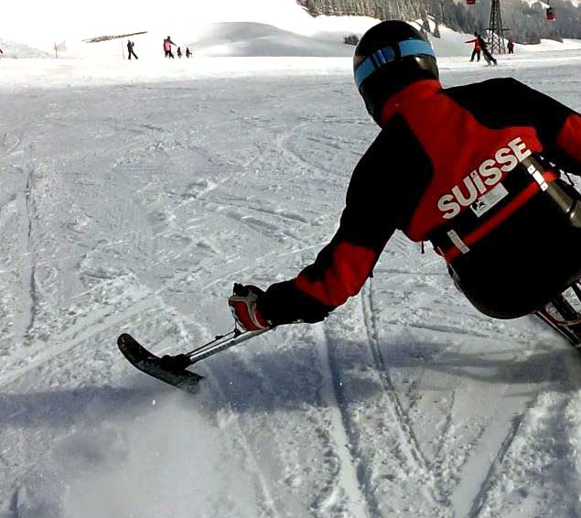
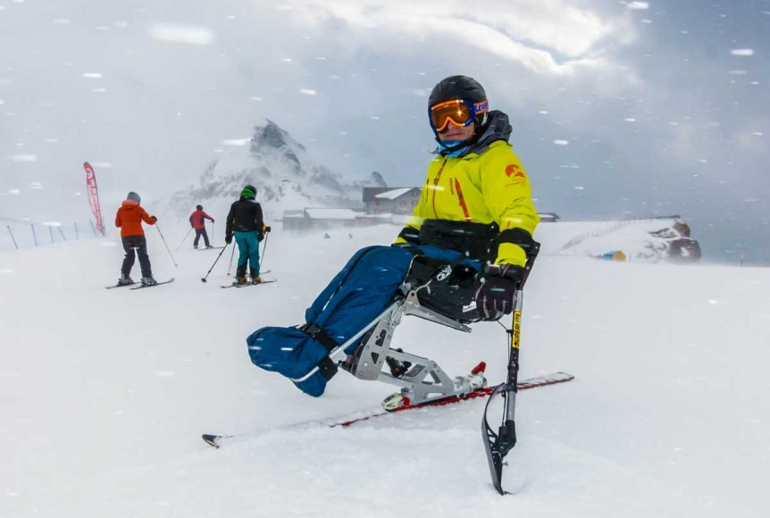
Additional information: Mono Ski
skiing for people with handicaps, like a wheelchair
has its own discipline in the Winter Paralympics
Notes:
Instead of two ski´s a monoskibob uses one ski (Bild 1) and special armresets (Bild 2)

Slide 15
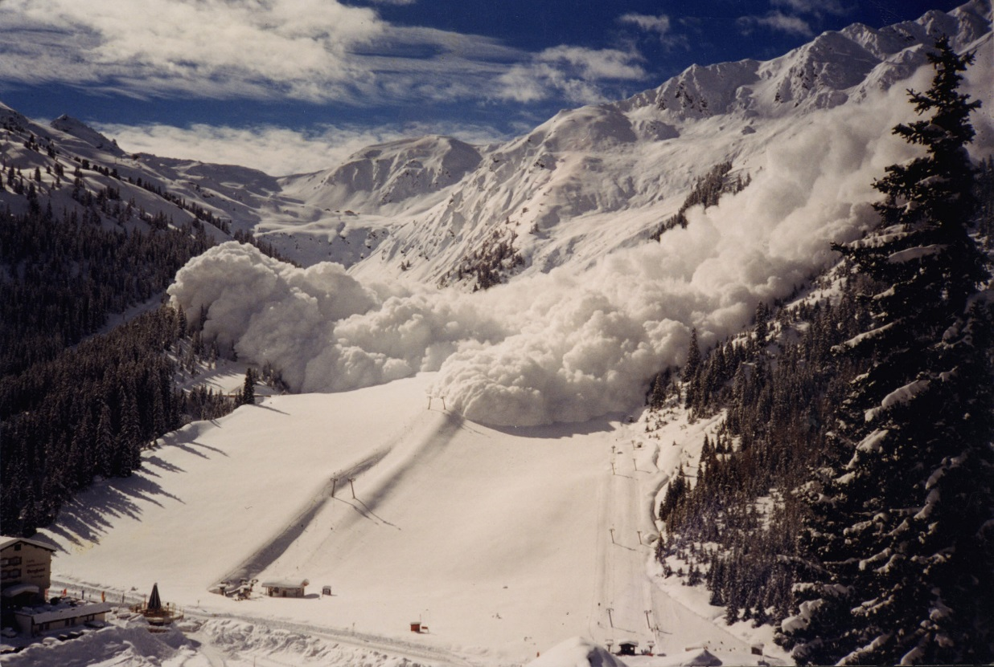
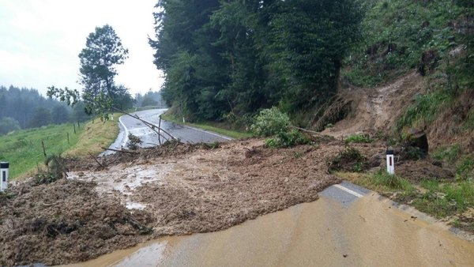
4. Negative impacts of non-sustainable winter sport activities
Avalanches
during winter
Mudflow
during the rest of the year
Notes:
Skiing on a ski slope doesn’t damage the nature much BUT creating a ski slope is really bad for nature. To create a ski slope the floor need to get bulldozed and many trees and stones need to get removed. Also the amount of tourists and buildings are bad for wildlife.
Also a big problems is skiing on non-prepared floor. The sharp blades of ski and snowboards together with the speed is very badly for the hillsides. These places are far more exposed to avalanches than normal places because the grass on the floor is getting cut and some people damage also trees which should protect us. Also all the Ski lifts and cars and the tourists at their own are also not the very best because it pumps Co² in the air and the houses producing heat what also causes more avalanches. And Exposing people to avalanches, damaging plants and damaging our environment is definitely not ‘sustainable’.

Slide 16
Snow cannons
is more and more needed in winter sport resorts due to climate change
water consumption in one winter is more than the whole water consumption in Munich for one year
needs more energy than the second biggest city in Bavaria (Nuremberg)

Slide 17
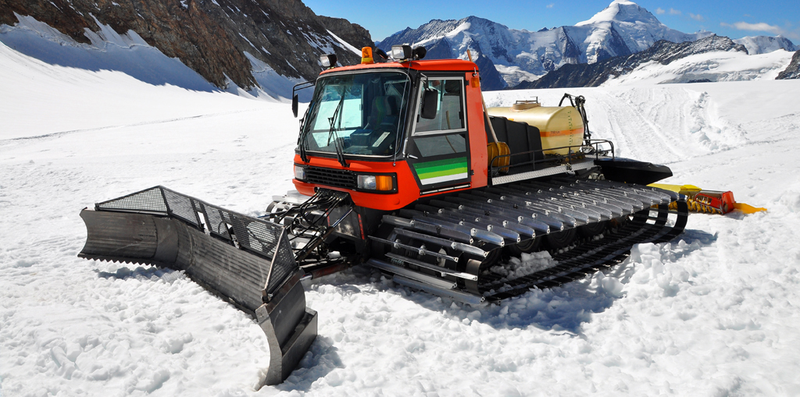
Snowcats
very harmfull for the environment due to the emission on carbon dioxide and the demage to the sward

Slide 18
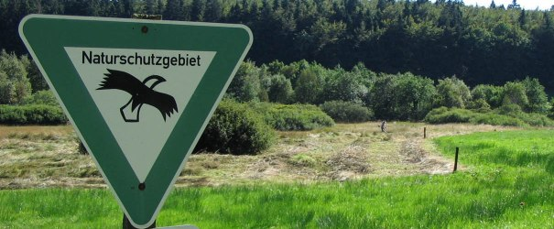
5. Possible solutions
practice only sustainable winter sport activities
be so efficient as you can with energy and the use of cars
don’t do sport activities in wildness

Slide 19
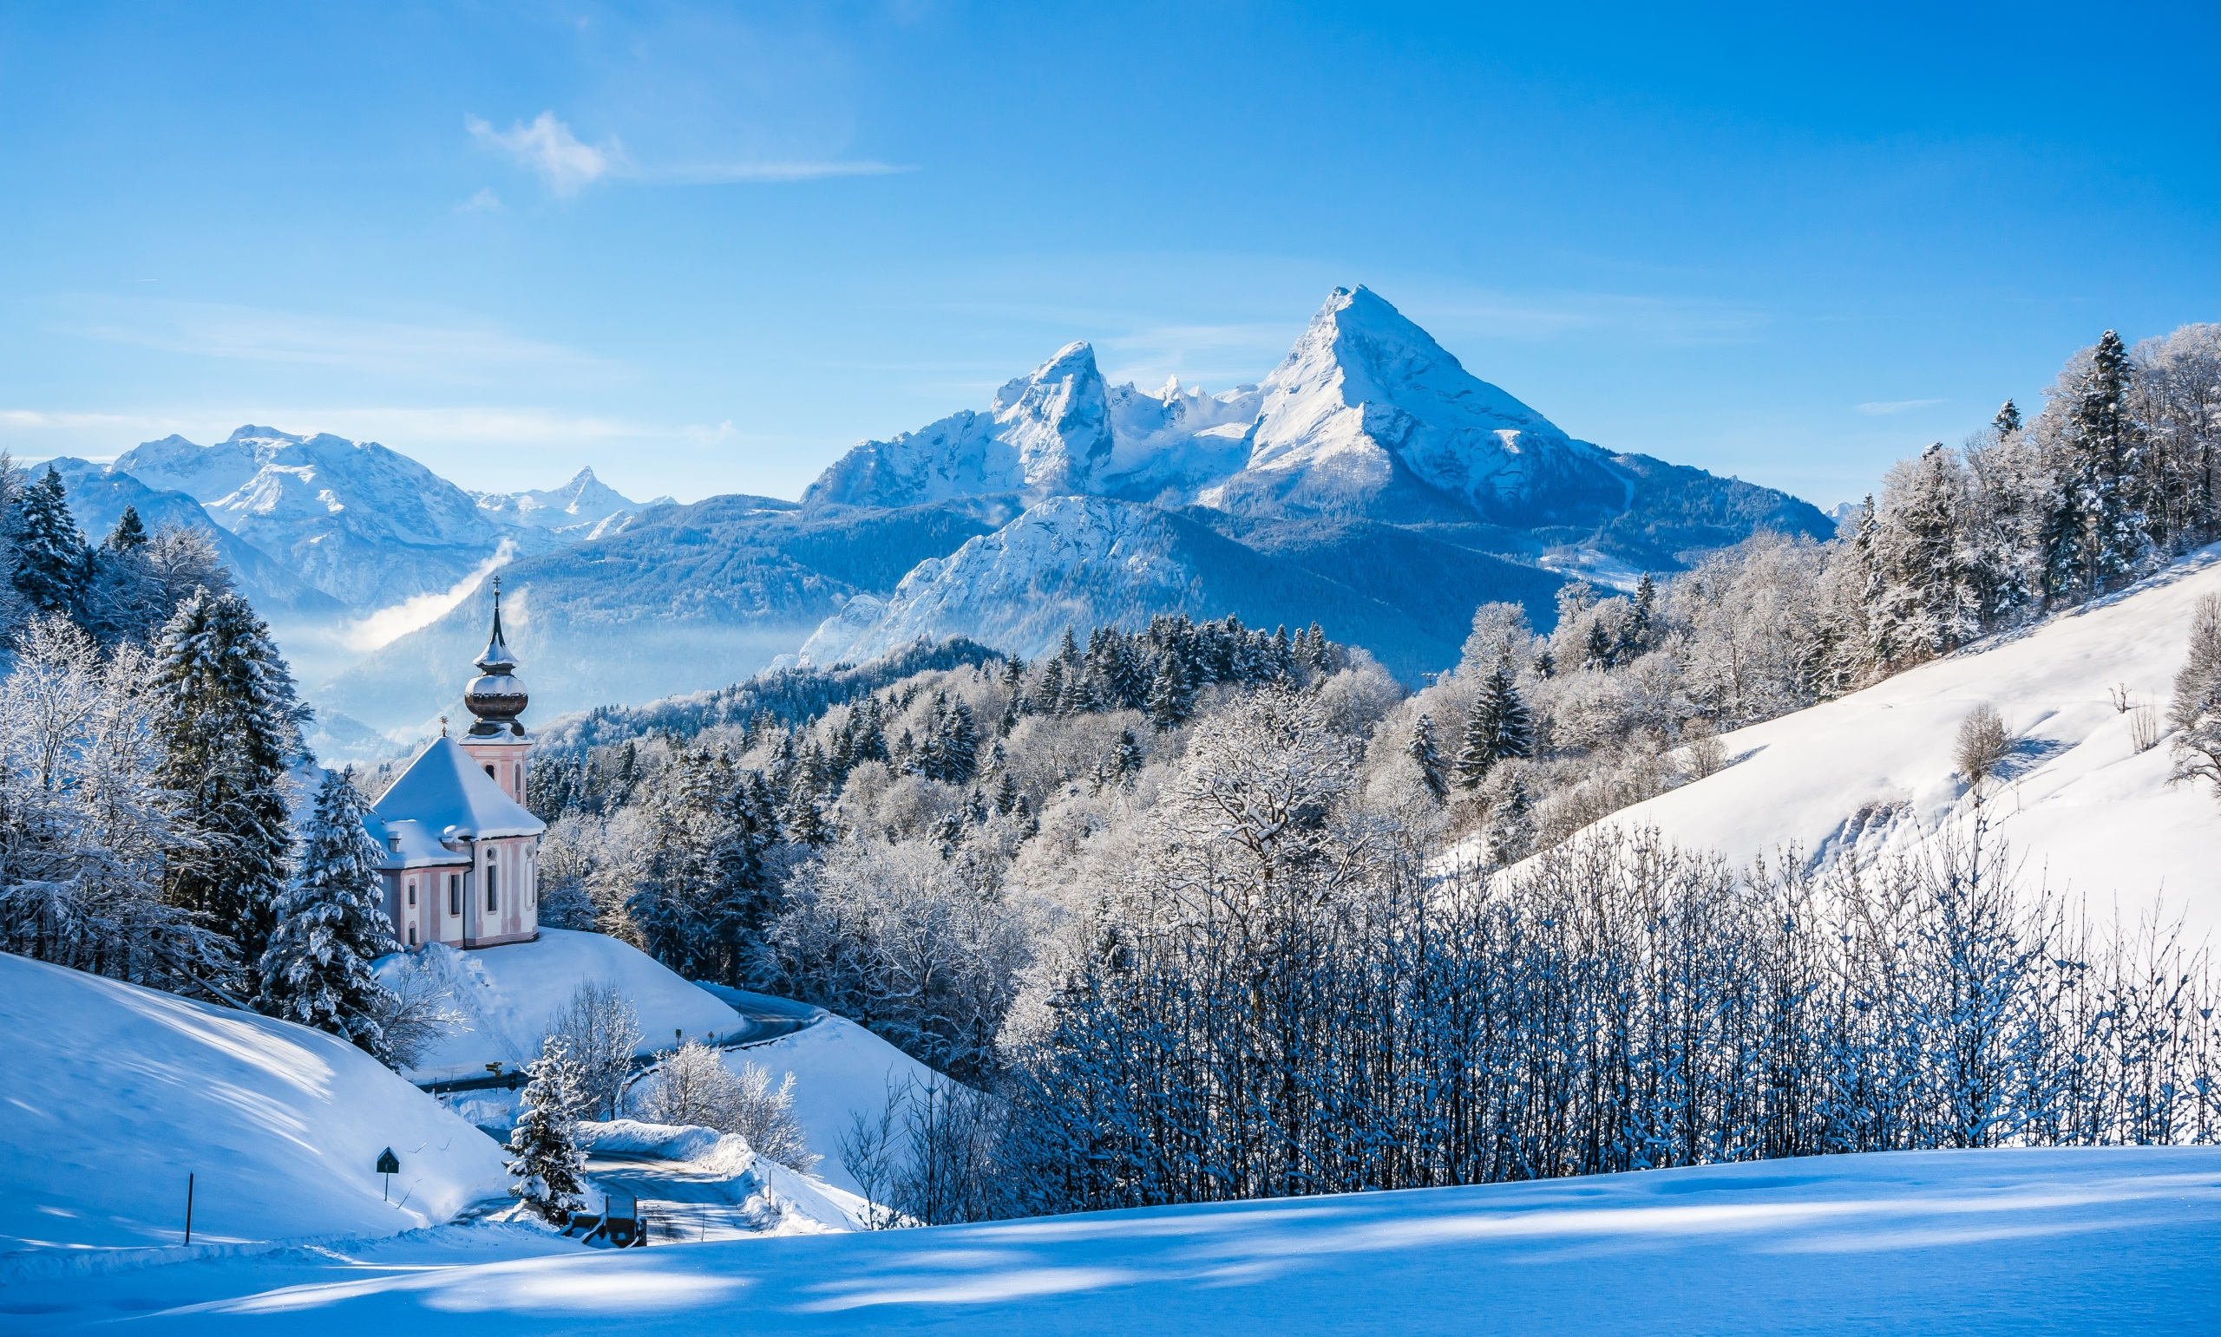
Thank you for your attention!

