Slide 1
Mountains, Caves, Canyons and Valleys of Slovakia

Slide 2
Mountains
We have several mountains in our little big country, but here are the two, that are most known for their greatness and beauty.
Hight Tatras with their highest peak - Gerlachovský štít (2655m) and Low Tatras with their highest peak - Ďumbier (2043m).

Slide 3
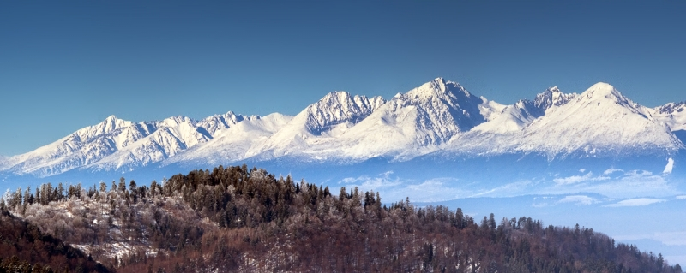
The High Tatras

Slide 4
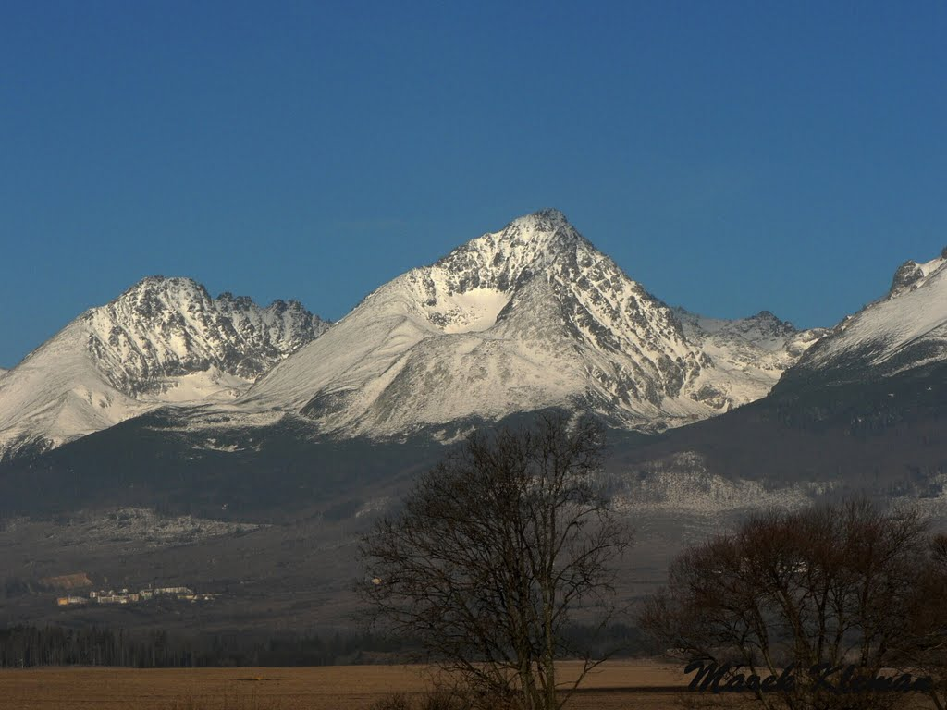
Gerlach peak (2655m)

Slide 5
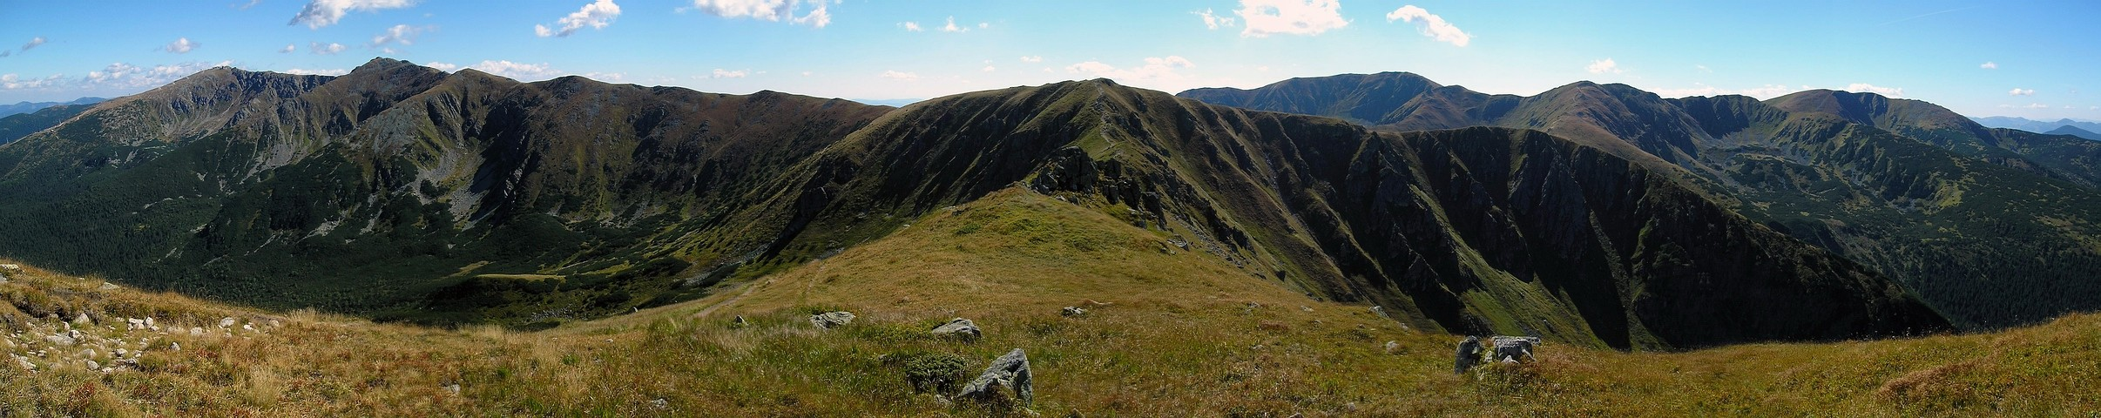
Low Tatras

Slide 6
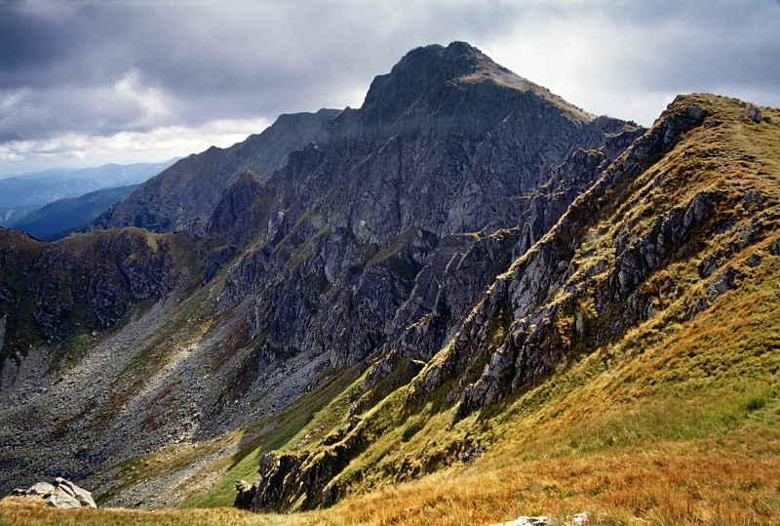
Ďumbier (2043m)

Slide 7
Caves
We have many MANY caves here. Not all of them are accesible for public because of their fragile beauty and need of protection.
The longest system of caves in Slovakia is Demänovská cave system and it includes over 30 caves with a total lenght about 40 kilometres.
The caves are connected together.
The most known caves from this system are:
Demänovská Ice Cave (accesible for visitors)
Demänovská Cave of Freedom (accesible for visitors)
Demänovská Cave of Piece (not accesible yet)

Slide 8
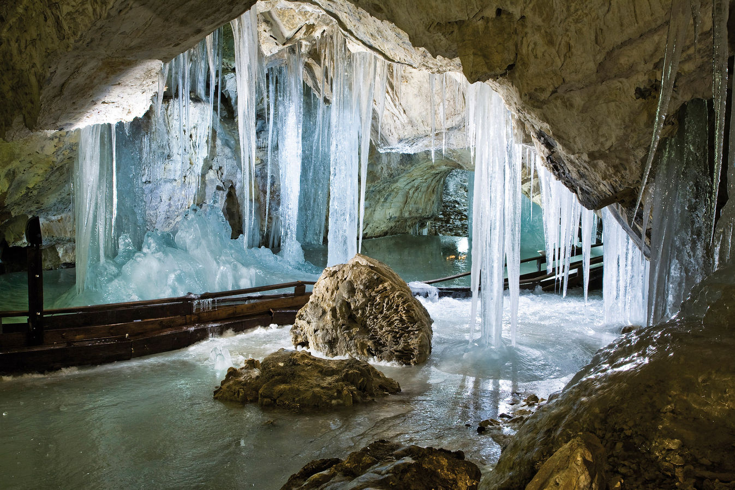
Demänovská Ice Cave

Slide 9
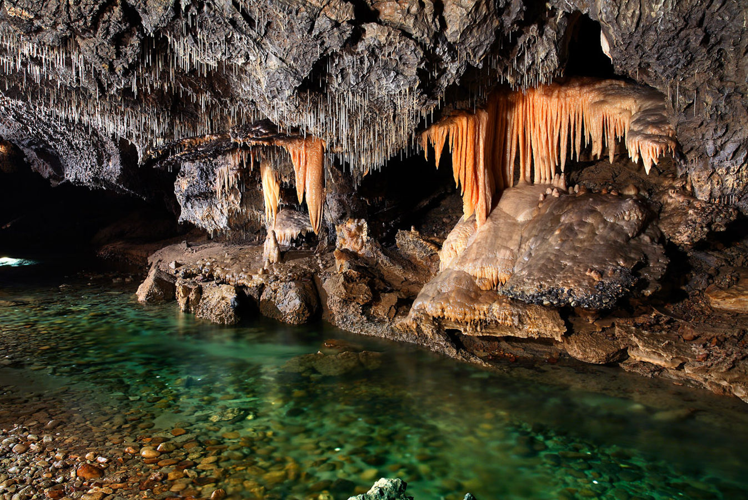
Demänovská Cave of Freedom

Slide 10
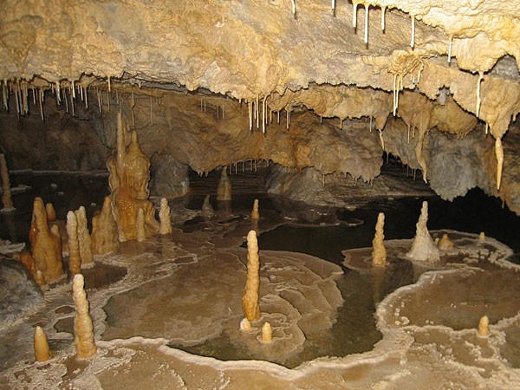
Demänovská Cave of Peace

Slide 11
Canyons
We also have some canyons or "narrow passages" in our country too.
Here are some of them:
Jánošík´s holes^{1 (next slide)}
Suchá Belá (in the picture the way through it)
Zádielský canyon

Slide 12
¹ Juraj Jánošík is our national hero, a legend. He was from Terchová (Middle-West-Northern Slovakia / Orava), born in 1688. He was from a poor family that (as the whole village) must have served and slaved their mean masters. Later he became a bandit and it is believed that he stole from rich people and gave to poor. He hid in the woods and canyons (later named after him), he was very succesfull (in stealing) and had his own band. The rich people hated him and were able to do anything to catch him. It is just a legend but it is said, that an old lady betrayed him, when the soldiers came to catch him in a pub. She spilled dry peas on a floor. He tried to escape but slipped on the peas and fell. He was busted and later executed very cruel way - they hung him on a big hook by his rib and let him there until he died.

Slide 13
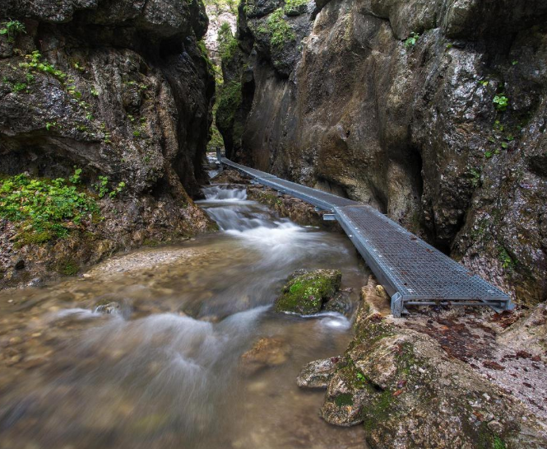
Jánošík´s holes

Slide 14
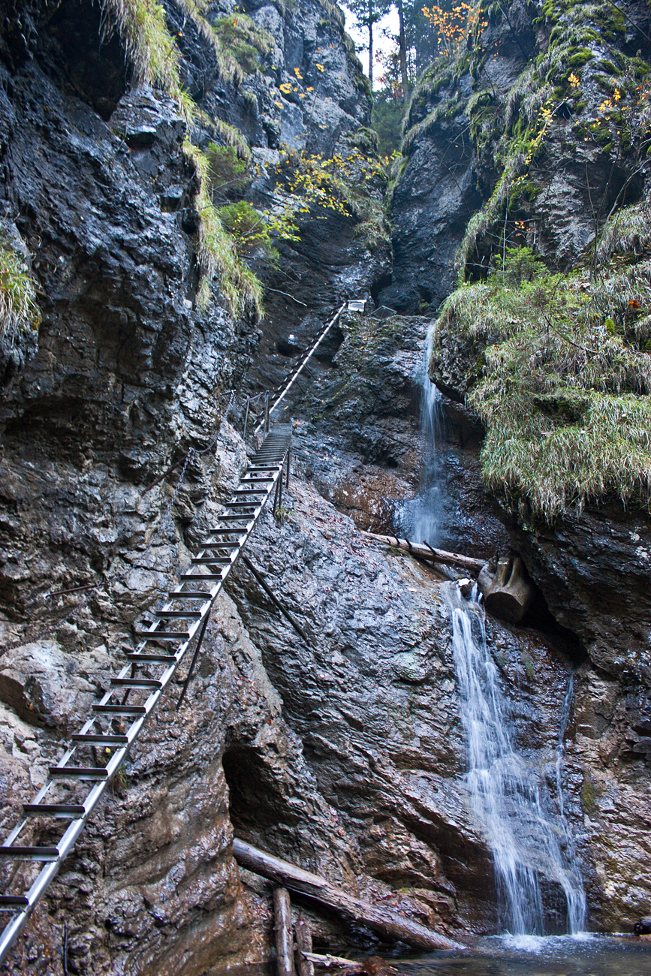
Suchá Belá (Dry Belá - walk through)

Slide 15
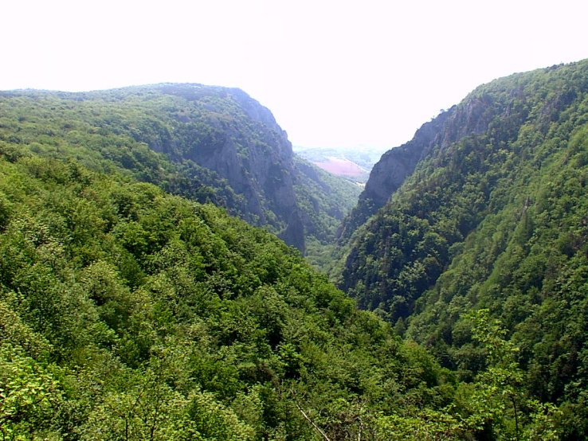
Zádielský canyon

Slide 16
Valleys
Under our beautiful mountains we also have lovely romantic valleys too. These are the two we decided to introduce to you today:

Slide 17
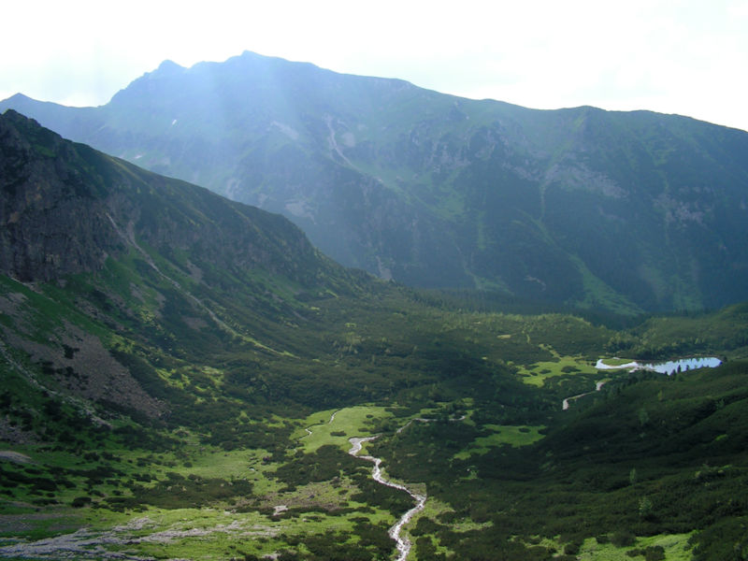
Black Valley

Slide 18
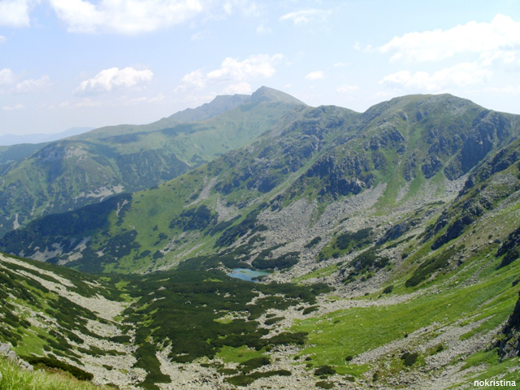
Demänovská Valley

Slide 19
Thank you

