Slide 1
Hello! We are students from a small school. Our school is near the lake of Rėkyva. Thats how she looks like from bird flight. We have a few stories about the lake.

Slide 2
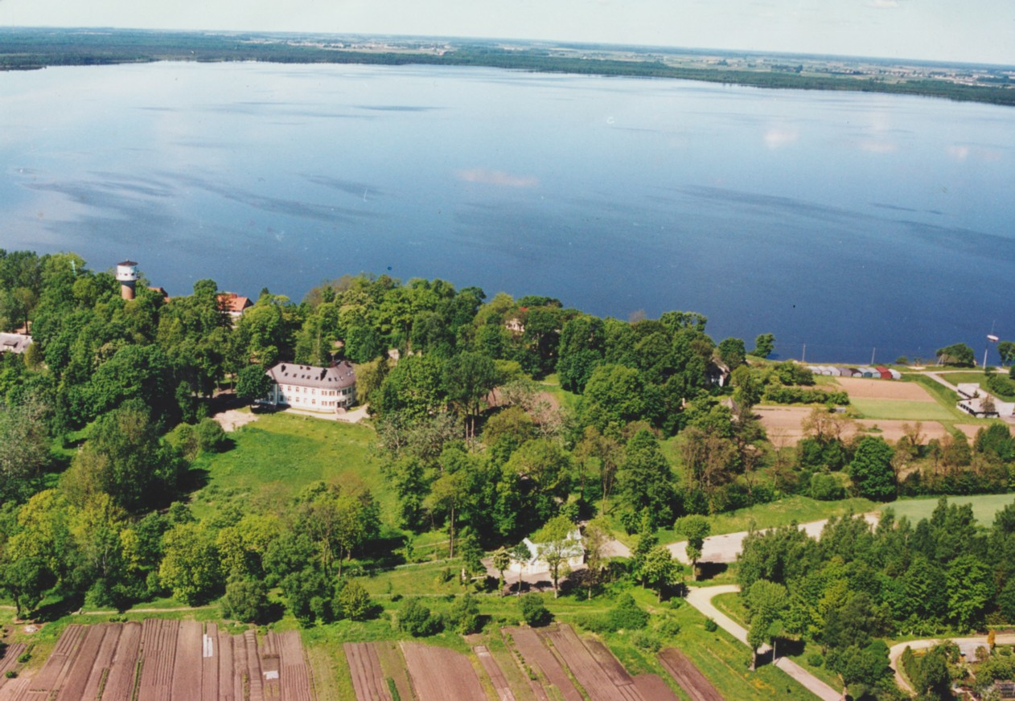
Rėkyva lake

Slide 3
The Original Name of the Lake
Originally the name of this lake was Kvartukas (Apron). Once upon a time, in the place where now Lake Rekyva stretches, there were wide meadows, and cattle of little poor village were grazing. Well then what happened !

Slide 4
One young mistress woke up ready for the morning housekeeping, but shen surprise rooted her to the ground: a white water- lily had burst into blossom in the fireplace. Mysterious, beautiful water- lily … Next morning white water- lilies burst into blossom in all fireplaces, in every hut.

Slide 5
Grey-headed wise men fell to thinking: what this could mean? “A lake will come into being !” – one of them said. And it happened. A few days passed, and then darkness came; the black blackest cloud covered the sky.

Slide 6
Lightning was flashing, thunder was pealing. Everybody was horror-struck. One woman running to her husband got entangled in her skirt. “Damn it! My apron – kvartukas (Lith.) - untied itself” – she uttered a frenzied scream. Her words were followed by a terrifying crash of thunder. Heavy cloud fell down and flooded the meadow. Then he sun started shining. And all this happened because this women had accidentally pronounced the real name of the lake – Kvartukas.

Slide 7
Nowadays this lake is called Rekyva, from the name of that village. Only the oldest of the elderly know original name of the lake – Kvartukas. And this story was told them by their forefathers."

