Slide 1
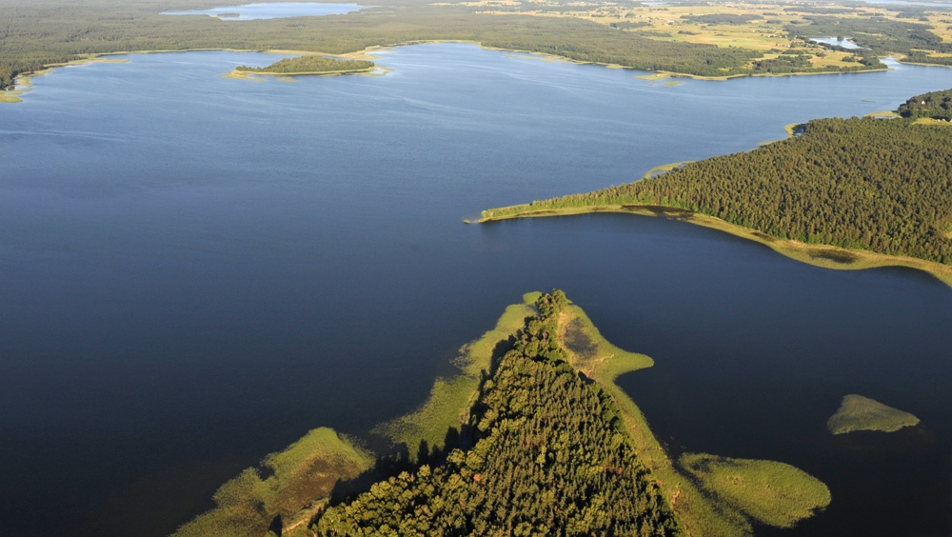
Lithuania is a little country, but inside her there is about 5930 lakes. In Lithuania the bigest lake is Drūkšiai, deepest- Tauragnas, and the longest- Asveja.

Slide 2
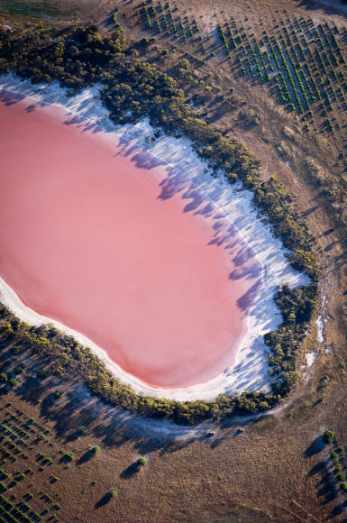
Hiljero lake that is in west of Australian coast, in Midlo island is one of the most mysterious in the world. No one can tell why 600m width lake is in pink color.

Slide 3
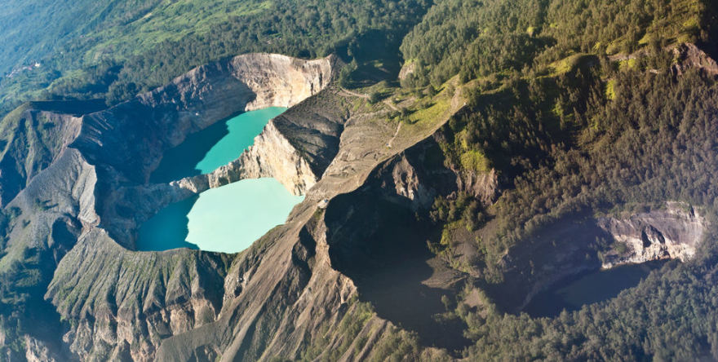
ypatingi
Kelimutu, is one of Floreso island in Indonesia standing already extinguished volcano, in 1,6 km height aukštyje keeping three different color lake.They are special that they have changed their colors: from whiten coffe , red brown and blue, to black green and turquish.

Slide 4
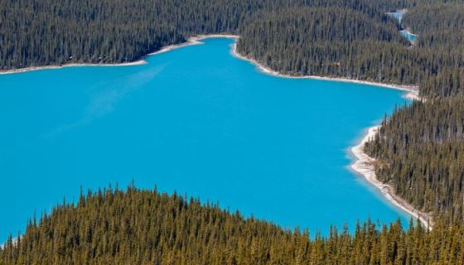
Peyto lake in Canada is surounded by impressing mountains and forests, Peyto lake distinguishes its own perfect blue color, which looks that its going to burn your eyes from his brightness.

Slide 5
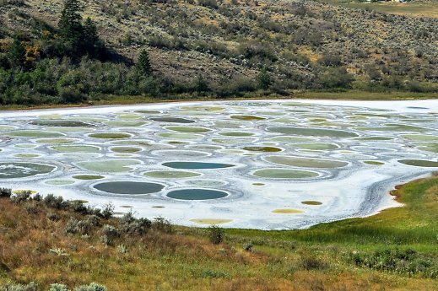
Spotted lake (Canada). The Spotted lake shimmers with all cind of collors and is easy to see from a far.

Slide 6
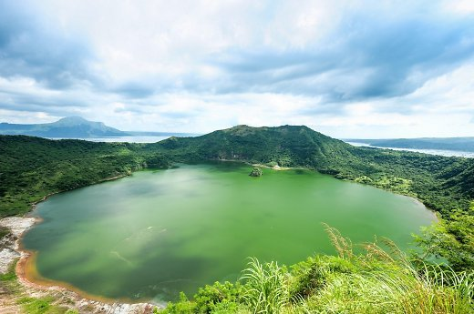
Taal lake (Philipphines). Taal lake is just breathtaking, if we look from above. He is surounding the volcano island and is lieing in the centre of the island so it’s a lake in a lake.

Slide 7
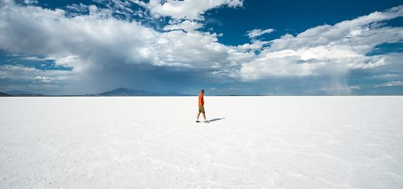
Great Salt Lake in USA - Utah. It’s the biggest lake in west from Mississippi. Lakes area is around 4184 km². Length is 121 km. Width reaches 56 km.

Slide 8
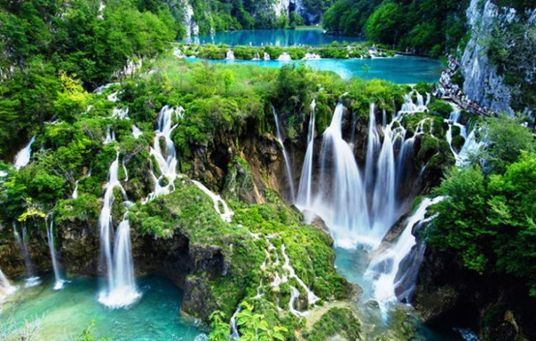
Plitvico lakes in Croatia.

Slide 9
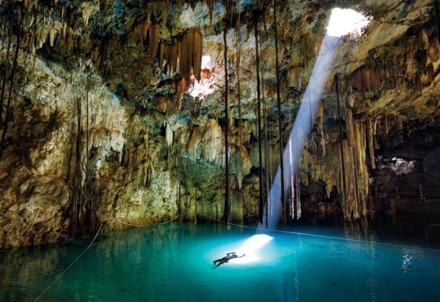
Yucatan - lake in cave in Mexico.

Slide 10
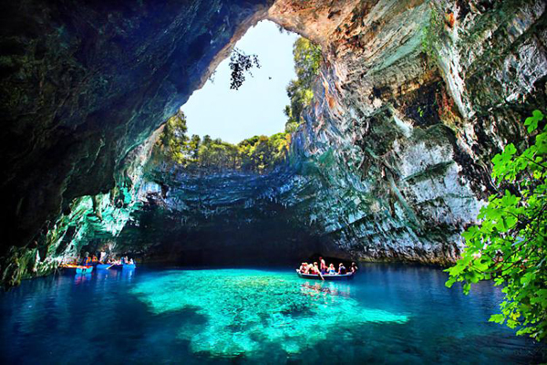
Lake Melissani in cave in Greece.

