Slide 1

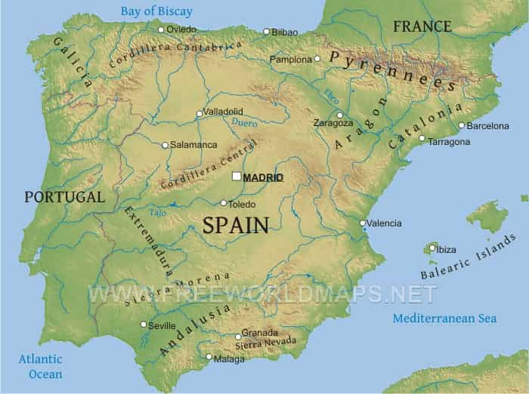
Water in Spain
As you can see Spain is sorrounded by water...

Slide 2
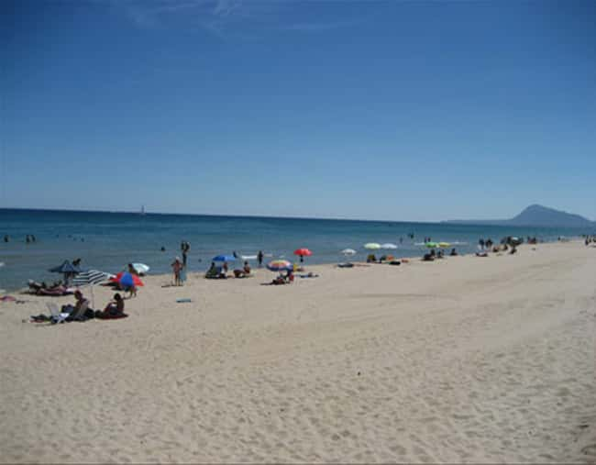
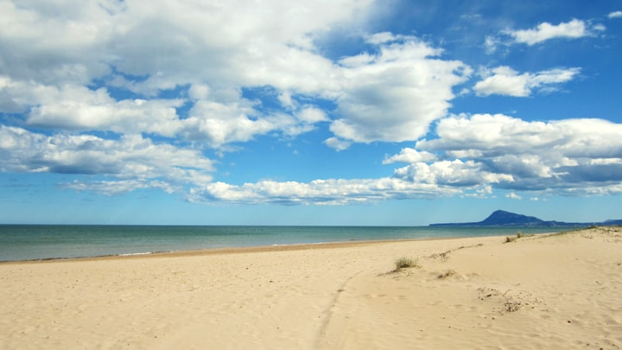
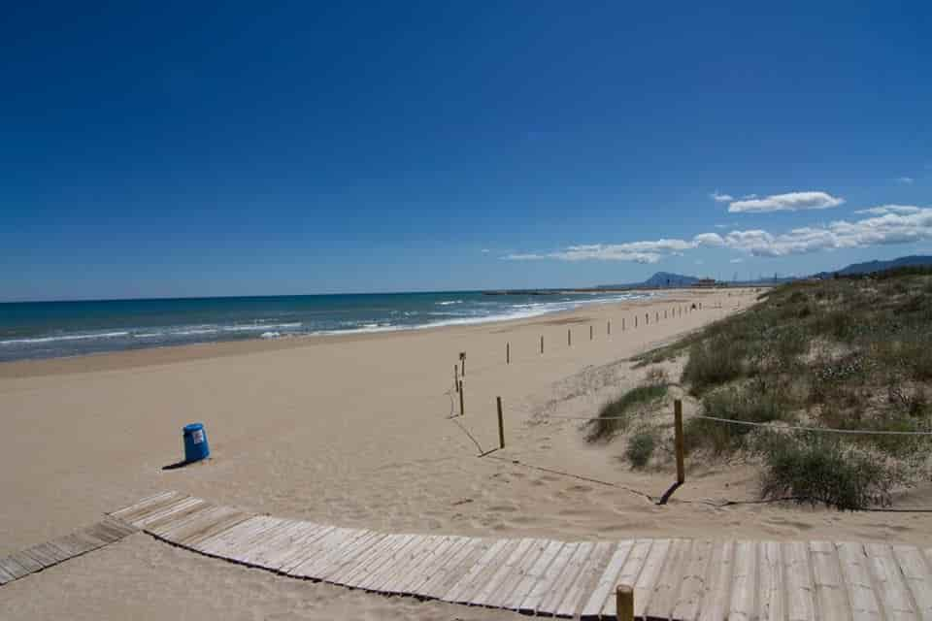
We live by the Mediterranean Sea. We´ve got a long beach!

Slide 3
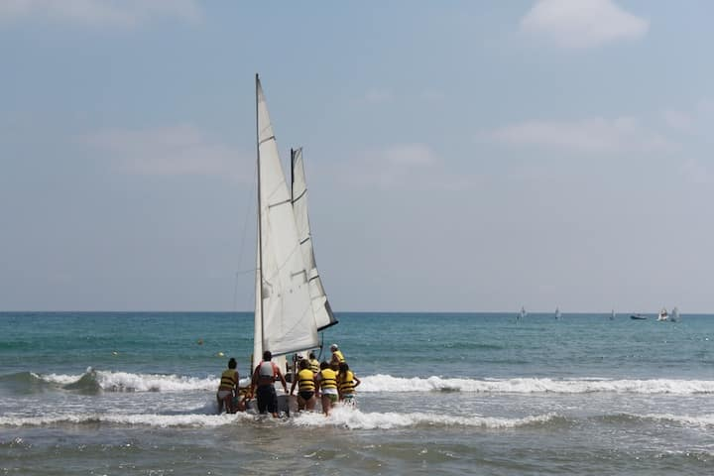
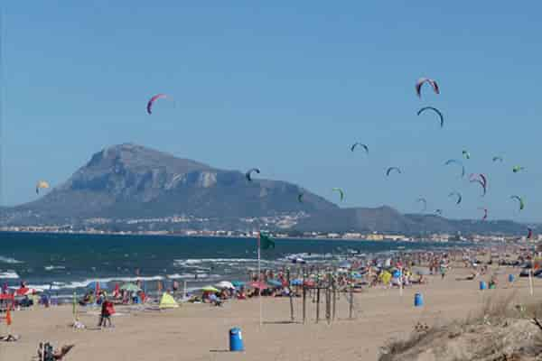
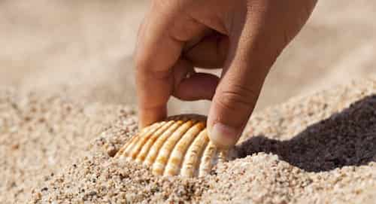
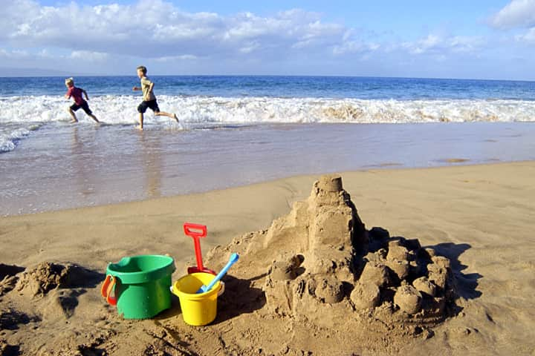
We love doing water sports, making sandcastles, collecting shells and swim!

Slide 4
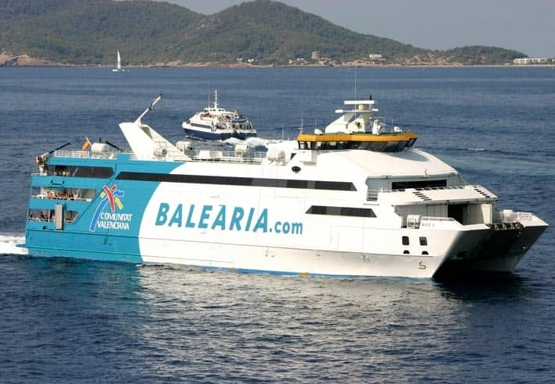
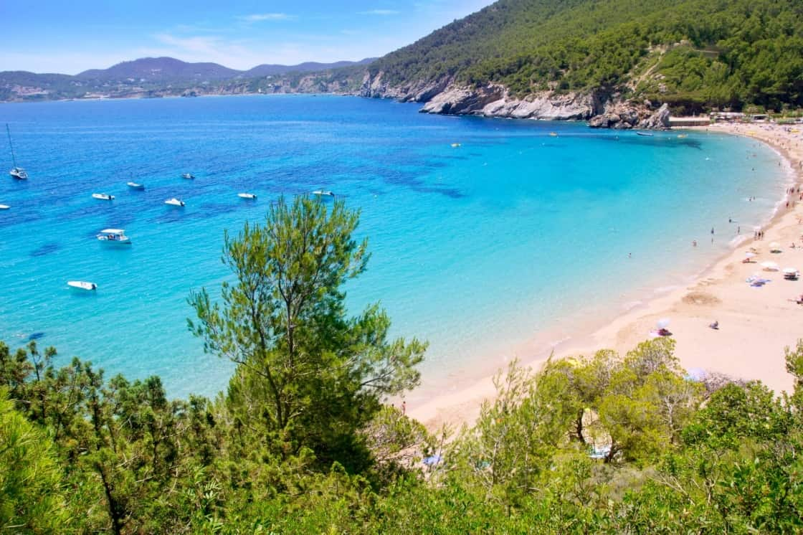
Sometimes we go by boat to the Balearic Islands...

Slide 5
Our Seas and Beaches are our Treasure, but they're in Trouble. Here's How You Can Help!
Be an ocean hero!
1.Conserve water. Try turning the water off when you brush your teeth, taking shorter showers, fixing leaky pipes...
2.Say NO to plastic bags. Every piece of plastic ever made still exists. There are LOTS and LOTS of pieces of plastic floating our oceans.
3.Help Take Care of the Beach. Whether you enjoy diving, surfing, or relaxing on the beach, always clean up after yourself. Explore and appreciate the ocean without interfering with wildlife or removing rocks and coral.
4.Learn about the ocean. Read about the ocean and ways you can help.
Thanks!!!

