Slide 1
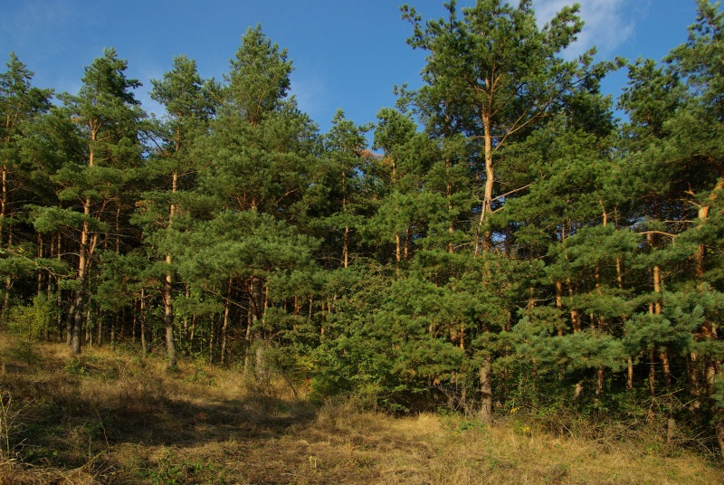
Forests and woods

Slide 2
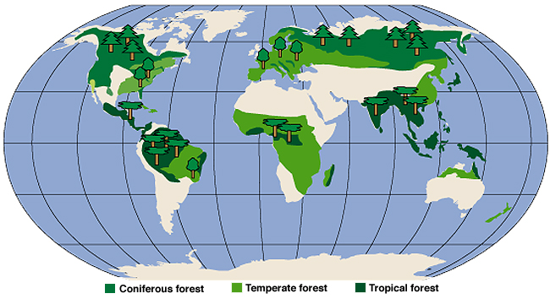
FOREST
a forest is a large area dominated by trees
forests cover four billion hectares (15 million square miles) or approximately 30 percent of the world's land area

Slide 3
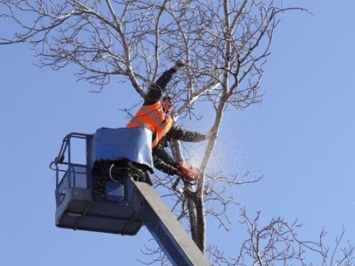
human society and forests influence each other in both positive☺ and negative ways☹
forests provide ecosystem services to humans and serve as tourist attractions.
forests can also affect people's health.
human activities, including harvesting forest resources, can negatively affect forest ecosystems.

Slide 4
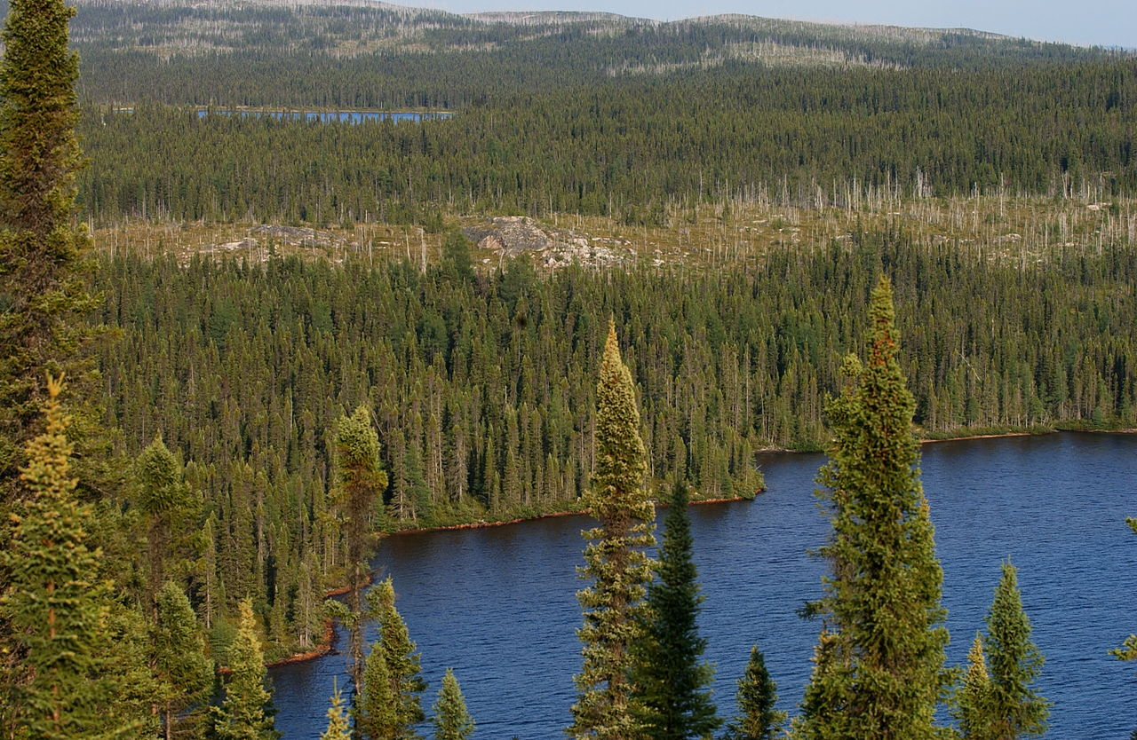
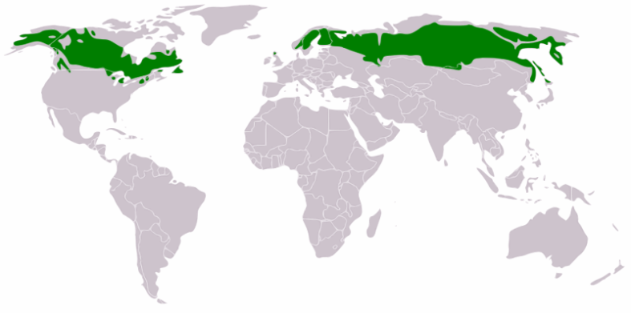
Boreal forest
boreal forest or snow forest, is a biome characterized by coniferous forests of pines, spruces and larches.

Slide 5
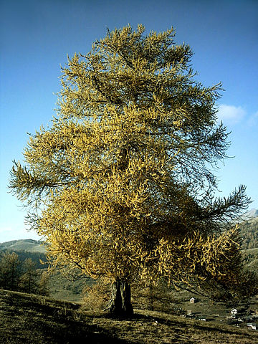
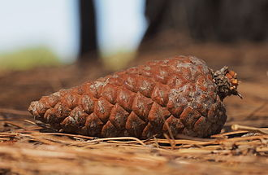
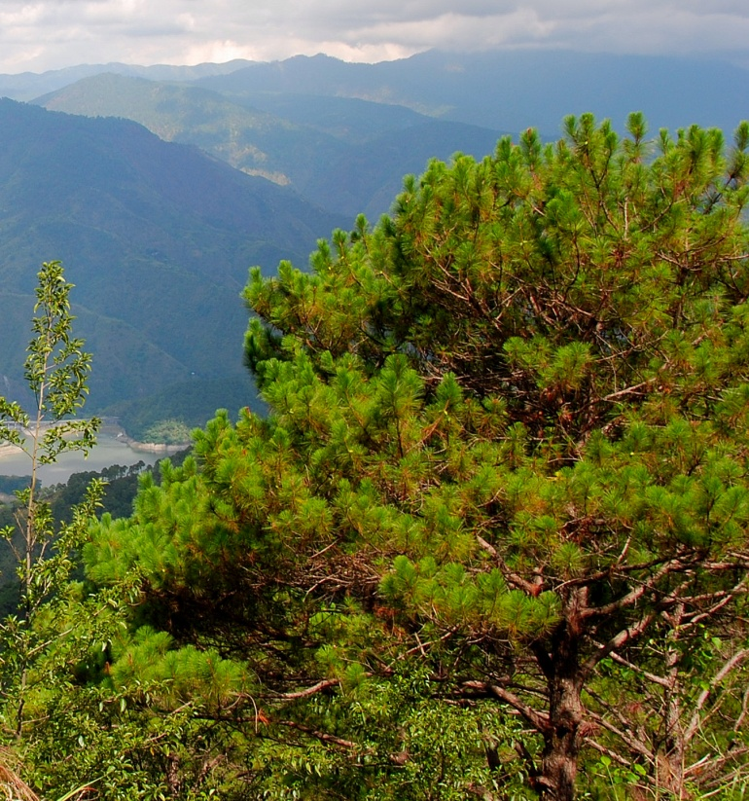
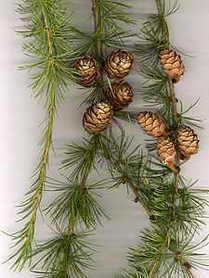
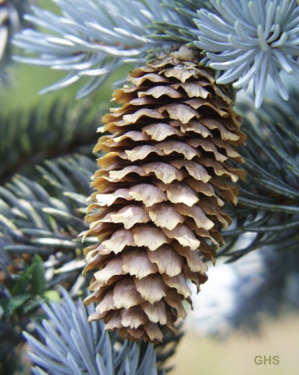
larch
spruce
pine cone
pine

Slide 6
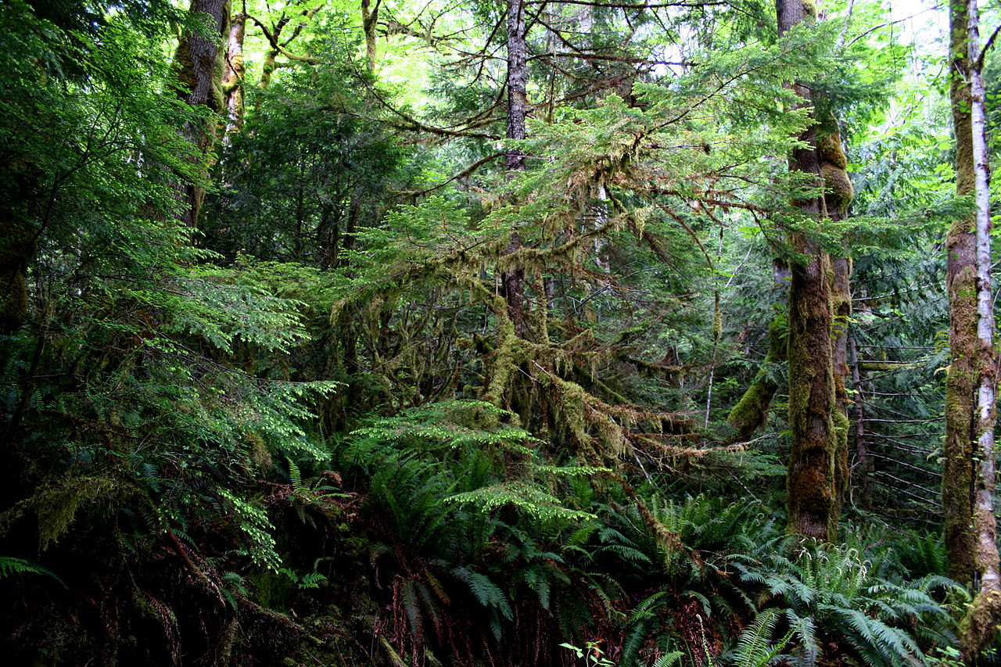
Temperate forests
the northern and southern hemisphere
winters are mild, heavy rainfall
trees, shrubs and bushes
it is the same as a tropical forest except for the climate and some of the animals adaptations
the main trees are the great redwood, oak, ash, maple, birch, beech, poplar, elm and pin

Slide 7
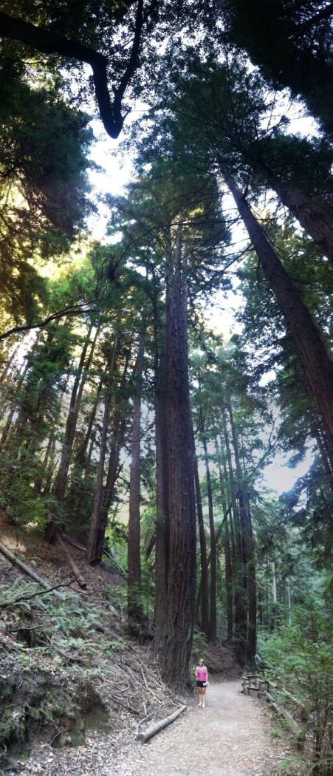
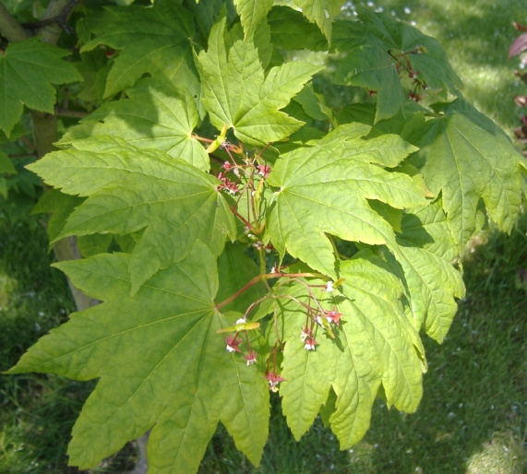
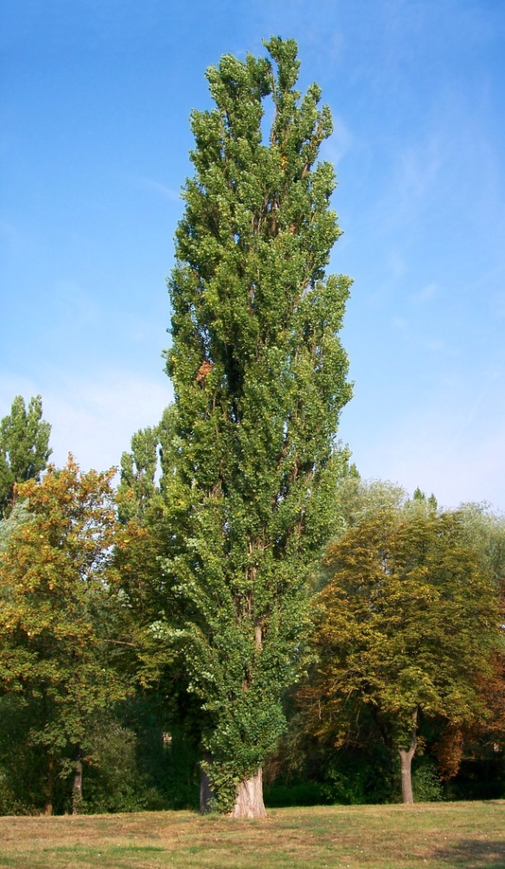
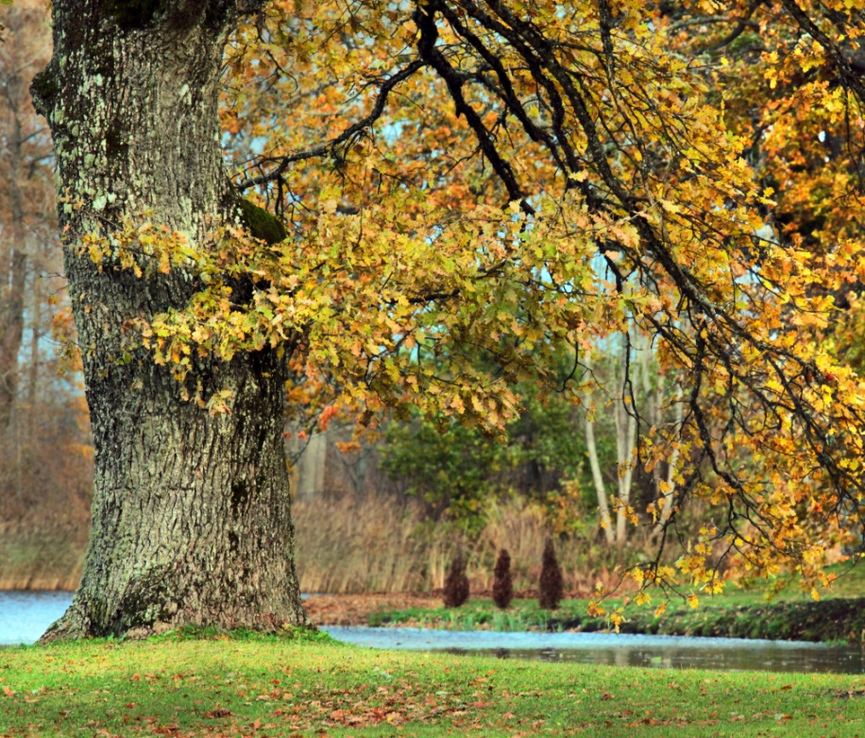
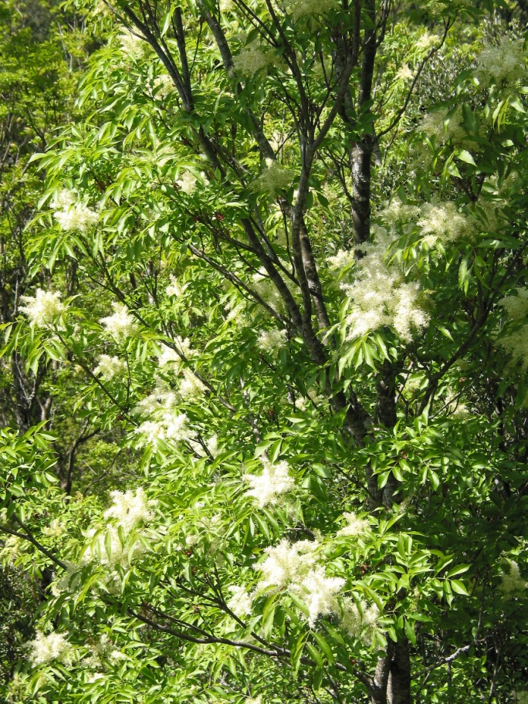
maple
poplar
redwood
oak
ash
beech

Slide 8
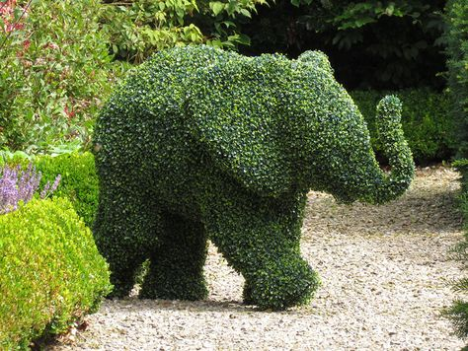
Shrubs and bushes
a shrub or bush is a small to medium-sized woody plant. It is distinguished from a tree by its multiple stems and shorter height, usually under 6 m (20 ft) tall.

Slide 9
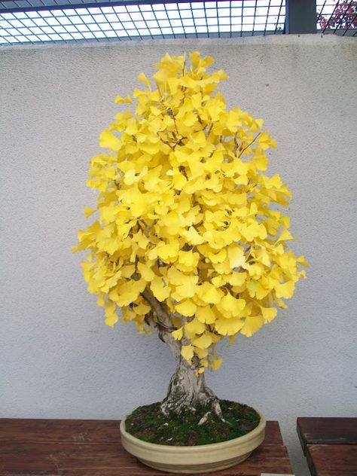
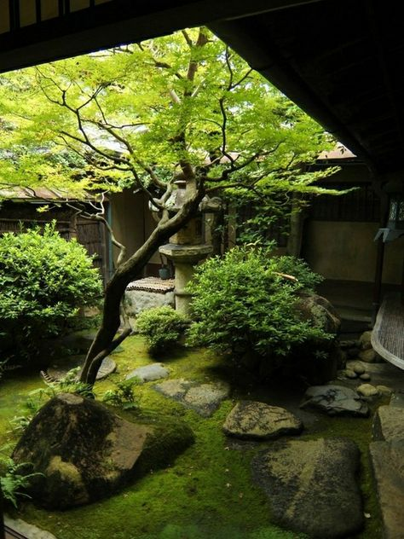
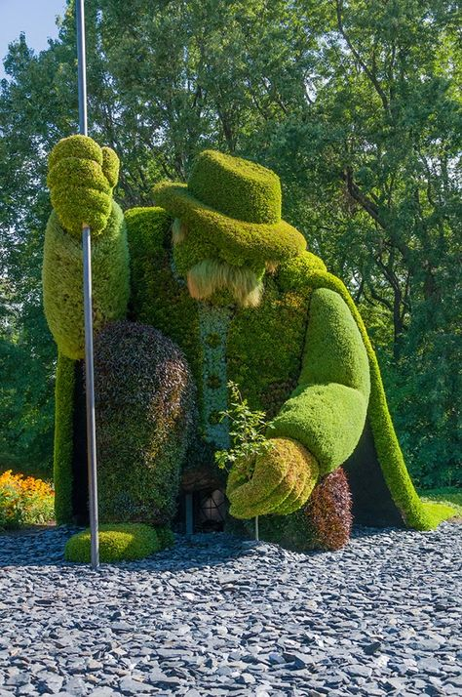
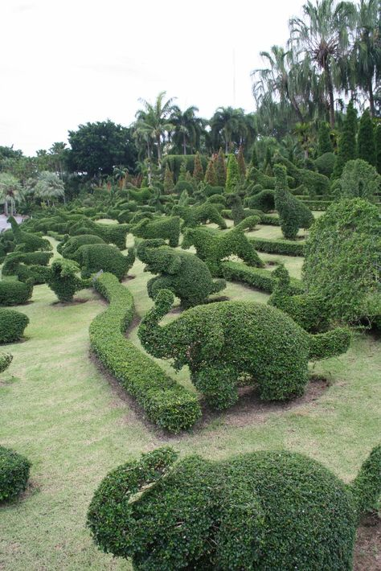
Japanese garden
ginko bonsai
topiary elephants
Montreal Botanical garden

Slide 10
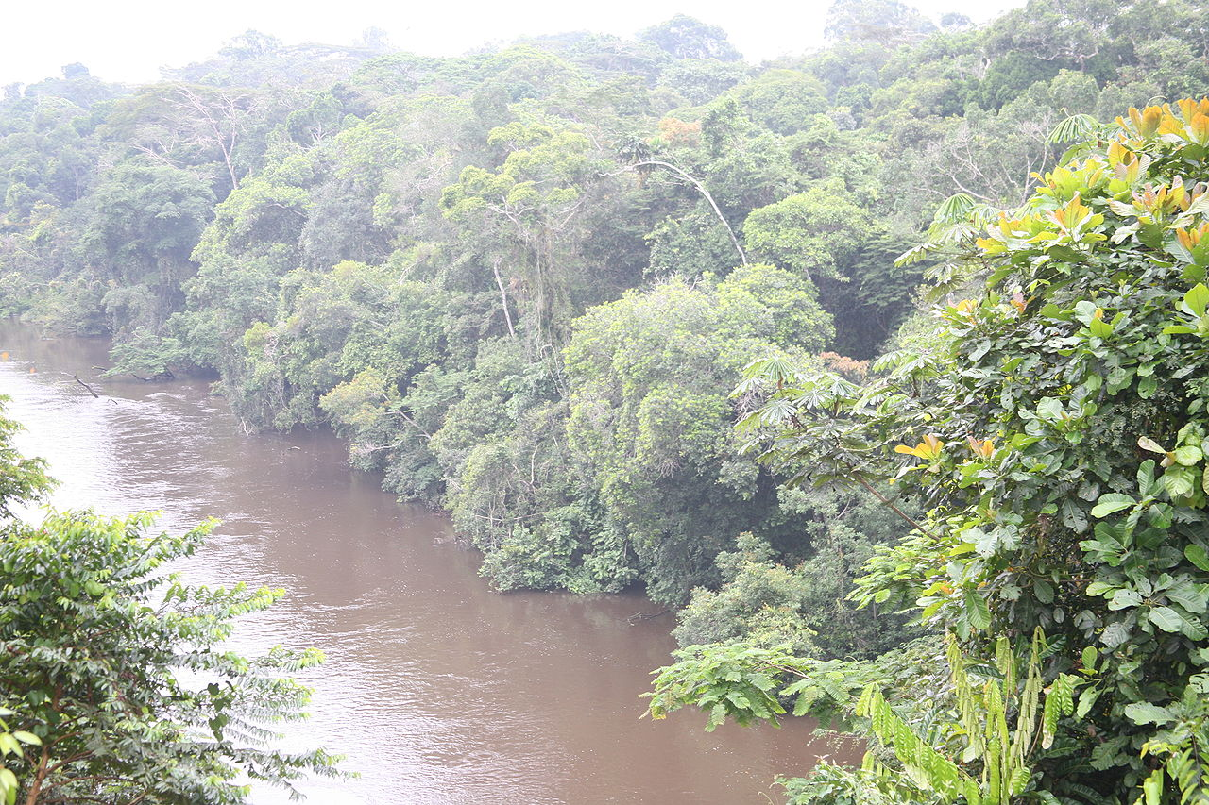
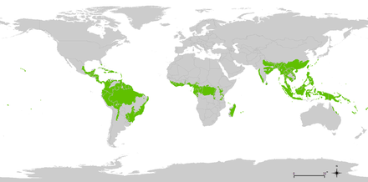
Tropical forest
near the equator
tropical and subtropical forest biome, jungle.
high rainfall
warm summer wet season
cooler winter dry season
have a monsoon or wet savannah climates

Slide 11
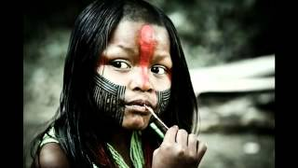
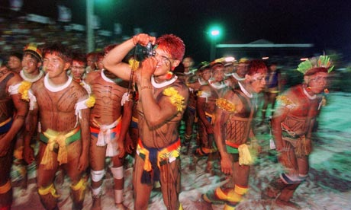
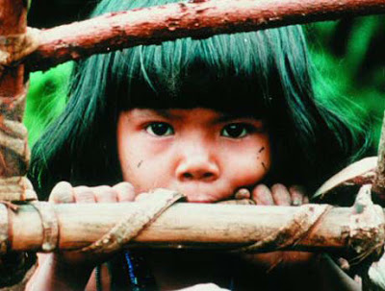
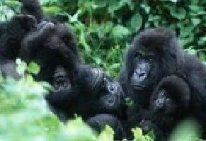
Rainforest life
natural tribes
national parks

Slide 12
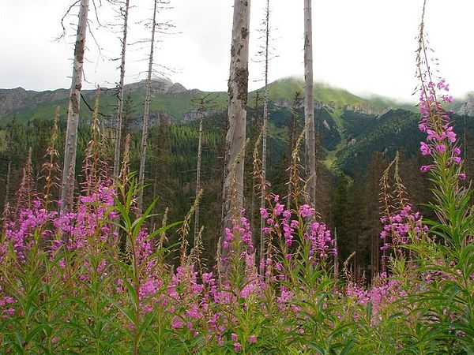
Woodland
a low-density forest with plenty of sunlight and limited shade.

Slide 13
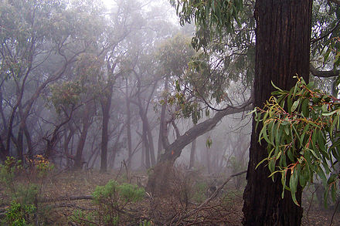
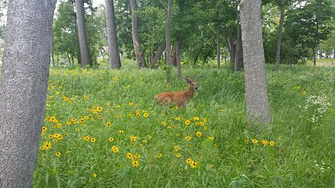
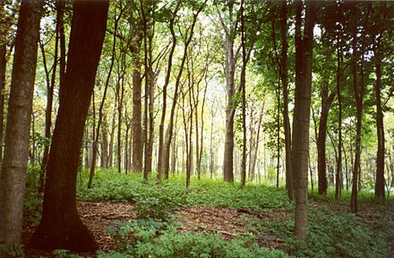
Woodland ecoregions

Slide 14
10 most beautiful forests in the world

Slide 15
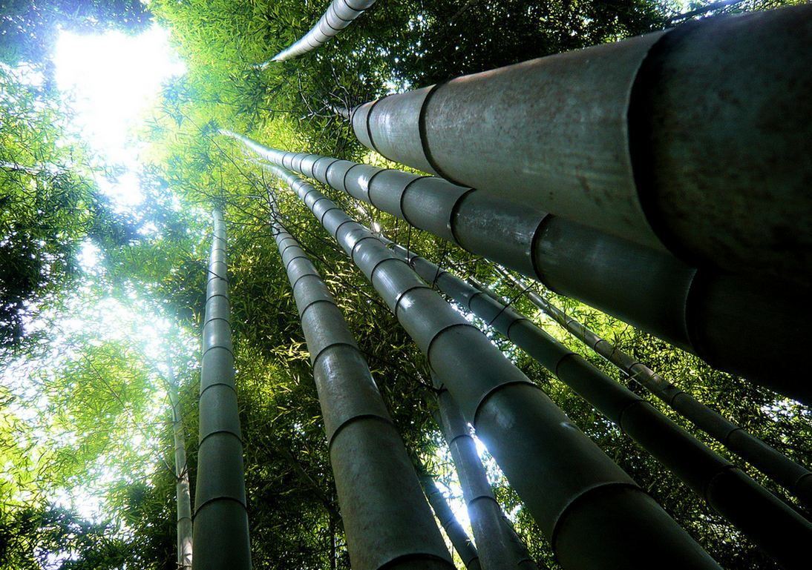
Sagano Bamboo Forest Japan

Slide 16
bluebells in Halle's forest, Belgium

Slide 17
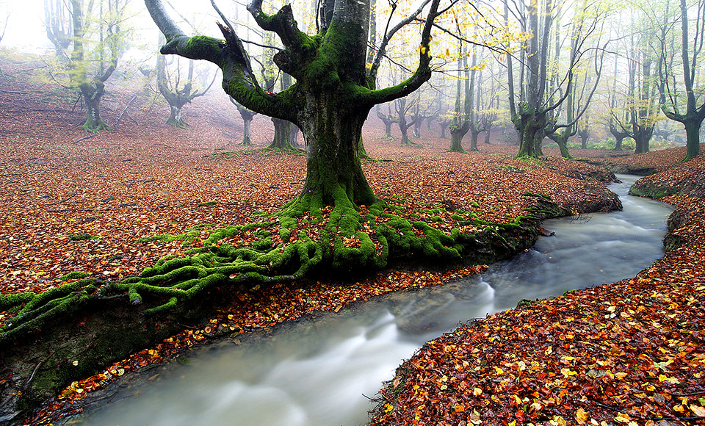
moss forest, Spain

Slide 18
splendid yellow forest

Slide 19
natural tunnel near Halnaker, England

Slide 20
deep in the green forest, France

Slide 21
mysterious glowing light in a Finland forest

Slide 22
White Carpathians forest

Slide 23
magical winter in Quebec forest, Canada

Slide 24
Animal world

Slide 25
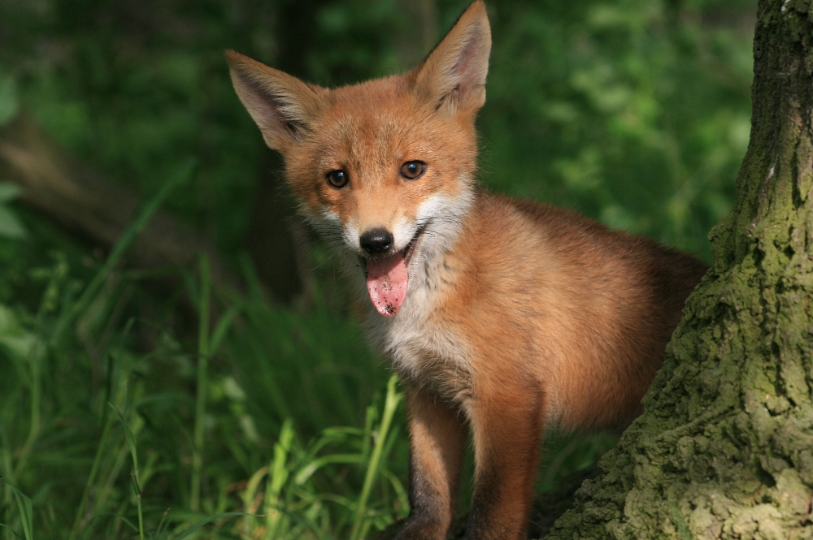
fox

Slide 26
red deer

Slide 27
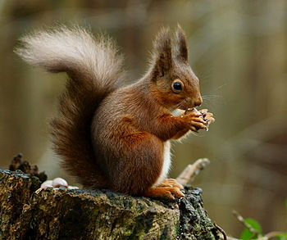
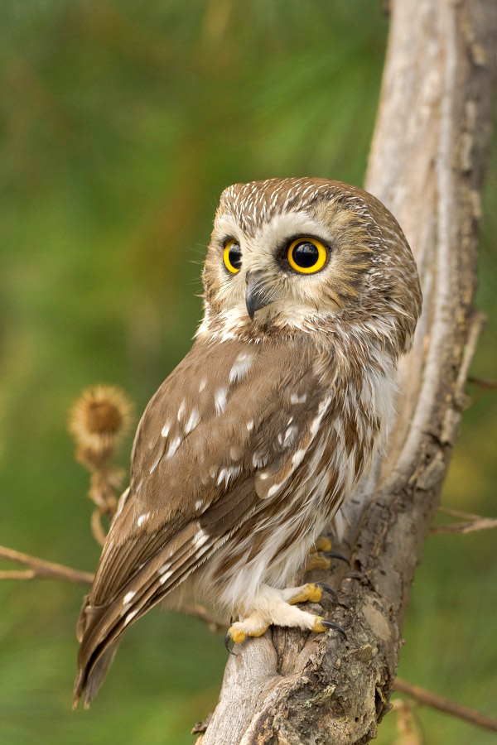
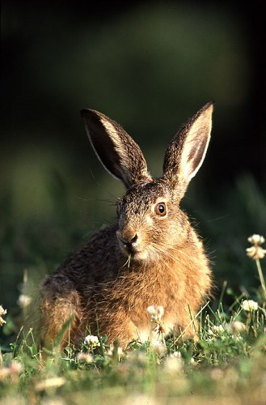
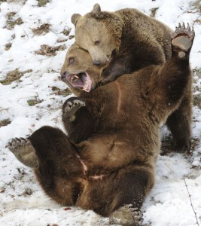
badger
squirrel
owl
hare
bear

Slide 28
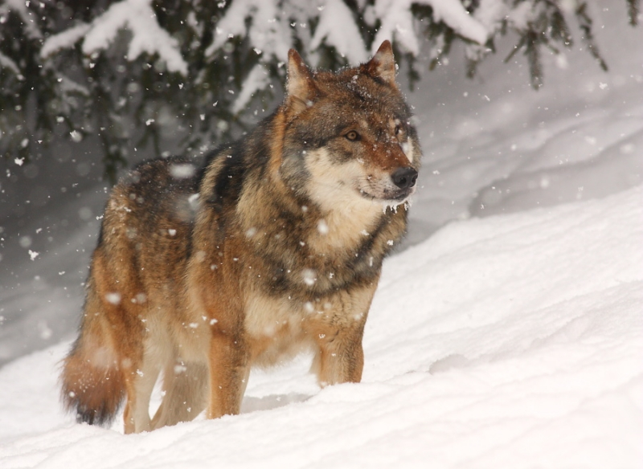
wolf

Slide 29
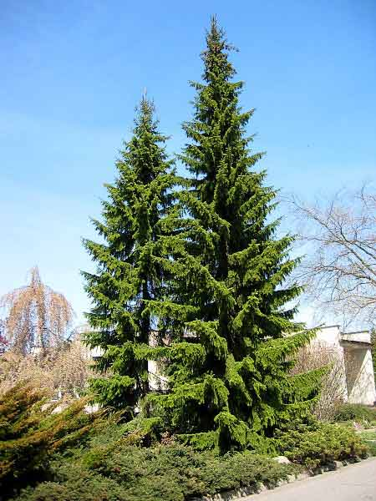
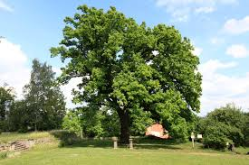
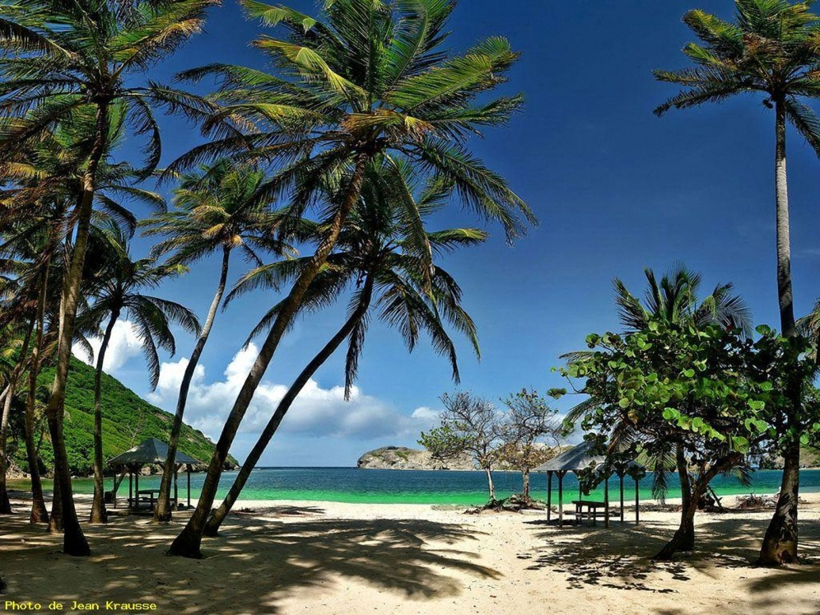
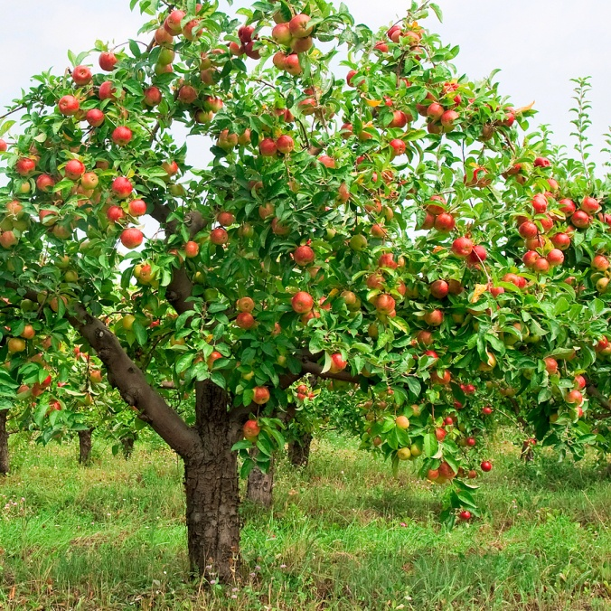
Kinds of trees
broad-leaved tree
coniferous tree
palm tree
fruit tree

Slide 30
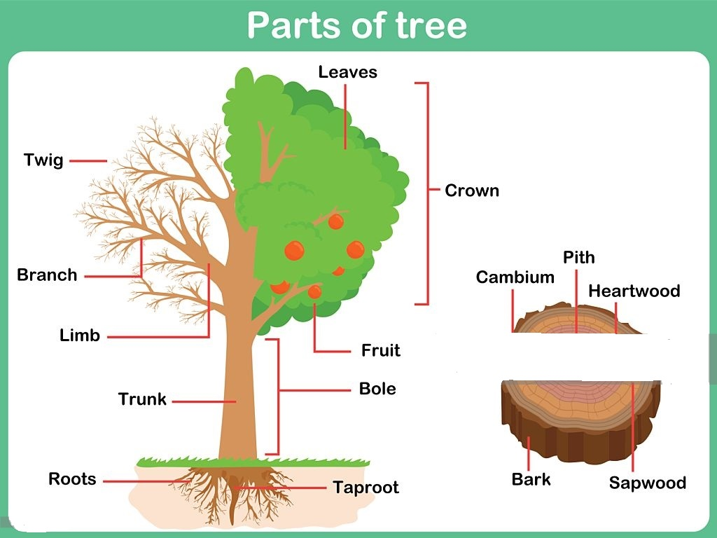
tree stump

Slide 31
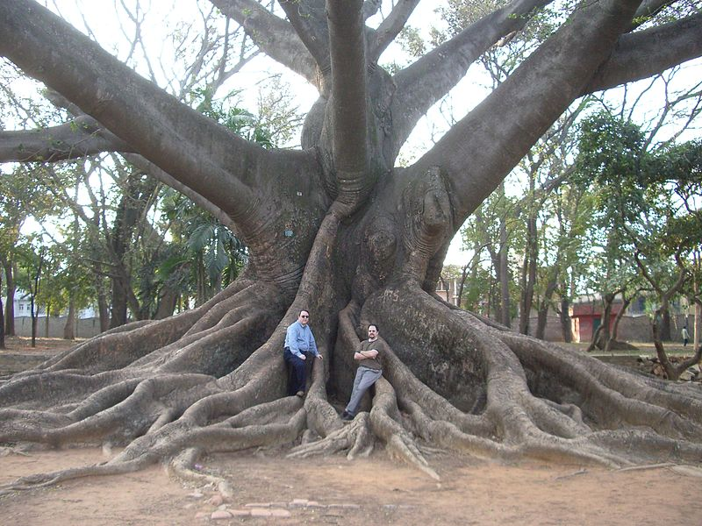
roots of tree

Slide 32
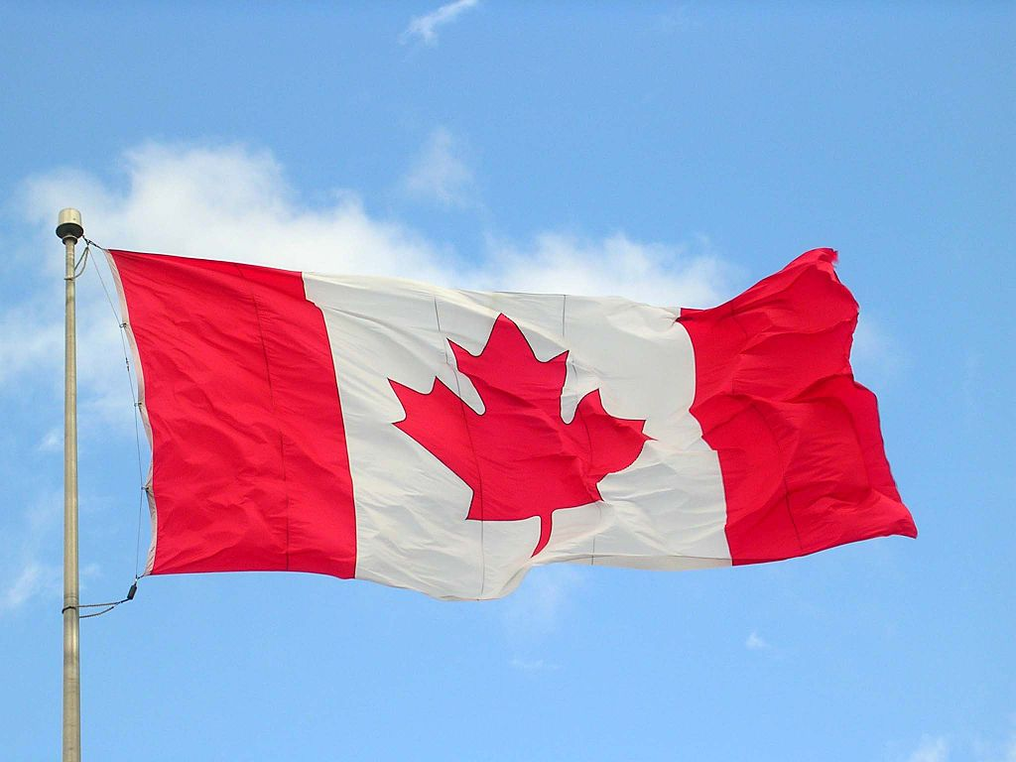
Tree as a symbol
A maple leaf is on the coat of arms of Canada, and is on the Canadian flag

Slide 33
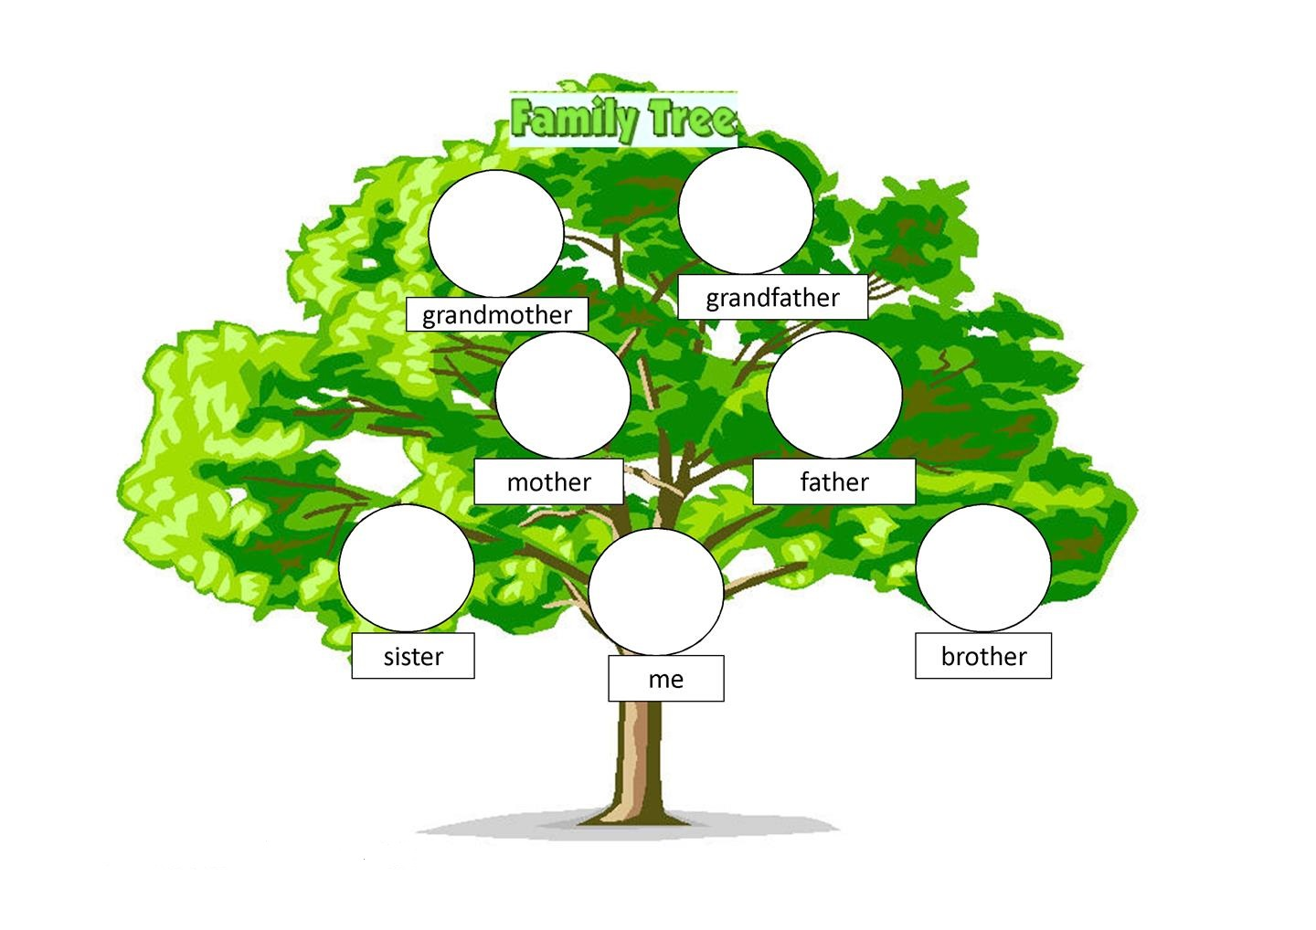

Slide 34
The World’s Most Amazing Trees https://www.youtube.com/watch?v=tA6tue5KA4M

Slide 35
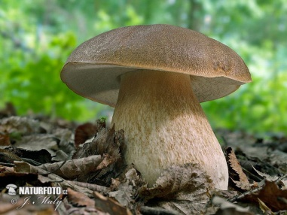
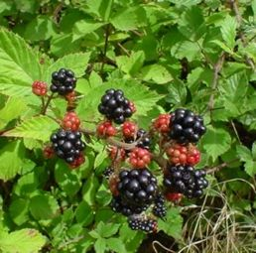
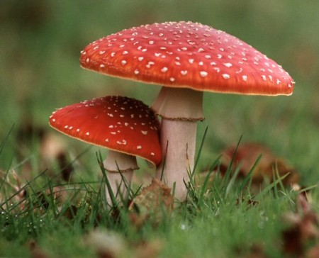
Do you like mushrooms or berries?
blueberry
bolete
fly agaric
blue
berry
rasp
berry
cran
berry
strawberry
blackberry
Yum!
Ugh!
Yum!
Yum!

Slide 36
Plant pests
Deforestation
Environmental disasters
Forest fires

Slide 37
tornado

Slide 38
Forest protection
to control deforestation
environmental stability and ecological balances
preservation of forests biological diversity and genetic resources
national parks
endangered species

Slide 39
How can you protect forests and woods?
In forest don´t
litter
shout
set fires
walk in prohibited areas
pick protected plants
What to do?
save paper
clean the rubbish
Recycling in our school
project Recyclogames
recycling of paper
recycling of aluminium
recycling of batteries

Slide 40
Clean-up of Konopiště park

Slide 41
And that´s all………..
Thank you for your attention

