Slide 1
Mountains, Caves, Canyons and Valleys of the Czech Republic

Slide 2
Mountains

Slide 3
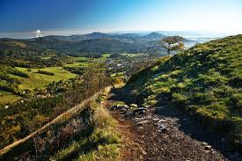
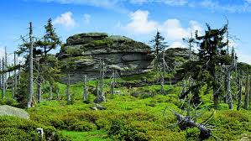
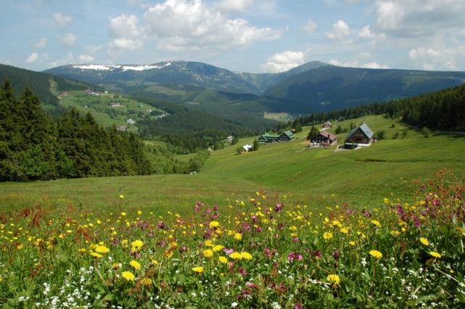
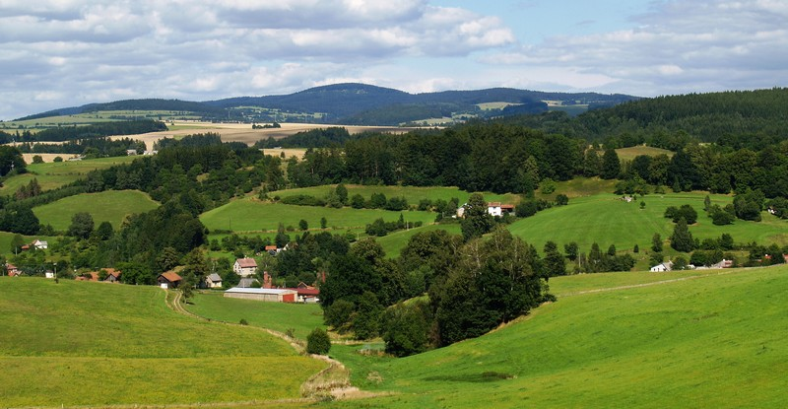
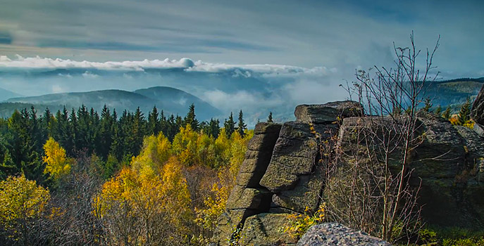
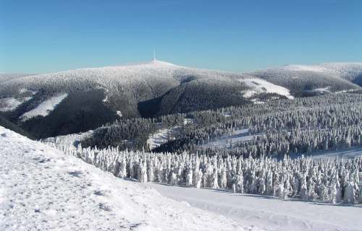
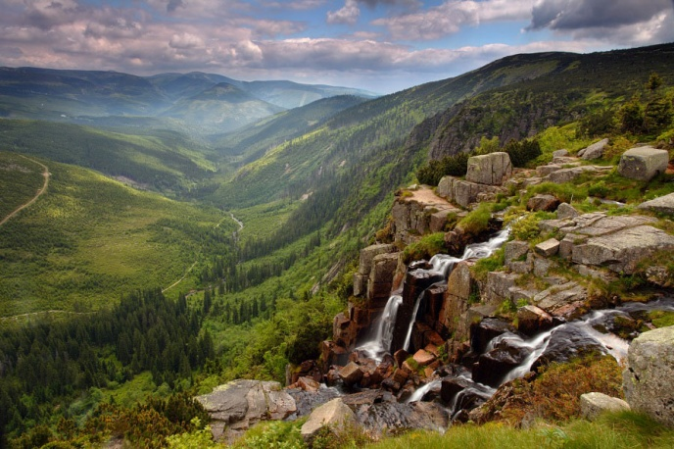
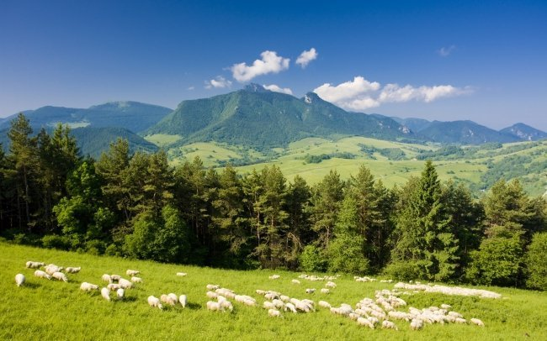
Jizerské mountains
Krkonošemountains
Orlické mountains
Lužické mountains
Krušné mountains
Jeseníky mountains
Šumava mountains
Beskydy mountains

Slide 4
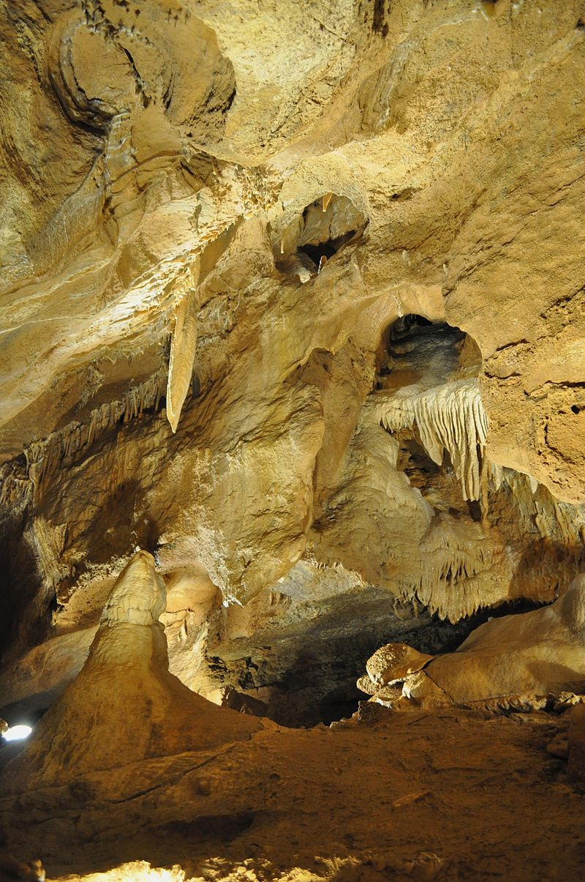
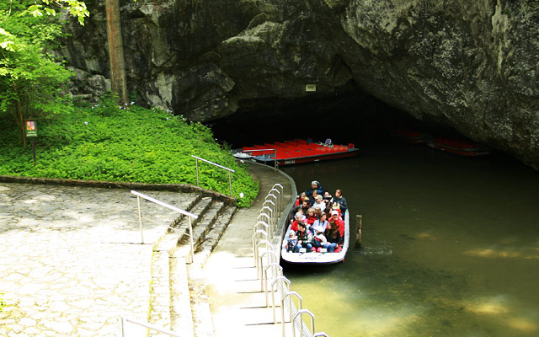
Caves
Koněpruské caves
Chýnovská cave
Macocha

Slide 5
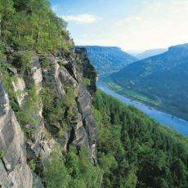
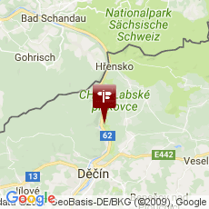
Canyons
The biggest canyon in the CR and in Europe – Labe river near Děčín
15 km long, 300 m deep
80 m high rocks

Slide 6
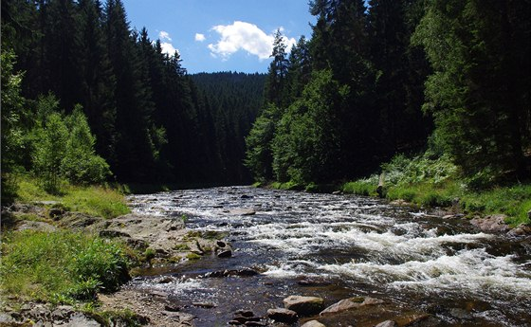
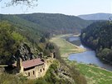
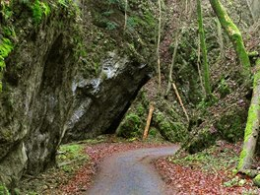
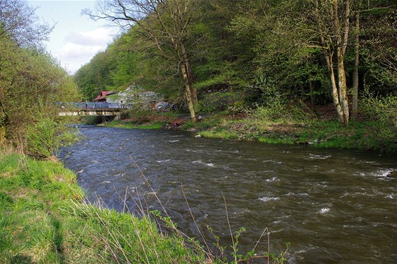
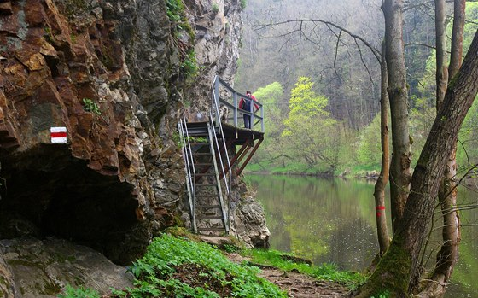
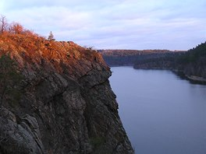
Valleys – 7 the most beautiful in the Czech Republic
Kamenice river
Berounka river
Šumava mountain river Křemelná
Lužnice river
White Water river
Odra river
Jihlava river

Slide 7
Thank you for your attention

