Slide 1
UID Project 2018-2020
The tradition of restoration of art paintings in Naples
By students of
Scuola Secondaria di Primo Grado A. Ristori, Napoli, Italy

Slide 2
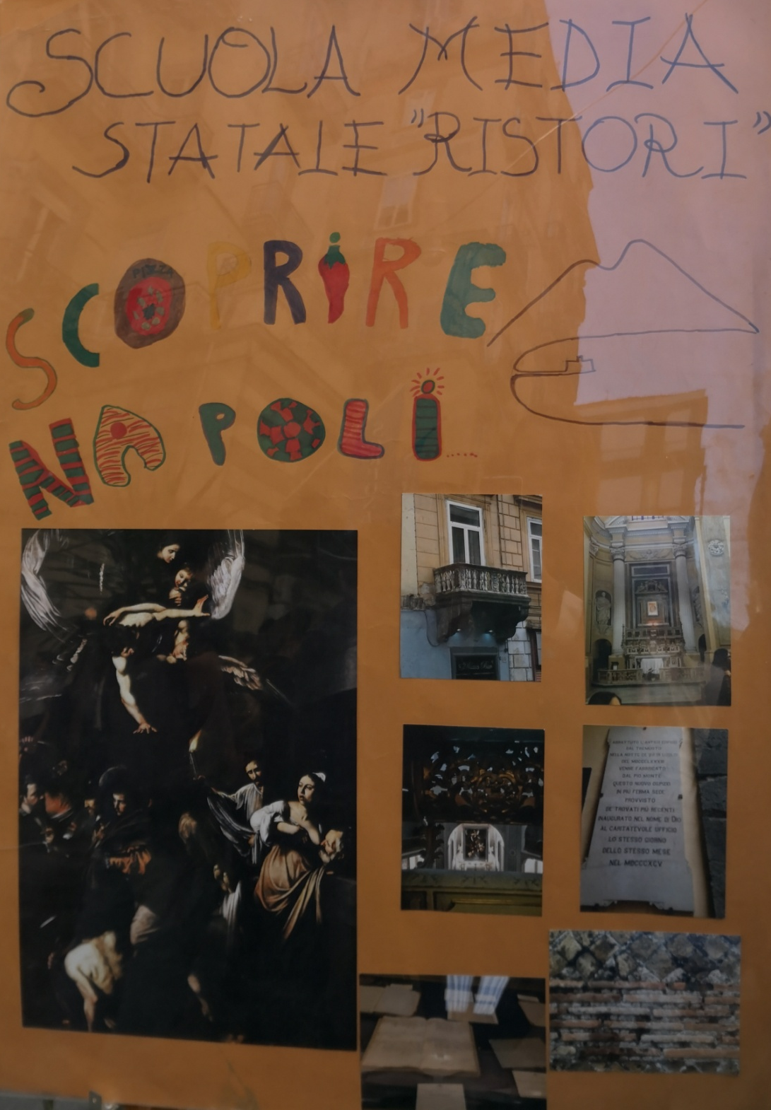

Slide 3
Un esempio di restauro:
la tavola della
“Madonna con bambino” di Pietro Perugino
An example of restoration:
the table of “Virgin with Child”
by Pietro Perugino

Slide 4
Before restoration (photo 1)
The paint film is blurred by yellowed and oxidized paints. Two triangular wooden inserts are evident, added during an ancient restoration and probably the painting had another form. The causes of the intervention and the original shape are not known,. There are localized drops of color at the edges of the additions, integrated during a restoration in 1957, now chromatically altered.
During cleaning (photo 2-4)
The cleaning has recovered the brightness of the colors, revealing some altered and revealed areas, such as the sky and the mantle of the Virgin, which allow you to glimpse the layer of azurite under the veil of overseas. The oldest restoration emerged with the chromatic integration similar to the original of the two triangles, later made recognizable by a brown glaze.
UV fluorescence UV rays highlight paint overlaps, improper and altered pictorial integrations that compensate for gaps in pictorial layers and abrasions of colour.

Slide 5
Reflectography
The preparatory drawing is spread on a white lead primer diluted in oil over the preparation of plaster and glue. The representation is not modified with respect to the drafting of the drawing. Reading the reflectography does not show the method of transposition adopted.
After restoration
The gaps were filled with plaster diluted with lapin glue and prepared with a tempera similar to the light and warm color of the preparation. It was decided to maintain the transformations undergone by the work, now stratified in its conservation history, even considering that for lack of certain data it is not possible to determine the original shape and size of the table. The gaps have been integrated, the abrasions have been compensated with light veiling to restore chromatic continuity and the altered tone of the antique touches along the edges has been corrected. The colour of the integrations applied in ancient times on the triangular inserts, very similar to the original, was flat and could hardly have been modified to make it bright and modulated. It was then covered with a clear tempera, proceeding with successive tonal steps to tune the remake to the chromatic preciousness of the sky.

Slide 6
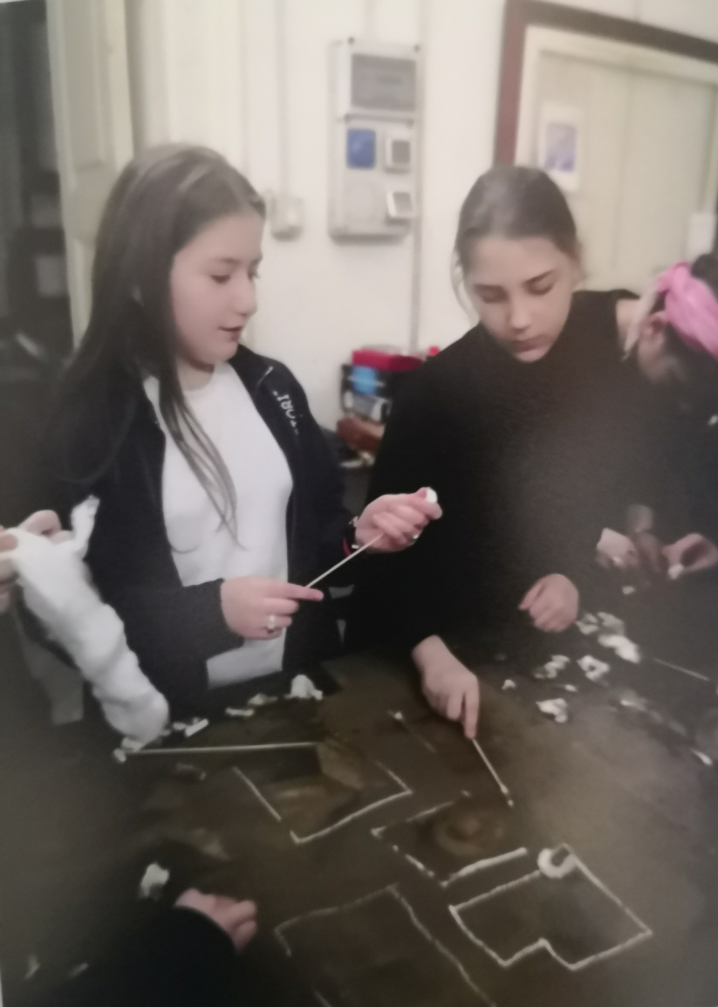
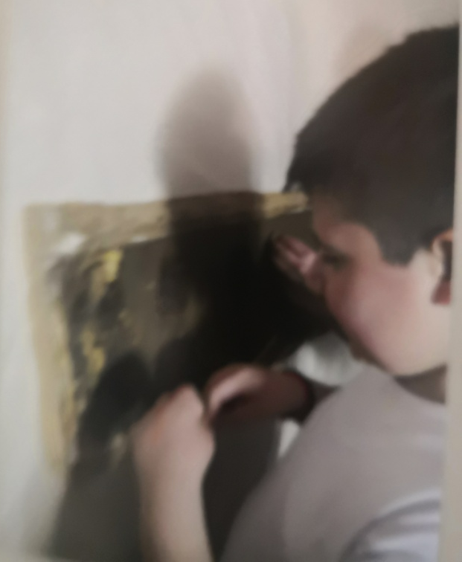
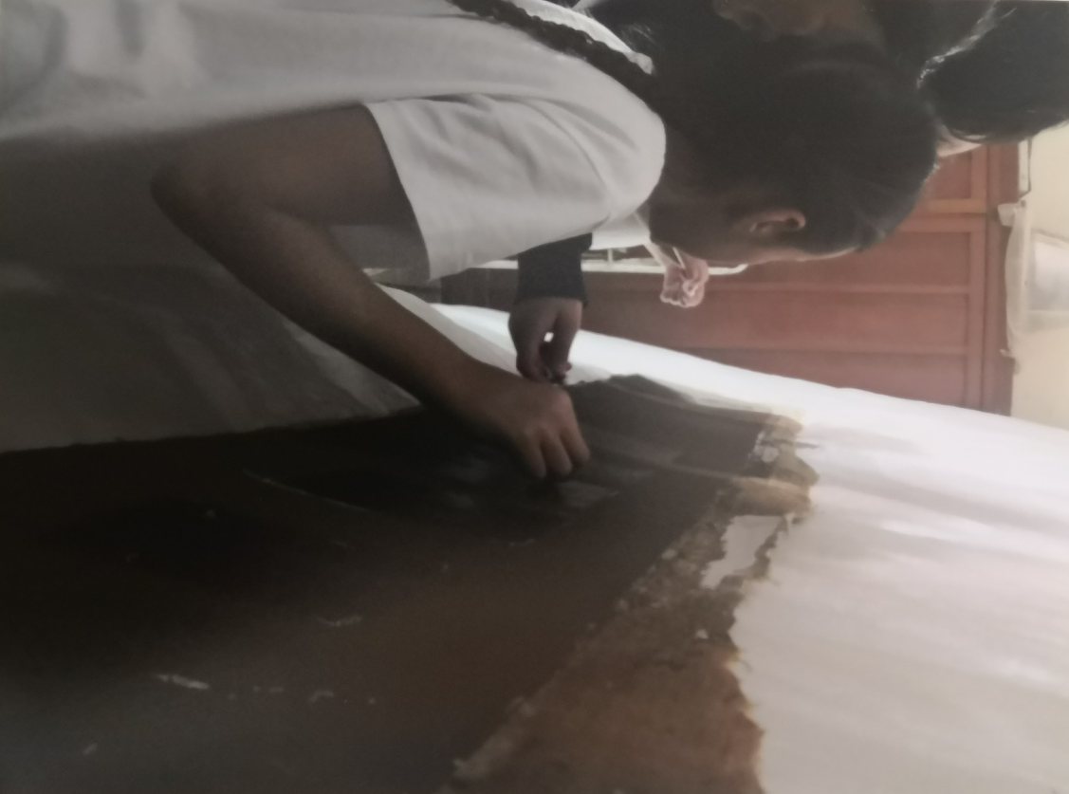
Piccoli restauratori all’opera nel laboratorio di Giulia Zorzetti
Our restorers at work in Giulia Zorzetti's workshop

Slide 7
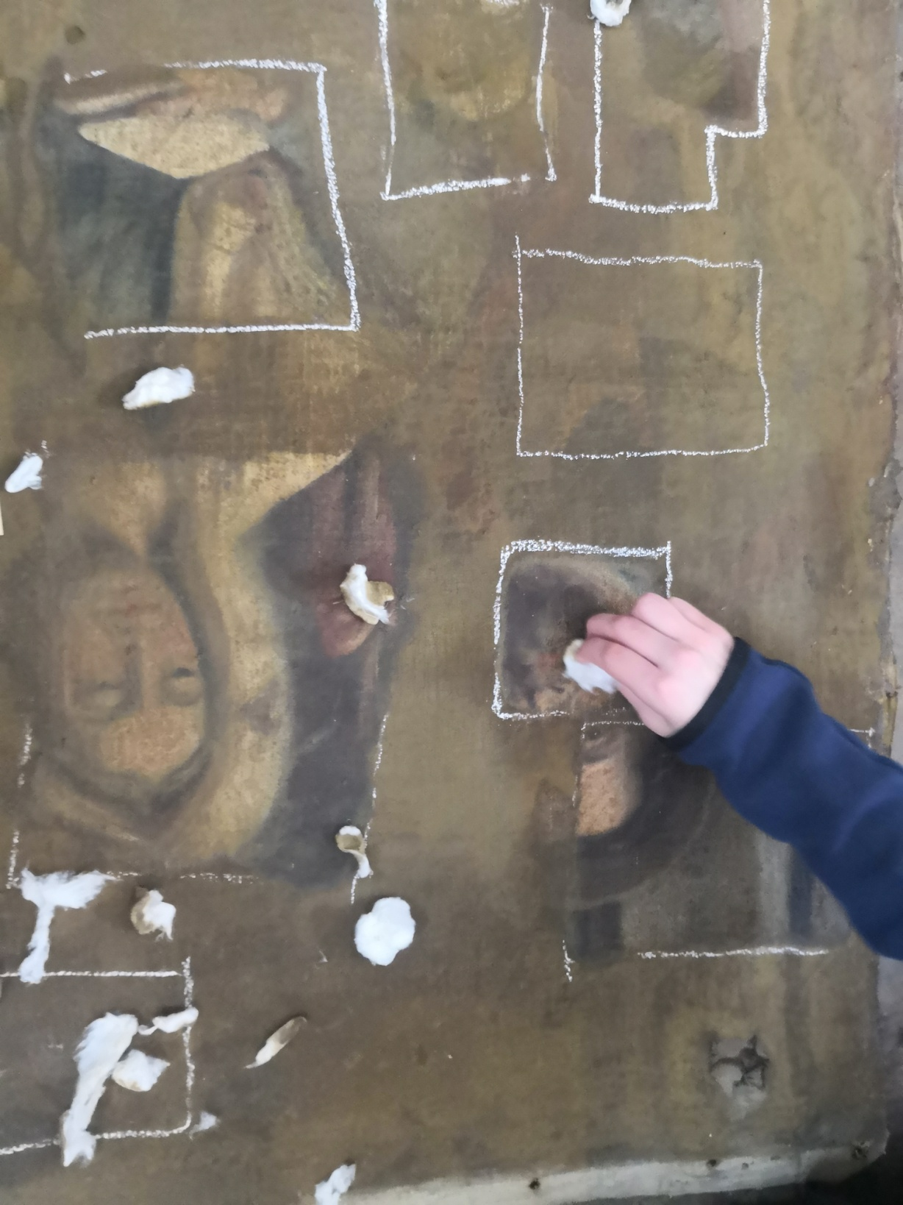
Saggi di pulitura
Cleaning tests

Slide 8
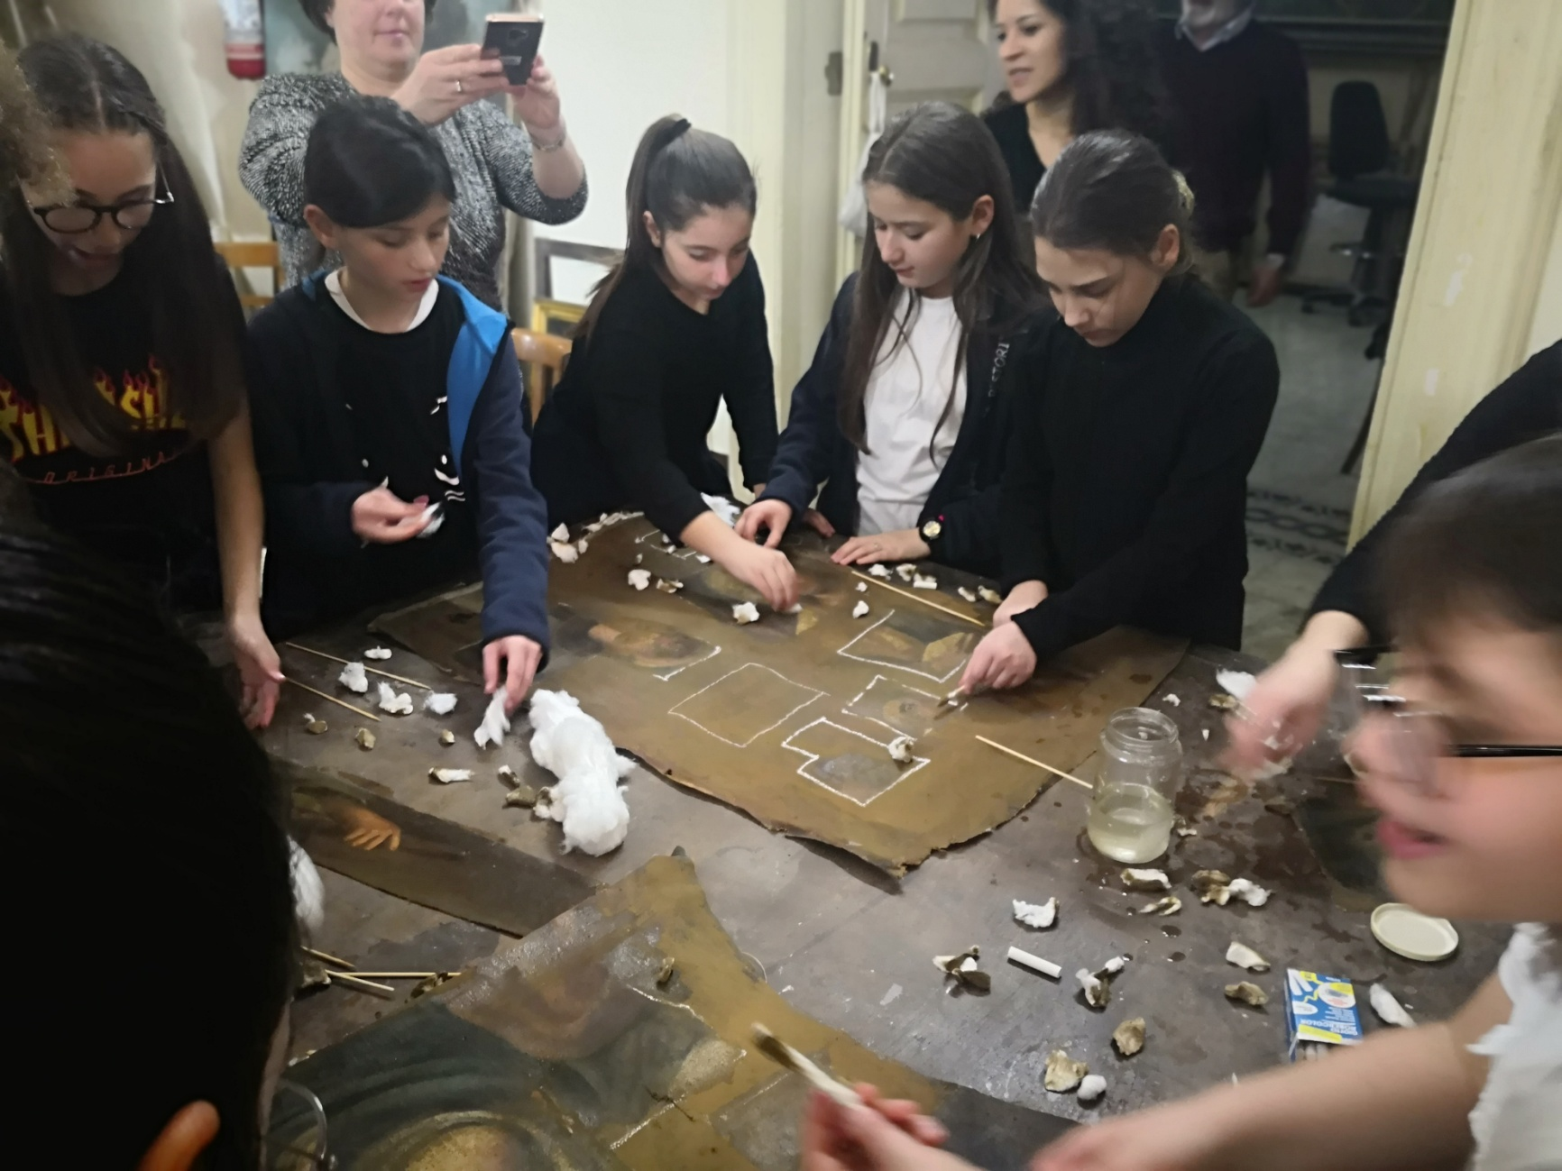

Slide 10
Il laboratorio durante la manifestazione
del Maggio dei Monumenti 2019
Restoration laboratory during the exhibition “Maggio dei Monumenti 2019”

Slide 11
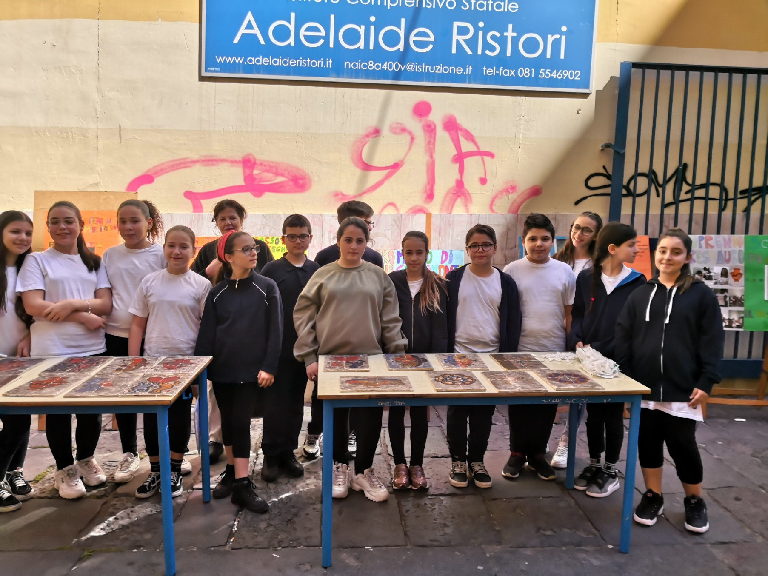

Slide 12
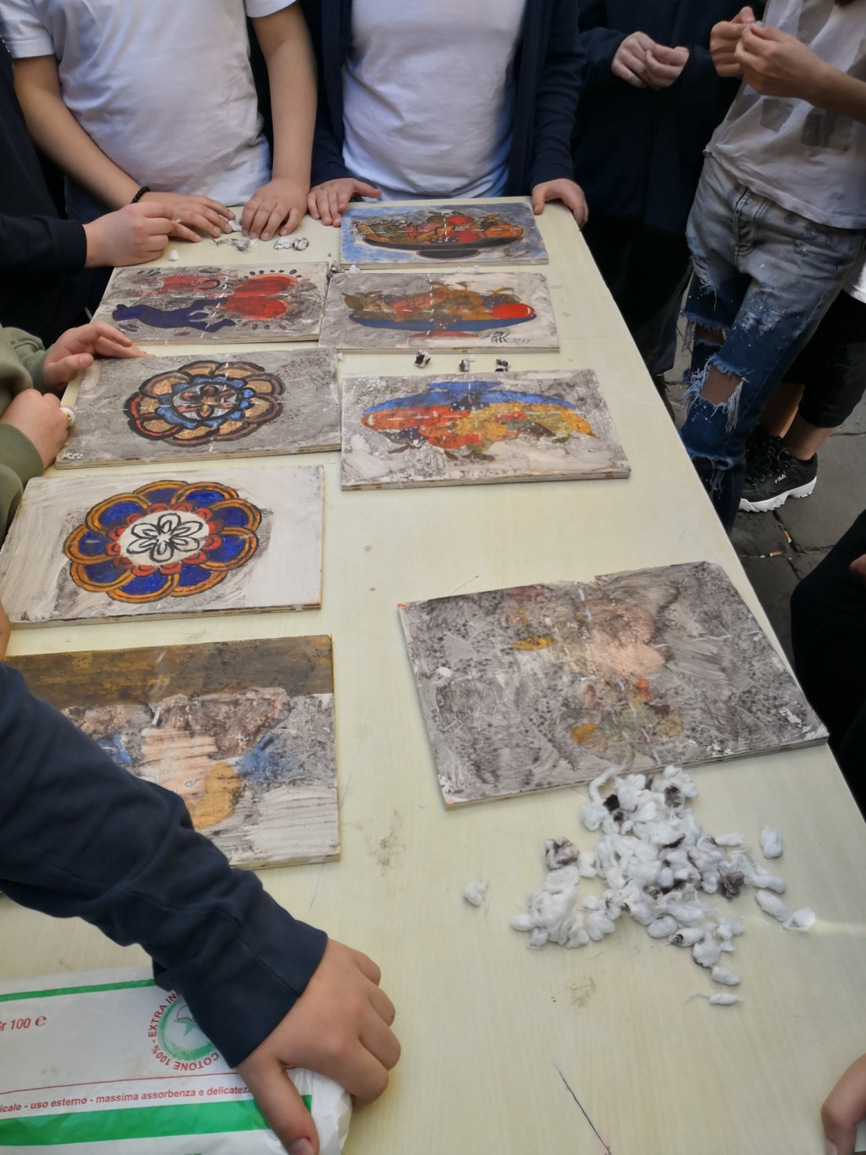
Pulitura delle tavolette lignee dei dipinti eseguiti dai ragazzi
Polish of wood tablets draw by scholars.

Slide 13
