Slide 1
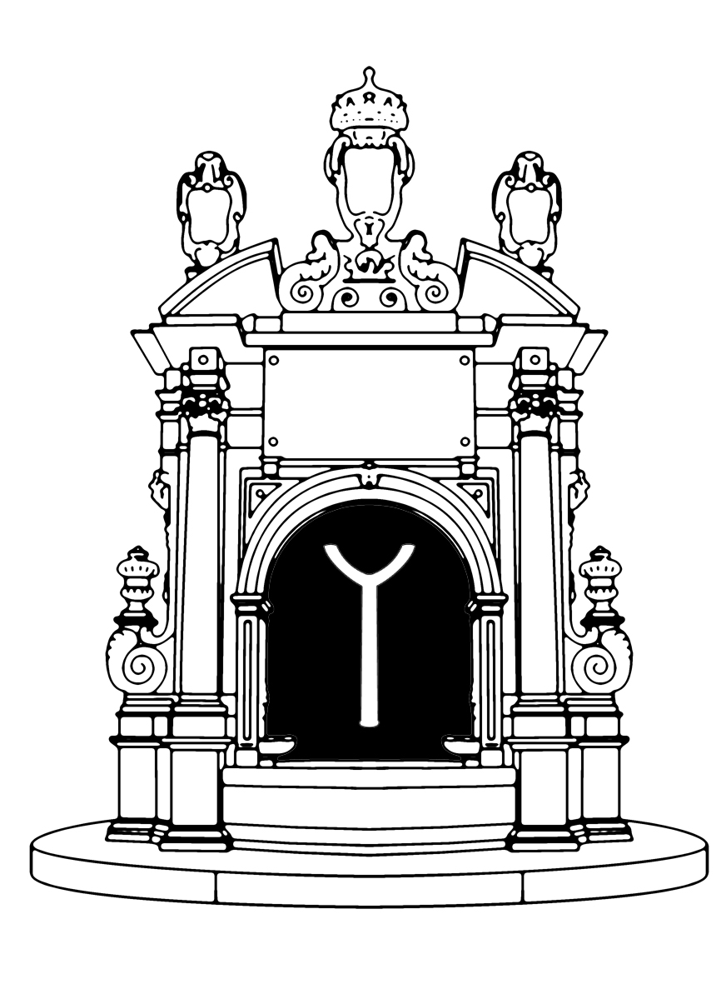
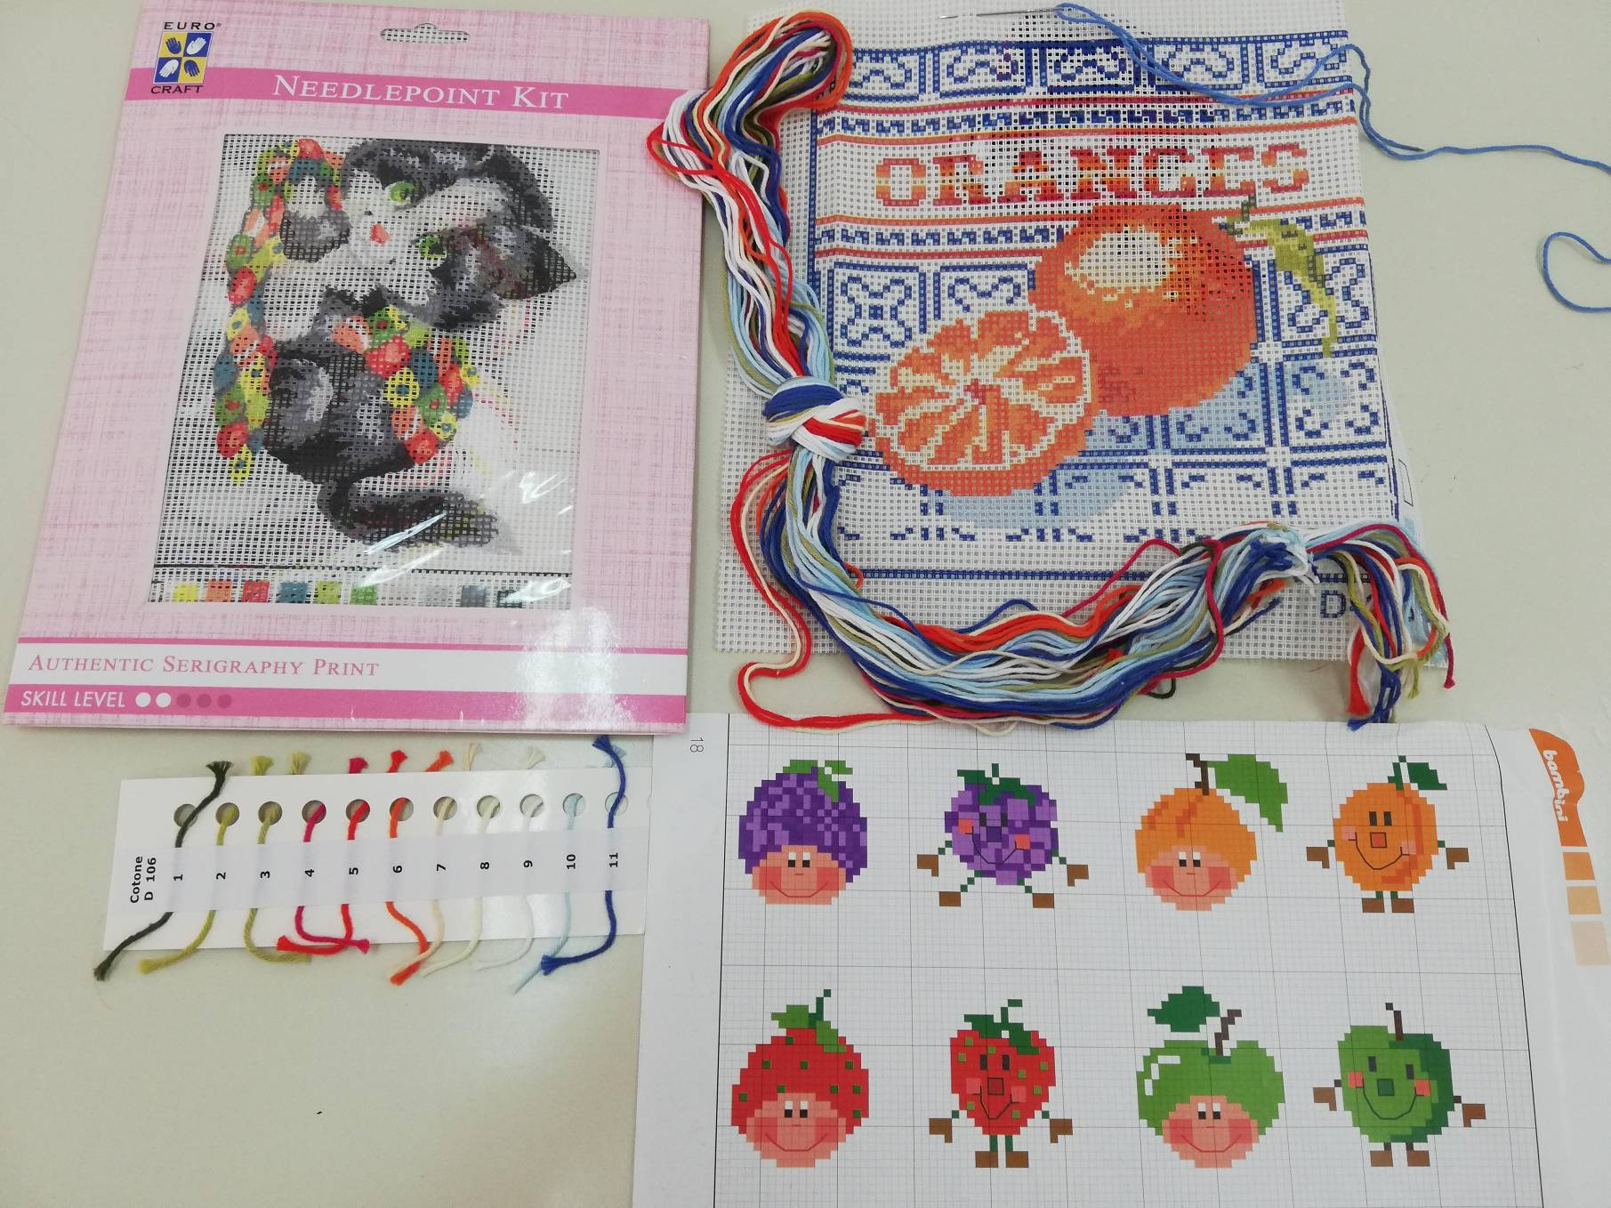
Istituto Comprensivo Statale “ADELAIDE RISTORI“ Via L. D’Alagno, 16 - 80138 – Napoli
United in diversity 018-1-EL01-KA229-047809_4
Embroidery tradition and the cross stitch

Slide 2
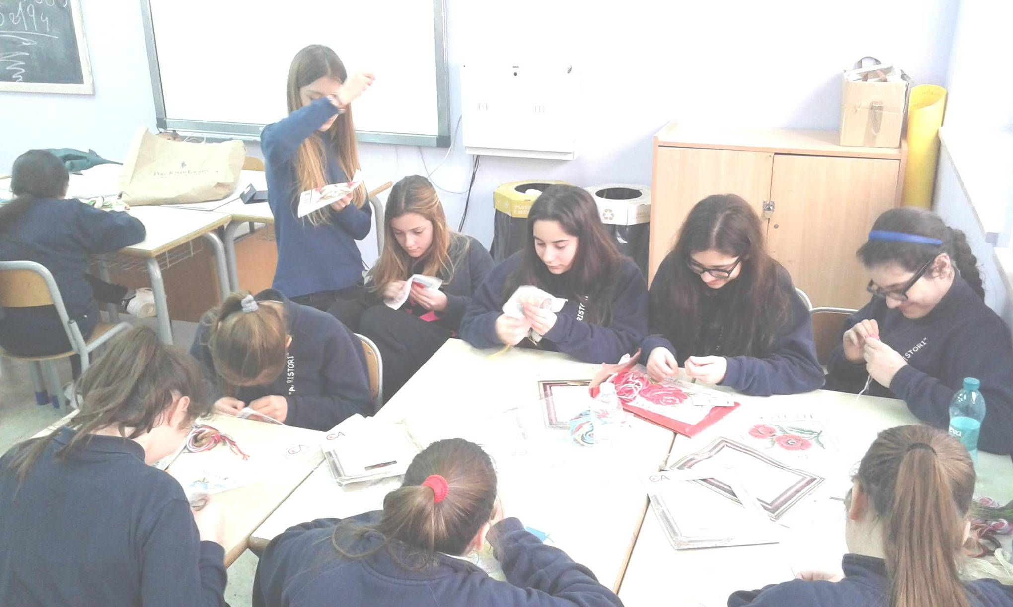
Istituto Comprensivo Statale “ADELAIDE RISTORI“ Via L. D’Alagno, 16 - 80138 – Napoli
United in diversity 018-1-EL01-KA229-047809_4
In my school we learned how to make cross stitch.
It is easy if you follow these instructions.
Step 1: use a kit for cross stitch with the fabric called Aida, a round end tapestry needle, the cross stitch chart, different colour of threads.
Step 2: start working from the center of your fabric.
Step 3: you work cross stitch in rows goingfrom left to right. Starting from the back side of the fabric, bring your needle up through a hole toward the front, leaving about an inch of thread at the back. You will cover the tail with your stitches as you work to secure it.
It is shown in the video

Slide 3
Istituto Comprensivo Statale “ADELAIDE RISTORI“ Via L. D’Alagno, 16 - 80138 – Napoli
United in diversity 018-1-EL01-KA229-047809_4

Slide 4
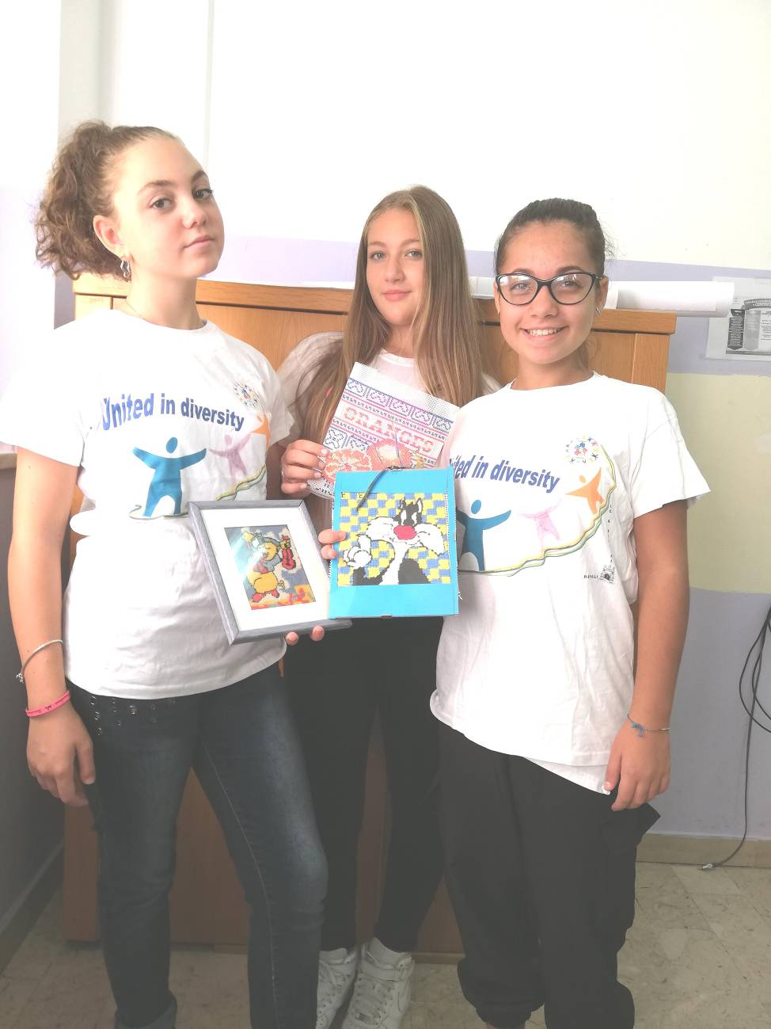
Istituto Comprensivo Statale “ADELAIDE RISTORI“ Via L. D’Alagno, 16 - 80138 – Napoli
United in diversity 018-1-EL01-KA229-047809_4
Next pass your needle through a hole diagonally across from where you started to make a slanted half cross stitch (/). Be sure to hold on to the tail at the back of the fabric so it doesn’t slip through.
1 / / / / / ....
Continuing stitching along the row to make a series of half cross stitches (////).
Step 4: Next return across the row making a series of half cross stitches in the other direction (\\\\).
2 / / X X X
X X X X X
Step 5: Keep stitching until you reach the end of the thread or until you run out of stitches in your pattern. On the back side of the fabric, pass the needle under at least three completed stitches to secure the thread. Cut the remaining thread.
The result is guaranteed!

Slide 5
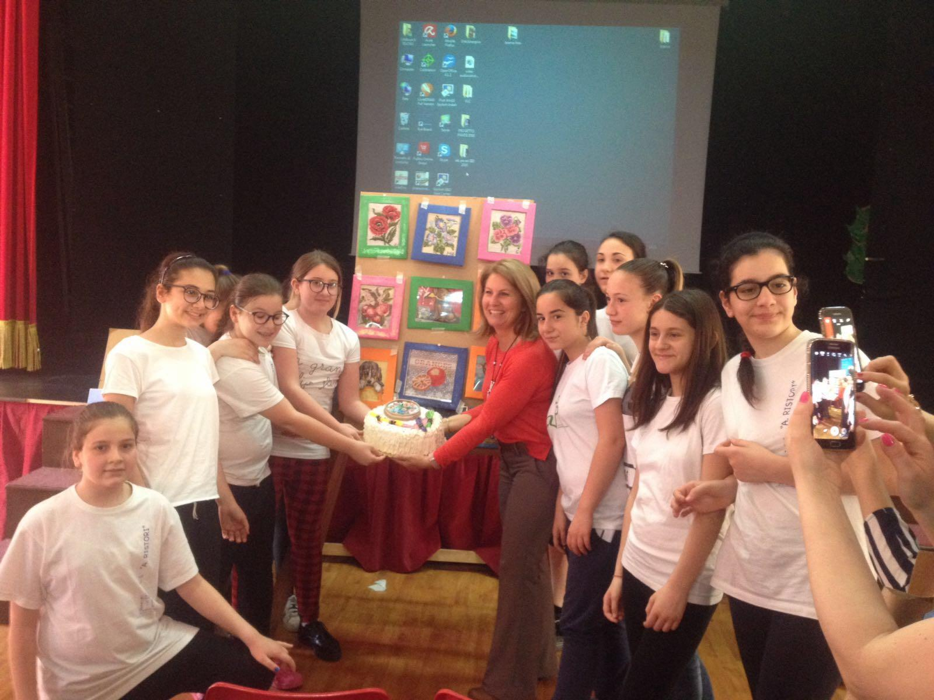
Istituto Comprensivo Statale “ADELAIDE RISTORI“ Via L. D’Alagno, 16 - 80138 – Napoli
United in diversity 018-1-EL01-KA229-047809_4

