Slide 1
POLAND
OFFICIALLY THE REPUBLIC OF POLAND
LOCATED IN THE CENTRAL EUROPE

Slide 2
MIGRANTS
THE MAIN CAUSES OF POLISH MIGRATION:
political situation
economic situation

Slide 3
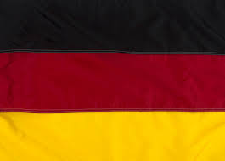
MIGRATION
At the end of the 19th century, the Poles went to:
France USA Canada Brazil Argentina Germany

Slide 4
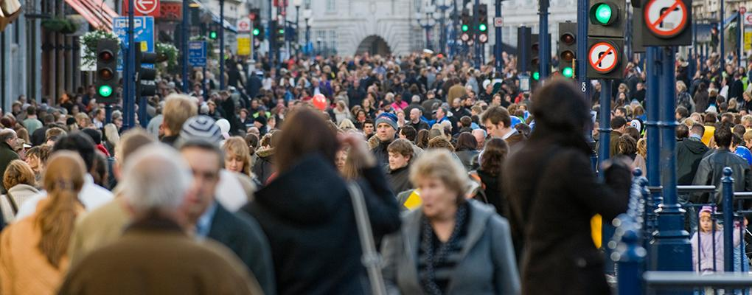
THE EFFECTS OF MIGRATION:
more work places
a large number of older people
better living conditions for emigrants

Slide 5
: Since 2004, many Poles went to Western Countries:
United Kingdom
Holland
France
Norway

Slide 6
JOBS PERFORMED BY MIGRANTS
THE MOST COMMON JOBS:
CAR MECHANIC
ELECTRICIAN
WAITER

Slide 7
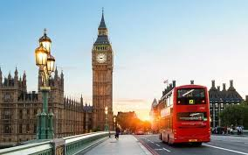
THE POLISH DIASPORA (POLONIA):
London has been a top destination for Polish migrants.

Slide 8
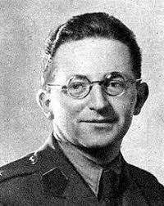
Famous Polish Migrants
MARIAN REJEWSKI JERZY RÓŻYCKI

Slide 9
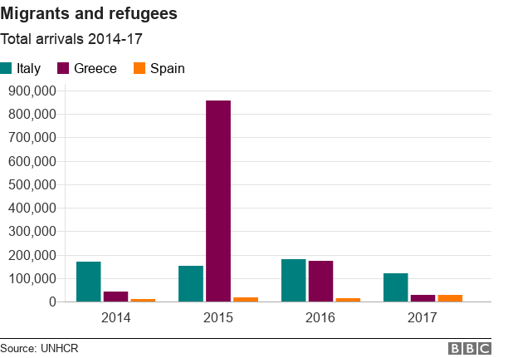
The number of Poles in western countries:
Great Britain (790,000 thousand)
USA (9 million)
Germany (2 million)
Brazil (1.8 million)
France (1 million)

