Slide 1
Save the water!
The students of the Primary school of Zervohoria made draws about clean water

Slide 2
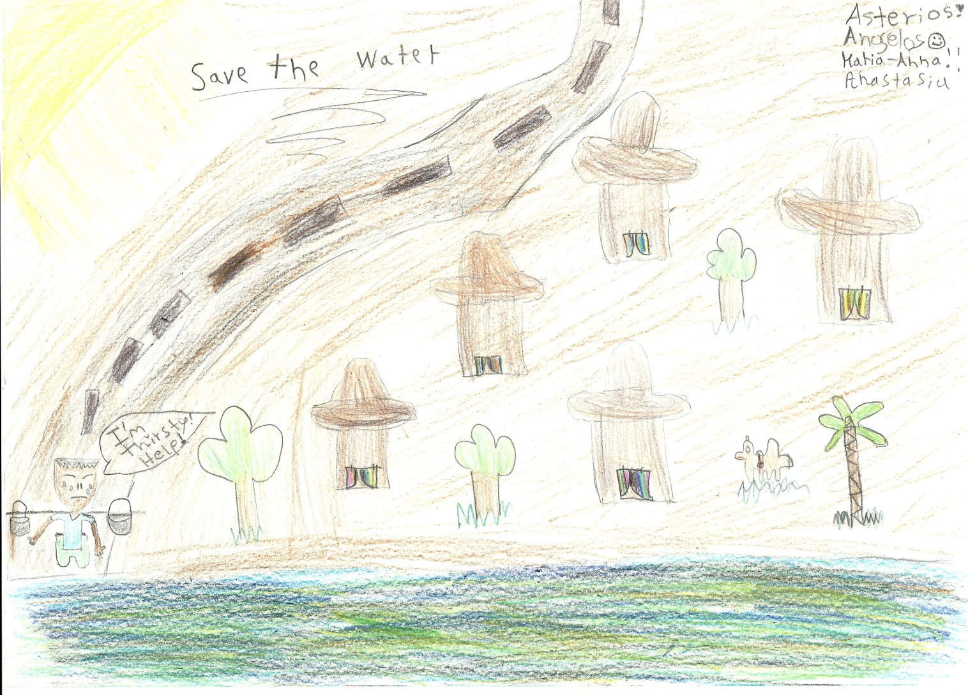
We need clean water!

Slide 3
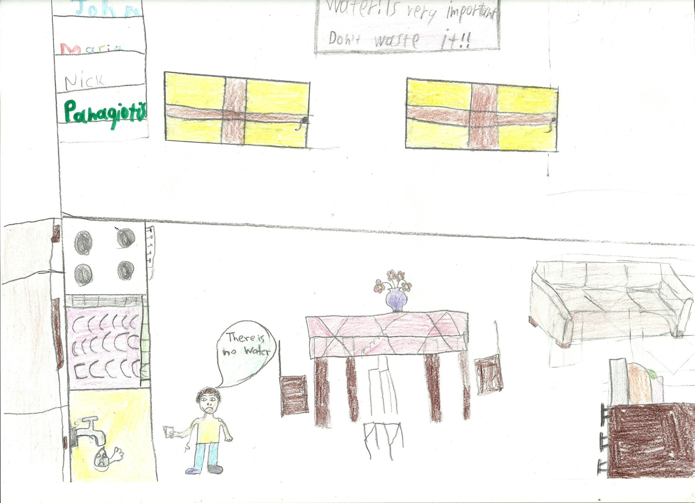
Even a drop counts!

Slide 4
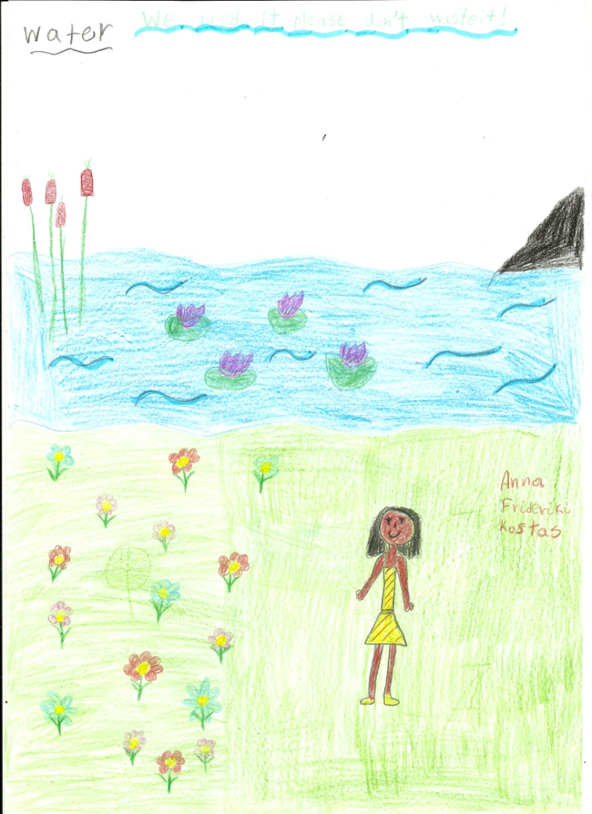
Don’t waste it!

Slide 5
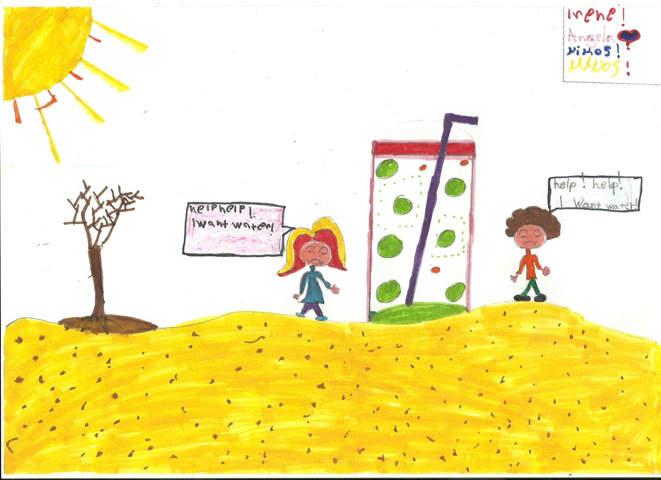
No water no life!

Slide 6
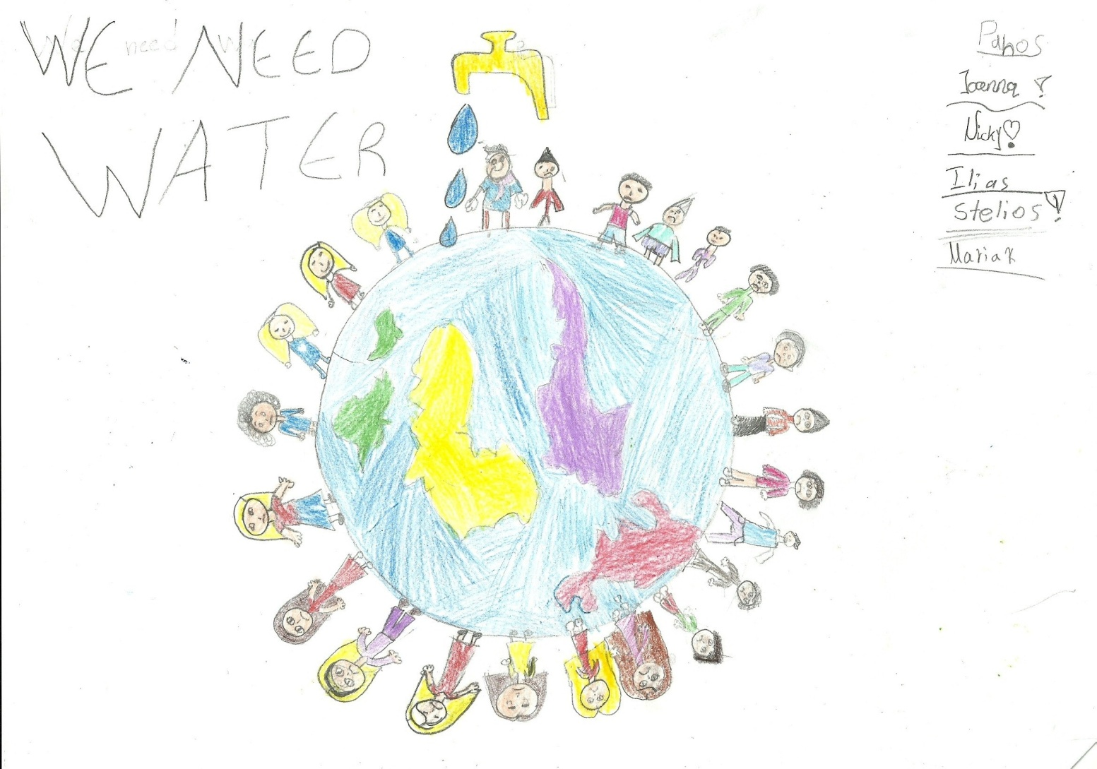
We need water!

