Slide 1
Save water clean
Koknese primary boarding school – development centre

Slide 2
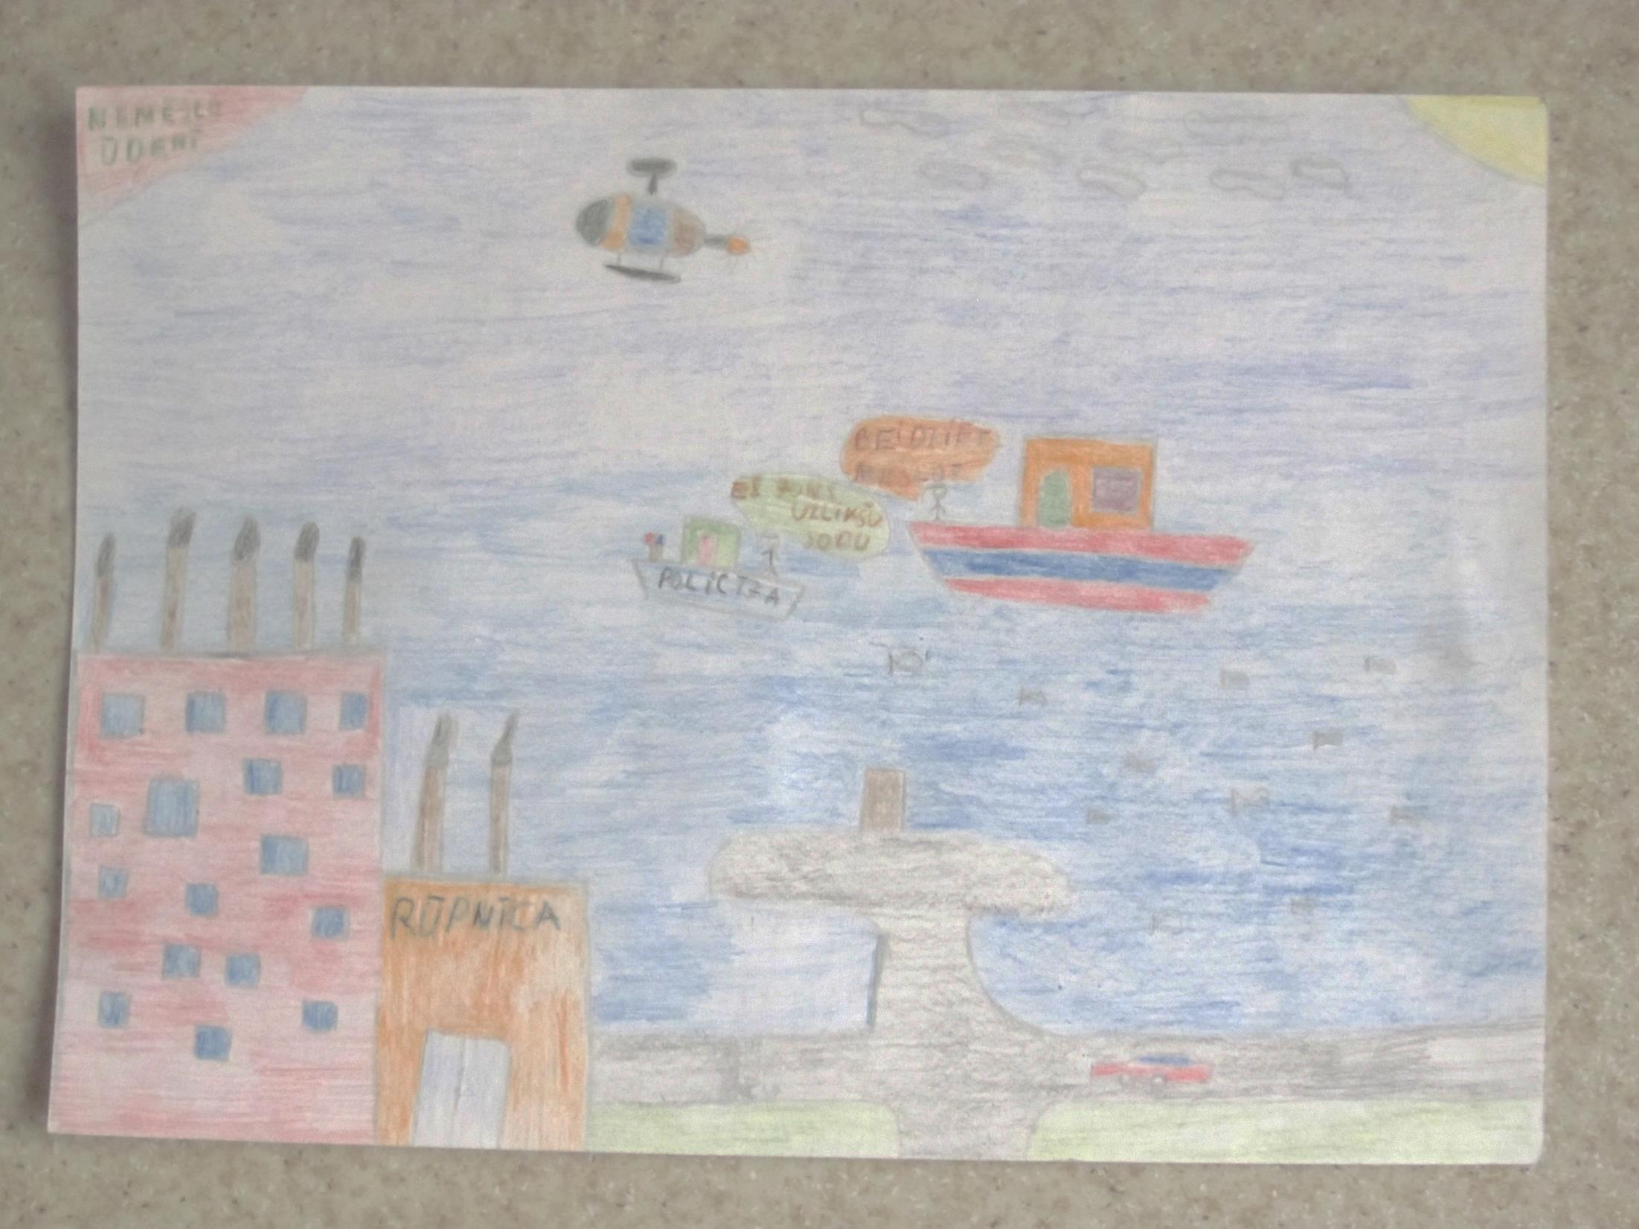

Slide 3
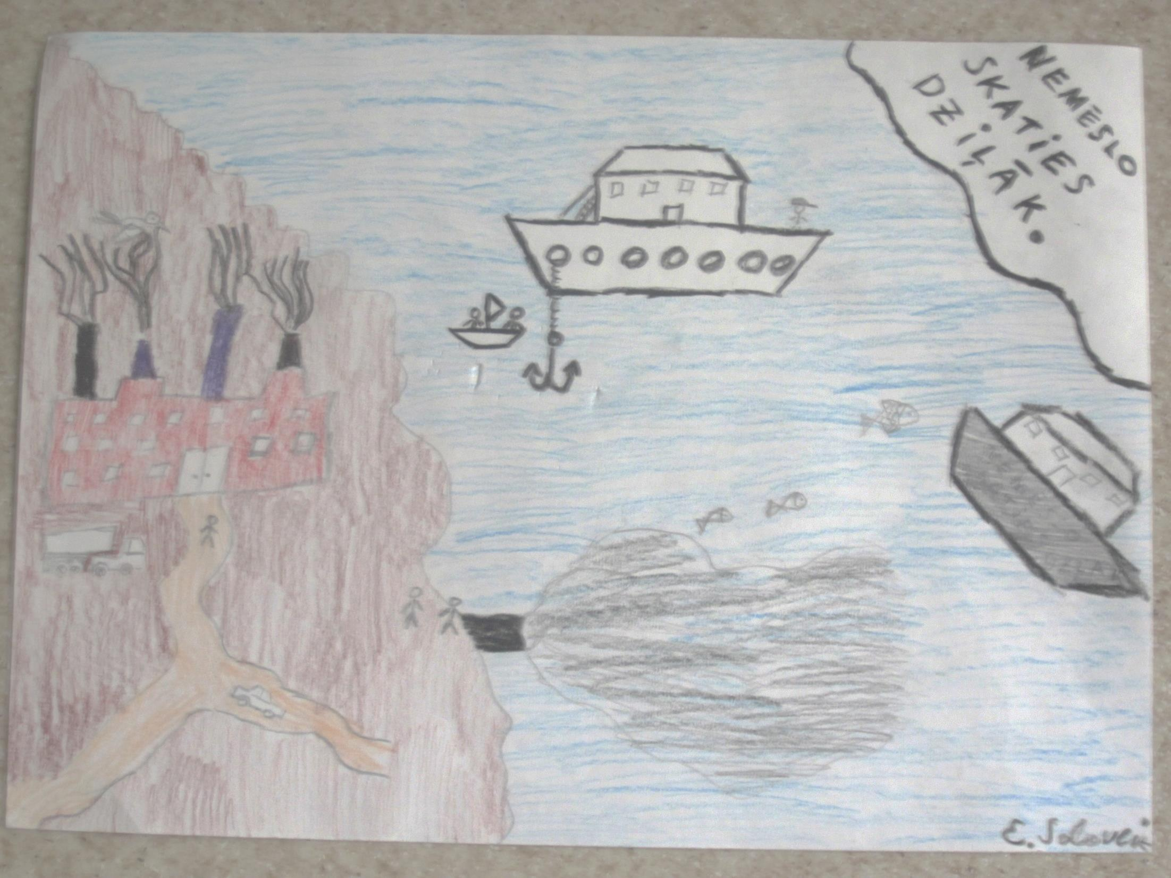
Don’t litter! Look deeper!

Slide 4
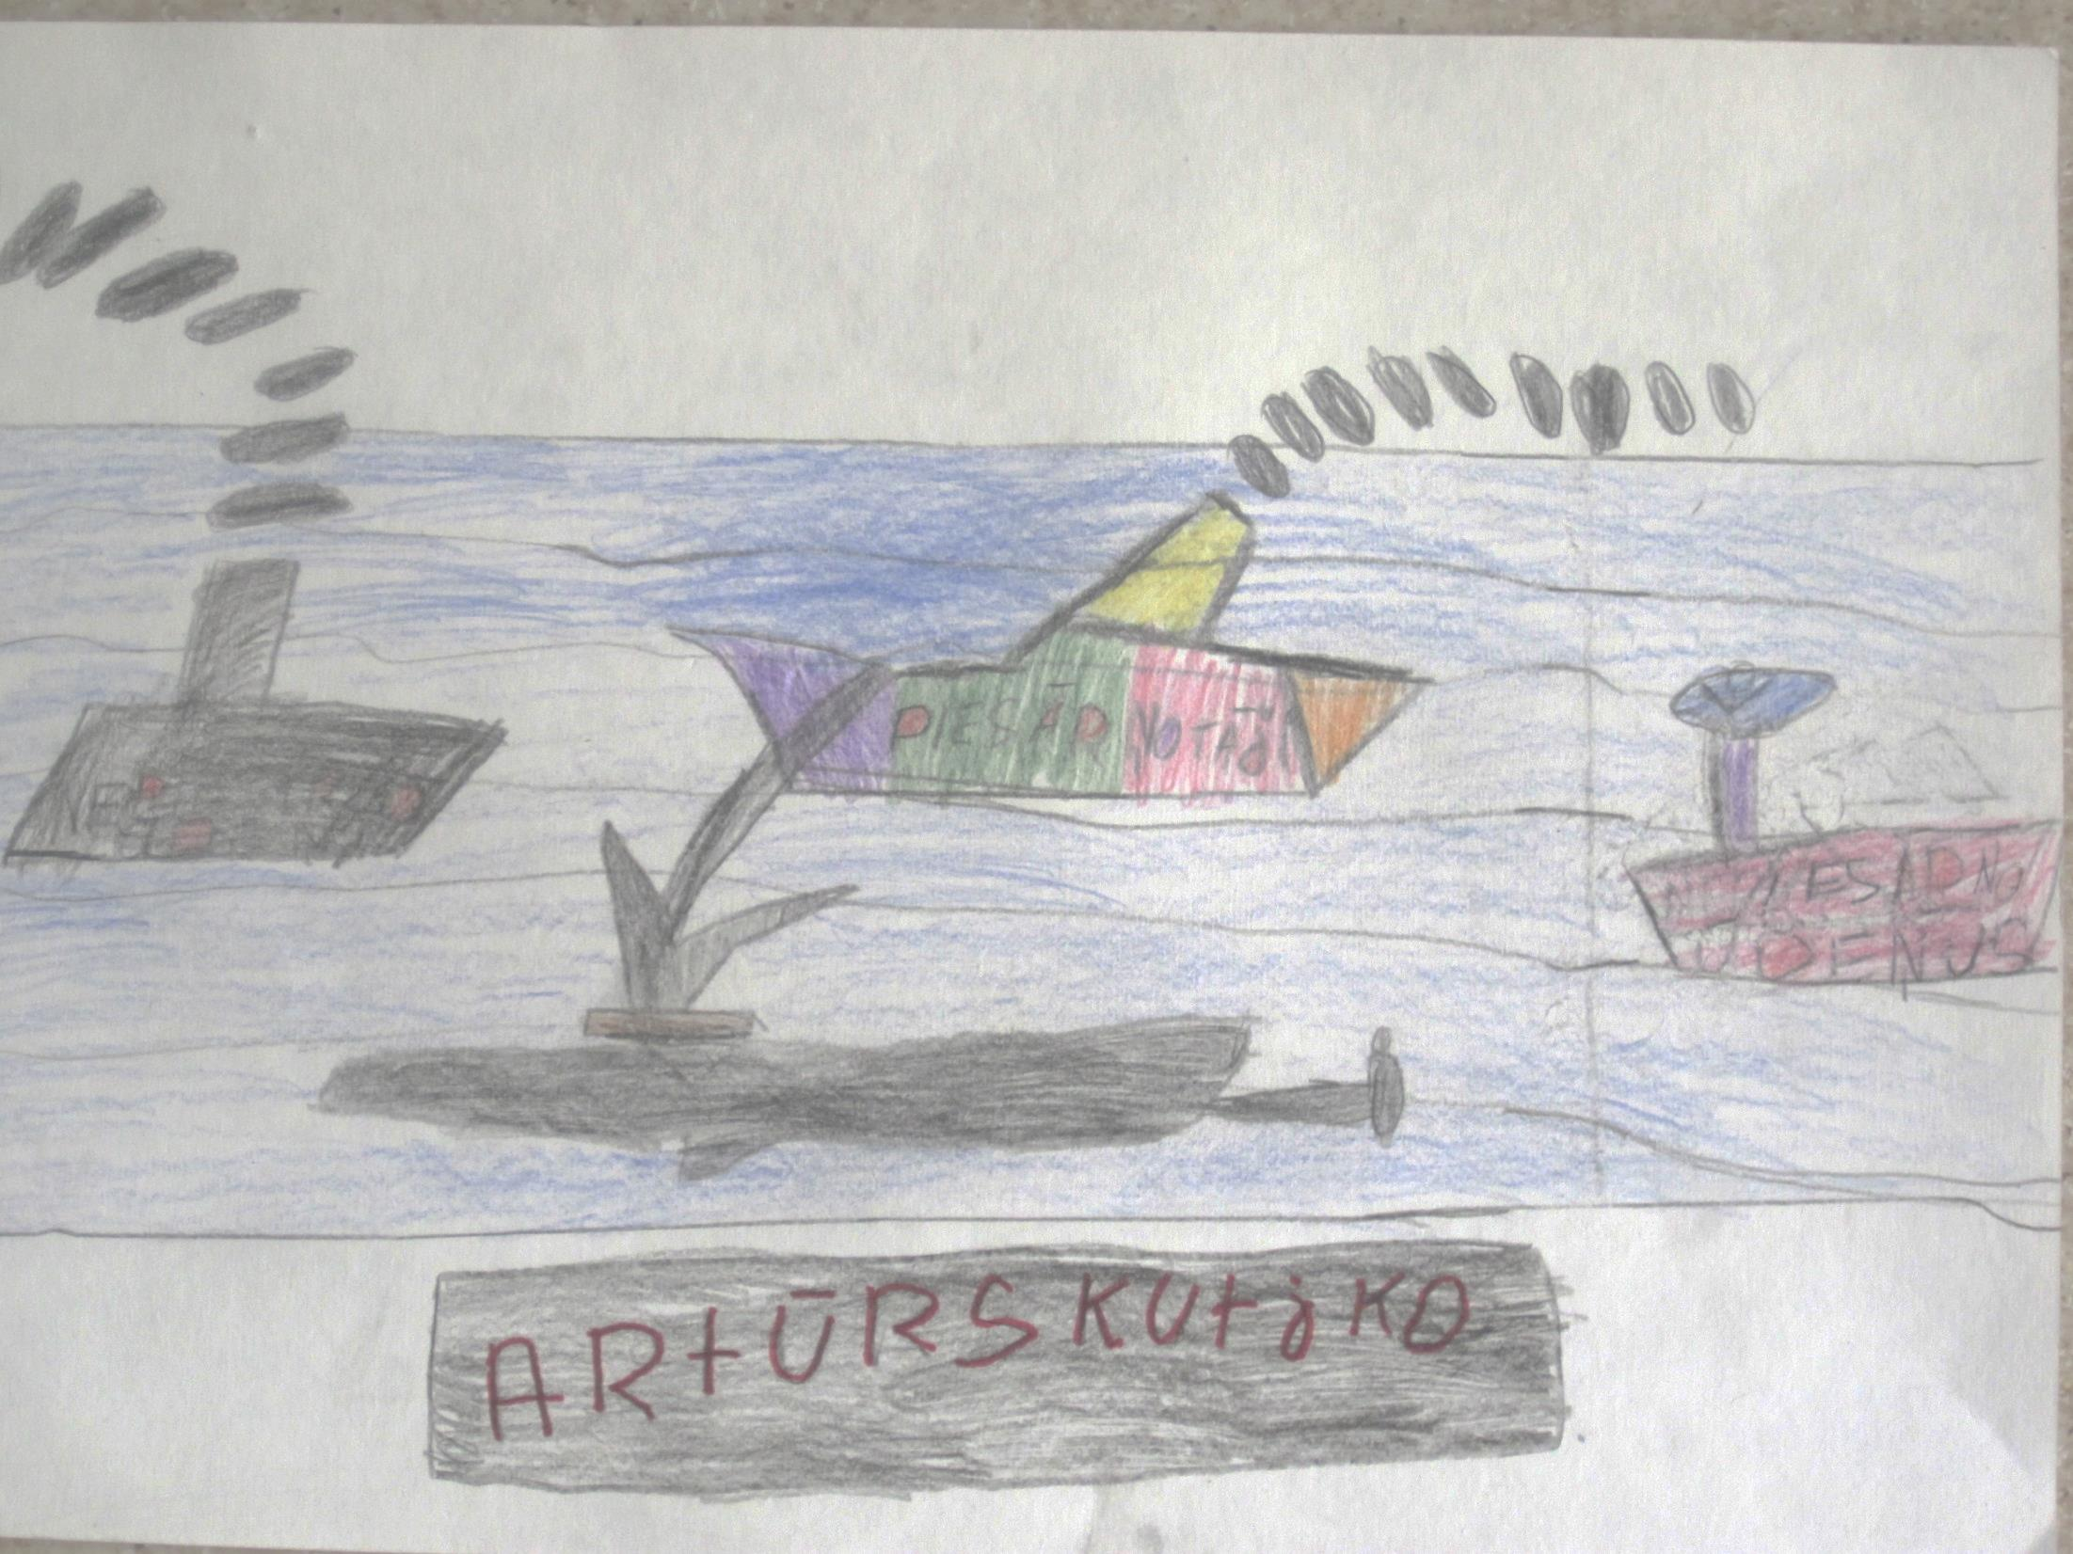

Slide 5
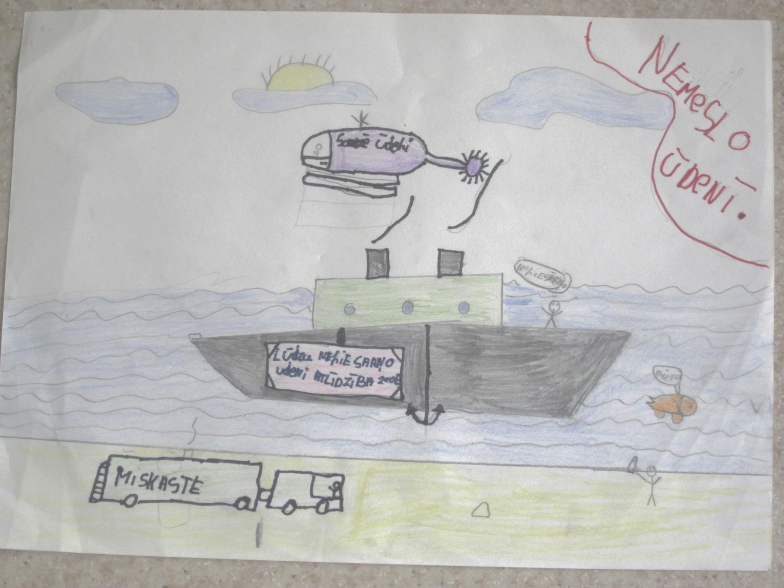
Don’t litter our water!

Slide 6
