Slide 1
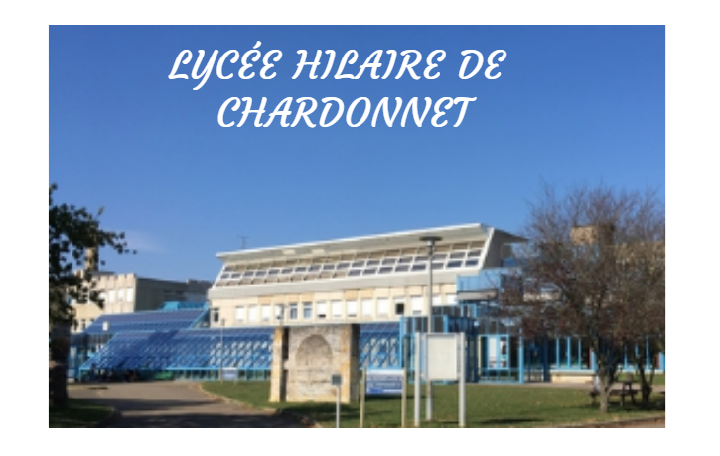
BY Gloria,Eymi and Elena 4thEso from Vic,Catalonia.

Slide 2
The French School
Location: Hilaire de Chardonnet 1 Rue Henri Dunant, 71100 Chalon-sur-Saône, France.
Opened in 1988.

Slide 3
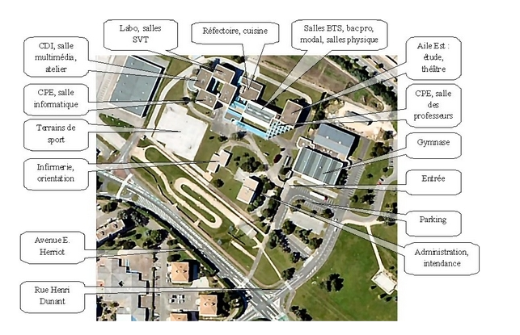

Slide 4
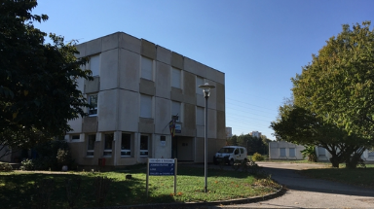
ADMINISTRATION OFFICES

Slide 5
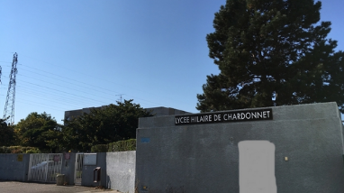
SCHOOL ENTRANCE

Slide 6
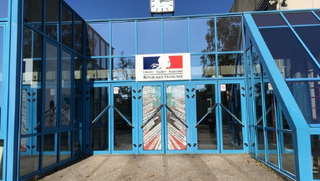
2ND ENTRANCE

Slide 7
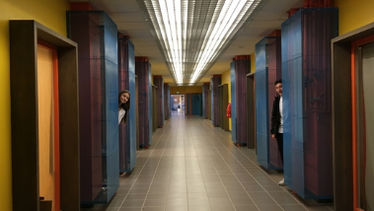
CORRIDOR

Slide 8
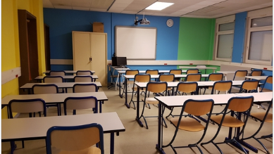
CLASROOM OF GESTION

Slide 9
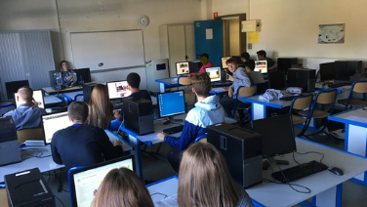
COMPUTER-ROOM

Slide 10
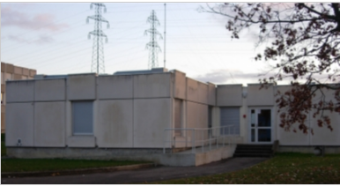
INFIRMARY

Slide 11
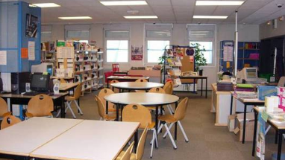
Center to Documentary and Information

Slide 12
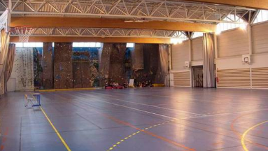
GYM

Slide 13
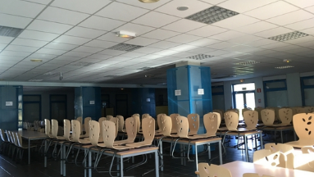
DINING-ROOM

Slide 14
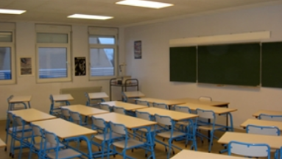
CLASSROOM

Slide 15
KITCHEN

Slide 16
THANKS DEAR FRENCH PARTNERS FOR THE PICTURES OF YOUR SCHOOL!

