Slide 1
countries
by Kelvin, Ayla, Mounirou, Destiny(Vic)
france

Slide 2
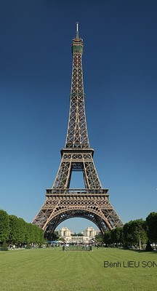
PARIS
Eiffel Tower it was named after the engineer Gustave Eiffel whose company designed the tower in 1887–1889
the French are really proud of it

Slide 3
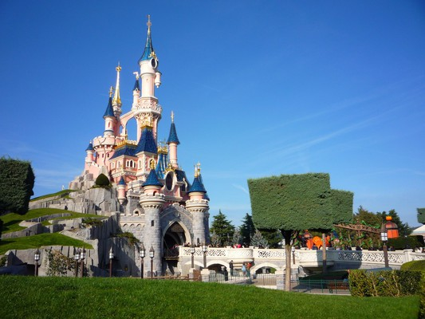
PARIS
Disneyland Paris, it’s an amusement park set in Disney movies. it is a beautiful experience to go on some of its rides

Slide 4
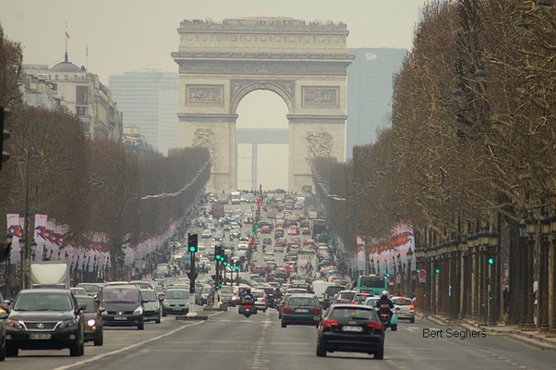
PARIS
Arc of triumph is a monument built by order of Napoleon in the early nineteenth century
It is a beautiful avenue
and underneath there is the tomb of the unknown soldier

Slide 5
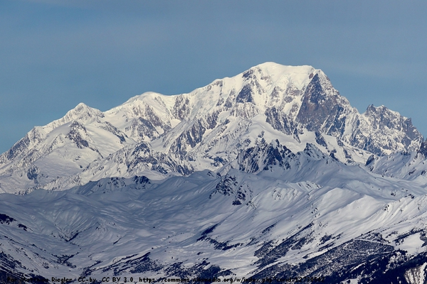
THE ALPS
mountain range. Its highest peak is Montblanc really nice and cool for skiing

Slide 6
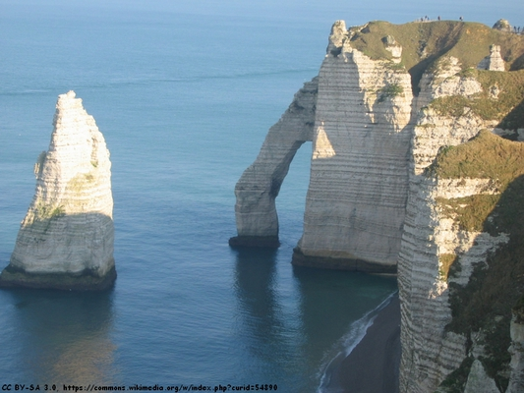
NORMANDY
the White Chalk Cliffs
and Arches at Etretat

Slide 7
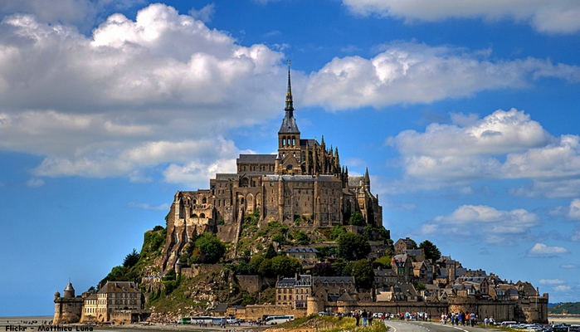
MOUNT SAINT MICHAEL
It is a famous mount in Normandy. It has an abbey
they have biscuits with this name

Slide 8
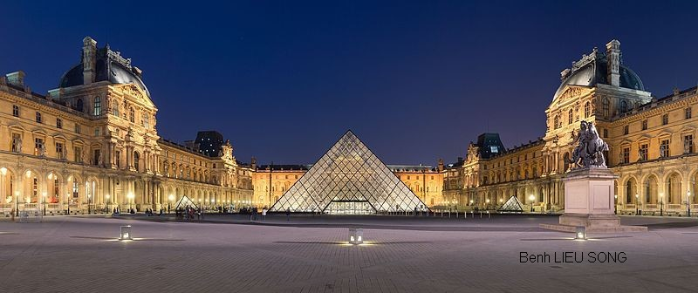
PARIS
Louvre Museum is one most important museums of the world located in Paris in former royal Palace of the Louvre there is an Apple store underneath

Slide 9
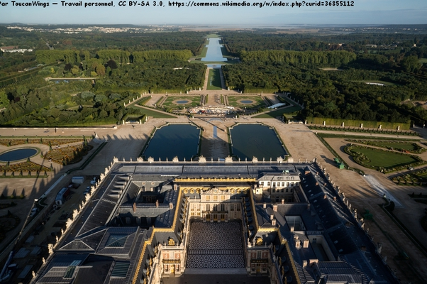
VERSAILLES PALACE
a World Heritage Site near Paris.
one of the greatest achievements in French 17th century art
Today the Palace contains 2,300 rooms spread over 63,154 m2. it is the louis xiv castlel

Slide 10
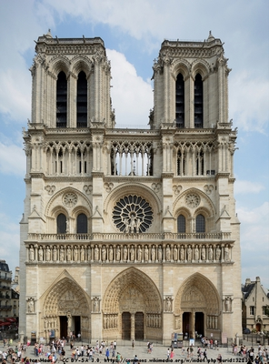
PARIS
Notre Dame is one of the oldest Gothic buildings of the city built between the 12th century and the 14th century.
There is a good book about it!

Slide 11
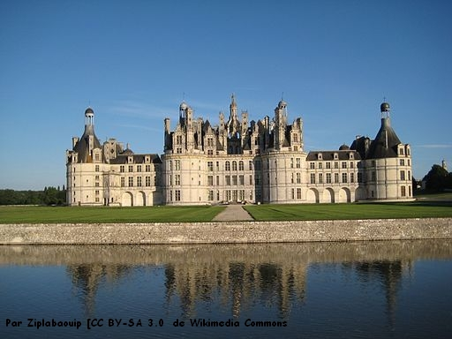
CASTLE ON THE LOIRE
This is the Château d' Chambord,
one of the many castles on the
river Loire

Slide 12
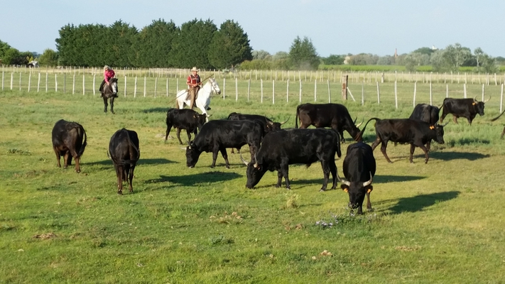
CAMARGUE
a natural park in the south of France
famous for its horses, black bulls and flamingos
Lae

Slide 13
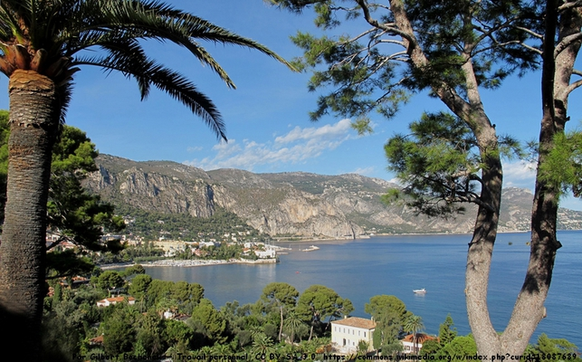
CÔTE D’AZUR
between the southern Alps and the
Mediterranean,
the Côte d'Azur (or French Riviera)
is a paradise of pines, blue waters and
cliffs. they have a lot of casino

Slide 14
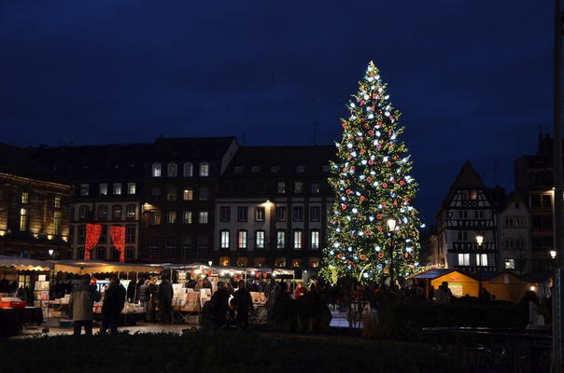
CHRISTMAS IN Strasbourg, Alsace
Very popular Christmas market in Alsace. it is the christmas market of Strasbourg, near Colmar

Slide 15
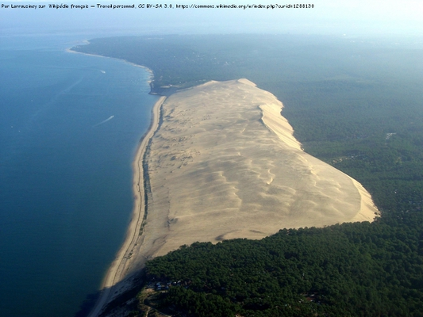
THE DUNE OF PILAT
It is Europe’s highest dune
On the Atlantic Ocean

Slide 16
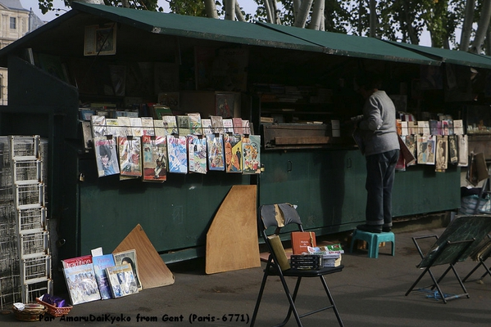
PARIS
Booksellers stalls along the banks of the River Seine

Slide 17
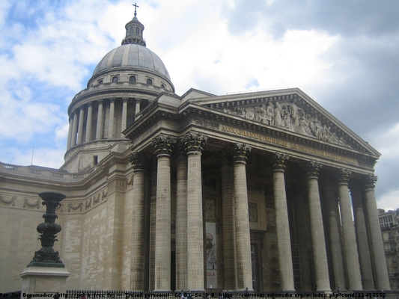
PARIS
The Panthéon is a building in the Latin Quarter in Paris
First a church and now a mausuleum for well-known French.

Slide 18
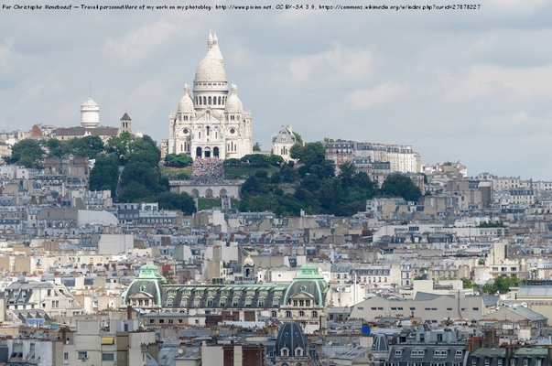
SACRÉ COEUR DE PARIS
consecrated in 1919
it is one of the most iconic
monuments
in Paris

Slide 19
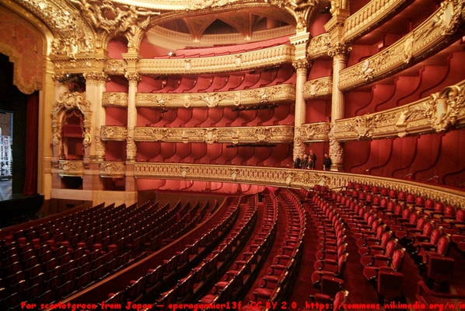
PARIS
National Opera of Paris
A 19th-century architectural masterpiece, the Palais Garnier Opera House, built by Charles Garnier and opened in 1875,

Slide 20
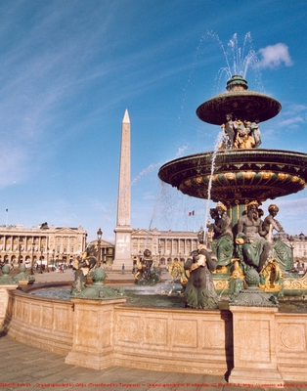
OBELISK - PARIS
The Luxor Obelisk (French: Obélisque de Louxor) is a 23 metres (75 ft) high Ancient Egyptian obelisk standing at the centre of the Place de la Concorde in Paris, ..

Slide 21
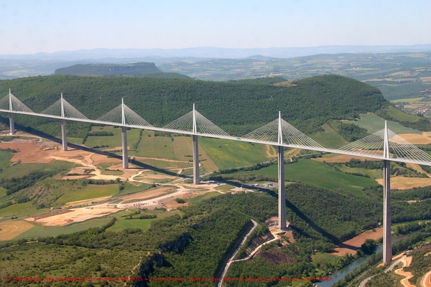
BRIDGE OF MILLAU
The Millau Viaduct is a
cable-stayed
bridge that spans the
gorge valley of the Tarn
near Millau
in southern France

Slide 22
THANK YOU FOR YOUR ATTENTION AND GOD BLESS YOU

