Slide 1
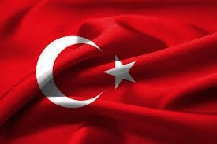
TURKEY
Marc Vilalta
David Raurell
Arnau Cirera

Slide 2
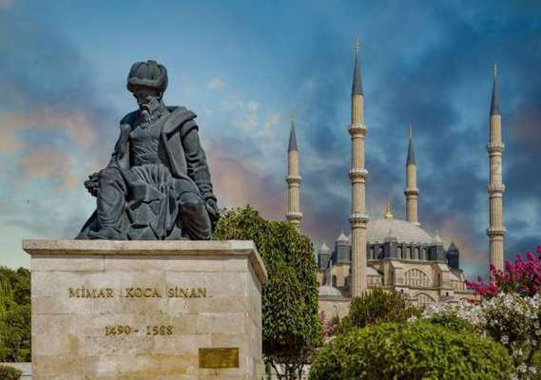
EDIRNE
Edirne it’s a city of Turkey, it’s in the region of Marmara and the province of Edirne. There are more than 120.000 inhabitants. Close to Turkey’s borders with Greece and Bulgaria.

Slide 3
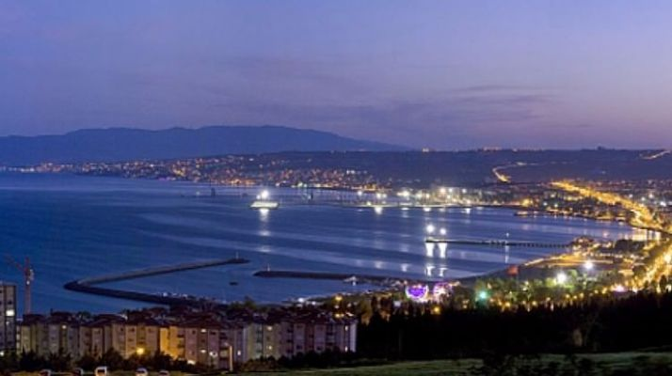
TEKIRDAG
It is a city of Turkey near of the Maritza. The language that they talk is turkish. In Tekirdag, there is a lot of agricultural productivity.

Slide 4
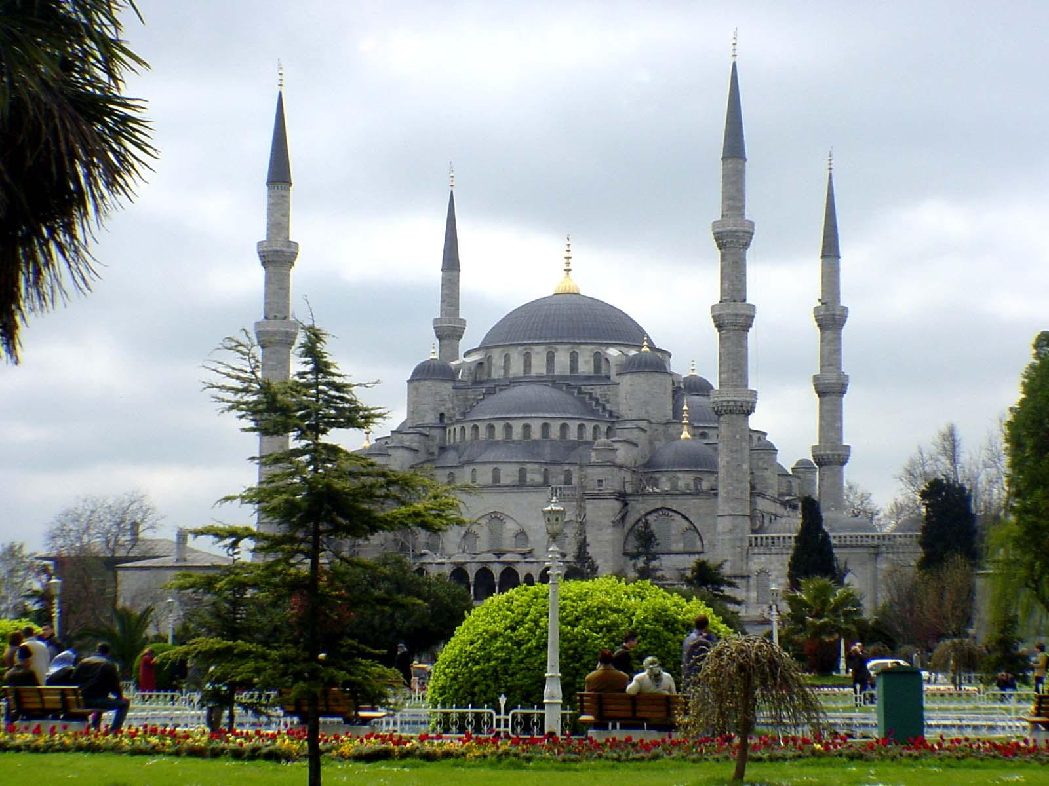
BLUE MOSQUE
The Blue Mosque or Sultan Ahmed Mosque is a historic place located in Istanbul, Turkey. This construction, as it is popularly known, was constructed between 1609 and 1616 during the rule of Ahmed I. Hand-painted blue tiles adorn the mosque’s interior walls, and at night the mosque is bathed in blue. It sits next to the “Santa Sofia”, another popular tourist site.

Slide 5
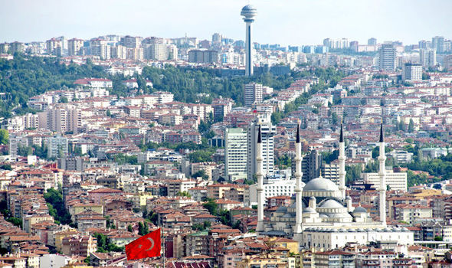
ANKARA
Ankara is the capital of the Republic of Turkey. With a population of 4.587.000 in the urban center and more than 5.150.000 in its province, it is Turkey’s second largest city after Istanbul.

Slide 6
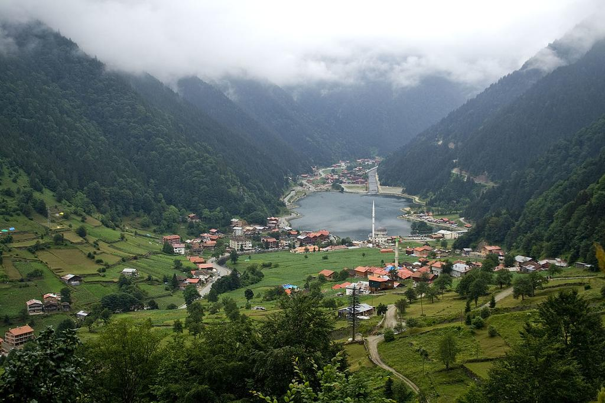
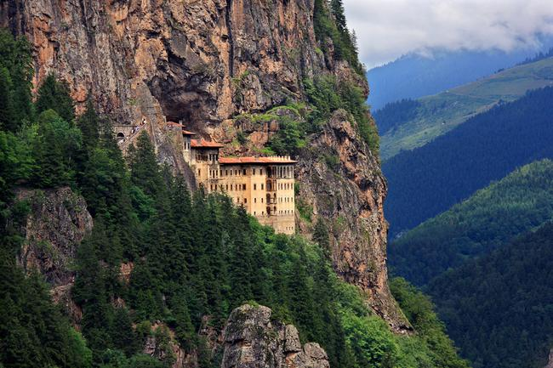
TRABZON
Trabzon is a city situated on the Black Sea coast of northeastern, Turkey. and the capital of Trabzon Province. The governor of this city is Yücel Yavuz.

Slide 7
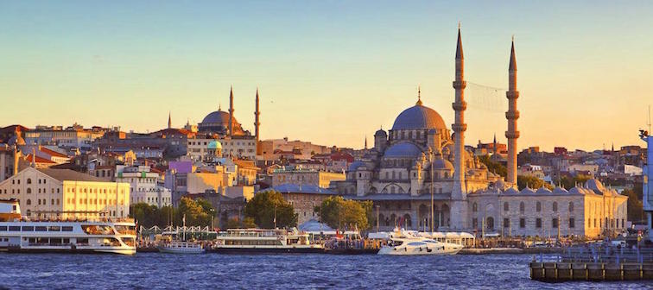
ISTANBUL
Istanbul is the most important city of Turkey. It was the capital of states such as the Roman or Ottoman Empire. The year 667 b.C was founded and has a population of 15.000.000 inhabitants.

