Slide 1
CHALON SUR SAÔNE
FRANCE
MIQUEL GALLEGO
ANNA CANADELL
CARLA SERRA
JÚLIA ERRA
BRUNA BLANCAFORT
4t C 2018/2019

Slide 2
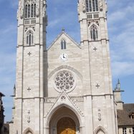
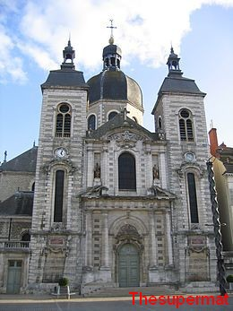
Is a Roman Catholic Church. A former cathedral that it was
the seat of the Bishop of Chalon. Parts of the building date
from the 8th century, but the Neo-Gothic façade is from the 19th.
Saint Vincent Cathédral
Saint- Pierre church
St. Pierre Church is located on the west side of Asi River and by the west foot of Hac (Staurin) Mountain. The west façade was constructed by Kapuchin Priests in 19th century.

Slide 3
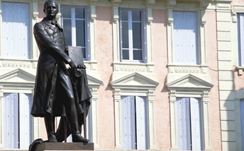
Nicéphore Nièpce statue
He was born in 1765, first of all he design an internal combustion engine and then he was credited as the inventor and a pioneer of photography. He also developed heliography and invented the Pyréolophore along with his brother.

Slide 4
Élan Sportif Chalonnais, is a French professional basketball club that is based in Chalon-sur-Saône, France. The team's main colors are red and white, and their mascot is a moose. They play their national domestic league games in the LNB Pro A league and internationally in the Basketball Champions League. The team's home arena is called Le Colisée, which seats 5,000 spectators.

Slide 5
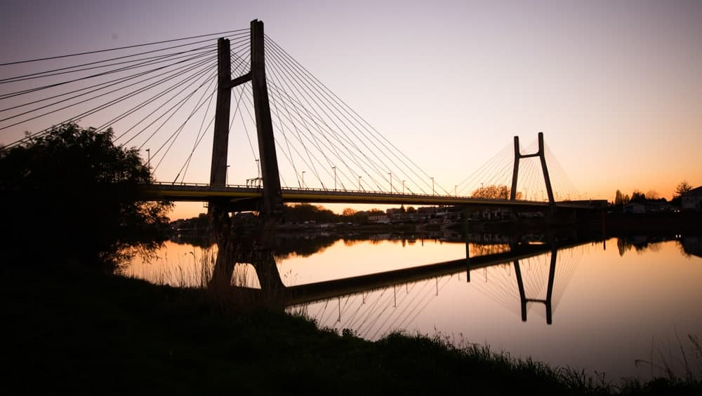
Bourgogne bridge
The Bourgogne bridge cross the Saone river, and it mesures 352m,
the beginning of the works began at 1989 an was completed in 1992.

Slide 6
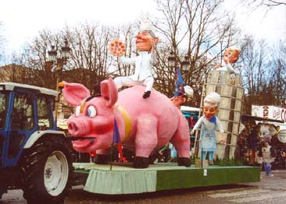
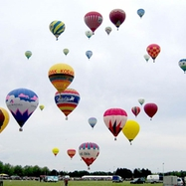
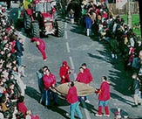
Chalon sur Saone carnival
Hot and air balloon festival
In autumn, every year, the world's most international balloon festival, which is the Lorraine Nature Park, is celebrated every ten years. An original concept, which has become the great event in France, Europe and around the world.
The carnival of Chalon sur Saone is end february and end march

Slide 7
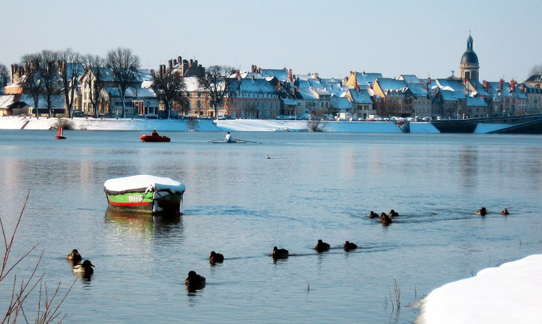
It is a river in eastern France. The Saône rises at Vioménil at the foot of the cliff of the Faucilles in the Vosges. The Saône has always been the most navigable of French rivers. The high-capacity (grand gabarit) waterway from Saint-Jean-de-Losne to Lyon amply justifies this separate entry, not just for the character of the river and dimensions of its locks and channels, but also as an itinerary.
Saône river

Slide 8
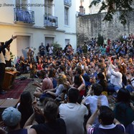
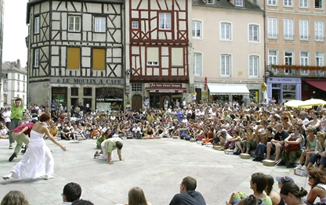
Chalon dans la rue
We can see some medieval festivities with a lot of people and different traditions.

Slide 9
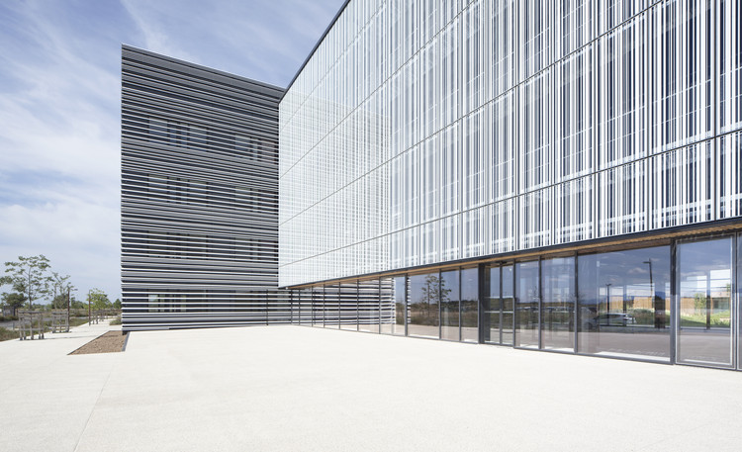
Brunet Saunier Architecture
This is a not very famous hospital in the city that have a good and modern architecture,
it was built at 2016 by Brunet Saunier

Slide 10
Thanks French students for the pictures

