Slide 1
Burgundy
The French Region
Marco Peña
Albert Pérez
Mohamed Ahfid
Martí Jordana
Institut Jaume Callís
4t ESO C

Slide 2
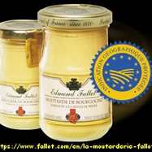
Bourgogne Mustard
Dijon mustard (Moutarde de Dijon) is a traditional mustard of France, named after the town of Dijon in Burgundy, France
The usual ingredient of vinegar in the recipe with verjuice, the acidic juice of unripe grapes

Slide 3
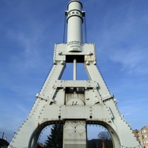
Creusot steam hammer
The Creusot steam hammer was a giant steam hammer built in 1877 by Schneider and Co.
in the French industrial town of Le Creusot. With the ability to deliver a blow of up to 100 tons.

Slide 4
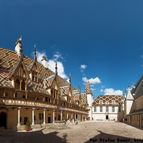
Typical town
Typical houses in Burgundy, and their architecture

Slide 5
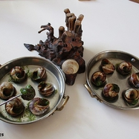
Escargots
Escargots, (French for snails) are a delicacy consisting of cooked edible land snails,and they are a typical food in Burgundy

Slide 6
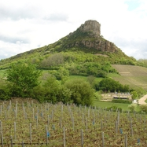
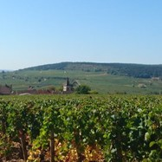
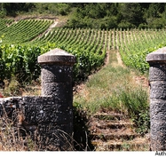
Burgundy Wine
The most popular dry red wines made from Pinot noir grapes and white wines made from Chardonnay grapes

Slide 7
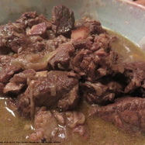
Boeuf Bourguignon
Boeuf bourguignon is also a major regional speciality. This heart-warming stew is made with beef chunks which are cooked slowly in red wine (yes, more wine), along with carrots, celery, onions, lardons and served with potatoes.

Slide 8
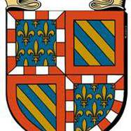
COAT OF ARMS
This is the coat of arms of the second Duchy of Burgundy and the province.

Slide 9
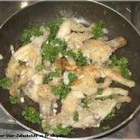
Frog Legs
Frog legs or cuisses de grenouille are a traditional dish particularly found in the region of the Dombes.
Widespread consumption of frog's legs is relatively recent, starting last two hundred years ago.

Slide 10
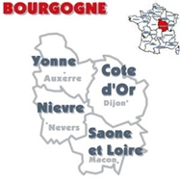
Burgundy Province
The departments of this region are Yonne, Cote-d’Or, Nievre and Saone-et-Loire. The region has around 15 arrondissements, 174 cantons and 2,045 communes. The total land area covered by this region is 31,582 square kilometers.

Slide 11
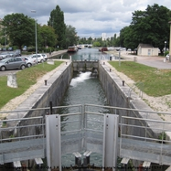
Burgundy Canal
The Burgundy Canal, in French: Canal de Bourgogne is a canal in Burgundy in central eastern France. It connects the river Yonne at Migennes with the Saône at Saint-Jean-de-Losne. Construction began in 1775 and was completed in 1832. The canal connects the Atlantic Ocean to the Mediterranean Sea via the Seine and the Yonne to the Saône and Rhône.

Slide 12
Thanks xoxo
Thanks for the images and links with information dear french bros and sis :*

