Slide 1
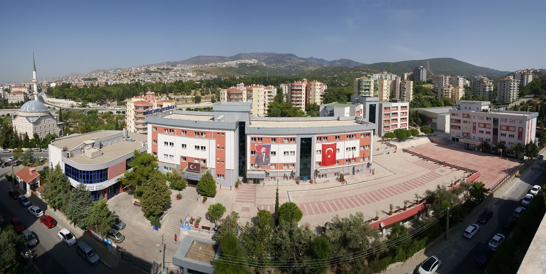
BORNOVA COLLEGE

Slide 2
Where are we

Slide 4
İZMİR

Slide 5
BORNOVA

Slide 6
About us
Our school ‘Private Bornova College’ was founded in 1994.
Our school campus is in the town of Bornova in İzmir, a beautiful city in the Aegean Region of Turkey.

Slide 7
About us
Our school had 80 students in Private Bornova High School then.
Now, we have a preschool, a primary school,
a secondary school, a science high school and
a high school with over 900 students.
In primary school there are 43 teachers, 1 assistant manager and 1 manager.

Slide 8
Campus
In our campus we have laboratories, a big library, music&art ateliers, a conference hall and sports hall.
Our classrooms are fully equipped with smartboards and educational technologies.
All our students have the opportunity to study with the latest technology in our school.

Slide 9
Timetable
Lessons start at 09.00am and finish at 04.35pm.
Lessons are 40 minutes and we have 10 minute break times.
Our students have to wear school uniform.
We have lunch at 12.02 – 12.38

Slide 10
In the afternoon, our students have lunch and
in their break time they can do sport activities or any activities they would like to do.
We have got 4 school canteens and 1 cafeteria.
At the weekend we have sports&cultural
(art activities, sport activies, drama etc.) and refresher courses which our students can participate.

Slide 11
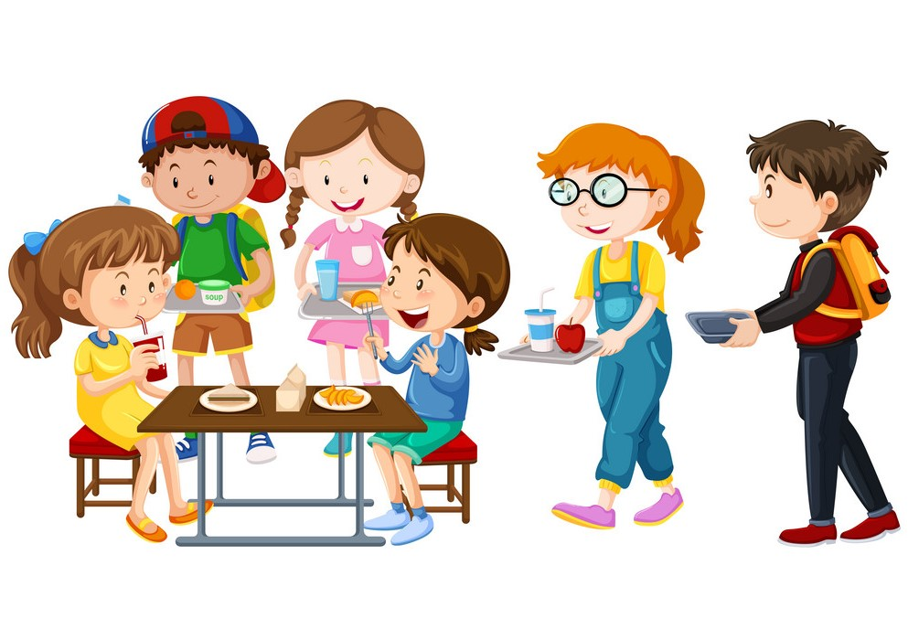

Slide 12
School Bus
Students benefit from the transportation services by a private transport service company.
Students who benefit from the school bus must obey the rules.

Slide 14
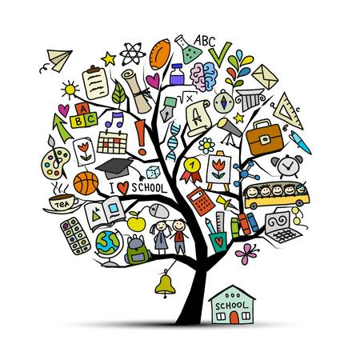
Subjects (primary school)
English
German
Turkish
Arts and Crafts
Music
Chess
PE
ICT
Maths
Science
Social Studies
Religion and Morals

Slide 15
Primary School

Slide 16
Secondary School

Slide 17
High School

Slide 18
There is a big library in our school.
Library

Slide 19
Our library in primary school

Slide 20
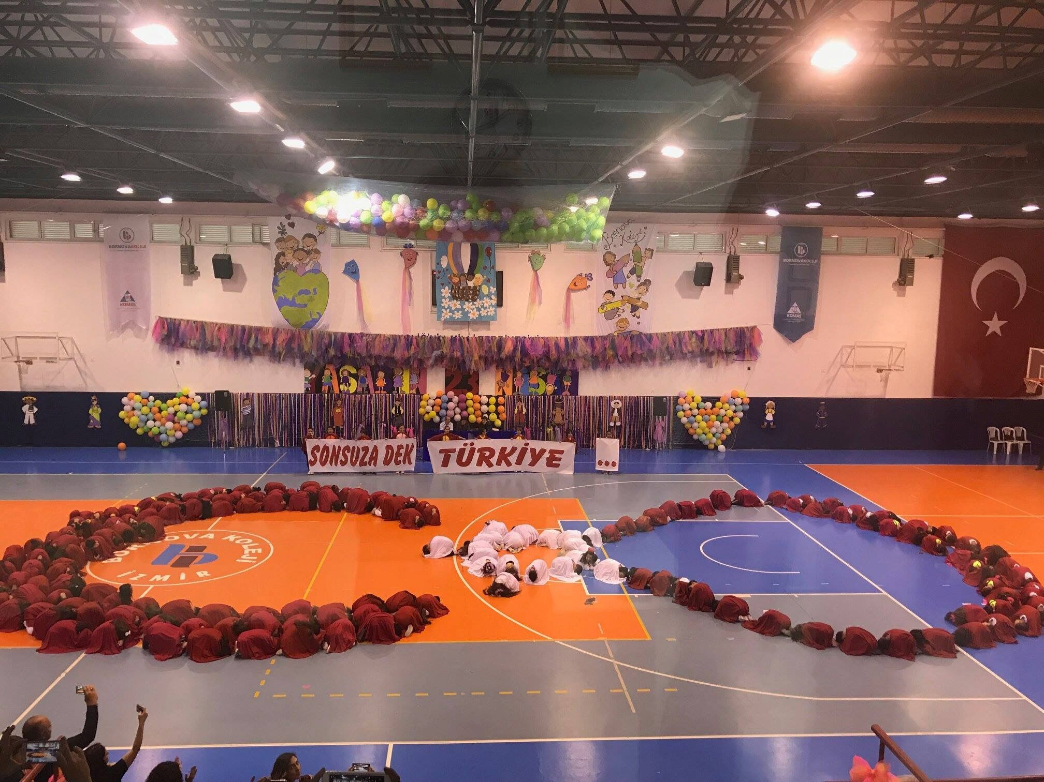
Sports hall

Slide 21
Conference hall

Slide 22
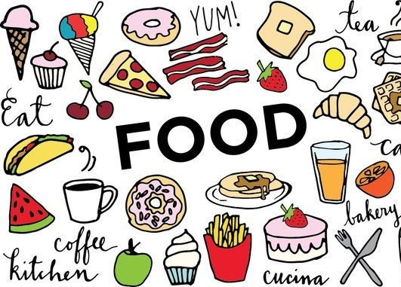
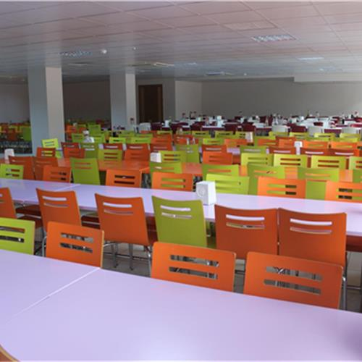
This is our school cafeteria. Our primary students have their breakfast before the first lesson.
Cafeteria

Slide 23
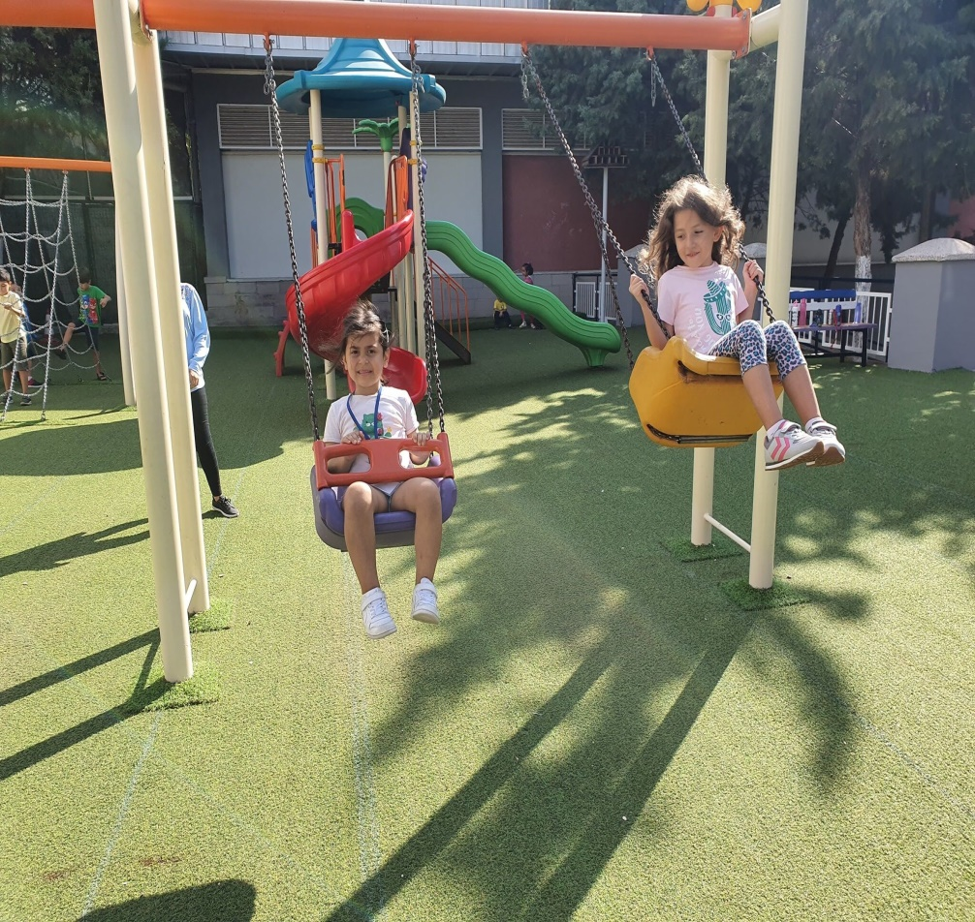
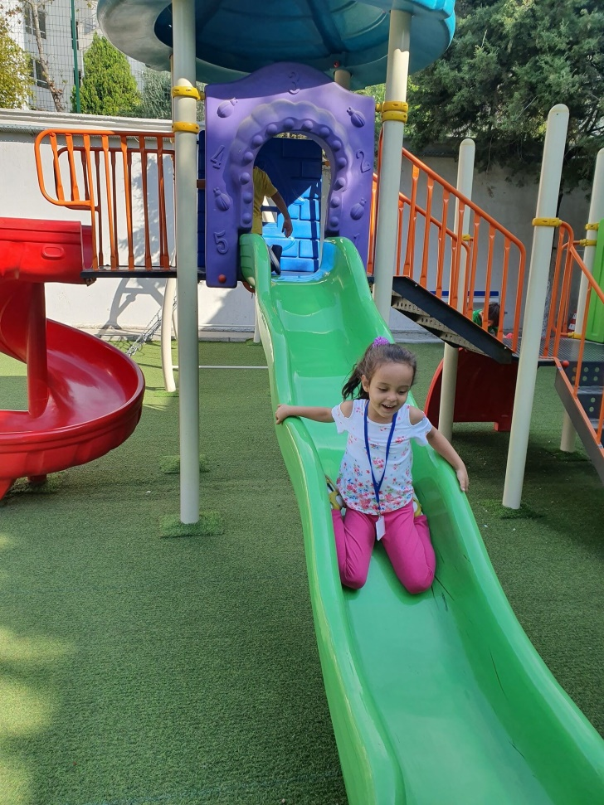
Playground

Slide 24
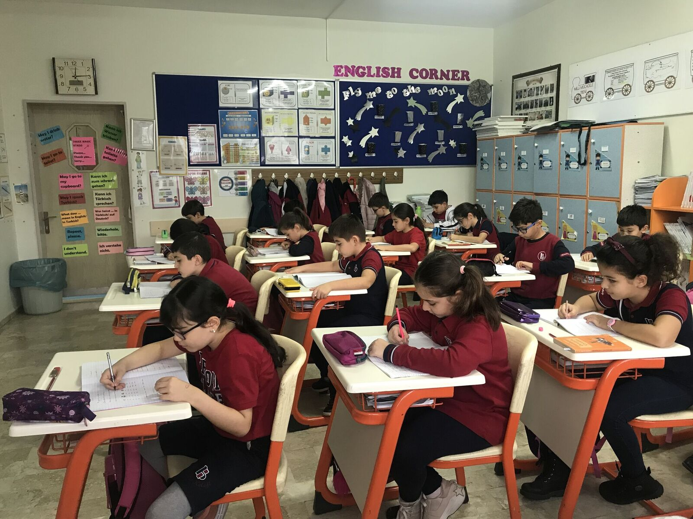
Our classroom in 4th grade

Slide 25
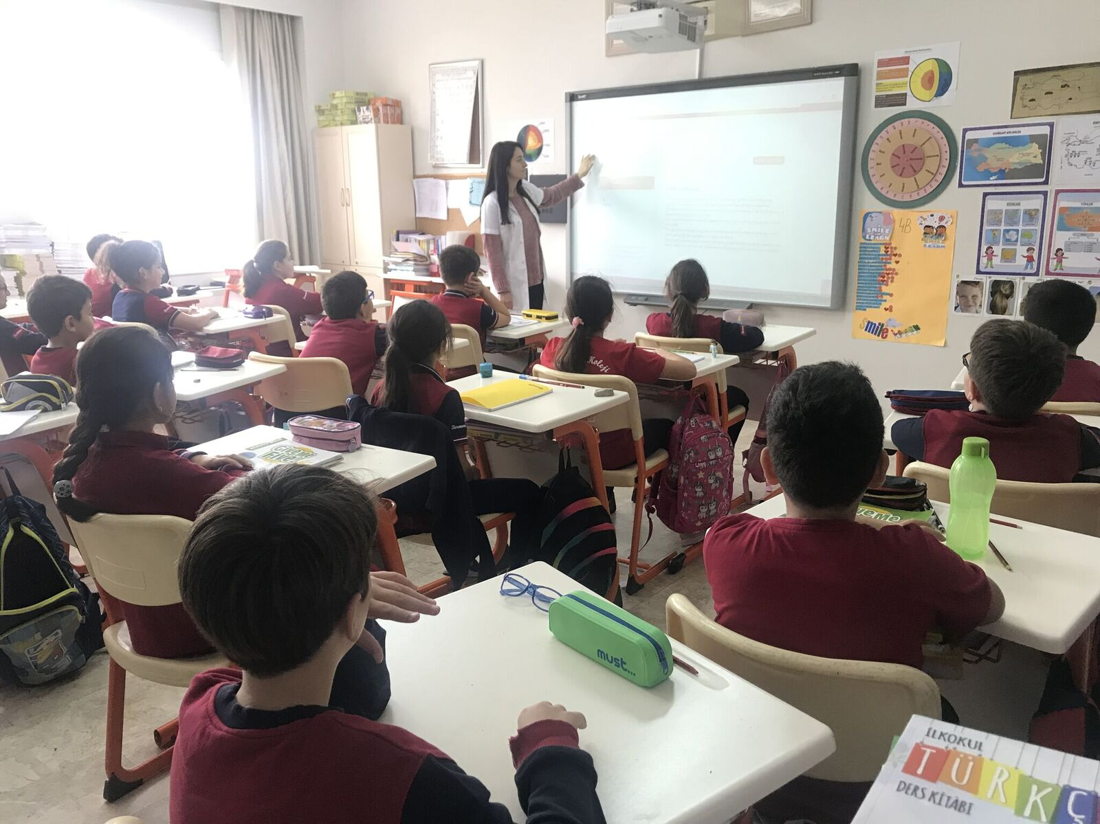

Slide 26
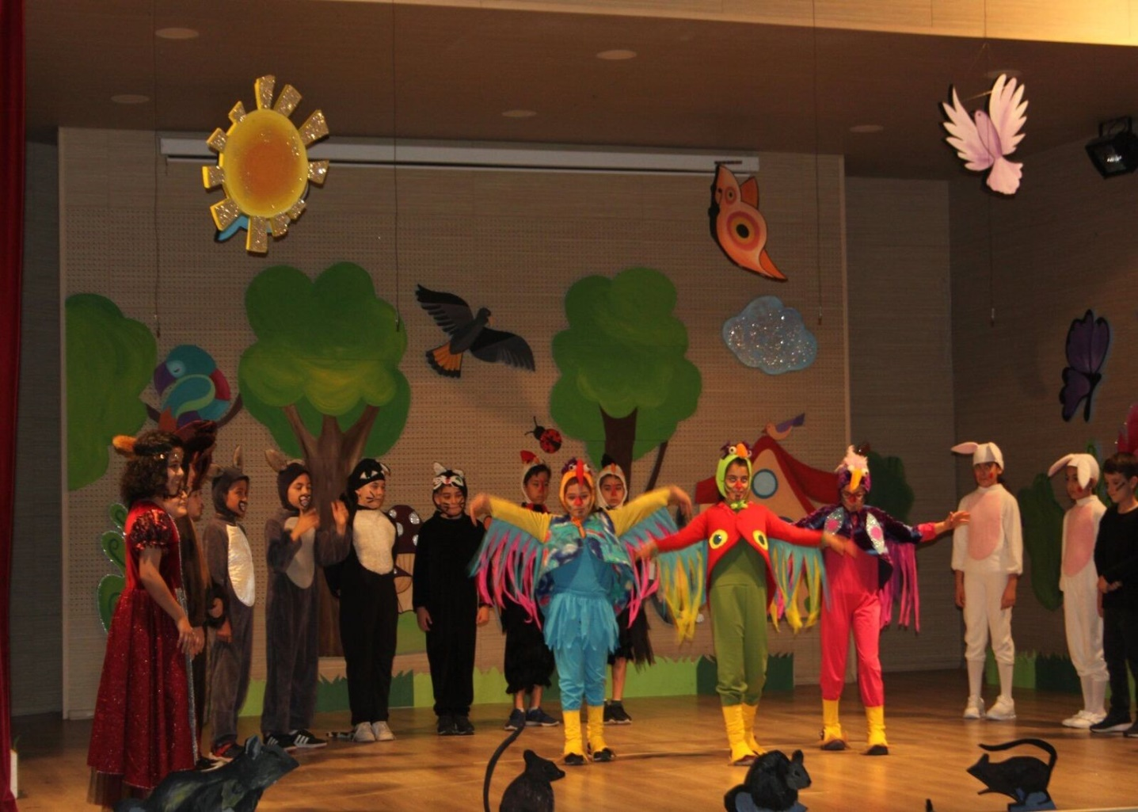
3rd graders’ English Show

Slide 27
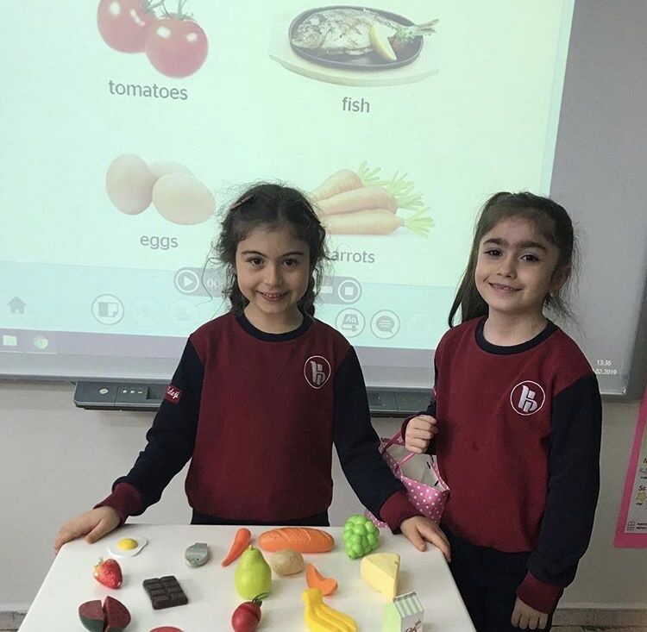
1st graders love learning English!

Slide 28
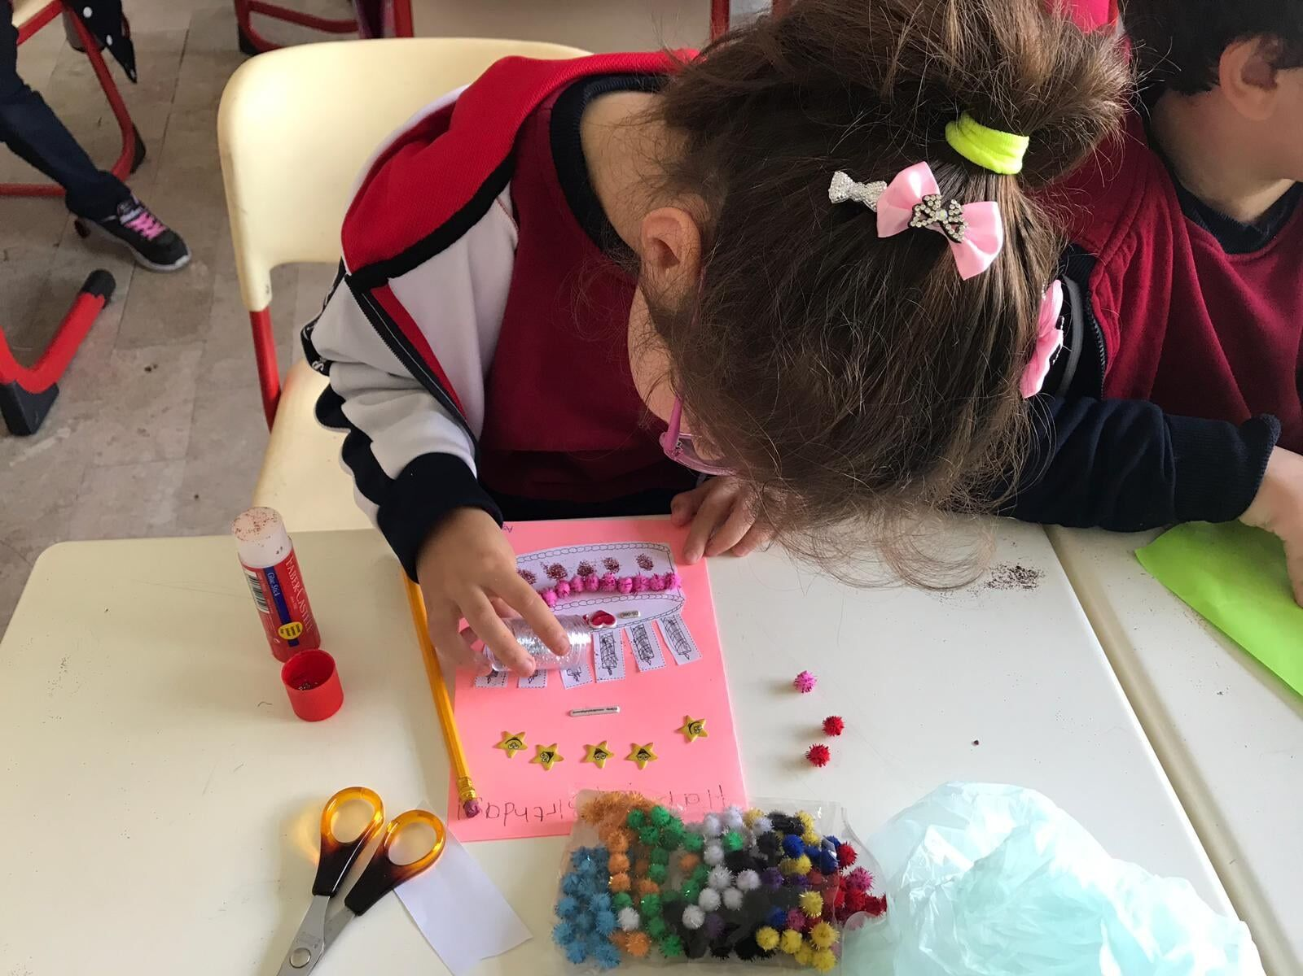
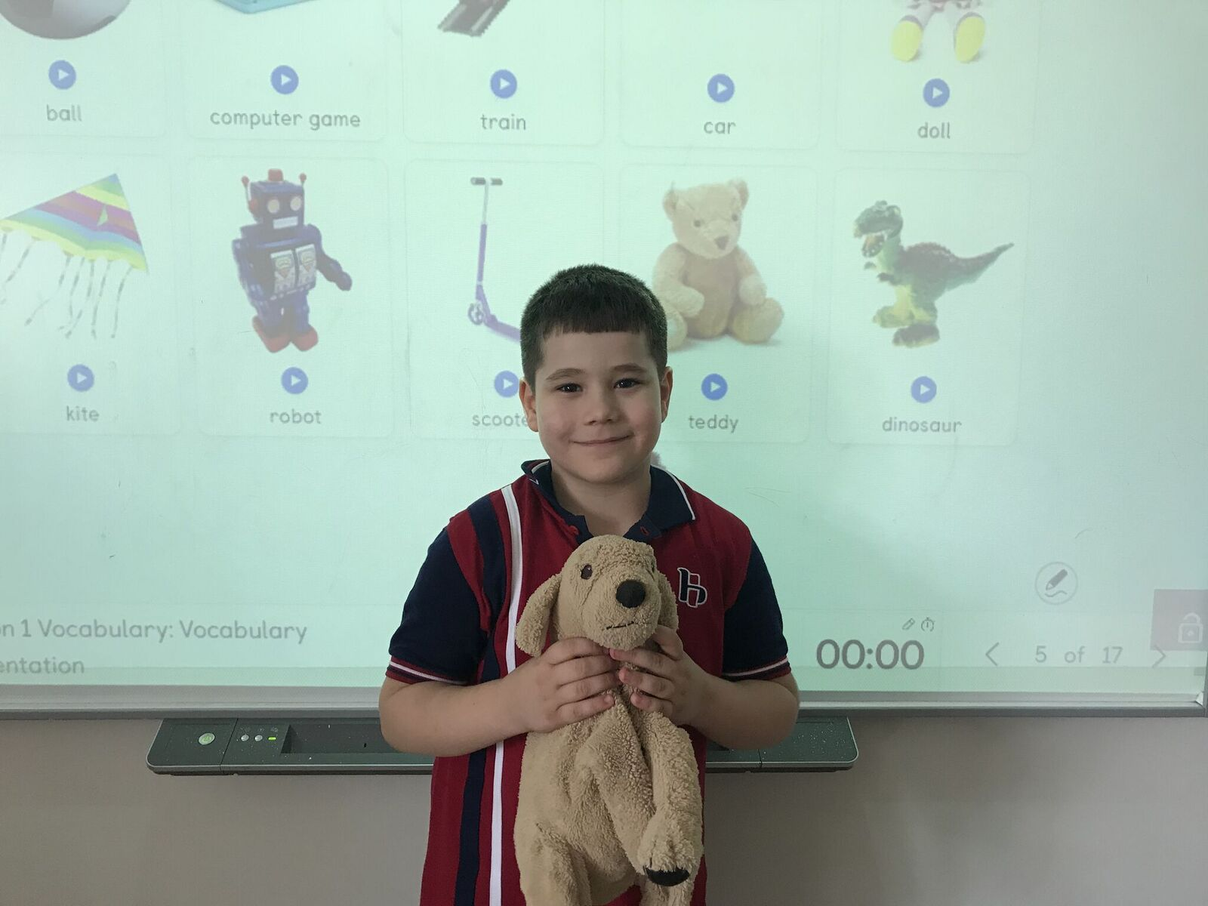

Slide 29
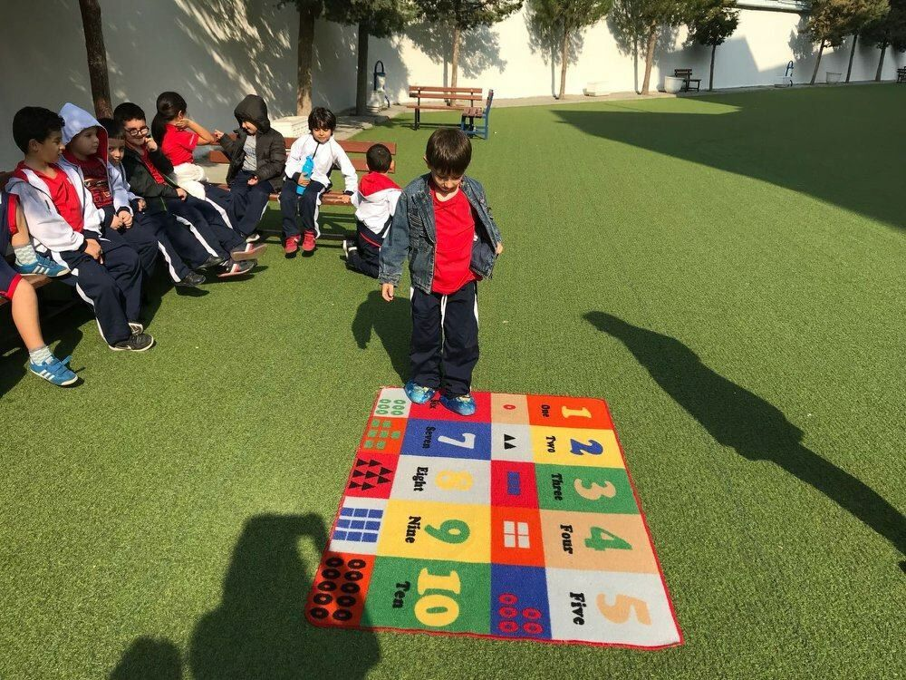
Our primary students in the garden! We sometimes do our lesson activities in the garden.

Slide 30
Our kindergarten students do activities in the garden.

Slide 32
Our students love playing chess.
☺

Slide 33
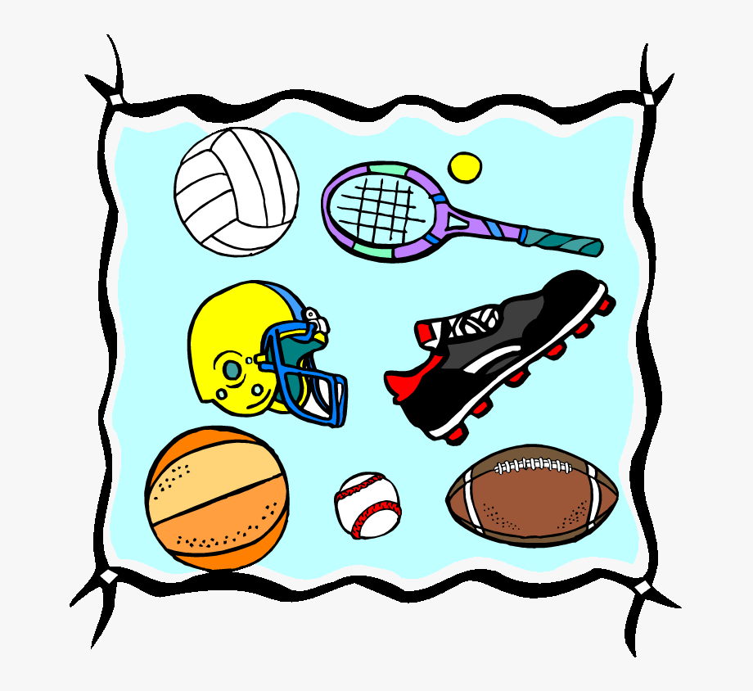
Students in PE lesson

Slide 34
At the weekend students have the ability to participate in different courses.

Slide 35
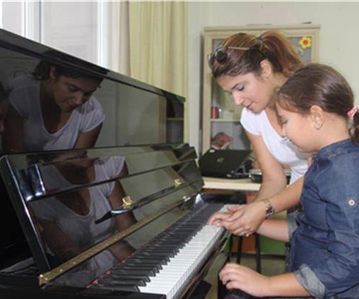
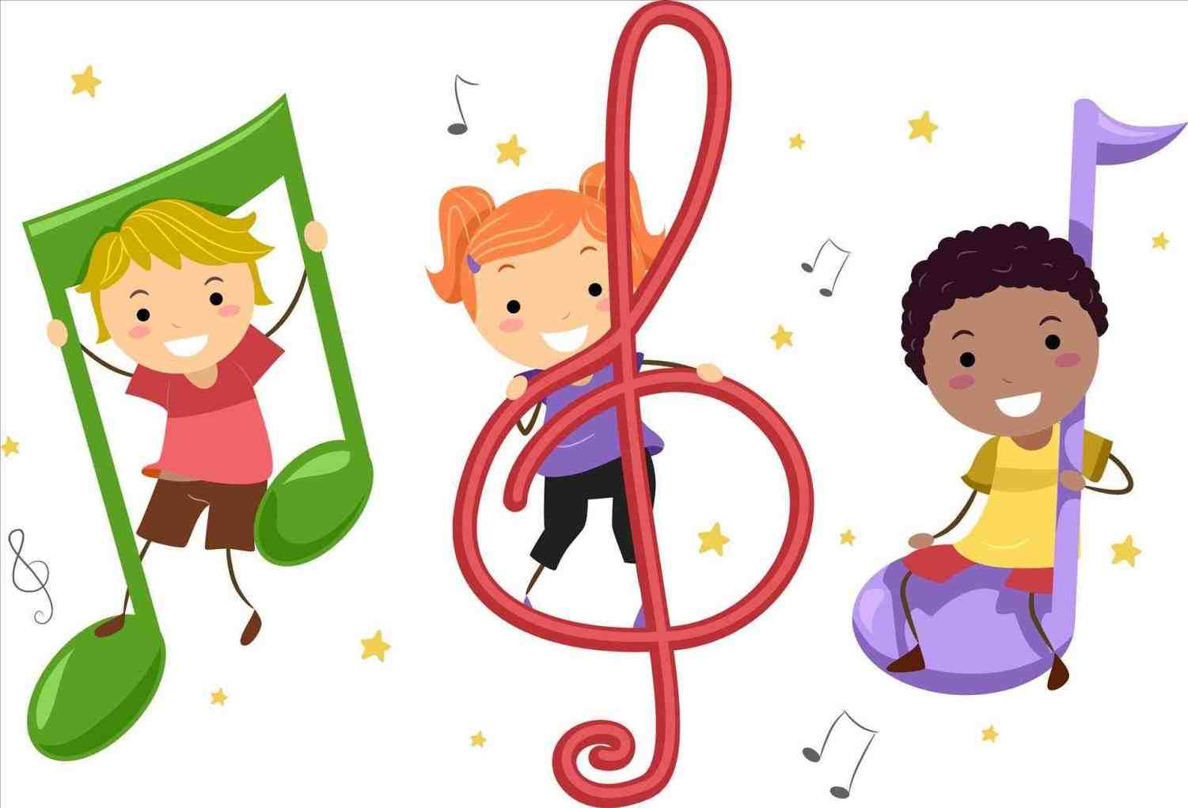
From our social cultural courses. We also have music courses for our students.

Slide 36
LOTS OF LOVE FROM TURKEY!

