Slide 1
Our school SPECIAL ACTIVITIES Abrahám, Slovakia

Slide 2
A Pumpkin CEREMONY
In our school every year a pumpkin ball takes place . At four o´clock pm we all meet and we have creative workshops till eight o'clock pm and then we go for a walk .
At the end we have a small party, parents help to organize it, too.

Slide 3
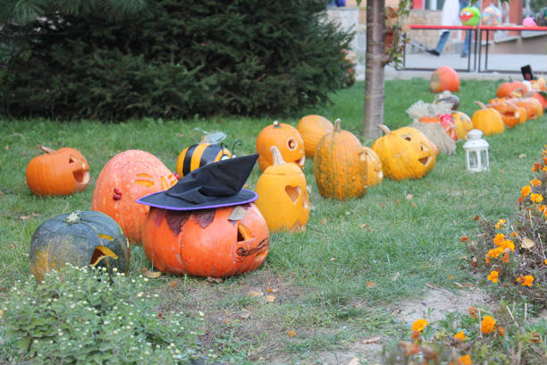
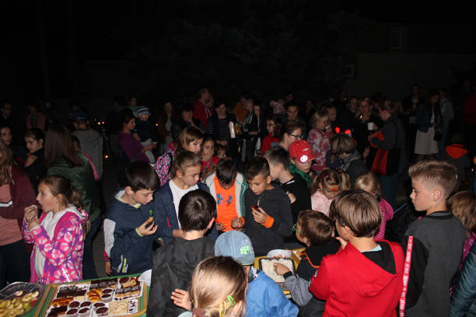
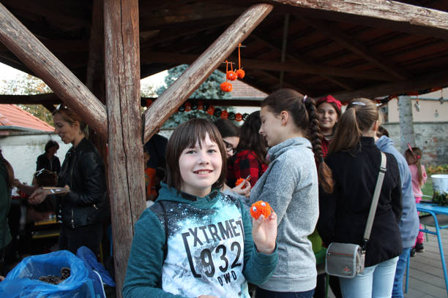
GalLery

Slide 4
Christmas SHOW
We also have a Christmas Academy that takes place every year. All classes prepare scenes or dances, sing songs. They perform it at first in the morning, it´sa kind of rehearsal and around 5pm for parents. Around 7:00 pm it's over and we go home.

Slide 5
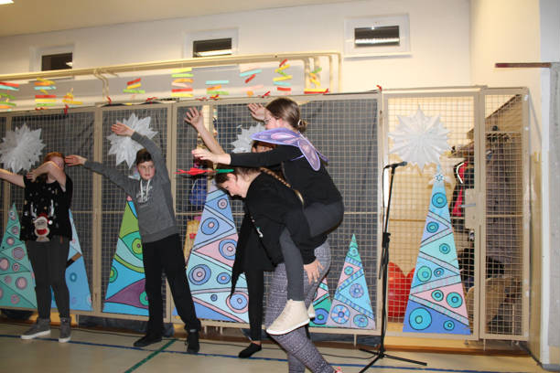
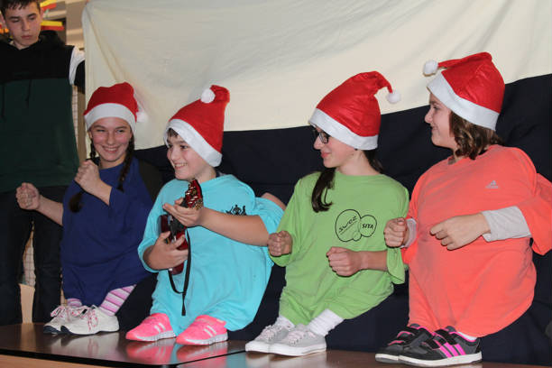
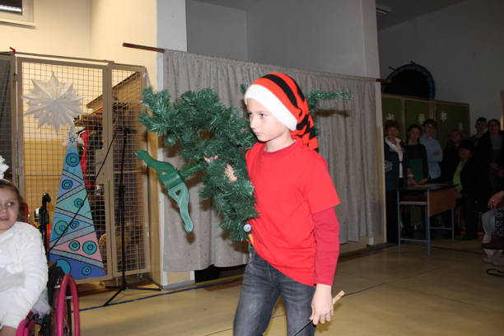
GalLery

Slide 6
Santa Claus in our school
There is also an event called Santa Claus is coming to us. The oldest students from class nine are dressed as angels, devils and one of them is always Santa Claus . They walk in classes and give us small presents.

Slide 7
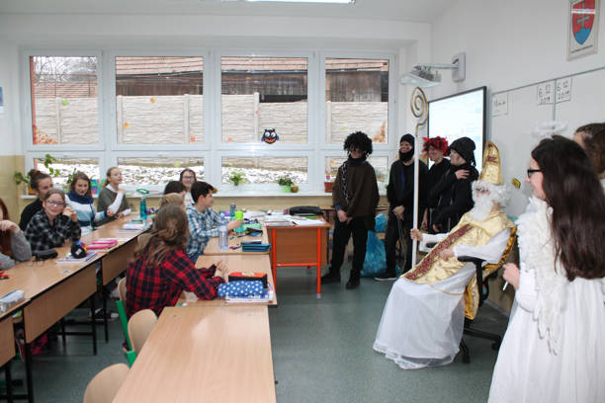
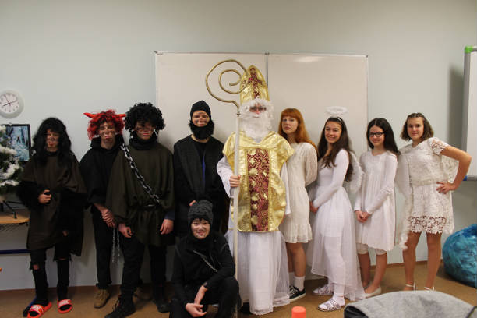
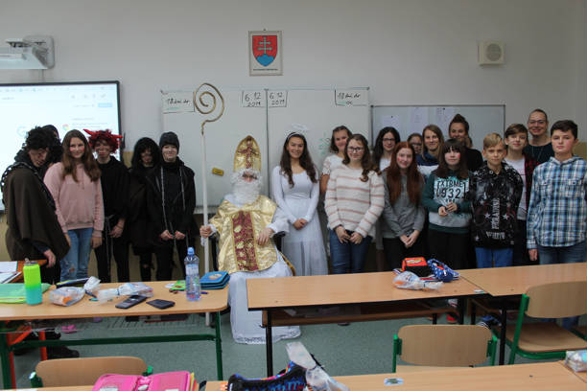
GalLery

Slide 8
Made by Katarína Grosmanová 7.class
Abrahám, Slovakia

