Slide 1
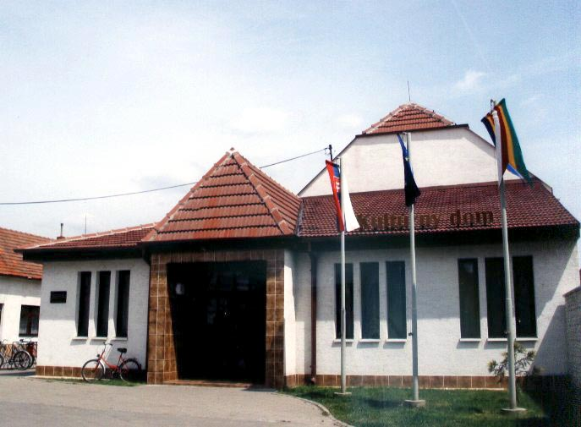
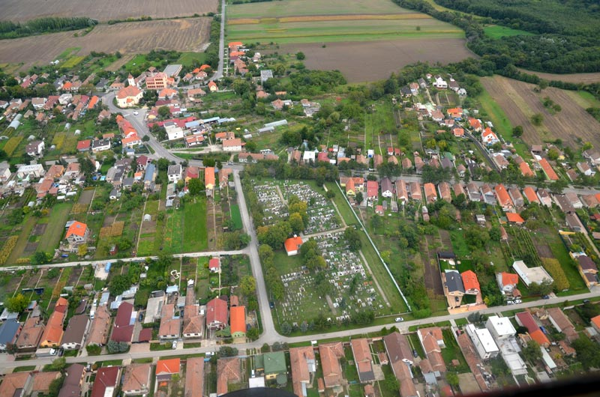
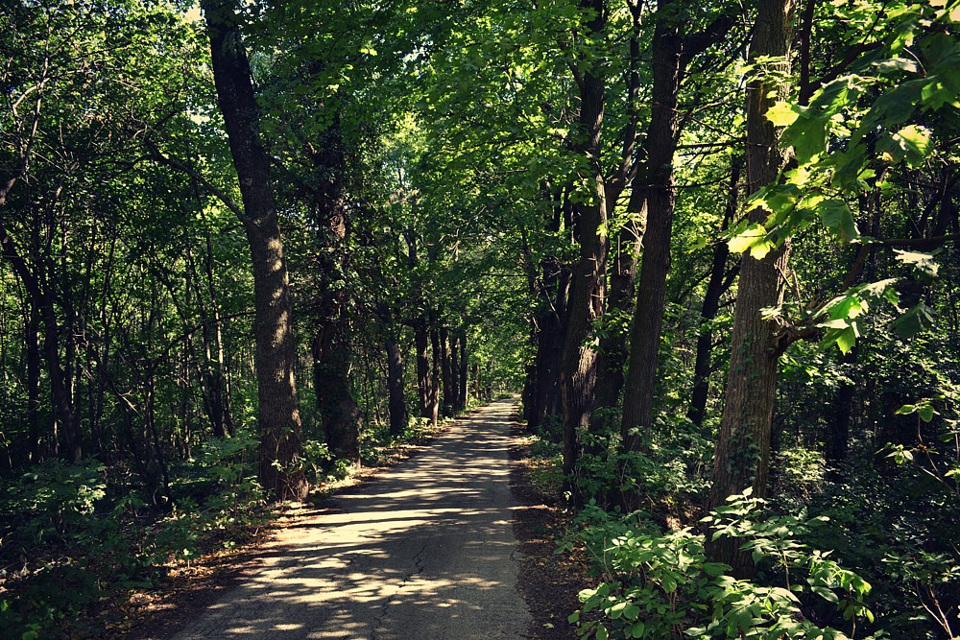
Abraham
view from above:pohľad z výšky
community Center:kultúrny dom
coat of arms: erb
Forest: les

Slide 2
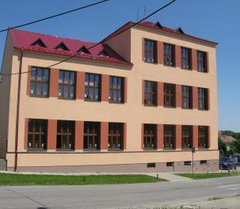
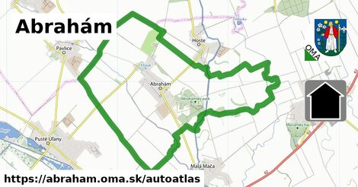
Information
Population:1033
Density:65,46 obyv./km²
Country:Slovakia
Area:15,78 km² (1 578 ha)
Name of the school:Základná škola M. Tareka, Abraham
School:škola

Slide 3
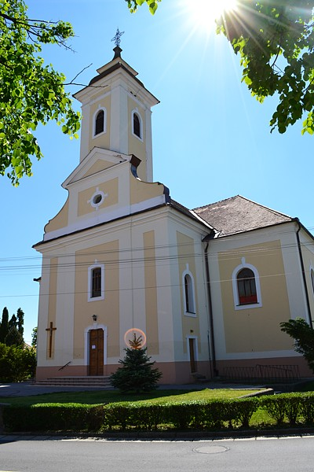
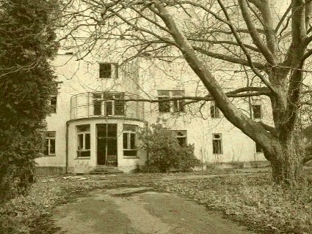
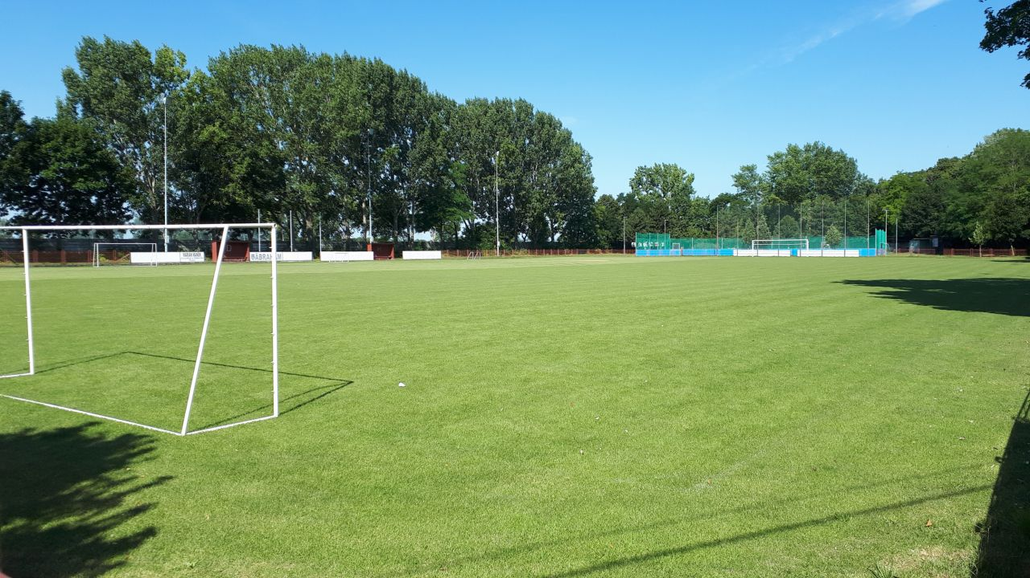
Other photos
A pond : Hliník
a sanatorium
a church
A football pitch

Slide 4
Made by
Kika Stefunkova and Kika Bohunicka
Abrahám, Slovakia

