Slide 1
“Europe 2020: Offering new Perspectives and Incentives for Young People”
KA201 : Strategic Partnership (school to school) 2014-2017
2nd Project Meeting (Short-term Exchange)
In Baza – Spain – at IES Pedro Jiménez Montoya
from 11 to 16 April 2016

Slide 2
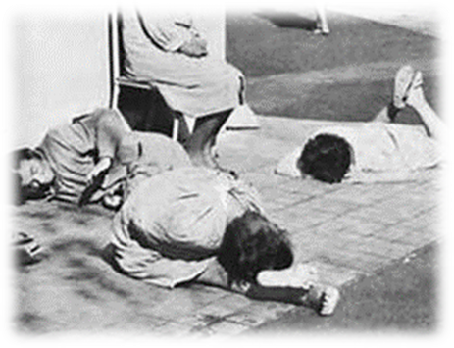
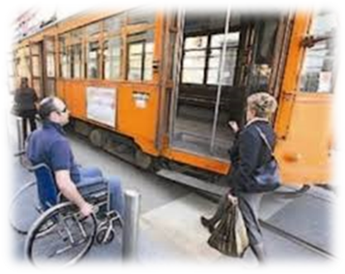
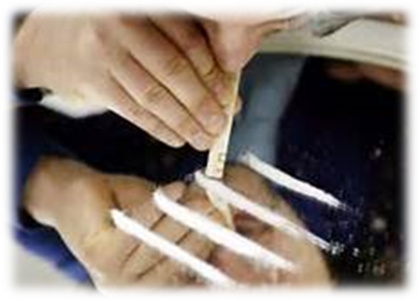
- People affected by physical, mental, sensorial disability;
- Widows, orphans, disabled for work, victims of terrorrism
and of organized criminality;
- Ex inpatient of psychiatric hospitals;
- Subjects in psychiatric treatment;
- Ex drug and alcohol addicts
- People detained in prisons admitted to work outside
jails as an alternative measure of detention

Slide 3
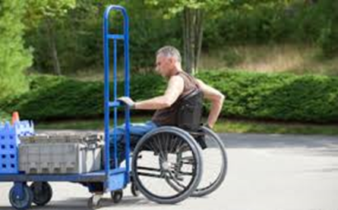
People affected by disability
Can they work?
Law 68/99 defines the disabled that can enter the
labour market in specific contexts:
- civil disabled with a certified legal disability
(stated by the ASL – Local Sanitary Institution) above 45%;
- working disabled with a certified legal disability
(stated by ASL) above 33%;
-deaf, blind, deaf and dumb with a certified legal category
(stated by ASL) from 8 to 1
to see the disabled effective capacity to work and their eventual working context

Slide 4
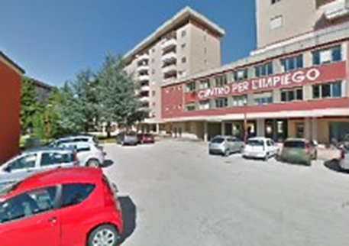
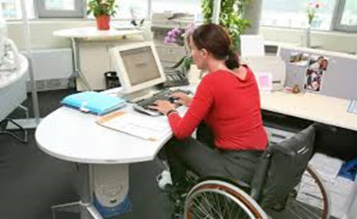
People affected by disability
How can they find a job?
- They have to enrol in the protected categories lists
of the Provincial Employment Center;
- employees find the most suitable solution both for the disabled candidate, considered as an
active and productive worker, and the public institution or private firm offering vacancies;
- the disabled can also be called directly by the employer,
after checking the public list (employers have a limited
number of direct calls);
- once disabled are enlisted they can find a job even
online (www.categorieprotette.it)

Slide 5
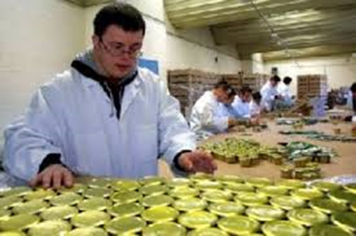
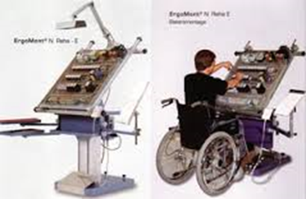
People affected by disability
Are there any employment priorities for disabled?
Both public and private enterprises are obliged to employ disabled enlisted in protected
categories according to their size:
A disabled per 35 employees;
two disabled per 50 employees;
7% of disabled for more than 50 employees and 1% for their family members

Slide 6
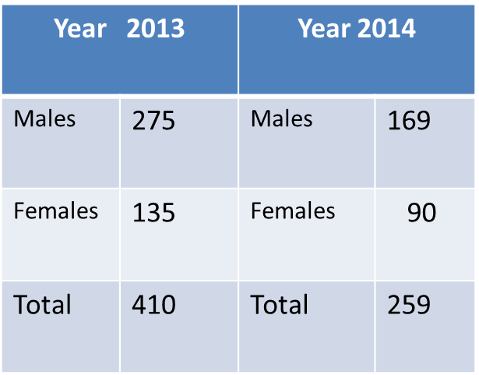
People affected by disability
How many disabled were employed
in Italy during 2013 and 2014?
Istat
Really few, as many companies instead of employing disabled prefer paying fines

Slide 7
Disabled and differently challenged people
What does Government do to favour those people’s employment?
Stability Law/2015 offers employers a lot of incentives and bonuses if they employ:
- young people (15-29 ) for indefinite time;
- women who had no work for 24 months;
- differently challenged people in social cooperatives;
- disabled people listed in protected categories;
- workers over 50 and others

Slide 8
Disabled and differently challenged people
And municipalities?
The municipality of Campobasso, together with other 24 ones, aims at:
- abolishing barriers and in providing social inclusion;
- contrasting poverty and marginalization;
- fostering the full integration of the disabled;
- providing socio – educational measures to contrast addictions, measures for ex prisoners, and immigrants;
- providing home care for the elderly

Slide 9
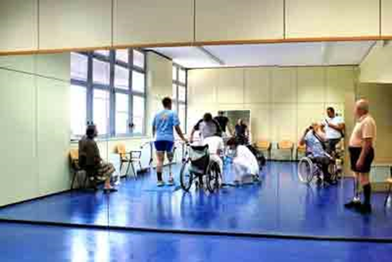
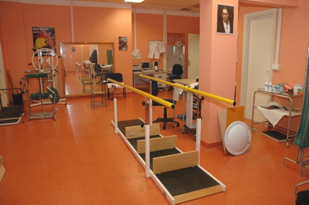
Disabled and differently challenged people
And municipalities?
- the municipality of Campobasso provides
home care for elderly people
- school assistance and transport for disabled students
- There are also NGOs as the socio-educational center
“Peter Pan” that offers disabled to experiment
laboratorial activities outside school
for ceramics, carpentry, etc

Slide 10
Disabled and differently challenged people
And municipalities?
The NGO Socio - educational Center “G.Palmieri” in Campobasso, that aims at making mental disabled, aged 18-35, more autonomus to manage money, to catch a bus, and to try to make them active and productive social sources to be employed in social cooperatives.
This Cented is financed by the Region and by the disabled families €30 per month.
Inserire foto dell’Assistente sociale (social worker) : Attilio Buccino

Slide 11
Disabled and differently challenged people
Then there is the Socio-cooperative
“Laboratorio Aperto” for mentally
disabled led by Ms Patrizia Russo. Inserire video.

