Slide 1
“Europe 2020: Offering new Perspectives and Incentives for Young People”
KA201 : Strategic Partnership (school to school) 2014-2017
2nd Project Meeting (Short-term Exchange)
In Baza – Spain - IES Pedro Jiménez Montoya
from 11 to 16 April 2016

Slide 2
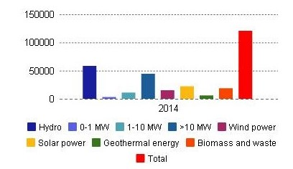
What are renewable energy sources?
Wind power, solar power, hydroelectric power,
geothermal energy, tidal power,
biomass and the renewable part
of waste which by the year 2020
will produce 60% of electric power
What are the main renewable
resources in Italy?
Italy, gross electricity production from
renewable energy sources – millions kWh
What are their benefits?
Reduction in greenhouse gas emissions
Diversification of energy supplies
Reduced dependency on fossil fuel markets (oil and gas)
Job creation in enviromental and renewable energy sectors
And in Italy?
Even in Italy, by the year 2020,
renewable energy should cover
20% of energy consumption in Italy
Source: Unioncamere data processing based on ISTAT ones

Slide 3
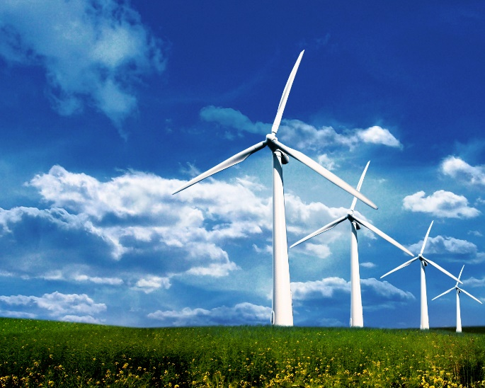
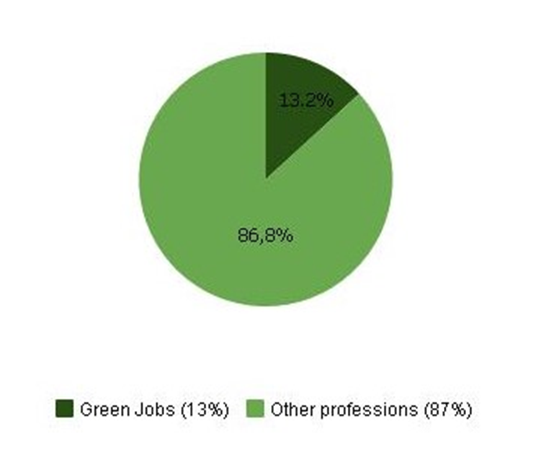
What are green jobs?
They are jobs that produce goods and services
in order to reduce the enviromental impact of productive processes
FOTO
People employed in Green Jobs in 2014
According to IRENA (International Renewable Energy Agency)
There are over 7.7 million people in the world who work
in the renewable Energy sector
The world’s leading countries for renewable energy employment
are China, Brazil, the United States, India, Germany, Indonesia,
Japan, France, Bangladesh and Colombia
Italy: about 3 million people (2.942.741),
that is 13.2% of the total national employment rate
Source: Unioncamere data processing based on ISTAT ones

Slide 4
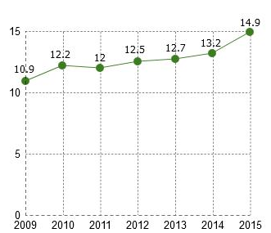
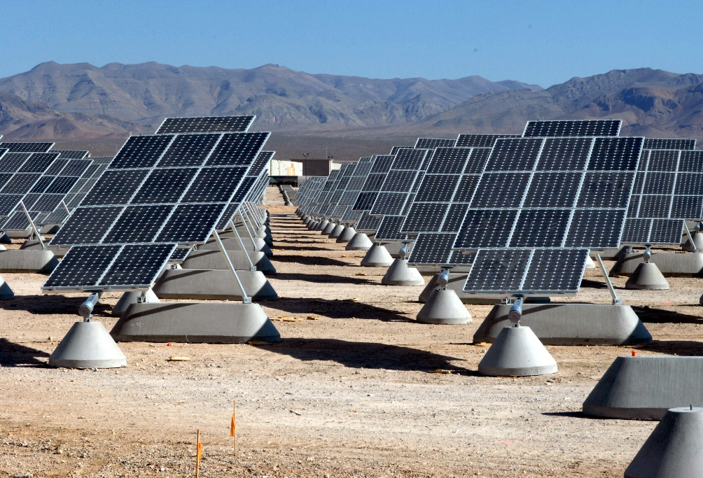
Green Jobs trend from 2009 to 2015 - Green Jobs percentage on total employment rate
In the year 2015 the people employed in the Green Jobs were 14.9% of the total national employment rate
Source: Unioncamere data processing based on ISTAT ones

Slide 5
Years 2009-2015 Green Jobs % incidence on total employment per professional figure
Green Jobs are quality jobs and they require specific high technical competences, in fact more that 40% of people employed
in green jobs have a university degree, while workers with a university degree employed in other jobs represent only 11%
People with a University degree People with a secondary school diploma
Source: Unioncamere data processing based on ISTAT ones

Slide 6
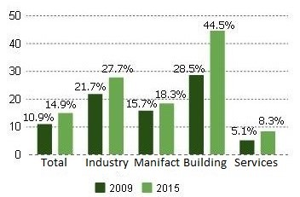
Years 2009-2015 Green Jobs % incidence on total employment per economic sector
Green Jobs are specially requested in building industry, mining, chemical and oil industries,
machinery and means of transport industry and in the electric and electronic industries
These are industries that have
high emissions level
or that consume a lot of energy
and therefore need qualified staff
to reduce the enviromental impact
Source: Unioncamere data processing based on ISTAT ones

Slide 7
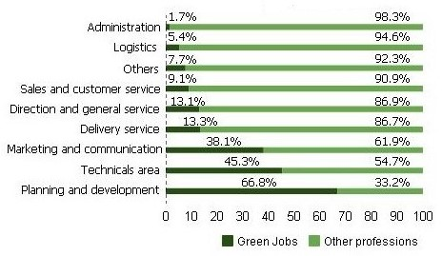
What is the employment rate of Green Jobs in each company area and the other professions ?
Green Jobs are specially requested in company department as planning, technical areas and marketing and communication
Source: Unioncamere data processing based on ISTAT ones

Slide 8
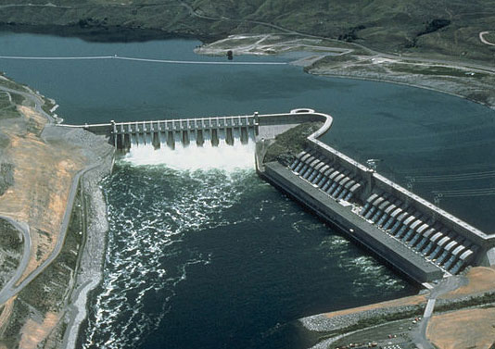
Green Jobs percentage employment incidence in comparison with that of other professions
Source: Unioncamere data processing based on ISTAT ones

Slide 9
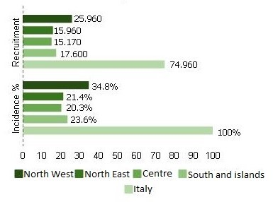
Italian areas per number of Green Jobs
Green Jobs are specially requested in the north of Italy, in regions as
Lombardia, Veneto, Emilia-Romagna; but also in Campania, Puglia and Sicilia
Source: Unioncamere data processing based on ISTAT ones

Slide 10
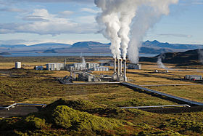
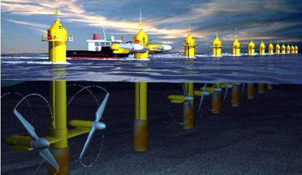
What are the most common green professions?
- Thermal plant installers
Energy engineers in the building industry,
in agriculture, in transport
Mechatronic technicians that make motors more efficient and environmental respectful
Eco-brand managers that plan and promote
sustainable products
Green buying experts that spots and buys low impact
products and services
Source: Unioncamere data processing based on ISTAT ones

Slide 11
Thank you for your attention!
Photo’s source: https://www.google.it/search?q=green+jobs&biw=1366&bih=628&source=lnms&tbm=isch&sa=X&ved=0ahUKEwjHvYXZkPDLAhWGBSwKHSG2AuAQ_AUIBygC

