Slide 2
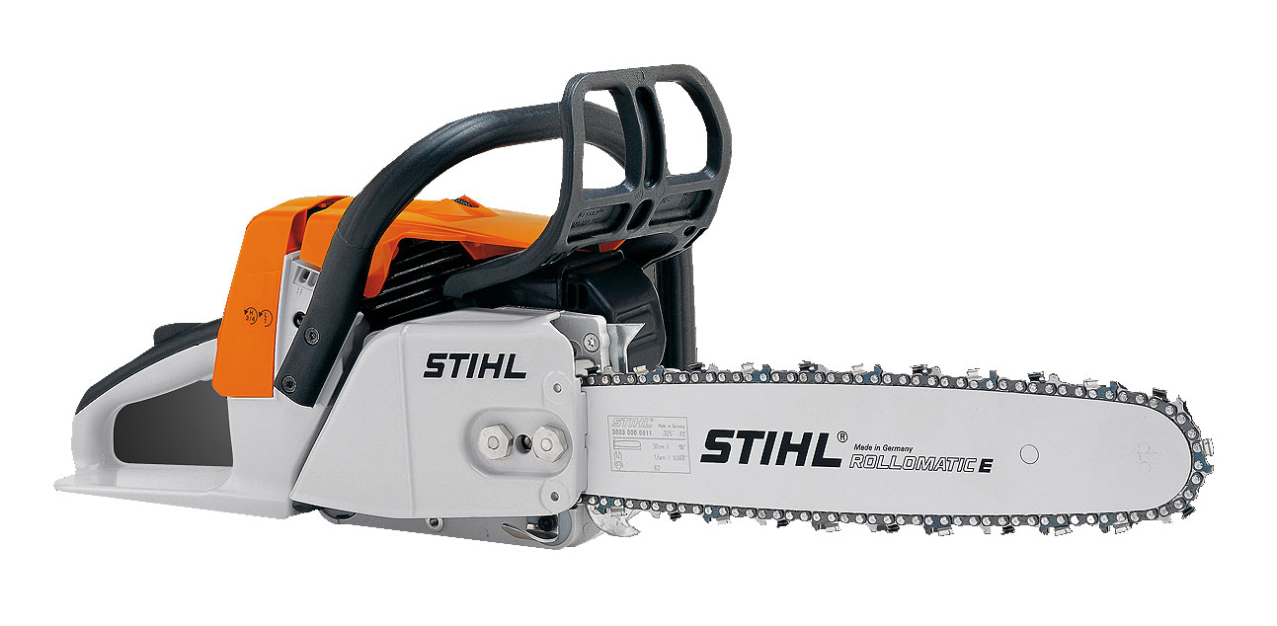
STIHL
situated in Waiblingen near Stuttgart
produced the first power saw ever in 1926
International market leader for power saws
Most sold power saw brand in the world

Slide 3
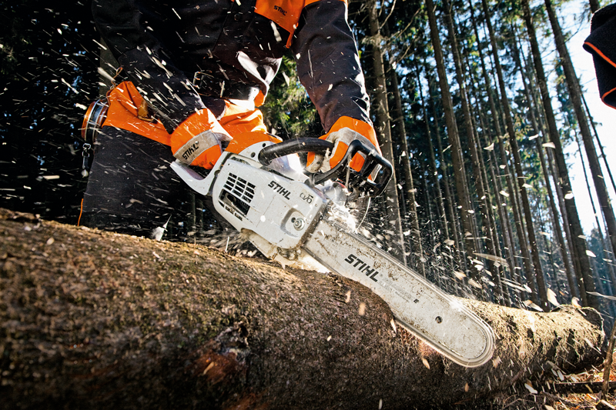
Today they produce power saws and other tools used in agriculture and forestry
They only sell in specialist shops where they can give you advice
Sell in more than 40.000 specialist shops in over 160 countries
In 2014 they had 14.300 employees and earned 2.98 billion euros

