Slide 1
Jobs of the Future
Body Part maker

Slide 2
Necessary Qualities
Medical Background
Design Mindset
Intermediate Computer Knowledge

Slide 3
Outdated Qualities
Knowledge of Fax Machines
Above Average Grades
Using the Internet

Slide 4
Differences: Now and the Future
Now it is more focused on grades, in the future more on social competences.
Now you have to know some things about using a computer, you will need to know more in the future.
In the future you will need to be able to see an idea from multiple perspectives/disciplines.

Slide 5
Our Qualities
Good Education
Extensive Social Background
Adequate understanding of multiple languages.

Slide 6
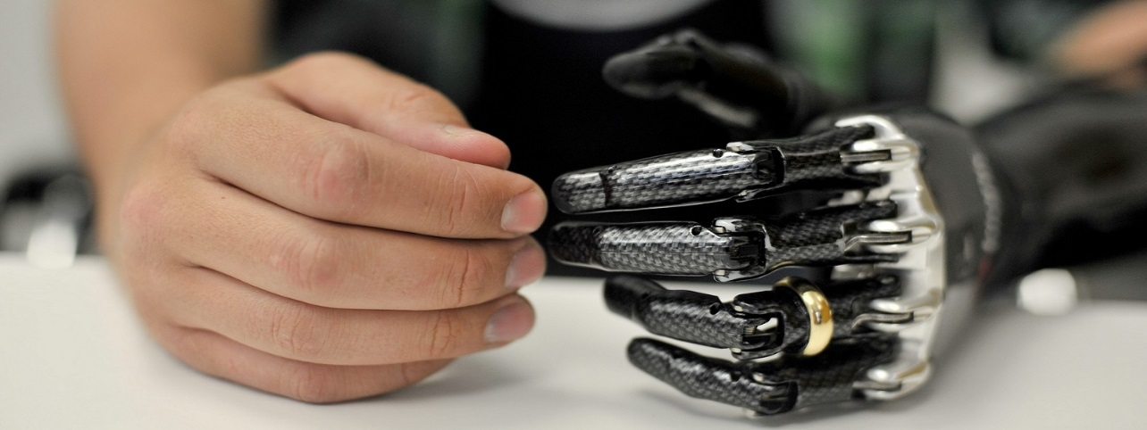
Advertisement
Do you want to save the lives of hundreds of people? Become a body part maker at our company. You will then create body parts using all the technology developed in the last decades and transplant those into human bodies and save a live with each organ you produce.
Requirements:
A medical background
Design and innovating mindset
Intermediate computerknowledge
Motivation to help and save people

Slide 7
Sources
Follow @bald.memes on Instagram

