Slide 1
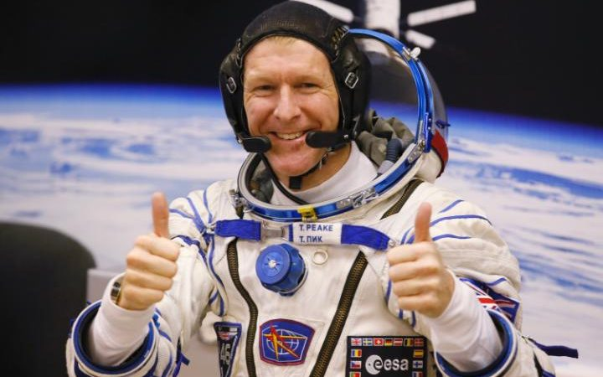
Space pilot

Slide 2
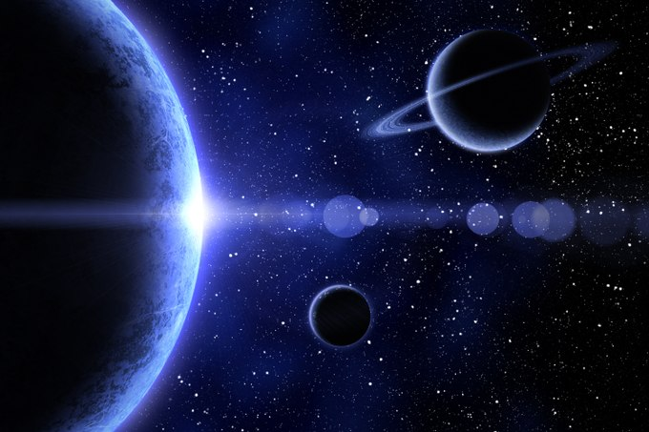
Space Pilots, architects and Guides
Habitation of space and the planets
Sasakawa International Center for Space Architecture (SICSA)
Possible Emergence as a Profession: 2035

Slide 3
Requirements
Bachelor for engineering, biological science, physical science or mathematics.
1000 hours of experience in a jet aircraft
Height between 1,57m and 1,90m
Blood pressure 140/90

Slide 4
REsponsibilities
Be able to: fly to many different planets
Advanced knowledge of cosmology, astronomy, space science, geography, history and geology
Be an excellent story teller, be very creative and an imaginer

