Slide 1
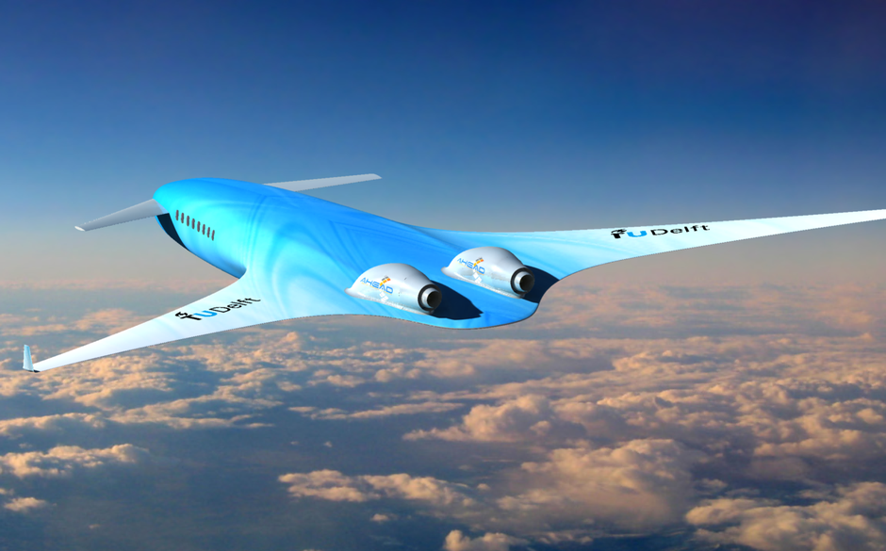
Have you got what it takes to be a weather marshall?

