Slide 1




T-SIGN

Slide 2
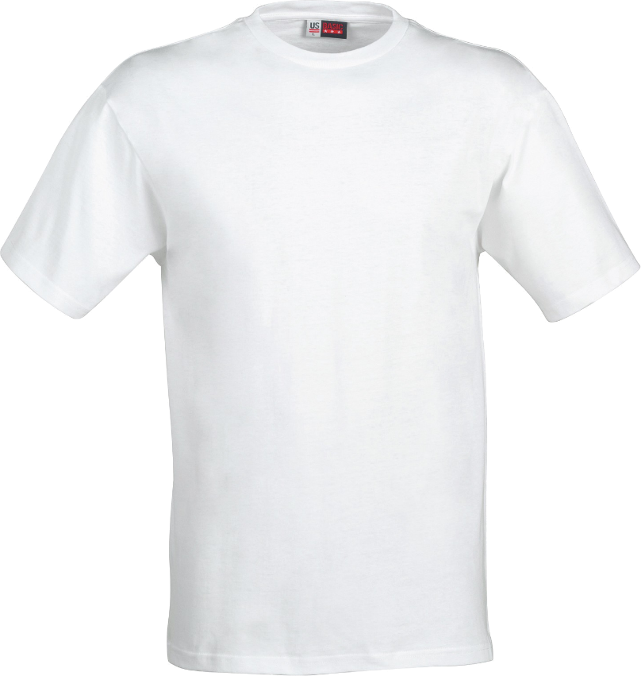
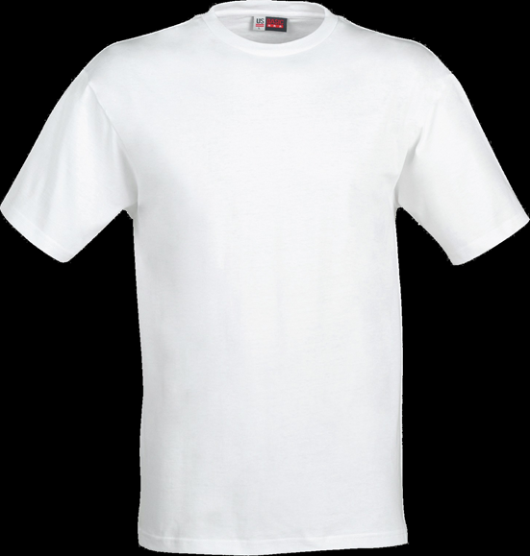

Product
+
=

Slide 3
Why you should buy our product!
Unique design
(Combination of monuments)
Only 20 t-Shirts
Relationship between the countries
Only one chance to buy it
Selfmade by students
YOU ARE WEARING THE WORLD

Slide 4
Calculation
Number of t-shirts | Price per unit | Cost | Sale price | Total sales | Profit
20 | 10 € | 200 € | 14 € | 280 € | 80 €
20 | 10 € | 200 € | 15 € | 300 € | 100 €
20 | 10 € | 200 € | 16 € | 320 € | 120 €

Slide 5
strategy
posters in school to get customers
walking around to get customers
Sales:
When you buy 2 t-shirts you only have to pay 25€

Slide 6

The end of our project is today
Last meeting of our countries

