Slide 1
Presentation of Telšiai "Germantas" progymnasium

Slide 3
Our town Telšiai

Slide 5
Our country Lithuania

Slide 6
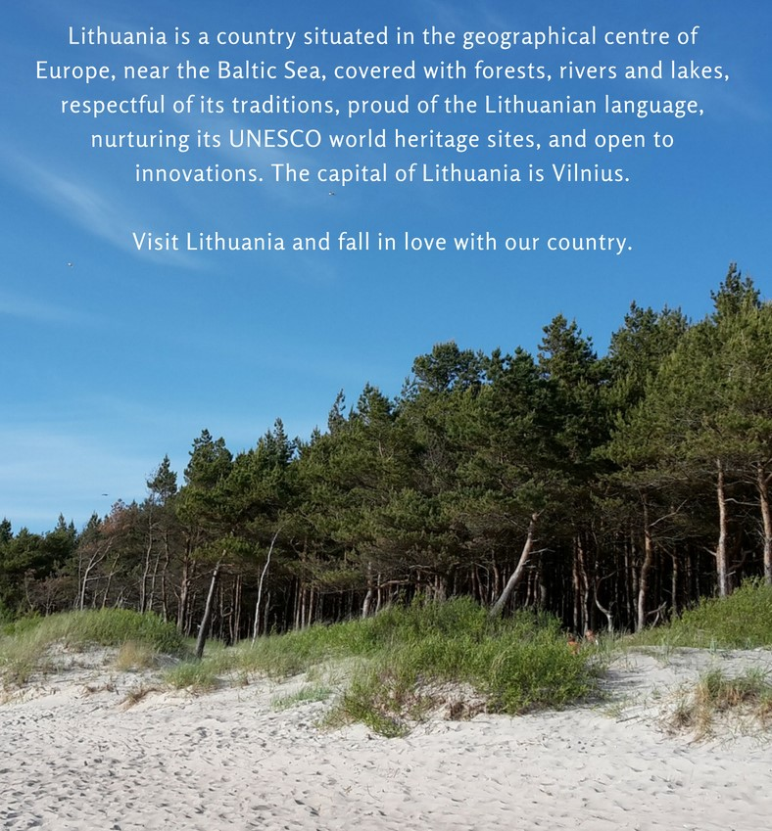
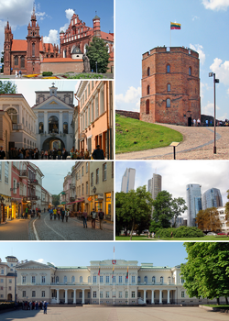
Vilnius is the capital of Lithuania
The flag of Lithuania

