Slide 1
LAVOISIER
Antoine-Laurent Lavoisier (1743-1794) is considered the father of the modern chemistry because of the statement regarding the weights of the elements
in a chemical reactions “ in a chemical reaction, the weights of the reactants is always equal to the weights of the products “….

Slide 2
But we would like to talk about Lavoisier’s life, instead of his mere work, because he was such a dreamer! He pursued science and knowledge with passion while working for the Ferme Generale, a private corporation that collected taxes for the French Crown

Slide 3
At the age of 25 years, Lavoisier was elected to the Academy of Sciences, France’s most elitist scientific society, because of his studies in geology.
A few years later he saved Marie Anne Paulze, the thirteen years old daughter of his boss, from a marriage with a man much older than her. The reason why he saved her was so that he could marry Marie Anne …..

Slide 4
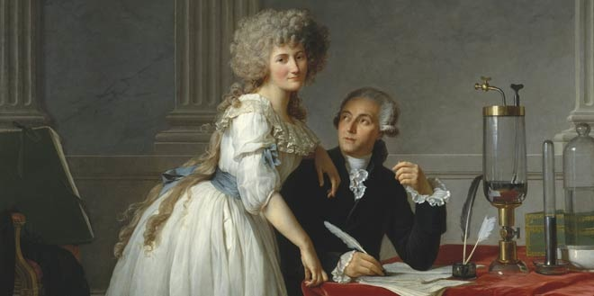
Madame Lavoisier translated from English for him and illlustrated his books. Hers are the drawings of the devices used for Lavoisier’s most famous experiments .

Slide 5
Lavoisier worked basically on combustion, respiration and the calcination or oxidation of metals.
He demonstrated that air is composed of two parts, one which combined with metals to form calxes (oxides of metals).
He named this portion “oxygen” (oxides’ generator) and the other azote (no life)
Later he discover hydrogen ( water former)

Slide 6
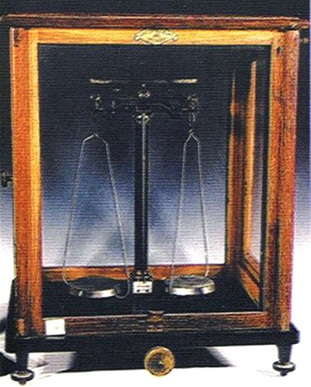
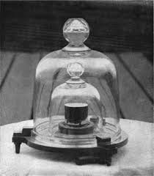

Slide 7
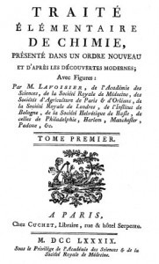
The Elementary
Treatise of Chemistry
(1798) Is the first modern chemical book)

Slide 8
Ironically, Lavoisier, the ardent and zealous chemical revolutionary, was caught in the web of intrigue of a political revolution. The Traité was published in 1789, the same year as the storming of the Bastille.
Lavoisier could not escape the wrath of Jean-Paul Marat, the adamant revolutionary who publicly denounced him in January 1791 for rubbery.
The true reason why he did this was due to the fact that Lavoisier, as a prevalent member of the Science Academy,had refused to test a device invented by Marat ( an infrared detector). Marat never accepted it, and, as soon as he could, took his vengeance.

Slide 9
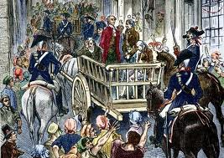
On the morning of May 8, 1794, Lavoisier was tried and convicted by the Revolutionary Tribunal as a principal in the "conspiracy against the people of France." He was sent to the guillotine that afternoon. His friend, the French mathematician Lagrange, remarked that "it took them only an instant to cut off that head, and a hundred years may not produce another like it.

Slide 10
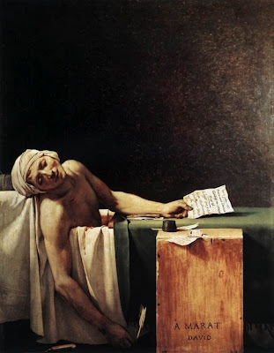
few years later, Marat died
in misterious circumstances….

