Slide 1
Plant nutrition

Slide 2
Green plants make simple sugars from carbon dioxide and water. Glucose molecules are then linked together to form larger starch molecules which are insoluble in water and are used from the plants as storage energy.
You can use iodine solution to test for the presence of starch in leaves and to find out whether photosynthesis has been happening or not.

Slide 3
Reagents and laboratory equipment
Reagents:
Laboratory equipment:
Water,
Ethanol,
Iodine,
Leaf.
Burner,
Test-tube,
Beaker,
Tripod,
Pipette,
Piece of white surface.

Slide 4
Diagram of experiment

Slide 5
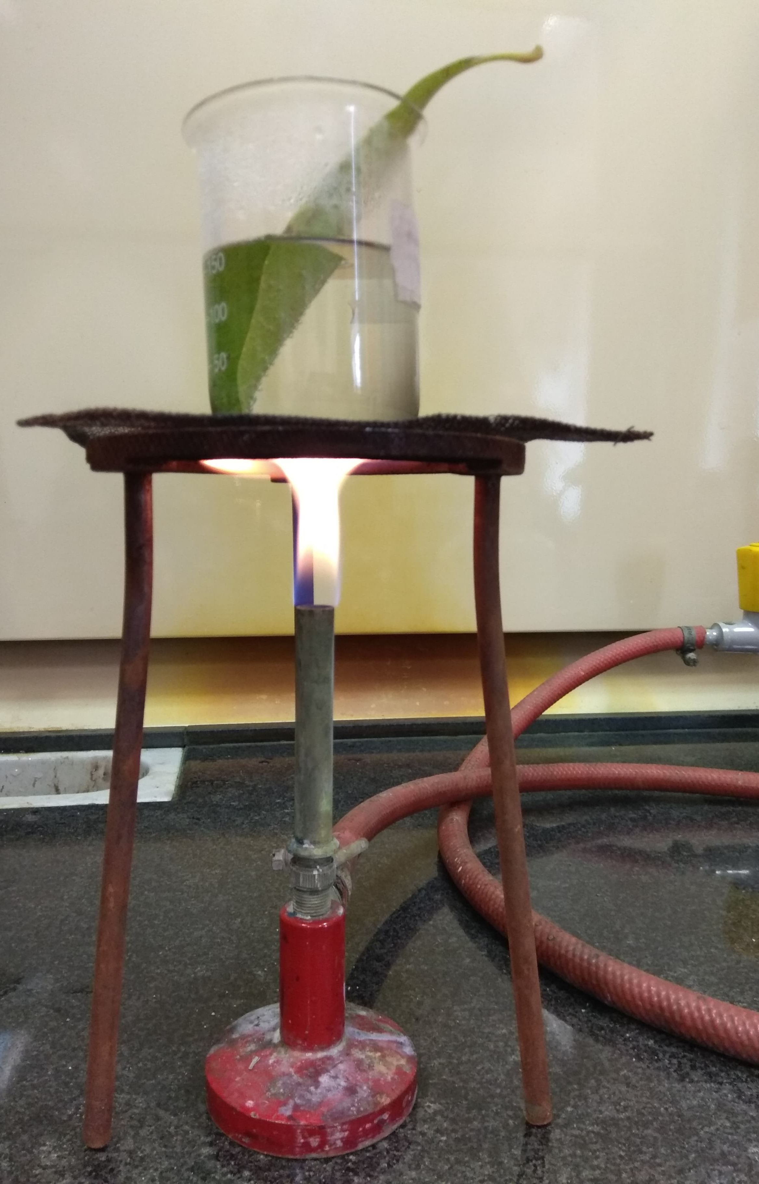
Testing a leaf for starch:
1) Submerge a leaf in boiling water for one minute. This process destroys membranes in leaf and making it easier to extract the chlorophyll.

Slide 6
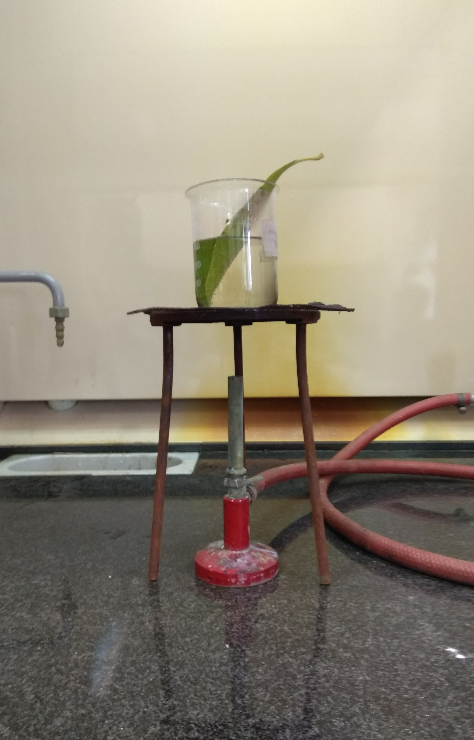
2) At this point turn off the burner.

Slide 7
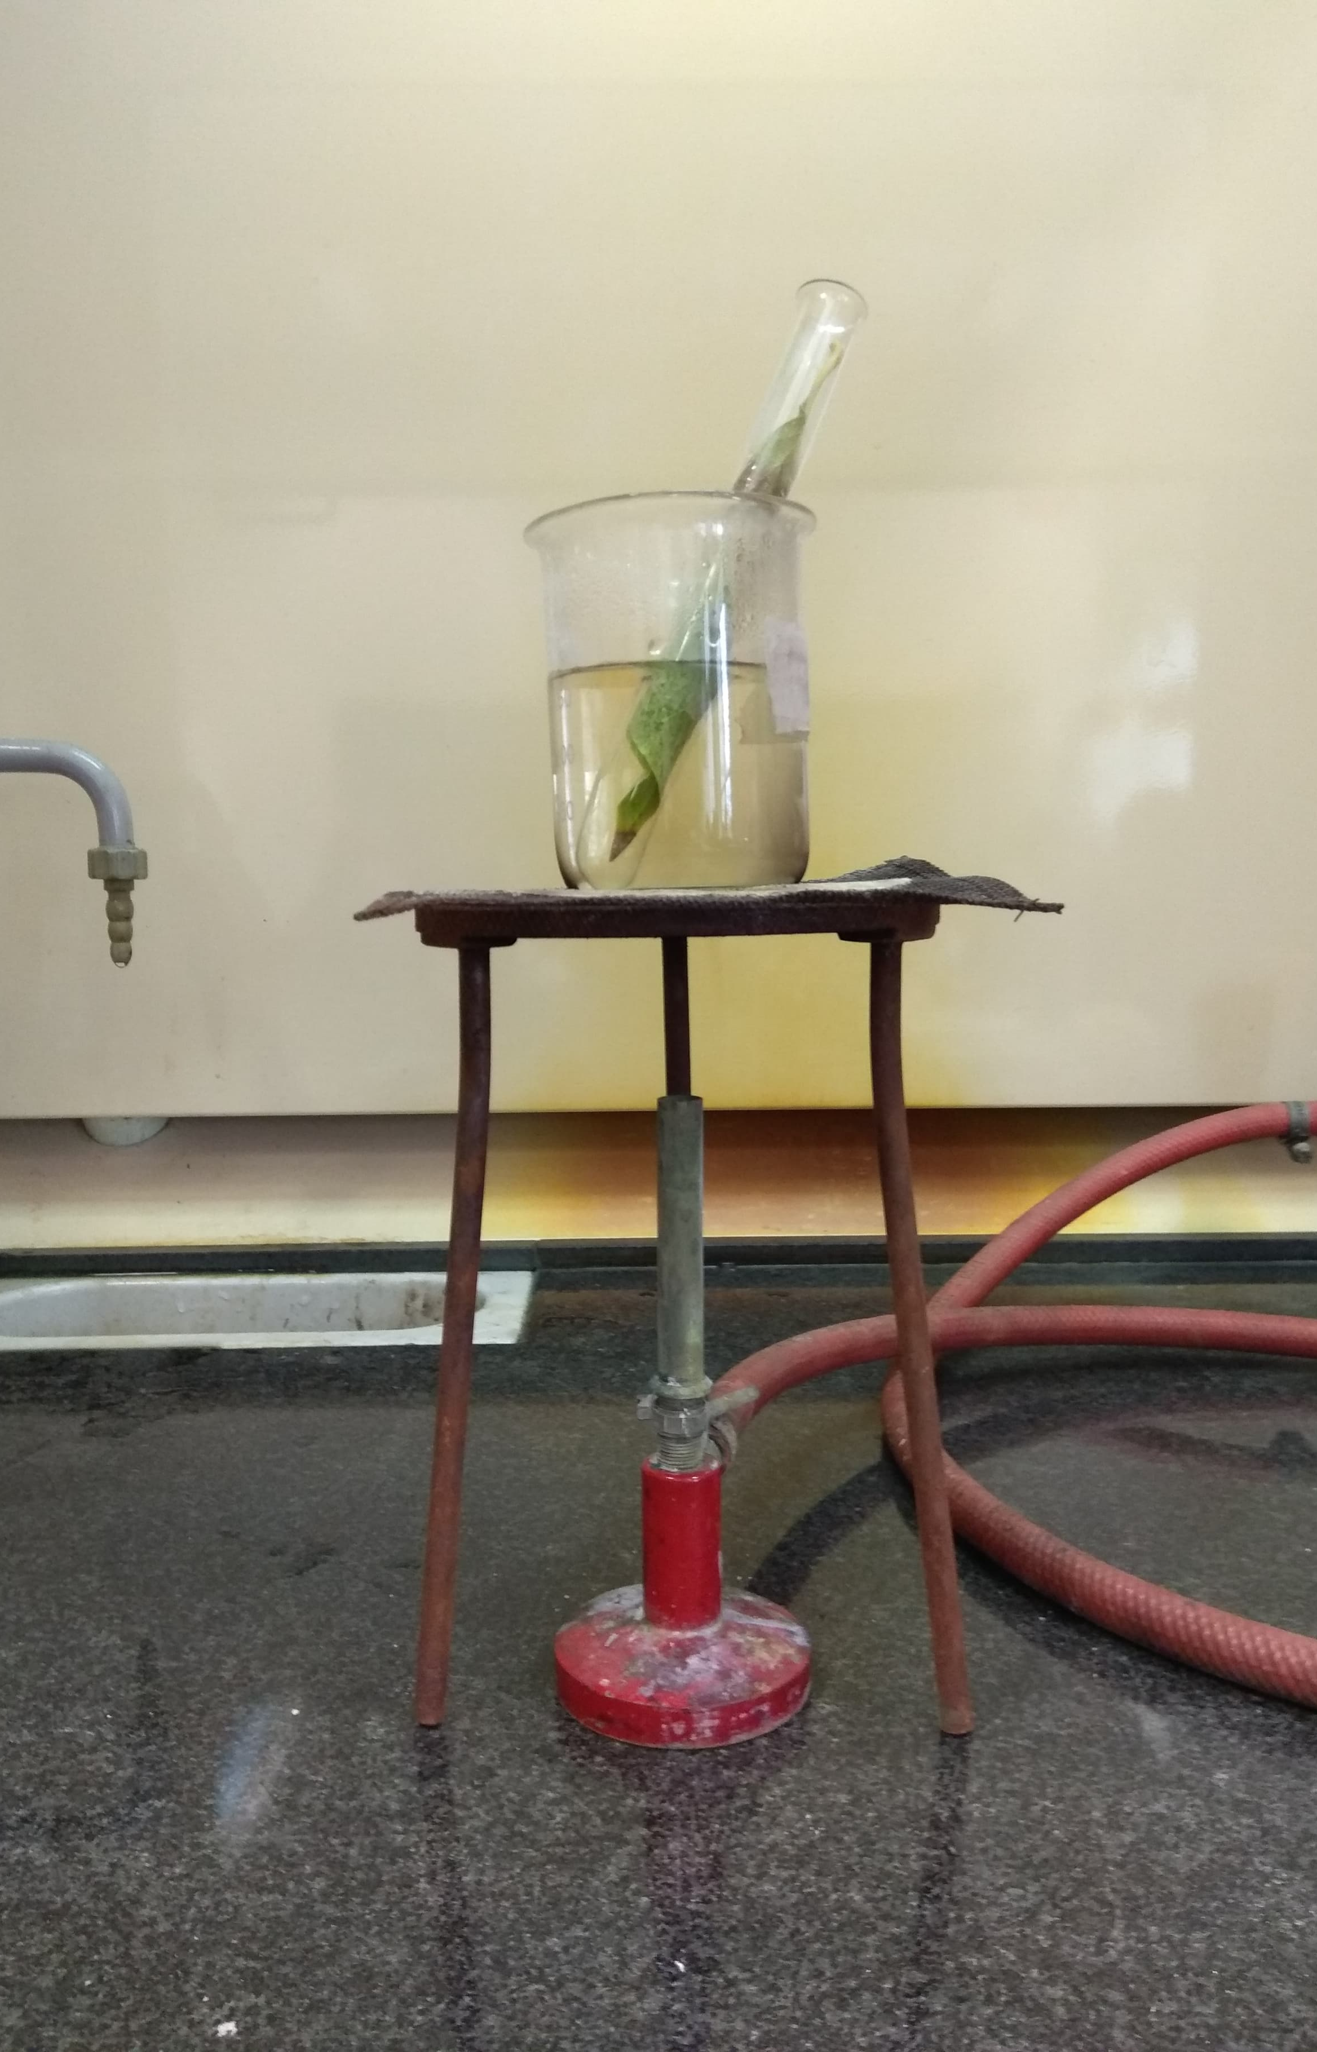
3) Put the leaf into a test-tube with ethanol. The chlorophyll is extracted by dissolving into the ethanol.
4) Stand the test tube in a beaker of hot water for about 10 minutes.

Slide 8
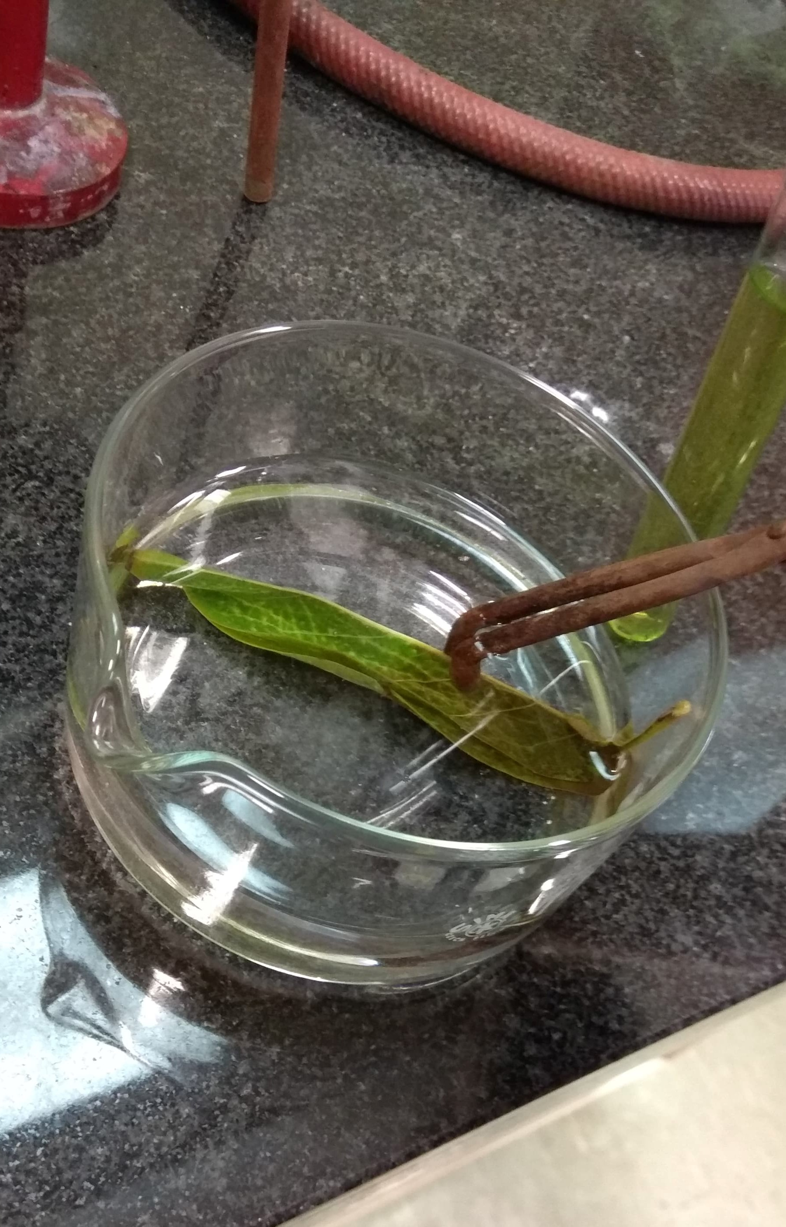
5) Wash the leaf in cold water. This removes the ethanol and rehydrates the leaf witch softens it and make it easy to spread out.

Slide 9
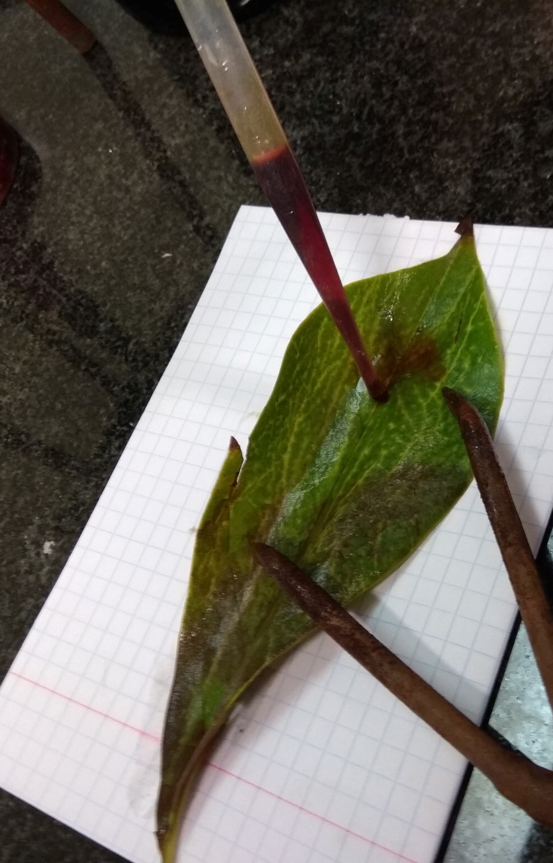
6) Spread the leaf out on a white surface and put some drops of iodine solution on it.

Slide 10
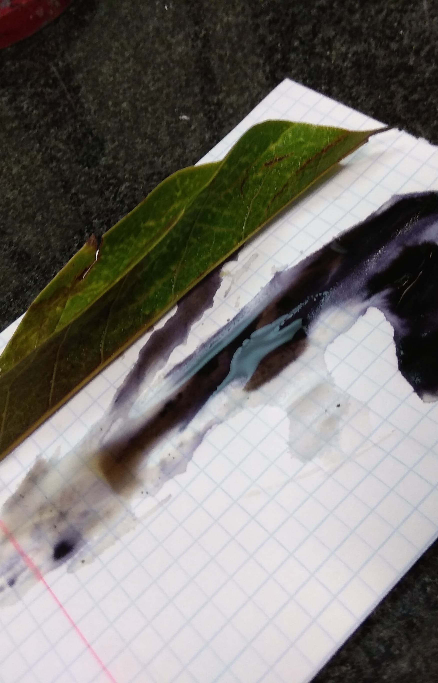
7) If the leaf goes blue-black, starch is present. If it stays red-brown, there is no starch.

Slide 11
Thank you for your attention!

