Slide 1
"RADA MILJKOVIC" PRIMARY SCHOOL, JAGODINA
Presentation prepared by : Sanja Pribakovic, teacher
Translation : Daniela Popovic, English language teacher
eTwinning

Slide 2
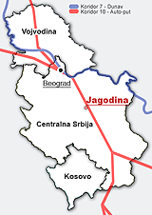
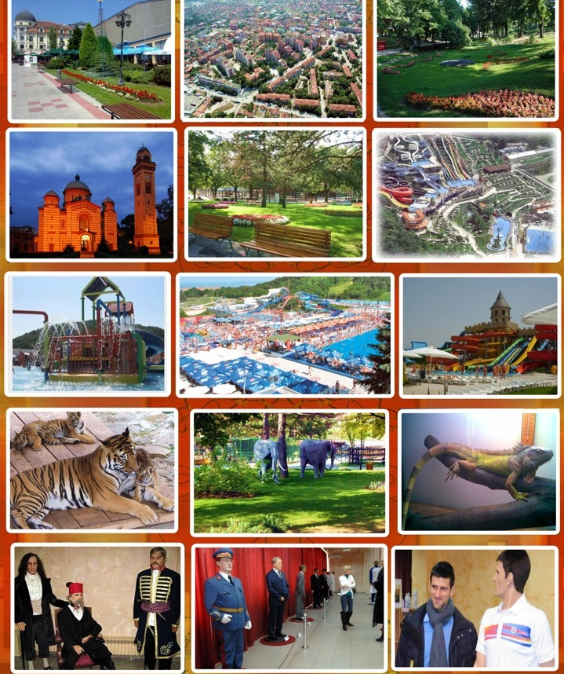
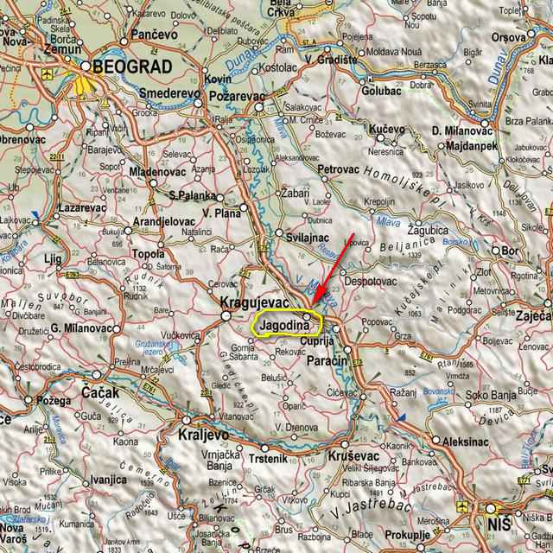
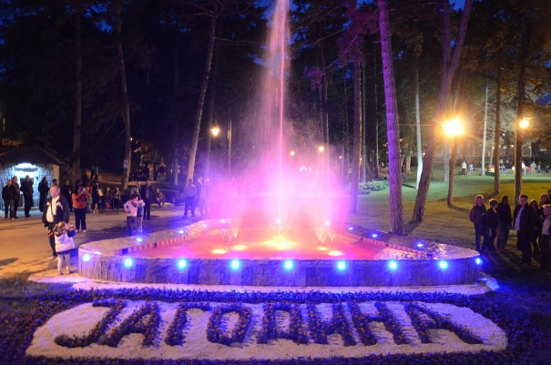
Jagodina

Slide 3
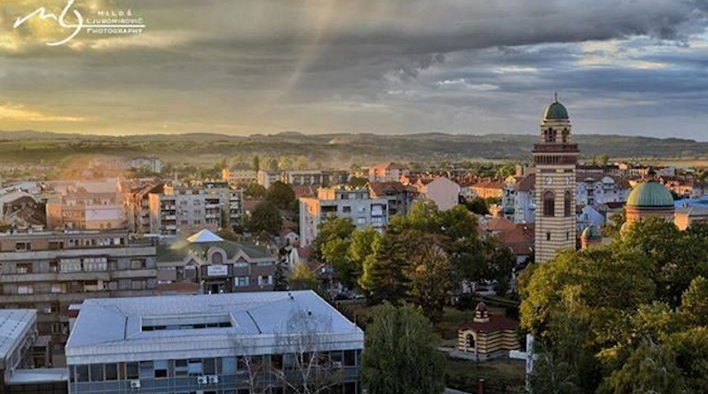
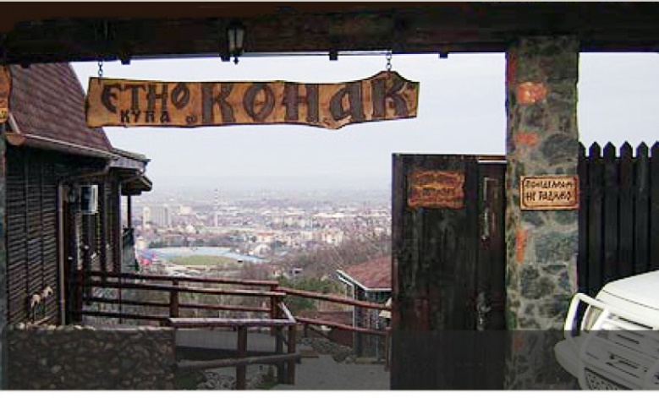
Jagodina

Slide 4
"Rada Miljkovic" Primary School
Address : Kneza Lazara, bb
Phone number : 035/243-516 ; Fax : 035/244-452
Website : www.radamiljkovic.nasaskola.rs
Email address : radamiljkovicjagodina@gmail.com ; rmiljkovic@ptt.rs

Slide 5
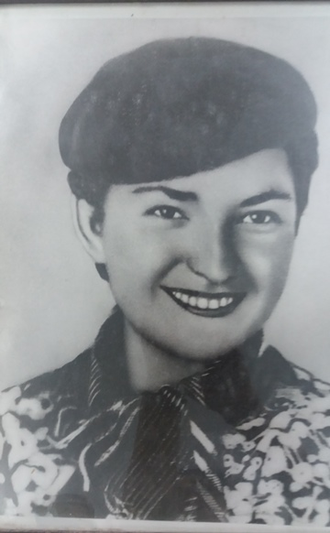
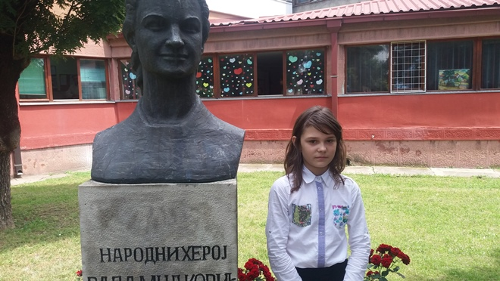
NAME
The primary school "Rada Miljkovic" is located in Jagodina in Serbia. It is named after the teacher Rada Miljkovic who took part in the National Liberation War in WWII and who was proclaimed a Yugoslavian heroine.

Slide 6
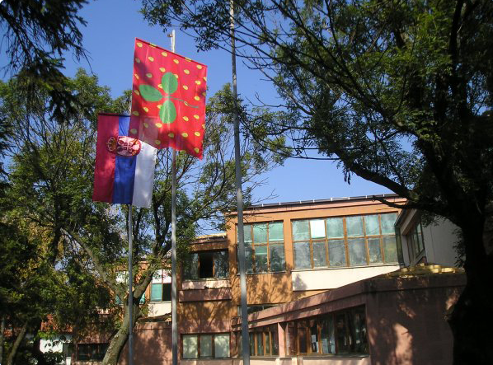
HISTORY
In 1960, "The First Primary School" in Jagodina was named "Rada Miljkovic".
The first building _ the "base " school unit is situated on the street Kneza Lazara bb.

Slide 7
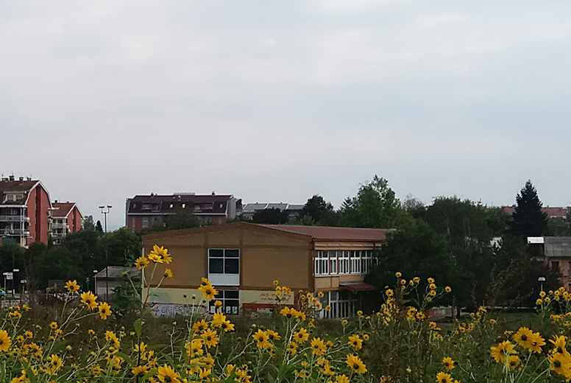
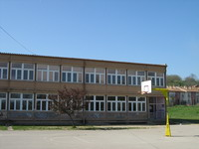
HISTORY
In 1986, the school extended its property by adding a satellite unit in the "Streliste" district of the city.

Slide 8
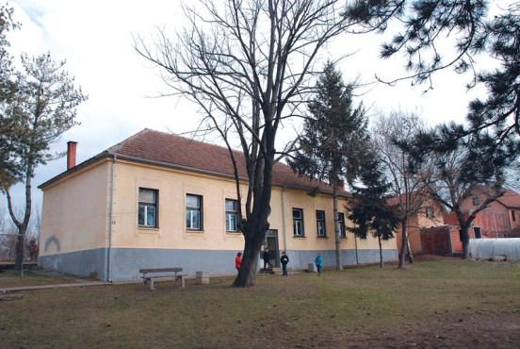
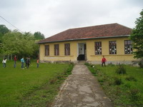
HISTORY
The primary school "Rada Miljkovic" also consists of a satellite sub-school opened in 1927 in the village Voljavce.
Another satellite unit built in 1938 in the village Bukovce pertains to the school too.

Slide 9
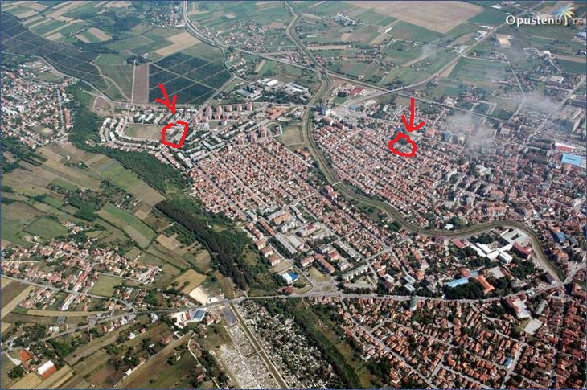
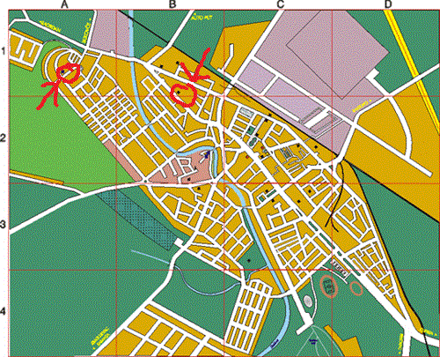
LOCATION
The base unit is situated at a distance of 1 km to the north from the city center.
•On the east side and on the west side of the base school unit, there are two high traffic main streets.
•By following one of these main streets to the south, at about 1 km, you reach "Mala skola" ("Small school") in the Streliste district.
•Following the main street which leads to Belgrade , at 4 km to the north of the city, you reach the school in the village Bukovce.
•The school in the village Voljavce is located about 3 km northwest of the city.

Slide 10
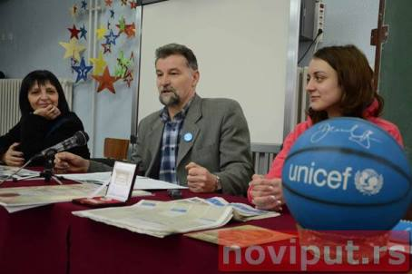
INFRASTRUCTURE AND FACILITIES
•There are about 1000 pupils in the school. Pupils are divided into 45 classes from the 1st to the 8th grade.
•Teaching is organised in two shifts in every unit of the school except in Bukovce.
• The Expert Assistants Staff consists of a psychologist, a pedagogist and a librarian.
•The Executive Staff of the school is made of a head teacher, a substitute head teacher and of a legal secretary.
•13 cleaning ladies take care of hygiene in the school.

Slide 11
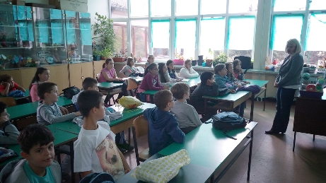
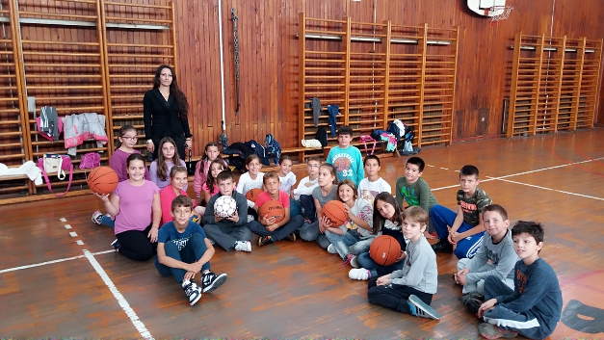
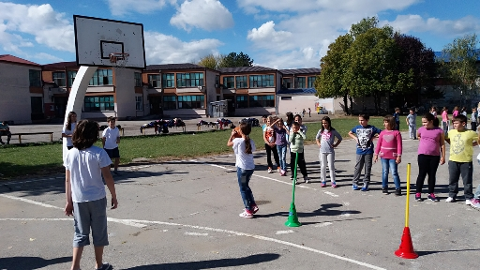
INFRASTRUCTURE AND FACILITIES
The school has 27 specialised classrooms, two sports halls and outdoor sports grounds.

Slide 12
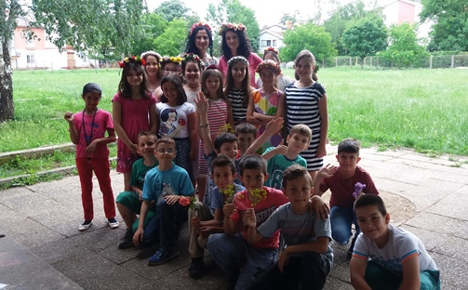
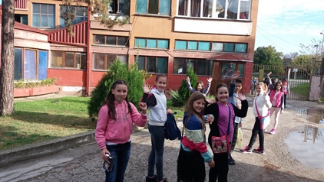
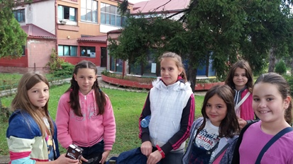
PHOTO GALLERY

Slide 13
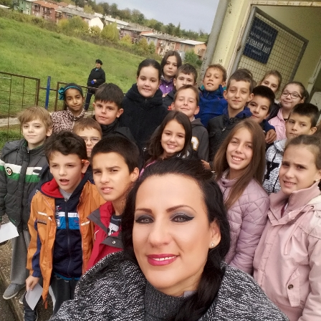
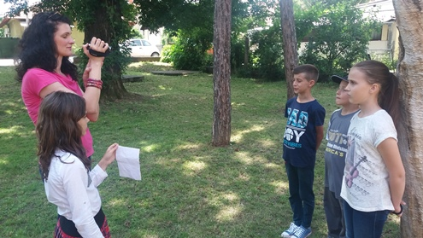
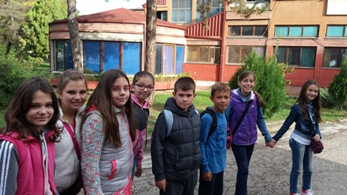
PHOTO GALLERY

Slide 14
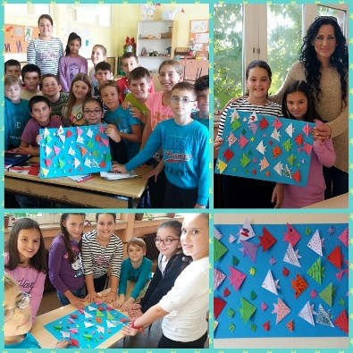
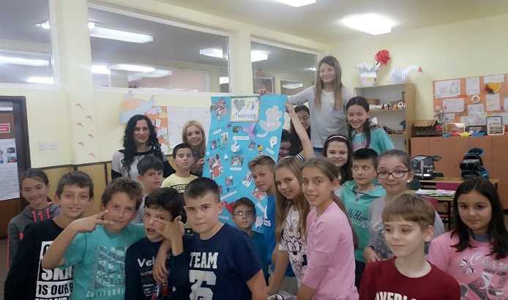
Photos

Slide 15
Greetings from Serbia !
4/3

