Slide 1
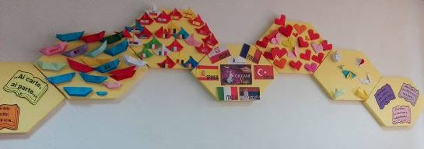
Origami Magic
Organisation and implementation of activities

Slide 2
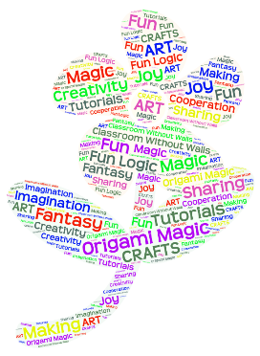
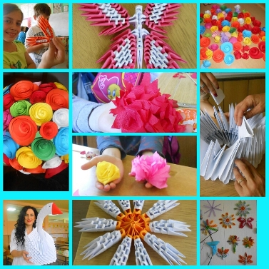
Origami Magic
Greetings to all of you, my dear friends, my dear partners!
This is the overview of our project activities so far.

Slide 3
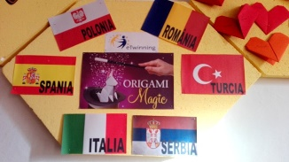
Origami Magic
We met in September: Serbia, Italy, Spain, Romania, Poland, Turkey. A large number of origami friendship boats were made during October. We continued making origami animals.
New partners from Serbia, Lithuania and Croatia joined us, too.

Slide 4
Project - step by step
Step 1 Let’s meet!
Teachers and pupils shortly described themselves, their school and the place they live in using photographs, videos,...
We familiarized with origami technique.
The ships of friendship – we made small ships in the colours of countries’ flags (countries participants).
We learnt greetings in the languages of the partner countries.

Slide 5
Project - step by step
Step 2 Animals
According to the guidelines which were shown in certain presentations, pupils individually made birds and fish.
Groups made creative presentations of their work.
Fish were attached to a painted water surface, or pupils went on imaginary fishing,…
Together, we made lots of different animals such as dogs, cats, flapping birds, cranes, swans, butterflies,…
Creativity was limitless! Pokemones were a part of it, too!
Halloween sparked our creativity and imagination as well.

Slide 6
Project - step by step
Step 3 Christmas and New Year’s Magic
These days, we are working on the organisation of activities based on Christmas and New Year. The idea is to make a Christmas tree, Christmas tree decorations, Christmas cards, …. Later, teachers and pupils will present their creations by photos, videos and, finally, a video conference. We will also exchange holiday greetings in all languages. The other idea is to exchange Christmas cards between the countries participants by mailing them.

Slide 7
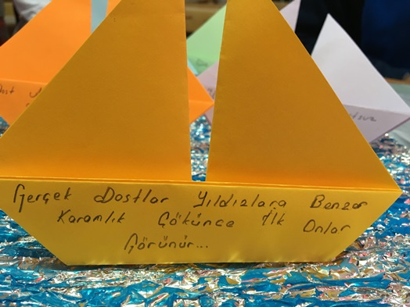
LOOK WHAT WE MADE TOGETHER! The ship of friendship
Turkey
Poland

Slide 8
The ship of friendship
Romania

Slide 9
The ship of friendship
Serbia - Jagodina

Slide 10
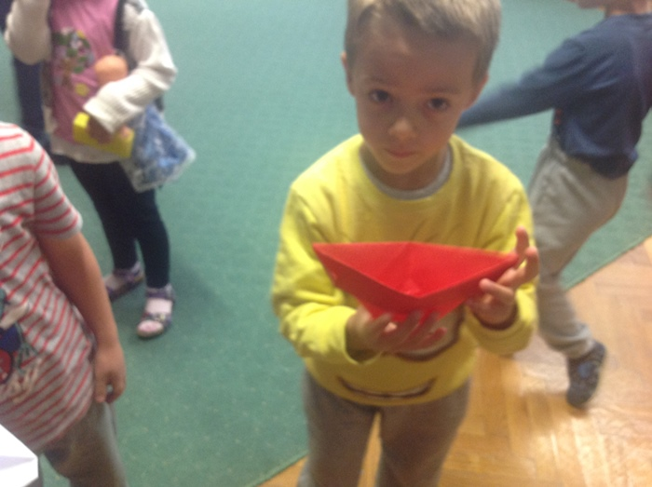
The ship of friendship
Serbia - Subotica

Slide 11
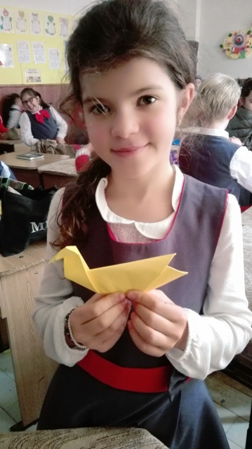
Animals
Romania

Slide 12
Animals

Slide 13
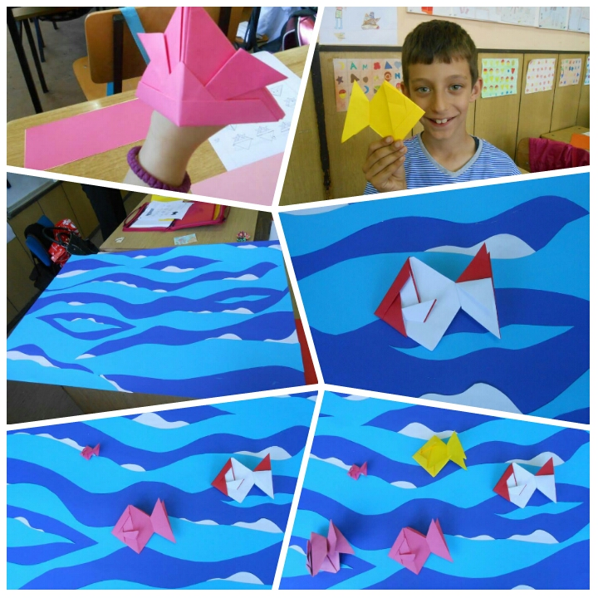
Animals
Serbia - Jagodina

Slide 14
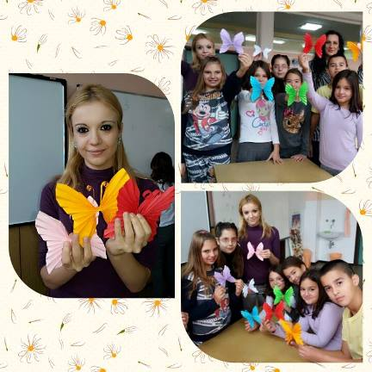
Animals

Slide 15
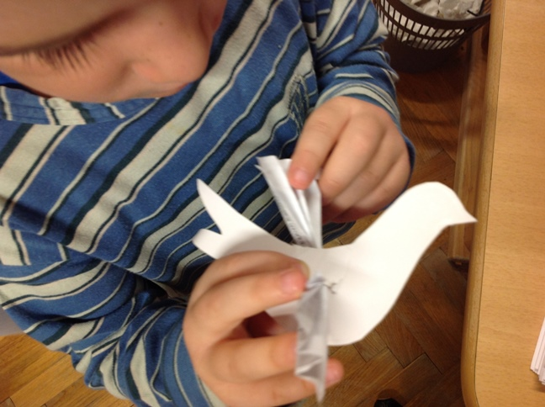
Animals
Serbia - Subotica

Slide 16
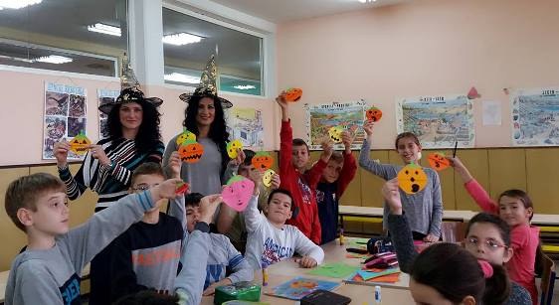
An idea more…
Halloween

Slide 17
Origami Magic
All works - photographs and video presentations are presented on the project pages. Project Journal is filled with interesting and nice comments of teachers and pupils.
Tulin from Turkey showed a lot of interesting video presentations.

Slide 18
Origami Magic
In the second half of November we can start creating origami New Year and Christmas products (Christmas tree, Christmas tree ornaments, greeting cards, decorations...).

Slide 19
Origami Magic
During December we can exchange greeting cards (we have partner schools’ addresses). Sign up students who would like to participate in greetings exchange, a special page will be created for them. Prepare for a video conference in December. We’ll present most of origami products then and ​​ wish Merry Christmas and Happy New Year in all languages.

Slide 20
Origami Magic
Have a nice work!
Till next time,
Sanja, Daniela & Ana

