Slide 1
Swedish school system
Nikola Vargová, Simona Bilková
Gymnázium Ivana kupca hlohovec
Iv.B.

Slide 2
Basic information
Swedish compulsory schooling consists of four stages:
1. förskoleklass (‘preschool year’ or year 0)
2. lågstadiet (years 1–3)
3. mellanstadiet (years 4–6)
4. högstadiet (years 7–9)
Children between ages six and thirteen are also offered out-of-school care before and after school hours
Compulsory education also includes sameskolor (Sami schools) for children of the indigenous Sami people

Slide 3
Förskola (‘preschool year’)
Is open to children from 1 to 5 years of age.
The Swedish tradition of preschool emphasises the importance of play in a child’s development and learning
The interests and needs of children are also key components of their education in the preschool curriculum
Gender-aware education is increasingly common in Swedish preschools
The aim is for children to have the same opportunities in life, regardless of gender

Slide 4
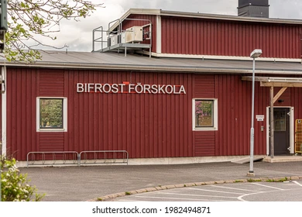

Slide 5
Förskoleklass (KINDERGARTEN)
All children are offered a place in kindergarten starting in the Autumn term of the year they turn 6 until they start compulsory schooling
Kindergarten is designed to stimulate each child’s development and learning, and provide a platform for their future schooling

Slide 6
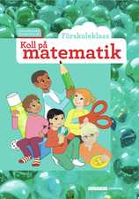

Slide 7
Compulsory schooling
This comprises of Elementary school (lågstadiet) for years 1–3 is followed by middle school (mellanstadiet) for years 4–6 and then junior high school (högstadiet) for years 7–9
These schools are either municipally run or publicly funded schools ‘free schools’ or there are boarding schools known as ‘private schools’, which are funded by privately paid tuition
There is a concerted effort to streamline education, as all students at primary school level take the same limited subject groups
Critics claim it has lowered results significantly among talented students without raising them within other groups
A community where a private school offers its services must support it with the same amount of money, or vouchers, per student that it provides to public schools
The amount of financing per student is the same, and schools that receive vouchers cannot charge additional fees

Slide 8
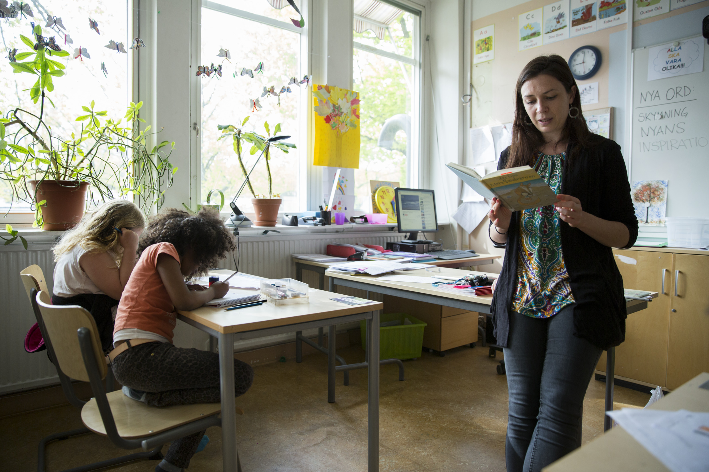

Slide 9
AFTER COMPULSORY SCHOOL
Senior high school (gymnasium) is optional and free of charge
Senior high school programs run for three years
To be accepted into a national program, students must have passing grades in Swedish or Swedish as a second language, English and Maths
For senior high school, students require passing grades in nine additional subjects, for a total of twelve
For a vocational program, students must have passing grades in five additional subjects, for a total of eight
As all education is publicly funded, all students have a large selection of choices
This prevents limiting choices for those with a less fortunate background

Slide 10
Right to choose
Interestingly, Sweden have a school choice arrangements where you are able to choose any other state school or a private school at no cost to yourself
If your child doesn’t like their school, it can easily be changed

Slide 11
Individualised model
These schools are deliberately different from the state school model
Kunskapsskolan’s ethos is perhaps surprising to British visitors who expect independent schools to be more traditional than their state equivalent
The Kunskapsskolan at Kista is the opposite: no uniform, very informal discipline and teaching, an open-plan layout, and an emphasis on individualised learning rather than formal classes
The students negotiate their own timetable each week and can do as few, or as many, formal classes as they wish
There is a heavy emphasis on internet-based learning and there are remarkably few books

Slide 12
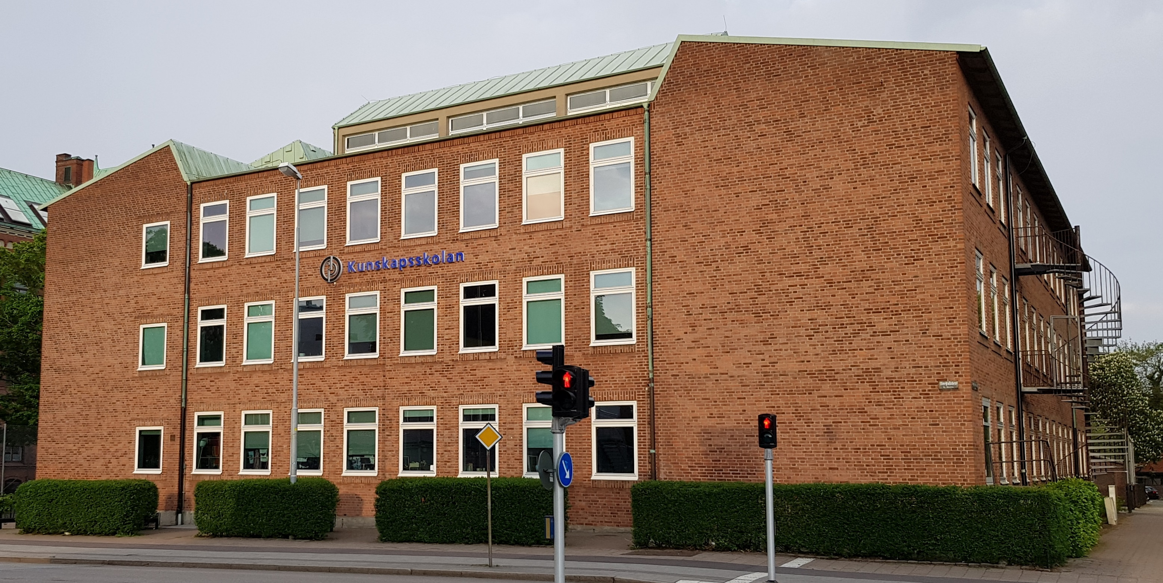

Slide 13
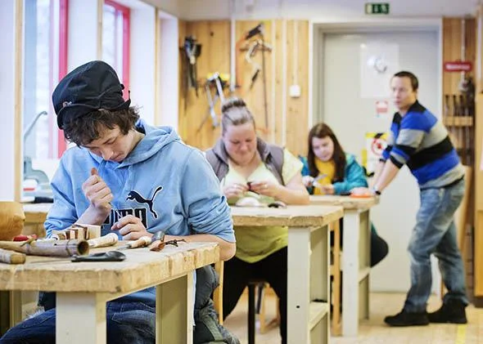
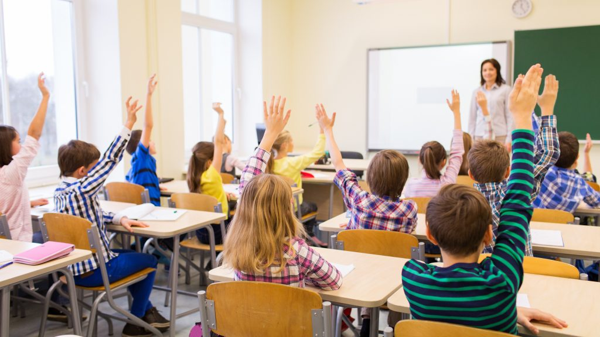
Why do Swedish children so well?
Educationalists talk about the whole system being less target-driven and more child-centred. Children start later and feel less pressured by external exams.

Slide 14
In general
Aged 1 to 5 – Pre-school provides all young children’s development needs of stimulation and adult supervision
Age 6 – This is when any child can attend a pre-school class, for a year in preparation for mandatory school
Age 7 to 16 – This is the mandatory period for all children to attend primary school. It consists of grade 1 to 9.
-It is compulsory that all pupils aged 12 to 15 learn and have classes in English, Swedish, foreign language, math, NO (physics, chemistry, biology, technology), SO (social studies, history, religion, geography), physical education, art, music, carpentry or sewing and home economics.

Slide 15
Age 16 to 19 – This is the time for upper secondary school, also known as the education of Gymnasieutbildning
-This is a tertiary school that teachs a pupil over three years. It is a type of university college
-These three years are designed to prepare the teenager for higher education or have vocational teachings
-When a student ha opted to do the vocational education, he or dhe must do at least 15 weeks workplace trainings as part of their studies
For 2 to 5 years – there may be attendance in higher education in undergraduate &graduate/master's level, at university colleges or universities
-This will enable the student to progress to postgraduate programmes at university (or university colleges permitted to do research in the studied field) in the doctorate level

Slide 16
Grading system
The grading system is A, B, C, D and E from highest to lowest passing grades.
F is awarded for failure.
In all Swedish education, from secondary to upper secondary school, a six-point grading system is used
Grade E has a value of 10, and the value of each grade over E increases by 2.5, so the highest value for a grade is 20.
Results that are not approved are given the grade F, which has a value of 0.

Slide 17
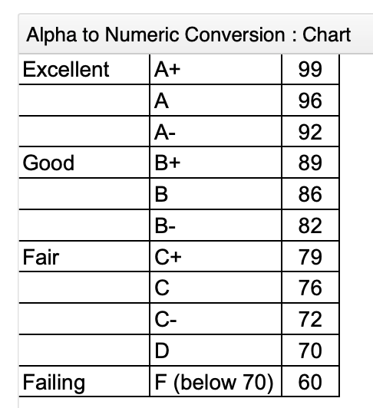

Slide 18
Examination
ACT (American College Test) ...
SAT (Scholastic Assessment Test) ...
SAT Subject Tests. ...
CLT (Classic Learning Test) ...
AP Test (Advanced Placement Test) ...
TOEFL (Test of English as a Foreign Language) ...
GED (General Education Development)

Slide 19
The main college entrance exams are the ACT and the SAT
The CLT is a newer alternative that is accepted by a small number of colleges
Colleges and universities, especially highly selective schools, may also require SAT Subject Tests
An examination (called tentamen or "tenta" in Swedish) is a test you take at the end of a university course
This test can be written or oral
Your examination will be returned to you after your teacher has graded it

Slide 20
Only Swedish and Mathematics have national tests in year 3.
The results from the tests are not used for grading, as students do not receive grades before year 6.
In grade 6 and 9 there are tests for all three core subjects Swedish, Mathematics and English.
These tests consist of both oral and written components
Forms of examination:
1. Written examination (Salstentamen)
2. Take-home examination (Hemtentamen)
3. Oral examination (Muntlig tentamen)

Slide 21
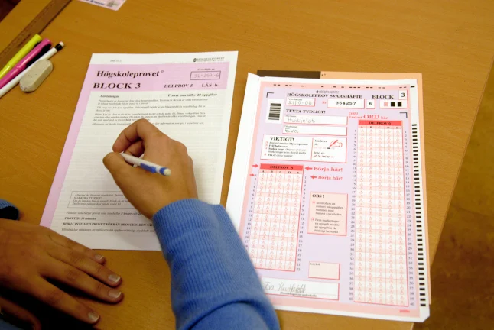
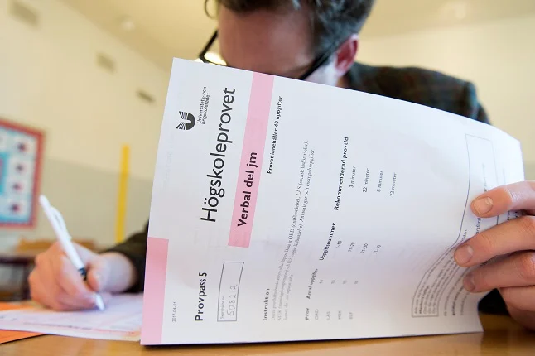
5. Written assignment (Inlämningsuppgift)
6. Memorandum (Promemoria, PM)
7. Laboratory session (Laboration)
8. Group work (Grupparbete)
9. Academic paper (Uppsats)

Slide 22
Subjects
In the Swedish compulsory school each student take 16 compulsory subjects which are, sorted by time allocated: Swedish, Mathematics, Physical Education, English, Handicrafts, Music, Visual arts, Technology, Physics, Chemistry, Biology, History, Social Studies, Religion, Geography and Home Economics
All of these subjects are taken in all three school stages, lower stage (grades 1–3), middle stage (grade 4–6), and upper stage (grades 7–9)
In sixth grade students can also choose a non-compulsory foreign language course
Shools have to offer 3 of the languages Spanish, French, and German
Many schools also offer additional help in the core subjects English and Swedish instead of the language course

Slide 23
School week
Normally, students between the ages of 12–15 would be in school somewhere between 8–9am to 2–4pm, including time for lunch and short breaks.
Each class would be around 1hr and you would study the core subjects (math, Swedish, English) roughly 4 times a week.
Aside from those, students would study arts, crafts, religion, civics, geography, biology, etc - basically all subjects available, providing a broad education which emphasizes reasoning skills, team work and writing rather than in-depth knowledge.

Slide 24
Final exams
Final exams are not taken at the end of the term but students take them at the end of each course
So basically they do not have final exams

Slide 25
Sources
https://www.simplylearningtuition.co.uk/advice-for-parents/everything-you-need-to-know-about-the-swedish-education-system/?fbclid=IwAR26GLoZmzX3huxrB4TDaI_Dwv_LqWO2U1ApxrG6sTAVsPSu65B3U3e73IQ
https://sweden.se/life/society/the-swedish-school-system
https://www.sidmartinbio.org/what-age-do-you-go-to-school-in-sweden/
https://www.sweden.org.za/education-in-sweden.html?fbclid=IwAR2ZM9lFxAx5-CdDwr73N476B1Dj2VwHmGvkKttSky9pb89sMNORhbNZsxI
https://www.up.edu/ready-for-college/college-entrance-exams-tests.html
https://en.wikipedia.org/wiki/Education_in_Sweden?fbclid=IwAR2YDgkBP2Ekc8RmEwfAczsQRayAIr5lRir7tPvr7F3Wvd2FzSk_E5sWzn4#Subjects
https://www.quora.com/What-does-the-school-week-look-like-in-Sweden

Slide 26
Thank you for your attention!

