Slide 1
DANISH SCHOOL SYSTEM
Kristína Drgoňová, Tatiana Šuchová
IV.B

Slide 2
General knowledge
Denmark's education system comprises of both public and private schools.
The educational approach in Denmark avoids class rankings and formal tests.
Children work in groups and are taught to challenge the established way of doing things.
The emphasis is on problem-solving, not memorization.
Teachers are called by their first names. (Danish custom, representative of their famously *egalitarian society)
*all individuals are born equal, and all members of society are said to have a right to equal opportunities.

Slide 3
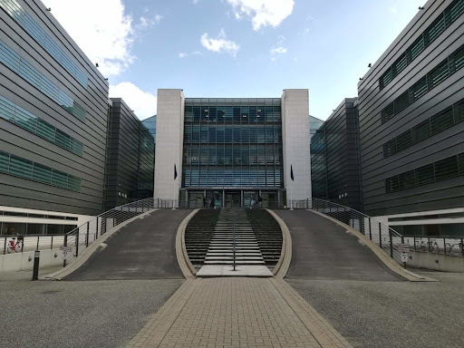
General knowledge
The education system in Denmark is one of the best in the world
The study is state-funded and free
Possible completion at more than 200 different educational institutions
5 universities in Denmark
The Danish school system:
primary school
secondary school
higher education.
Compulsory school attendance is 9 to 10 years

Slide 4
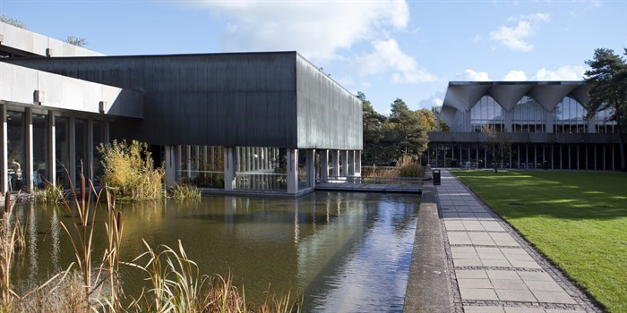
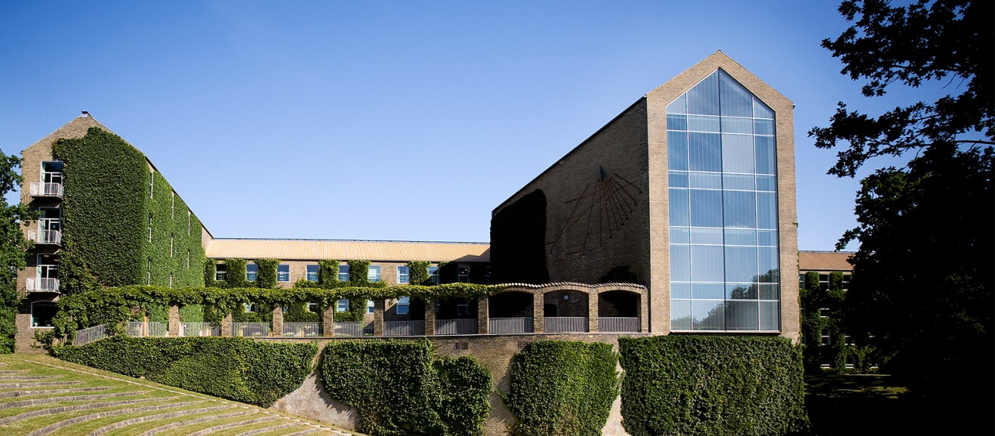
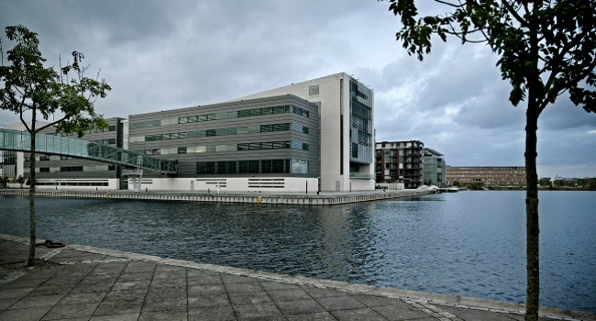
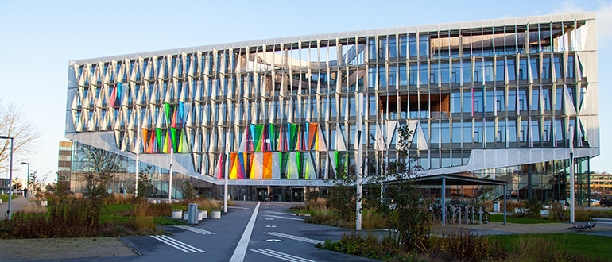

Slide 5
Free education
Higher education in Denmark is free for all Bachelor’s and Master’s students coming from the EU/EEA area and Switzerland, as well as for students participating in an exchange program
Up to 10% of all state expenditures flow from the state budget
You can also study for free in Denmark if:
You already have either a permanent or a temporary residence permit
One of your parents is from a non-EU/EEA country and works in Denmark
For non-EU/EEA citizens, tuition costs range between 6,000 – 16,000 EUR/academic year

Slide 6
Compulsory subjects
Danish- required level is A
History- required level is A
Mathematics- required level is B
English- required level is B
Second foreign language- required level is B or A
Physics- required level is C
PE and Sport- required level is C
An artistic subject- required level is C
Classical studies- required level is C
Religion- required level is C
Social Science- required level is C
Biology/Chemistry/Informatics- required level is C
Elective language: German, Spanishs

Slide 7
LEVELS explanation:
A-level: required time for the subject is 325 hours.
B-level: required time for the subjects is 200 hours.
C-level: required time for the subject is 75 hours.

Slide 8
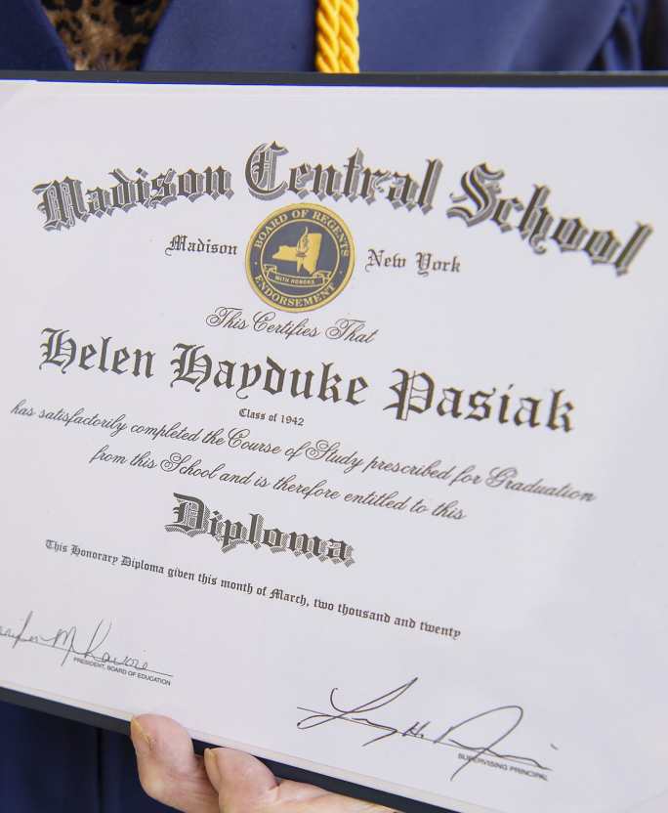
Entrance exams
The basic condition for admission to the bachelor's degree:
High school diploma education (12 years of schooling)
High school diploma-maturity
Danish equivalent maturity
Command of the language of instruction
Proof of knowledge of the English language
Danish is not compulsory!!
Very few programs require average in order to apply

Slide 9
Pupil/students assessment
Internal evaluation:
Continuous evaluation of the teaching and the students’ work.
Based on the evaluation the individual teacher has the possibility of adjusting the teaching so it is compatible with the students’ needs
The evaluation also provides a basis for a detailed guidance of the students with regard to their progress and academic level in the subject concerned.
General proficiency marks are given at least once every school year as a part of the continuous evaluation of the students.

Slide 10
Pupil/students assessment
External evaluation:
An evaluation of the individual student’s achievements in the subjects is made for external purposes. This is done in the following four forms of evaluation:
Marks for the year’s work,
Term marks,
Testimonials,
Examination marks.
Marks are based on the seven-point marking scale indicating the performance of the student. The grading scale is compatible with the European Train Control System grading scale (ETCS).

Slide 11
How many years of studying?
Education is for free (between ages 6 and 16).
Primary school is called ‘‘Folkeskolen‘‘.
9 years of study is compulsory .
10th year is voluntary. (‘‘Afterskole‘‘)
Ages:
primary and lower secondary: 7-15 years
10th grade: 16 years
Upper secondary: 16-19 years
Higher education: 19+ years

Slide 12
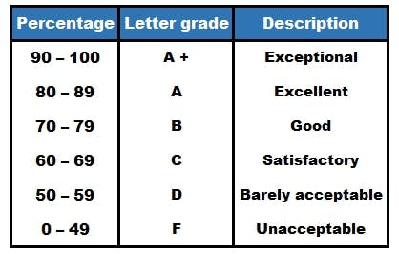
How many lessons?
Classes are daily at schools from Monday to Friday from 8:00 to 15:00
There are several shorter holidays during the school year
All subjects (except English) are taught in Danish
The school year lasts (similarly to our country) from the end of August to the beginning of June
Grading system:

Slide 13
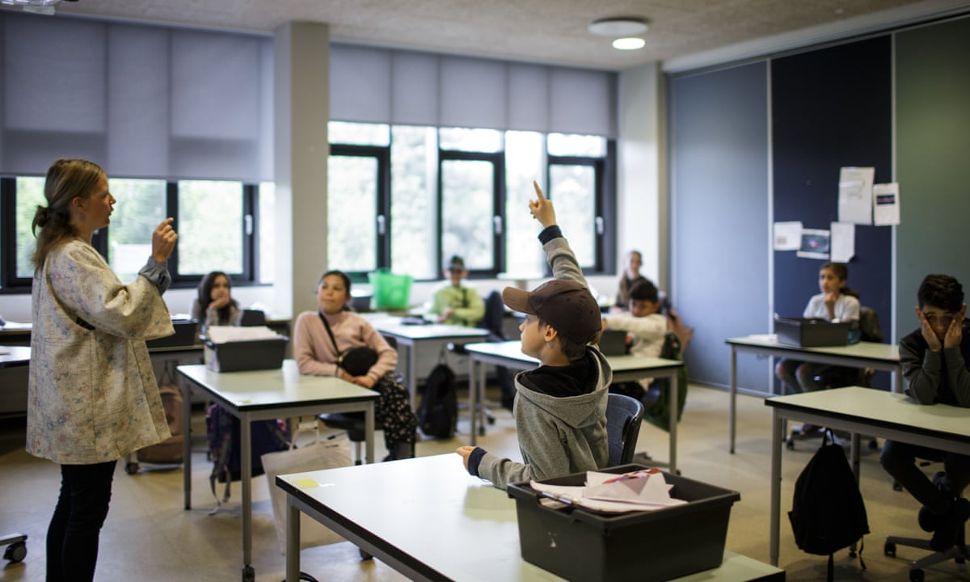
Schools emphasize the quality of study, so there are mostly fewer students in the classrooms
Teaching is in the form of discussion
In the first half of the lesson, the teacher explains the substance
In the second part of the lesson, the teacher gives you a few examples, on which you immediately repeats the course
There is „problem oriented" system taught → focus on practical issues and teamwork
Teachers are often consultants on a given issue in real life and therefore their experience greatly improves the whole study process

Slide 14
Sources:
https://en.wikipedia.org/wiki/Danish_Folkeskole_Education
https://eacea.ec.europa.eu/national-policies/eurydice/content/assessment-general-upper-secondary-education-12_en
https://eacea.ec.europa.eu/national-policies/eurydice/content/teaching-and-learning-general-upper-secondary-education-12_en
https://denmark.dk/society-and-business/lifelong-education
https://en.wikipedia.org/wiki/Danish_Folkeskole_Education
https://www.internations.org/go/moving-to-denmark/education
https://eng.uvm.dk/primary-and-lower-secondary-education/the-folkeskole/examinations-and-other-forms-of-assessment
https://www.dadteam.sk/studium-v-zahranici-studium-na-strednych-skolach/dansko/
https://www.mastersportal.com/articles/342/study-in-denmark-tuition-fees-and-living-costs.html
https://scandinavianstudy.sk/studium-v-dansku/odbory/

Slide 15
Thank you for your attention!

