Slide 1
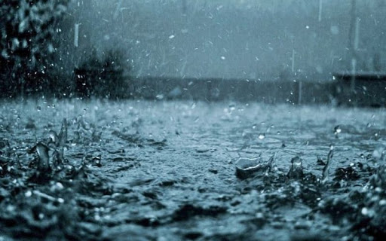
Globas water day

Slide 2
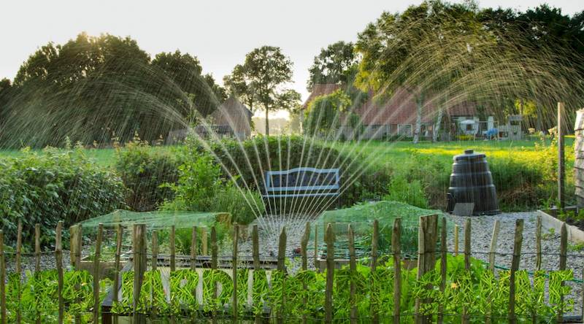
Where rainwater can be used:
Rainwater can be caught by watering the gardens

Slide 3
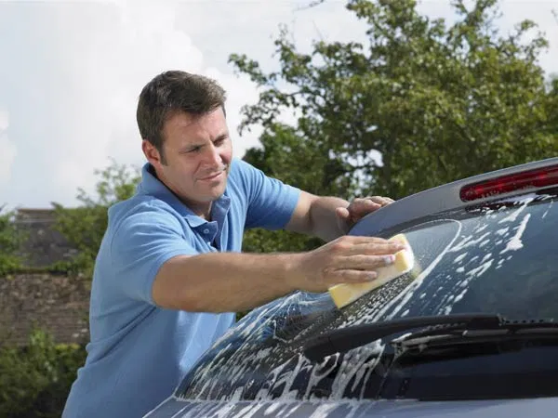
Rainwater can be used for car washing

Slide 4
Rainwater can be used to wash clothes

Slide 5
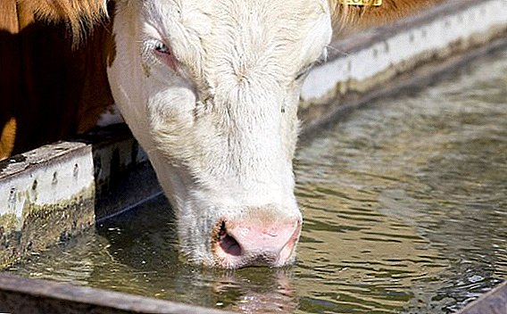
Rainwater can be used to drink cattle

Slide 6
Rainwater can be used to wash dishes

Slide 7
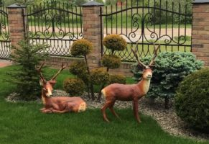
Rainwater can be used to wash outdoor decorations

Slide 8
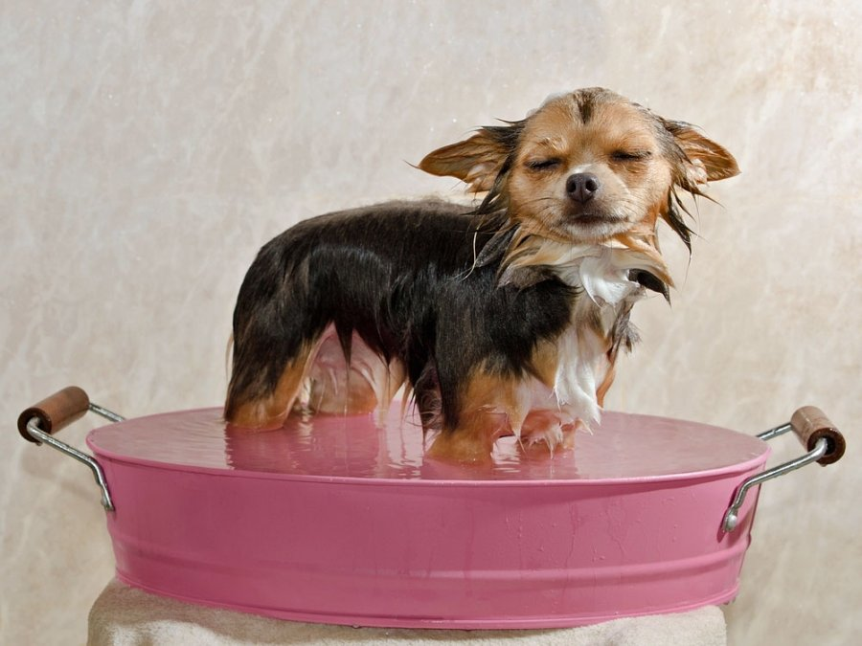
Rainwater can be used to wash animals

Slide 9
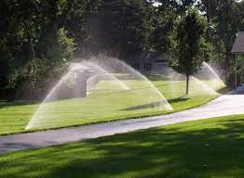
Rainwater can be used to irrigate lawns

Slide 10
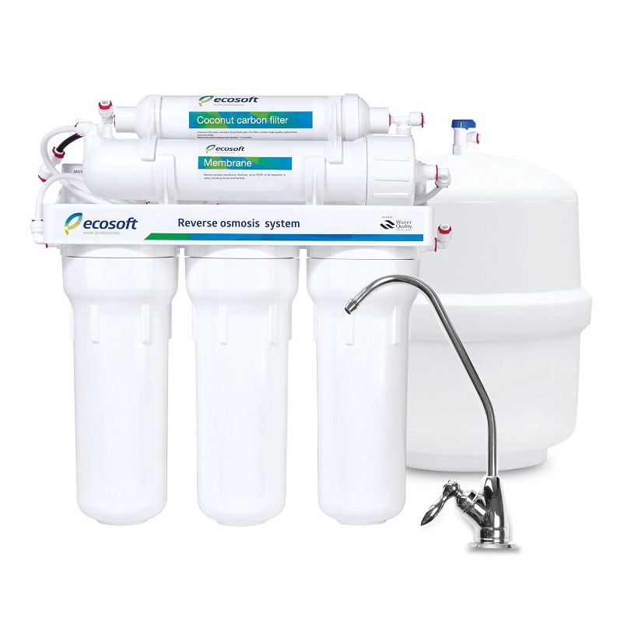
Rainwater can be filtered and can be drinking water

Slide 11
Rainwater can be used to wash stairs

Slide 12
Thanks for your attention

