Slide 1
Norway education system
Ninka Botková, Adela Hlavnová

Slide 2
Basic information
education in Norway is mandatory for children between years 6 and 16
the school year runs from August until June
the school year is divided into two terms
an average day of Norwegian high school varies between being six, seven or eight hours
students stay in the same classroom most of the time and the teachers change classrooms
at the beginning of high school in Norway students get computers from the school which they can use for school work, but also other stuff like checking facebook

Slide 3
School system
The Norwegian school system can be divided into four parts:
Kindergartens (up to the age of 5 years )*
Elementary school (Barneskole, ages 6–13)
Lower secondary school (Ungdomsskole, ages 13–16)
Upper secondary school (Videregående skole, ages 16–19)
- in primary and lower secondary school pupils have one shared curriculum
-upper secondary brings greater freedom of choice – between so-called vocational subjects and specialising in general studies.
*All public education in Norway is free of charge, while kindergartens have parental fees.

Slide 4
Curriculum-compulsory subjects
1.Norwegian
2.Mathematics
3..Natural Science
4.English
5.Social Science
6.Geography
7.History
8.Religion and Ethics
9.Physical Education
-all subjects are for Grades 1 to 13

Slide 5
Curriculum-voluntary(elective) subjects
-it differs from school to school
Music
Dance
Drama
Media
Communication
Arts
Design
Architecture
Information Technology
Technology and Research

Slide 6
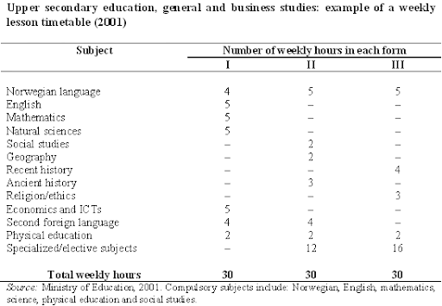

Slide 7
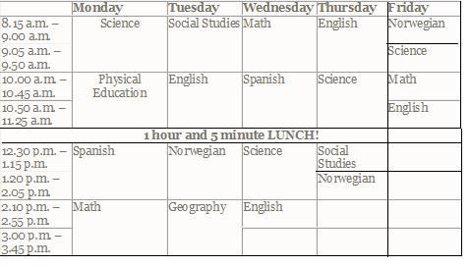
Example of schedule

Slide 8
Final exams
In general studies leading to higher education:
1.written examinations in Norwegian=compulsory
2.at least two written examinations = at least two other elective subjects
examinations are made by the Directorate for Education and Training and assessed by examiners appointed by the Directorate
the Overall Achievement grades given in each subject by the teachers at the end of Year 3 of upper secondary education are added to the Examination grades the pupil has received in the subjects that he/she has been examined in. They are used as a basis for applying for entry to higher education institutions.

Slide 9
Random selection of pupils and exams
The selection of candidates by the counties entails that pupils are distributed for examination. As a rule, this is based on the random selection following a principle of randomization.

Slide 10
Universities
with the exception of some private universities, all higher education institutions are state-run
since 2003 Norway has been following the objectives of the Bologna process in the European higher education
the academic year normally runs from mid-August to mid-June
public education is free
academic year is divided into two semesters

Slide 11
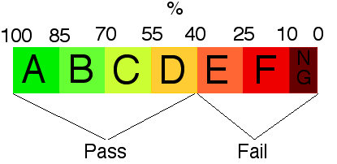
Grading system
According to the ECT-system the grading are given according to scale of six grades, ranging from an A to F, with A being the best and E the worst passing grade. F is a fail.
A normal study progression awards 60 credits (stp) per year (30 per semester), most institutions either use a 7.5 or a 10 credit block system
Examinations are usually held every semester, in December and June

Slide 12
Entrance exams for universities
Norwegian,written and oral exam from third year level in Norwegian upper secondary school
Test in Norwegian - advanced level(Test i norsk - høyere nivå) with a minimum score of “pass” (bestått) in both the written and the oral test
Norwegian for International Students, Level 3 at the universities
1-year course in Norwegian Language (60 ECTS) at Norwegian universities or university colleges
Norwegian Language test for adult immigrants from Kompetanse Norge with the result B2 or C1 in all the four diciplines

Slide 13
University school system
The national higher education system is in accordance with the Bologna process:
bachelor's degree/first cycle - three years
master's degree/second cycle - two years
doctoral degree/third cycle - three years

Slide 14
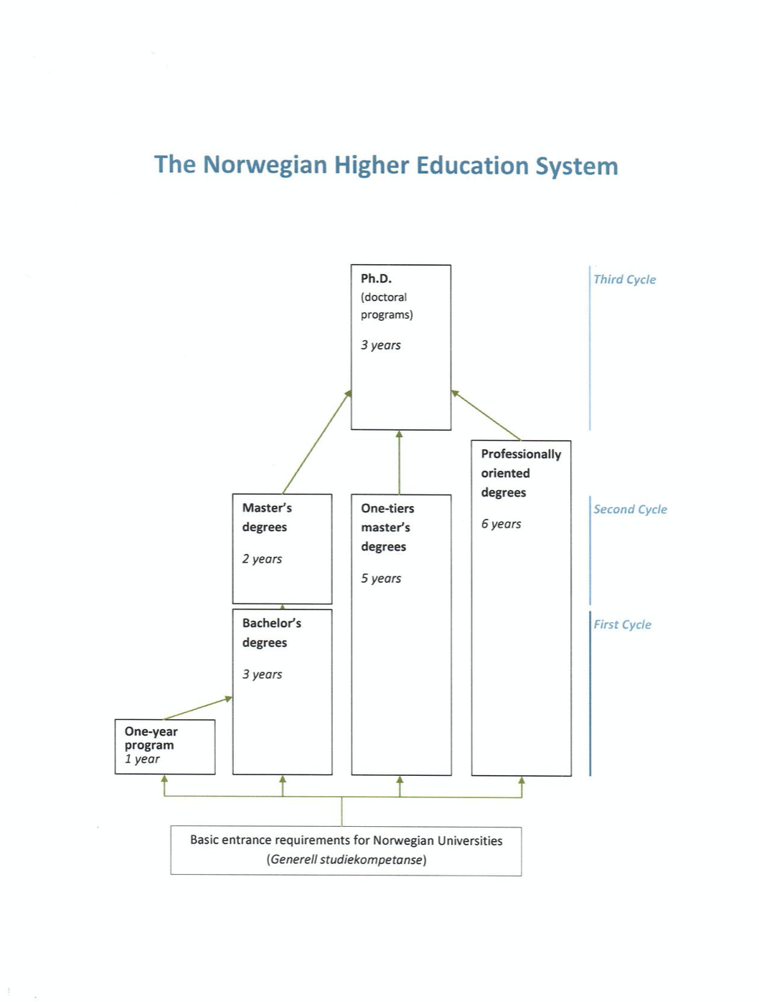

Slide 15
Thank you for your attention

