Slide 1
LATVIA
by Gabija Peciulevičiūtė, Akvilė Graužlytė

Slide 2
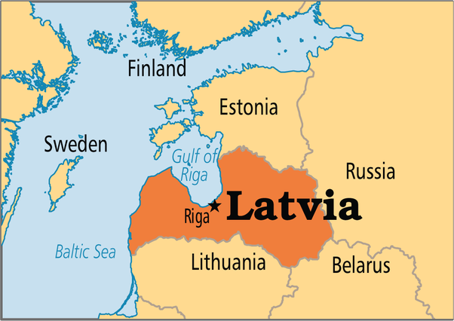
LATVIA
Latvia is one of the three Baltic States in northern Europe. There national language is Latvian and the capital of the country is Riga.

Slide 3
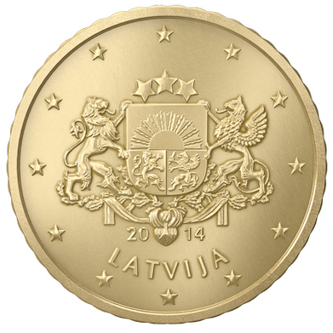
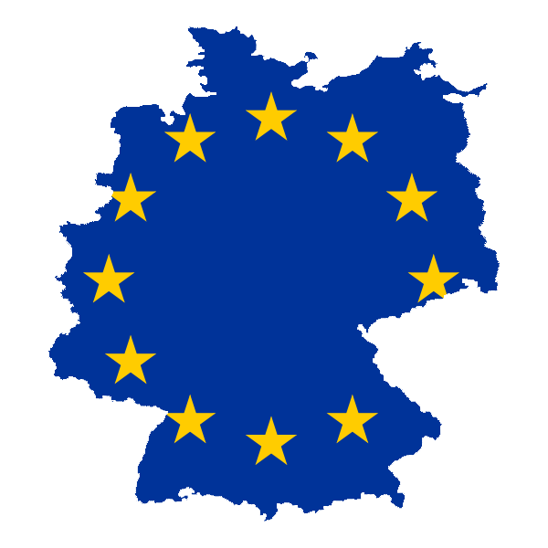
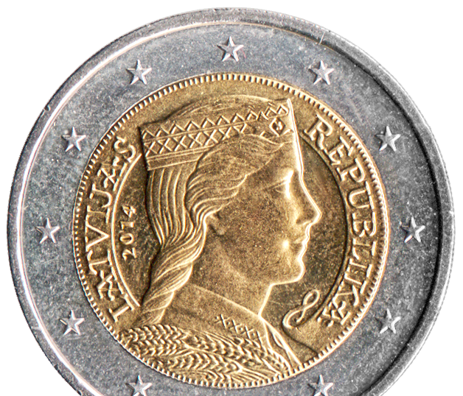
LATVIA IN THE EUROPEAN UNION
A member of the European Union, Latvia became on 4 May 2004.
Since 1 January 2014, Latvia uses the euro as its currency. An image of a woman in a traditional Latvian folk costume usually appears on its 1 or 2 euro coins.

Slide 4
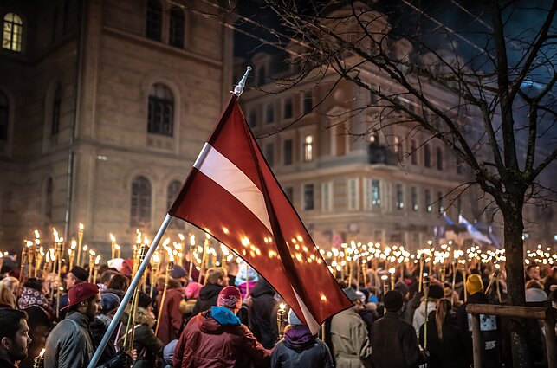
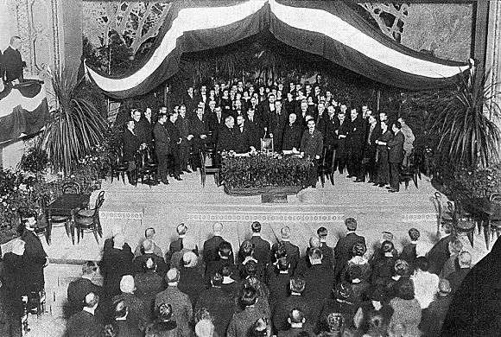
LATVIA's INDEPENDENCE
Since 1915 Latvia was occupied by both Germany and Russia. 1918 November 18 The Latvian People's Council declared the independence of the Republic of Latvia.
Latvia's independence by Germany was recognized after a week and by Russia only on April 11, 1920. This independence lasted until 1939 Ribentrop-Molotov Pact.
The restoration of Latvia's independence was announced again in 1991 August 21.

Slide 5
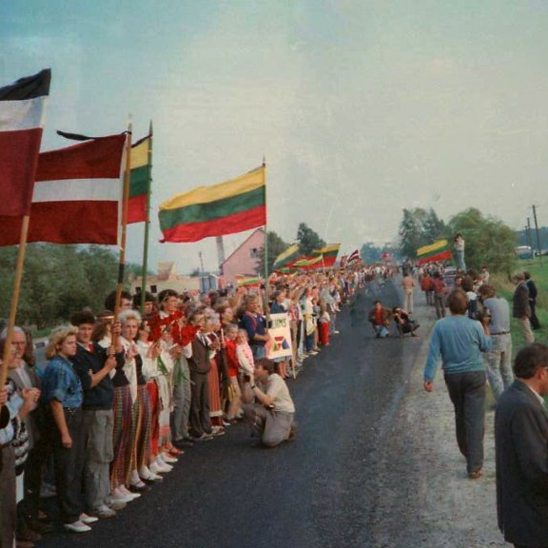
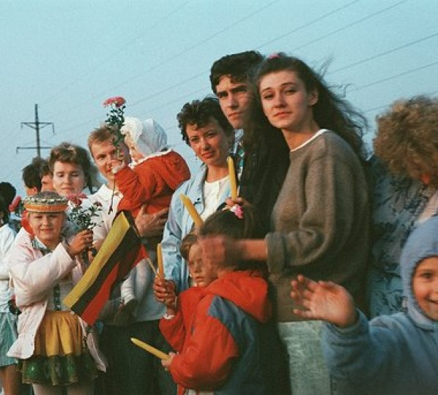
BALTIC WAY
Baltic way was a peaceful political demonstration that occurred on 23 August 1989. Approximately two million people joined their hands to form a human chain spanning 675.5 kilometres (419.7 mi) across the three Baltic states – Estonia, Latvia, and Lithuania, which were considered at the time to be constituent republics of the Soviet Union.

Slide 6
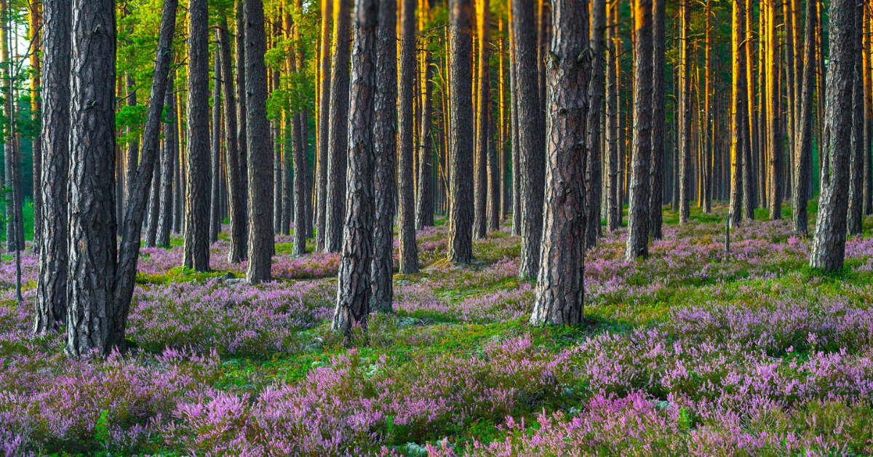
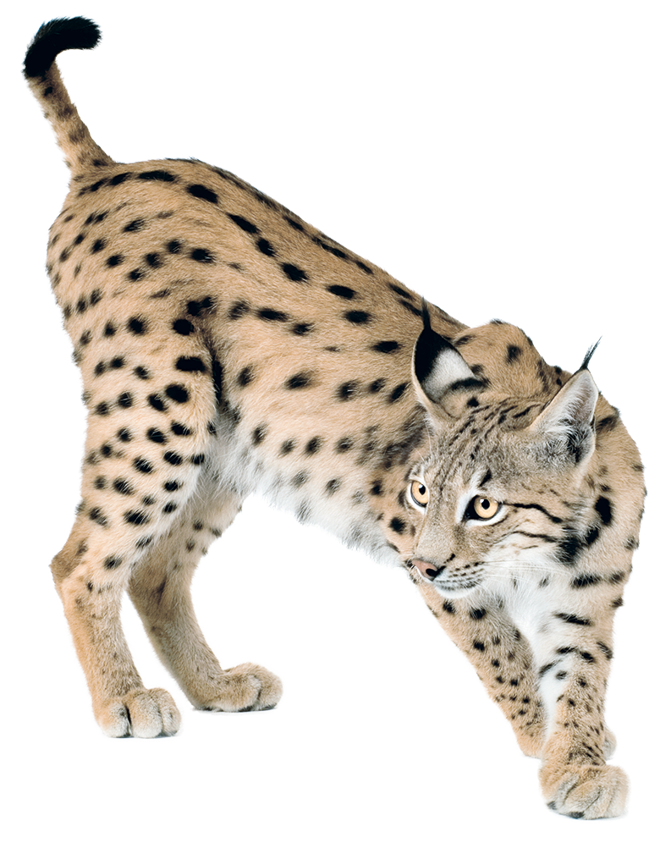
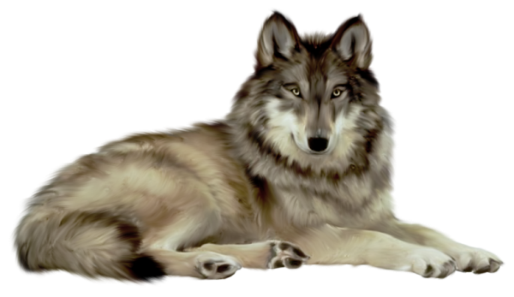
Nature
Latvia is a very flat and low-lying country with many forests, pastures and long sandy beaches. The country counts over 12 000 rivers and 3 000 lakes! 20% of its territory is protected, which makes Latvia a safe haven for many animals such as lynxes and wolves.

Slide 7
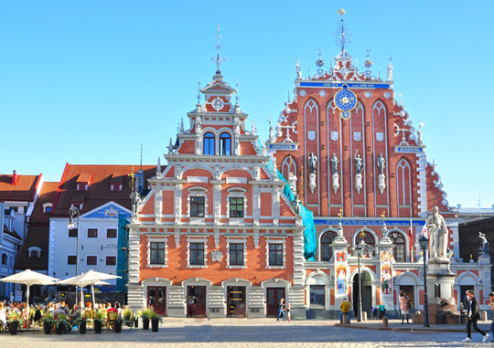
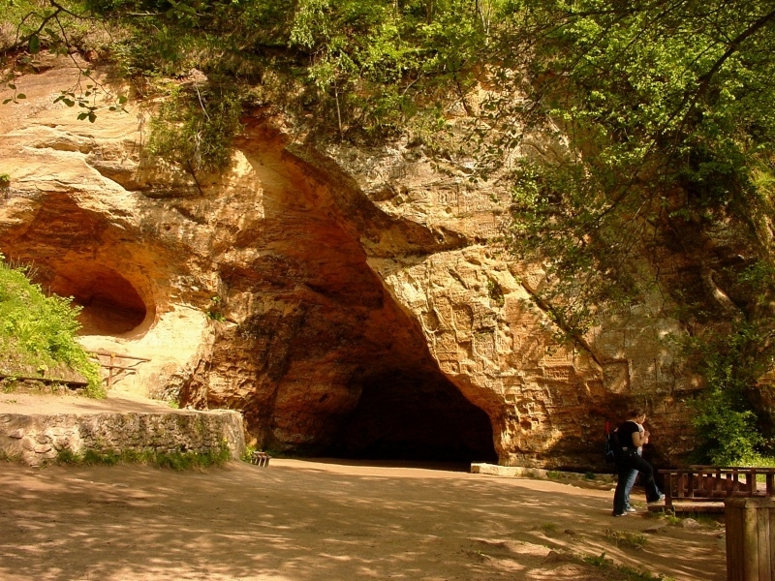
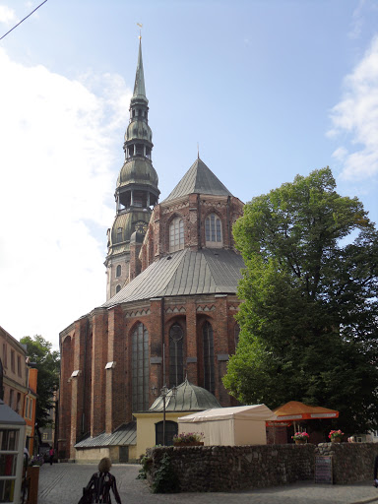
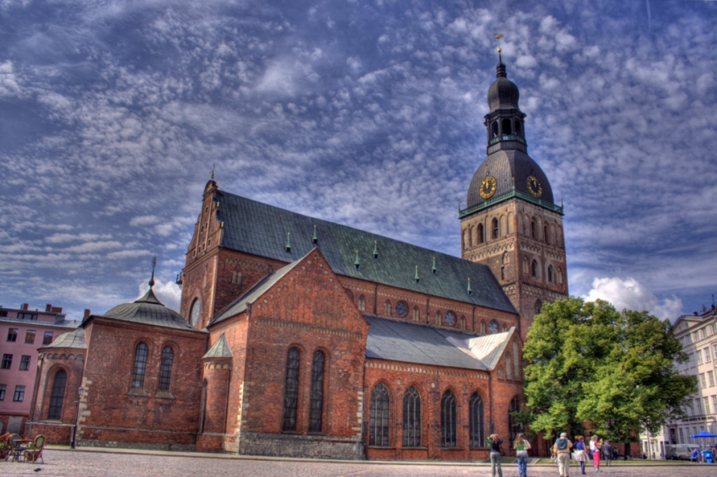
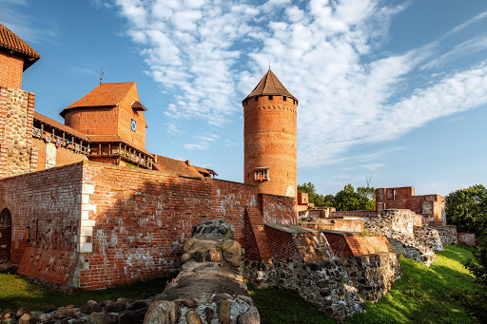
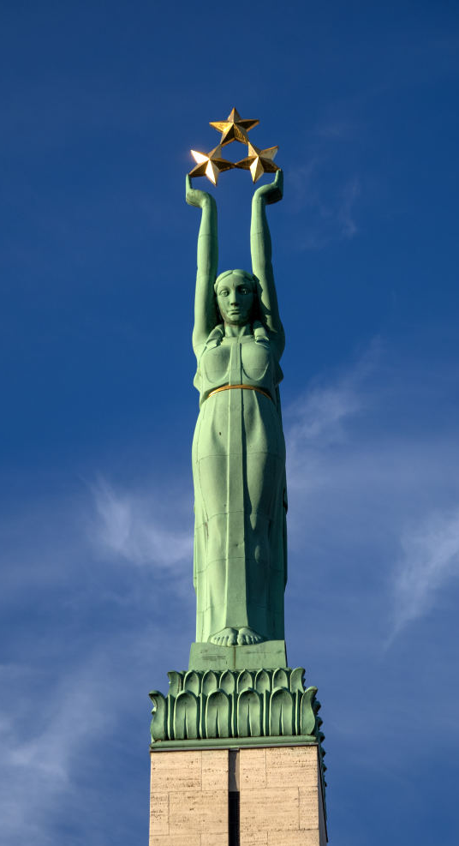
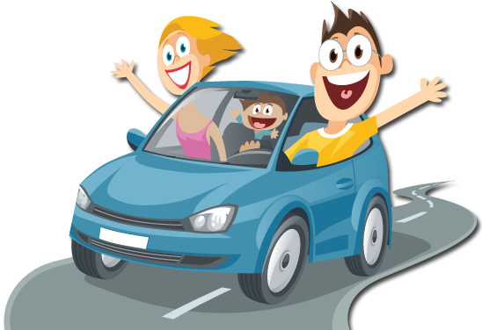
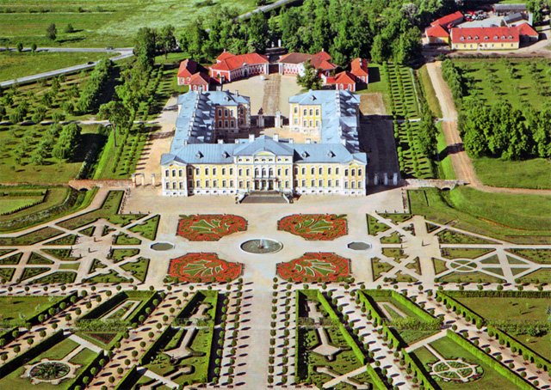
Popular places in Latvia
House of the Black Heads
Rundale palace
Freedom monument
St. Peters Church
Gauja National Park
Turaida Castle
Riga Cathedral
Riga Castle
Latvian National Ophera
Jurmala
TV Tower

Slide 8
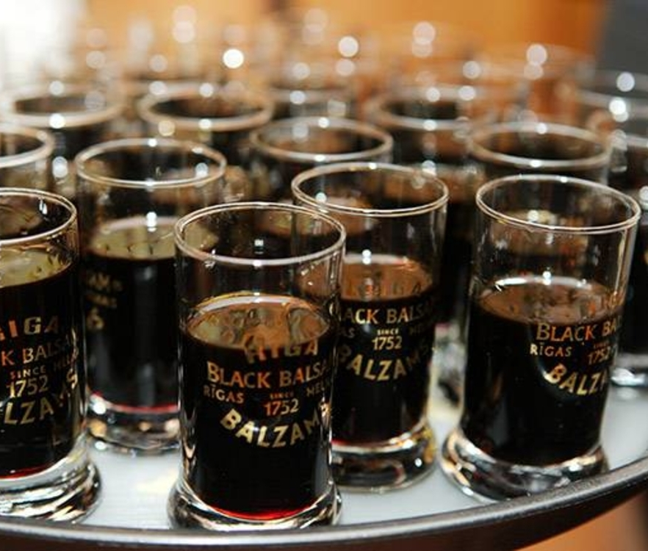
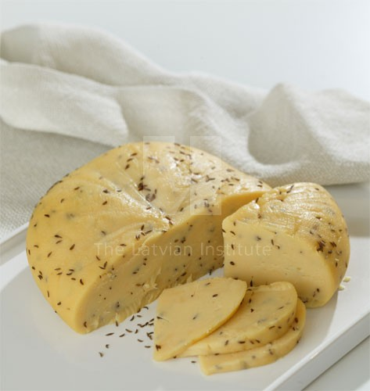
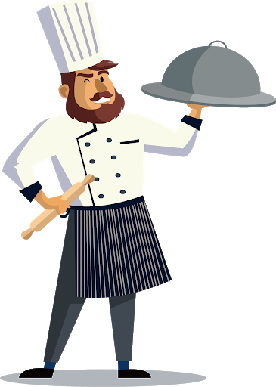
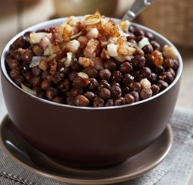
Cuisine
Typical Latvian dishes include the eternal classic of Latvian cuisine Grey Peas with Bacon and Caraway Cheese. For dessert, Latvians enjoy Layered Rye Bread Dessert.
Riga Black Balsam is a traditional Latvian balsam made using a single-barrel infusion technology.

Slide 9
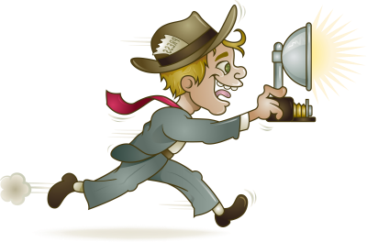
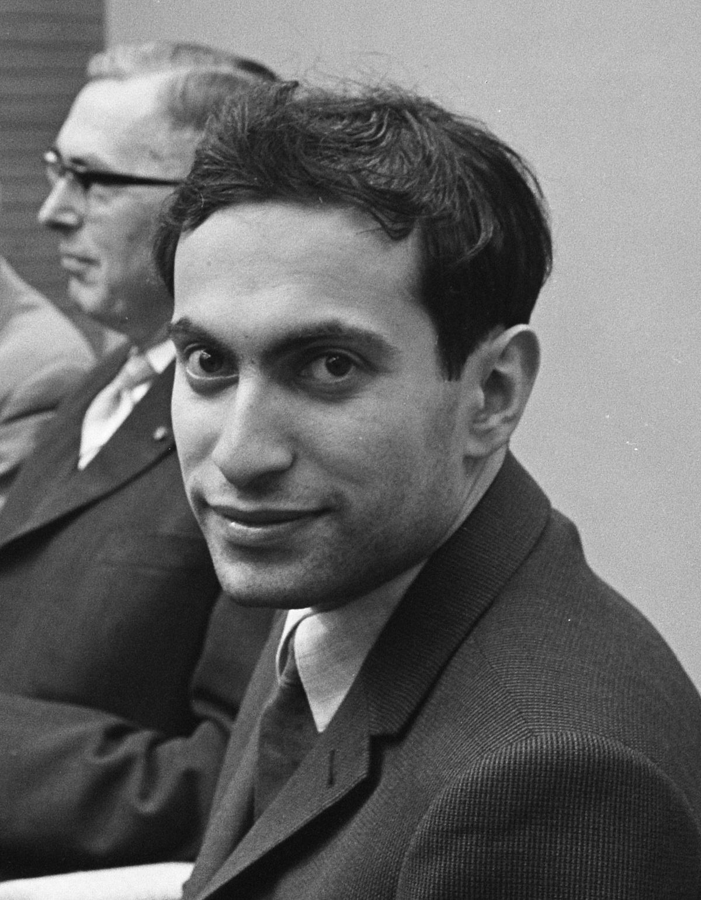
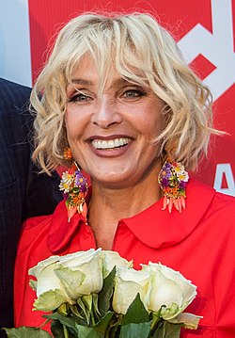
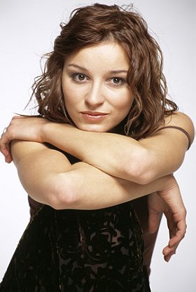
FAMOUS PEOPLE
Mikhail Tal
Laima Vaikule
Ernests Gulbis
Marija Naumova

Slide 10
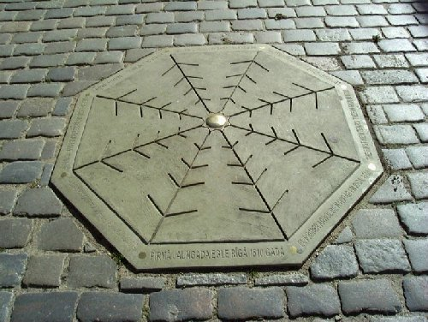
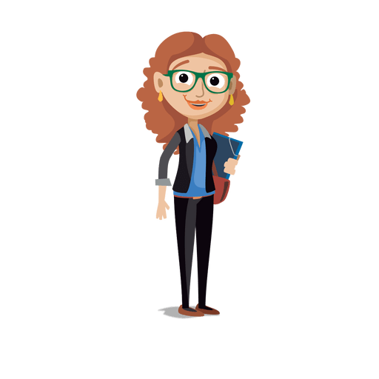
INTERESTING FACTS
The world's first ever decorated Christmas tree on record was put up in Riga's market square back in 1510.
Walter Zapp, a German from Latvia, invented the first mini camera in the world, the Minox, in 1936.
Latvia has one of the world's fastest internet networks! There are 800 free connection points in Riga.

Slide 11
THANKS FOR YOUR ATTENTION!

