Slide 1
System of education
in Finland
Hedviga Hlavnová IV.B

Slide 2
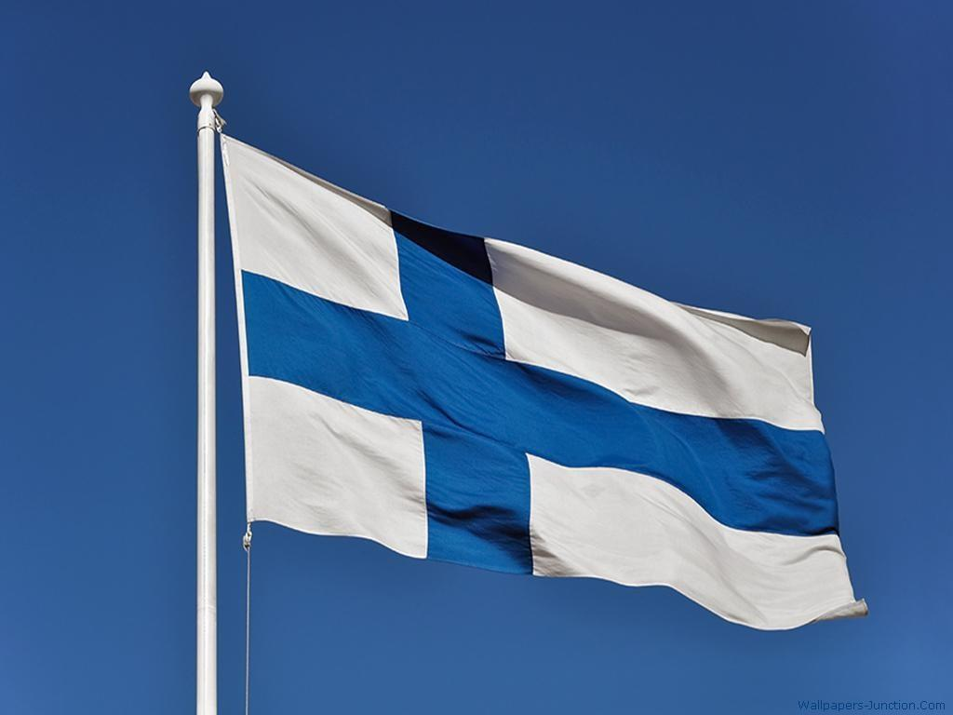
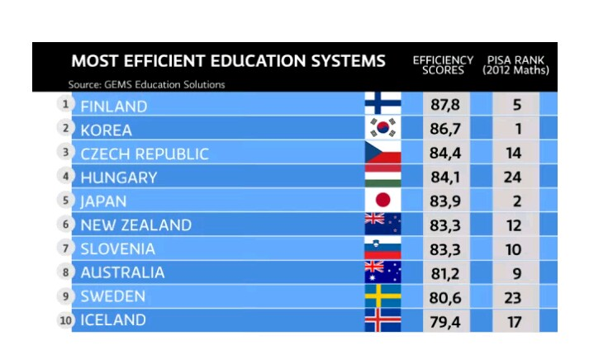
System of education
The educational system of Finland is considered to be one of the best in the world
The main line of the education system is its democratic character: equal opportunities to get an education for every resident in Finland
All foreigners of compulsory school age have the right to receive the same basic education as Finns

Slide 3
School system
The phenomenon of Finnish school education is that it allows children to study and squeeze less and, at the same time, increase their knowledge!
Check it out!
Finland's Formula for School Success (Education Everywhere Series) - YouTube

Slide 4
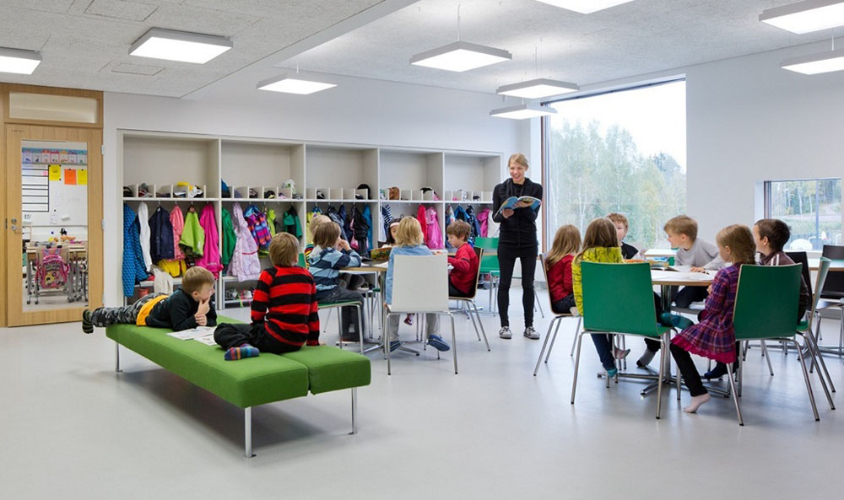
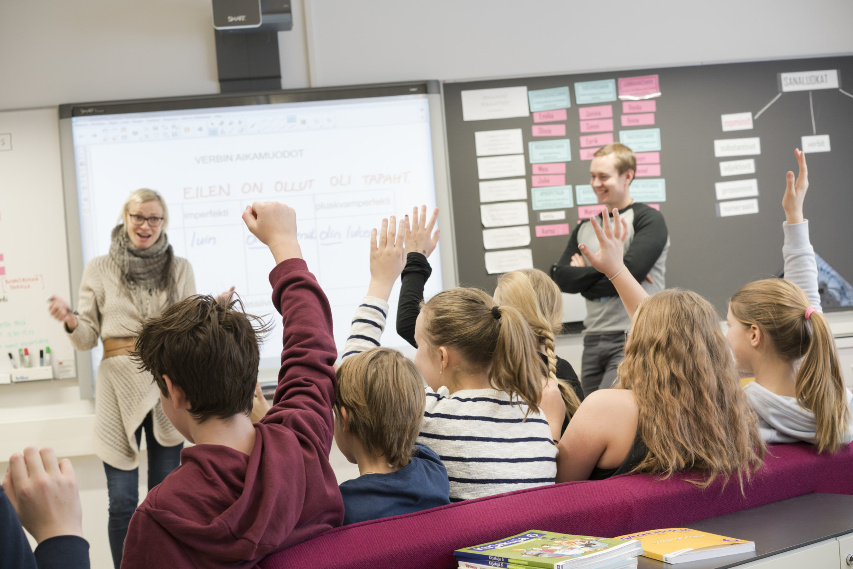
An educational approach is to prepare children for their future life, but not for exams
Classes are mainly focused on developing practical skills and there are no exams (the only exam they need to pass is the exam before university, taken at the age of 19)
The main principle of Finish education is respectful attitude and no punishments
There are no punishments even for the laziest students
Such attitude and approach require teachers to be the best professionals and, for sure, good psychologists

Slide 6
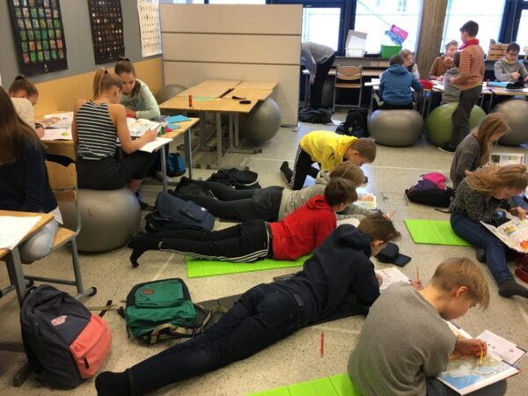
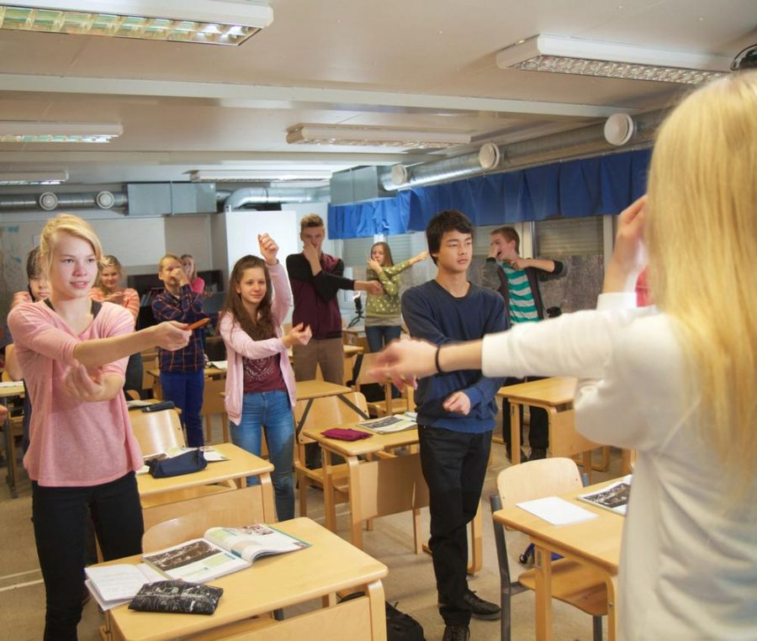
Secondary education
Finnish education has two tracks for secondary education: general upper secondary education and vocational education and training (from 16 to 19 years)
The general upper secondary education schools are for students who plan to attend university
The vocational education and training schools are for students who are transitioning to the workplace after finishing secondary education
Students in both tracks may take the national matriculation examination and attend university if their scores are competitive

Slide 7
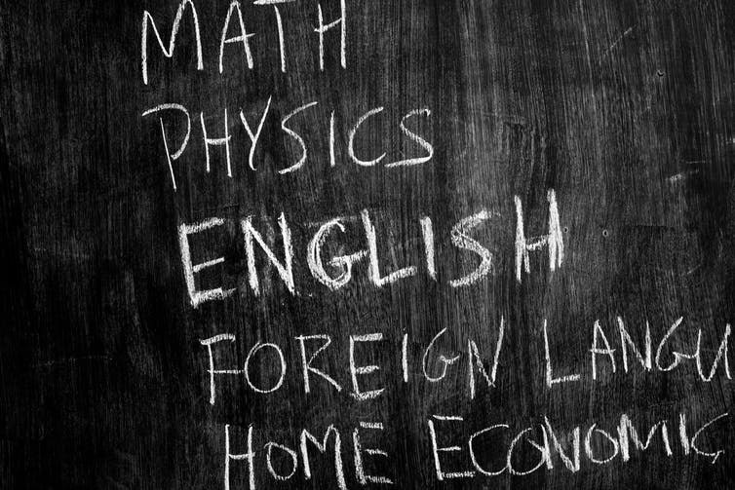
Curriculum - subjects
The curriculum is divided into compulsory, specialized, and applied courses
It consists of 38 lessons organized around the following subjects:
Mother tongue and literature (Finnish or other national language)
Foreign language, a second foreign language
Environmental studies
Civics
Religion or ethics
History
Social studies
Mathematics
Physics
Chemistry
Biology
Geography
PE
Music
Visual arts
Crafts
Home economics

Slide 8
School schedule
The syllabus for general upper secondary school comprises at least 75 courses (duration on average 38 hours) or, in the case of adult general upper secondary studies, at least 44 courses (duration on average 28 hours)
Lessons have different durations, depending on the difficulty of the subject and especially the effectiveness of learning
Every day, the duration of the subject changes, and the school schedule also includes several breaks after which students are fully focused on their studies
Difficulty levels are the same in all upper secondary schools
Even challenging subjects can be handled with easeness if an effective and inspiring way of learning them is found
Week school time in Finland is no more than 20 hours, no more than four hours in school a day + LB
Time | Mon | Tue | Wed | Thu | Fri
8:35- 9:05 | Breakfast in the Classroom | Breakfast in the Classroom | Breakfast in the Classroom | Breakfast in the Classroom | Breakfast in the Classroom
8:35- 9:05 | Flipped Classroom Language Arts Lesson | Flipped Classroom Language Arts Lesson | Flipped Classroom Language Arts Lesson | Flipped Classroom Math Lesson | Flipped Classroom Language Arts Lesson
9:05- 9:15 Brain Breaks | Music | Handicraft | Music | Handicraft | Music
9:15-10:15 | Language Arts Centers | Language Arts Centers | Language Arts Centers | Math | Language Arts Centers
10: 15-10:30 | Recess | Recess | Recess | Recess | Recess
10:30-11:05 | Math | Math | Math | Math | Language Arts
11:10-11:15 Brain Breaks | Dance | Dance | Dance | Dance | Dance
11:15-11:55 | Math | Math | Math | Computer Lab | Language arts
11:55-12:35 | Lunch and Recess | Lunch and Recess | Lunch and Recess | Lunch and Recess | Lunch and Recess
12:35-1:15 | Science | Science | STEAM | Science | Science Lab
1:15-1:30 | Recess | Recess | Recess | Recess | Recess
1:30-2:15 | Science | Science | STEAM | Early Out | Fun Friday
2:15-3:00 | Physical Education | Art | Library |  | Music
3:05 | Dismissal | Dismissal | Dismissal | Dismissal | Dismissal

Slide 9
Time | Mon | Tue | Wed | Thu | Fri
8:35- 9:05 | Breakfast in the Classroom | Breakfast in the Classroom | Breakfast in the Classroom | Breakfast in the Classroom | Breakfast in the Classroom
8:35- 9:05 | Flipped Classroom Language Arts Lesson | Flipped Classroom Language Arts Lesson | Flipped Classroom Language Arts Lesson | Flipped Classroom Math Lesson | Flipped Classroom Language Arts Lesson
9:05- 9:15 Brain Breaks | Music | Handicraft | Music | Handicraft | Music
9:15-10:15 | Language Arts Centers | Language Arts Centers | Language Arts Centers | Math | Language Arts Centers
10: 15-10:30 | Recess | Recess | Recess | Recess | Recess
10:30-11:05 | Math | Math | Math | Math | Language Arts
11:10-11:15 Brain Breaks | Dance | Dance | Dance | Dance | Dance
11:15-11:55 | Math | Math | Math | Computer Lab | Language arts
11:55-12:35 | Lunch and Recess | Lunch and Recess | Lunch and Recess | Lunch and Recess | Lunch and Recess
12:35-1:15 | Science | Science | STEAM | Science | Science Lab
1:15-1:30 | Recess | Recess | Recess | Recess | Recess
1:30-2:15 | Science | Science | STEAM | Early Out | Fun Friday
2:15-3:00 | Physical Education | Art | Library |  | Music
3:05 | Dismissal | Dismissal | Dismissal | Dismissal | Dismissal

Slide 10
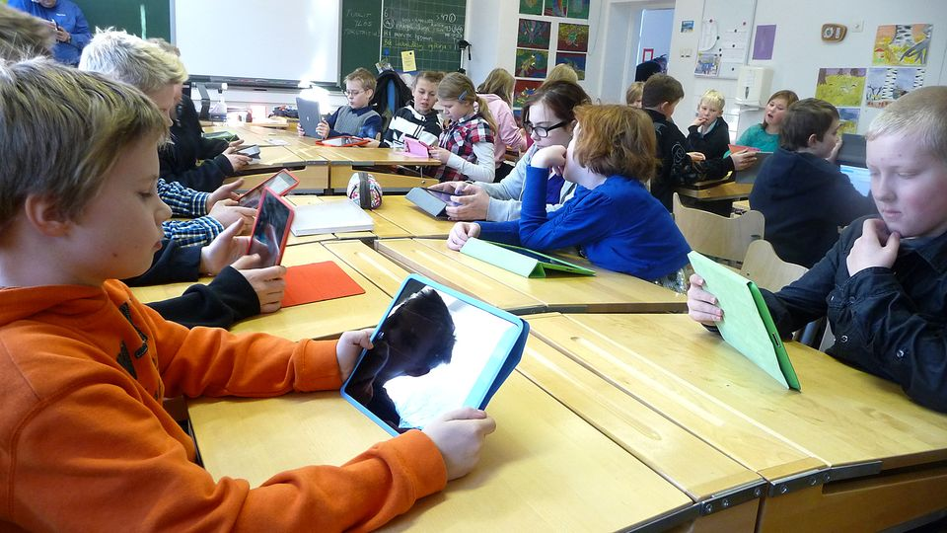
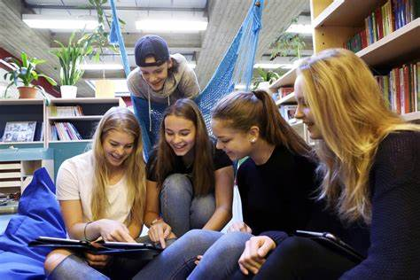
Years of study
Children in Finland do not go to school until the age of 7
Lower secondary education or basic education is compulsory and is subdivided into two parts:
junior general school (1-6 class) from 7 to 12 y.o
elder general school (7-9 class) from 13 to 15 y.o
general upper secondary education and vocational education and training (from 16 to 19 years)

Slide 11
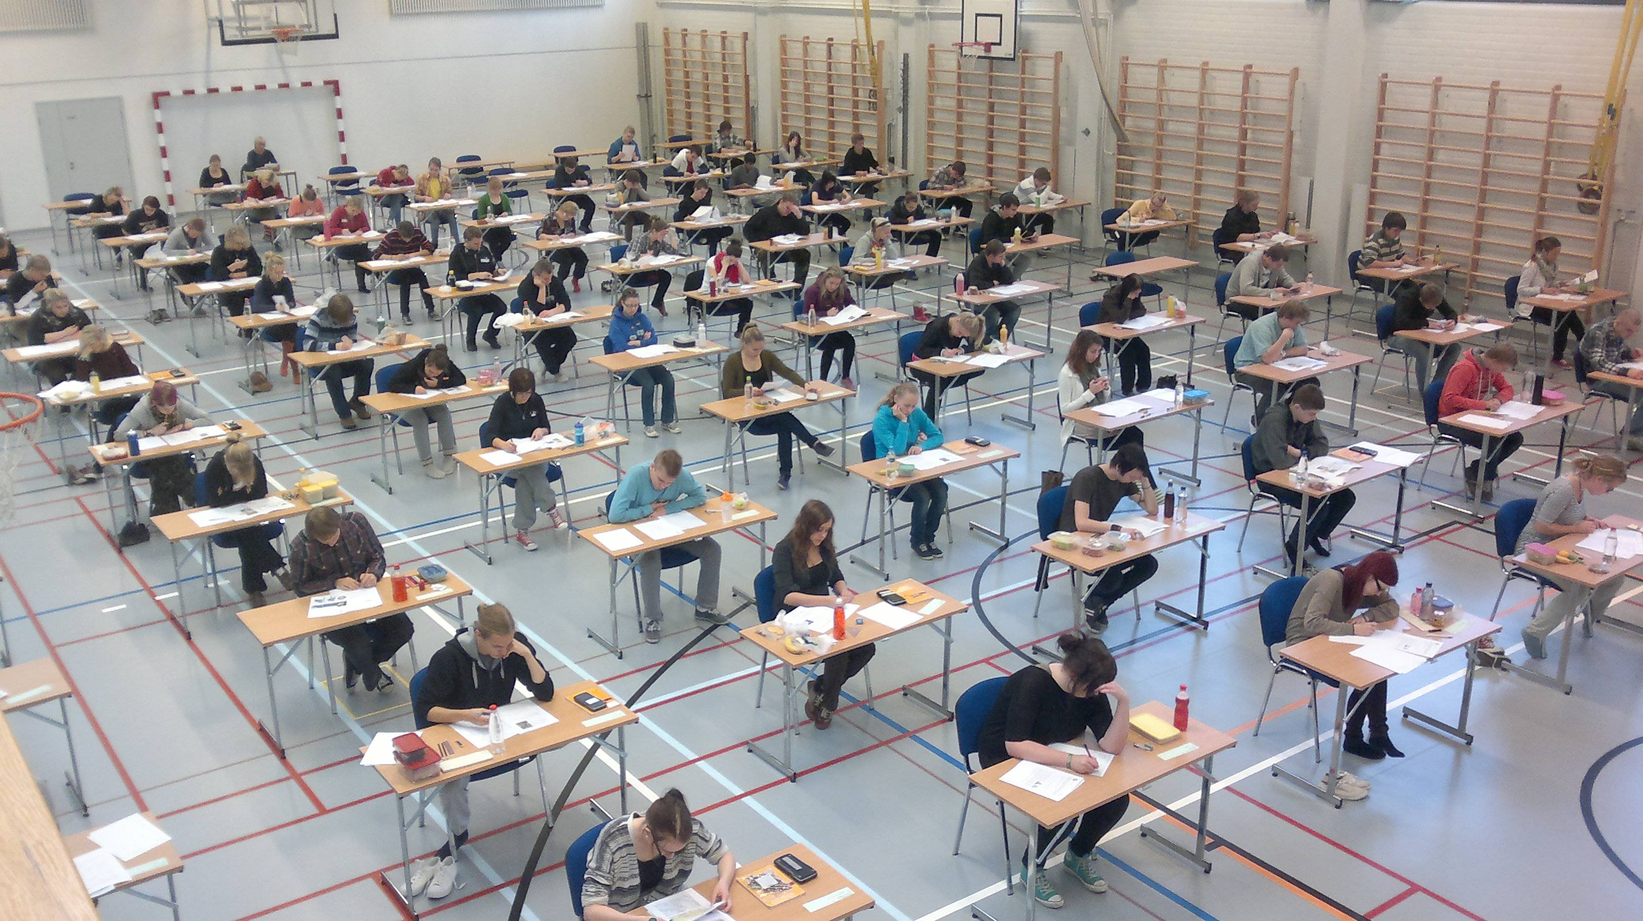
Matriculation examination
The Finnish Matriculation Examination is a national examination generally taken at the end of the Finnish upper secondary school
Its purpose is to discover the extent to which students have assimilated the knowledge, skills and an adequate level of maturity in line with the goals of general upper secondary education
Passing the Matriculation Examination entitles the candidate to continue their studies at university and other institutions of higher education
The matriculation event that follows the successful completion of final exams is an important rite of passage to a Finnish man or woman, and is viewed by some as on a par with christenings and weddings

Slide 12
Sources
Finland Guide: Secondary education, Vocational and upper secondary schools: Students can enter secondary (justlanded.com)
Finland - Secondary Education - Students, Schools, Vocational, and Upper - StateUniversity.com
General upper secondary education - OKM - Ministry of Education and Culture, Finland
10 Facts About Education in Finland | Education in Finland (in-finland.education)
matriculation exam in finland - Bing images

Slide 13
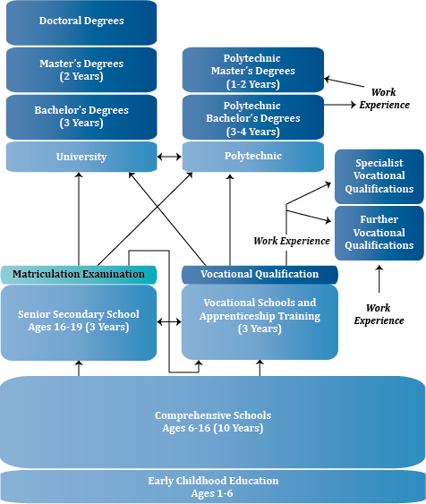

Slide 14
Thank you for your attention!
- Näkemiin! -

