Slide 1
The Danish education system
Michal Libant & Jakub Piňák

Slide 2
General upper secondary education programmes
There are four academically oriented general upper secondary programmes:
The 3-year Upper Secondary School Leaving Examination, Gymnasium (stx)
The 3-year Higher Commercial Examination (hhx)
The 3-year Higher Technical Examination (htx)
The 2-year Higher Preparatory Examination (hf)
Naturally, the more academic you want be the harder school you should choose

Slide 3
Subjects
All education programmes have compulsory subjects and electives subjects.
STX, HHX and HTX each have different academic profiles that are reflected in the specialised study programmes consisting of several specialised study subjects.
The subjects the students follow provides them with specific qualifications.
Of course, students are taught in Danish.

Slide 4
Number of hours in schedule
Subjects in general upper secondary education programmees are taught at three different levels depending on the hours that are allotted to the subject.
The levels range from A, B and/or C.
C-level subjects are allotted 75 hours
B-level subjects are allotted 200 hours
A-level subjects are allotted 325 hours.
Did you know? Education in Denmark is​
provided free of charge at all levels

Slide 5
The Higher Preparatory Examination programme (hf)
Danish A*
English B
Mathematics C
The Natural Science Group (Biology C, Geography C, Chemistry C)
The Humanities and Social Science Group (History B, Social Science C, Religion C)
A choice of either physical education C or an artistic subject C
A choice of one set of interrelated subjects oriented to a profession
A practical project every semester
A major written assignment in the 4th semester
One or more electives

Slide 6
The Higher Commercial Examination Programme (hhx)
Danish A
English A
2nd foreign language B or A (French, German or Spanish advanced B or beginner A, Italian beginner A, Russian beginner A, Chinese beginner A)
Business economics B
Marketing B
International economics B
Contemporary history B
Mathematics B (C-level if the student has 3 foreign languages or more)
Commercial law C
Social Sciences C

Slide 7
The Higher General Examination Programme (stx)
Danish A
English B
2nd foreign language B or A (French, German or Spanish advanced B or beginner A, Italian beginner A, Russian beginner A, Chinese beginner A)
History A
Classical studies C
Physics C
Physical education (PE) C
Artistic subject C (either visual arts, drama, media studies or music)
Mathematics B (C-level if the student has 3 foreign languages or more)
Religion C
Social sciences C
At least two of the subjects biology, chemistry or natural geography at C-level.

Slide 8
The Higher Technical Examination Programme (htx)
Danish A
Technical Sciences A
English B
Physics B
Chemistry B
Mathematics B
Technology B
History of Ideas B
Biology C
Communication/IT or Informatics C
Social Sciences C

Slide 9
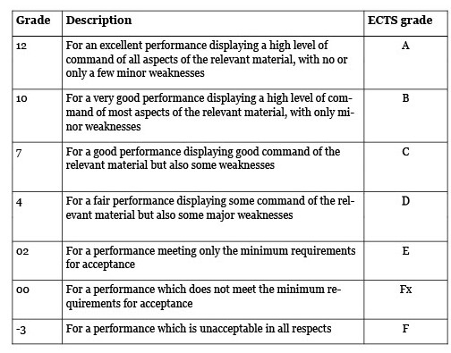
Grading system

Slide 10
Source:
https://ufm.dk/en/education/the-danish-education-system
https://eacea.ec.europa.eu/national-policies/eurydice/content/denmark_en
https://denmark.dk/society-and-business/lifelong-education
the_danish_education_system_pdfa.pdf

