Slide 1
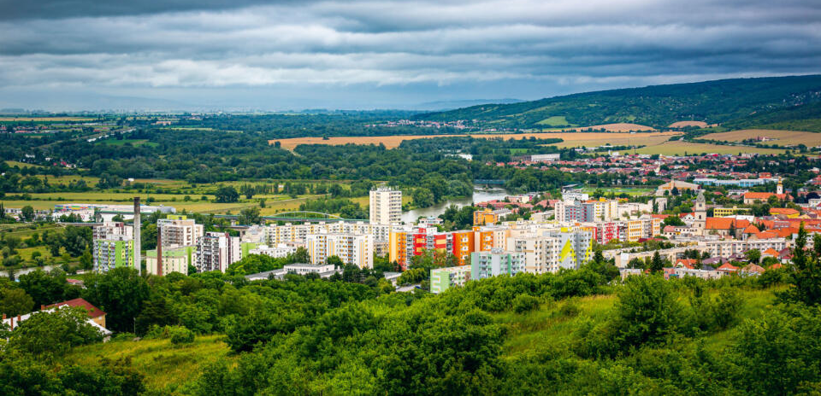
Hlohovec

Slide 2
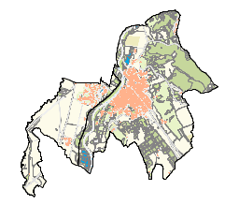
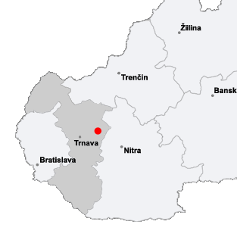
Geography
Hlohovec is located in a valley between Považský Inovec and Nitrianska pahorkatina.
The river Váh, which is the longest Slovak river, flows through the town.
Hlohovec is situated between two historical towns Trnava and Nitra and near a world known spa town Piešťany.

Slide 3
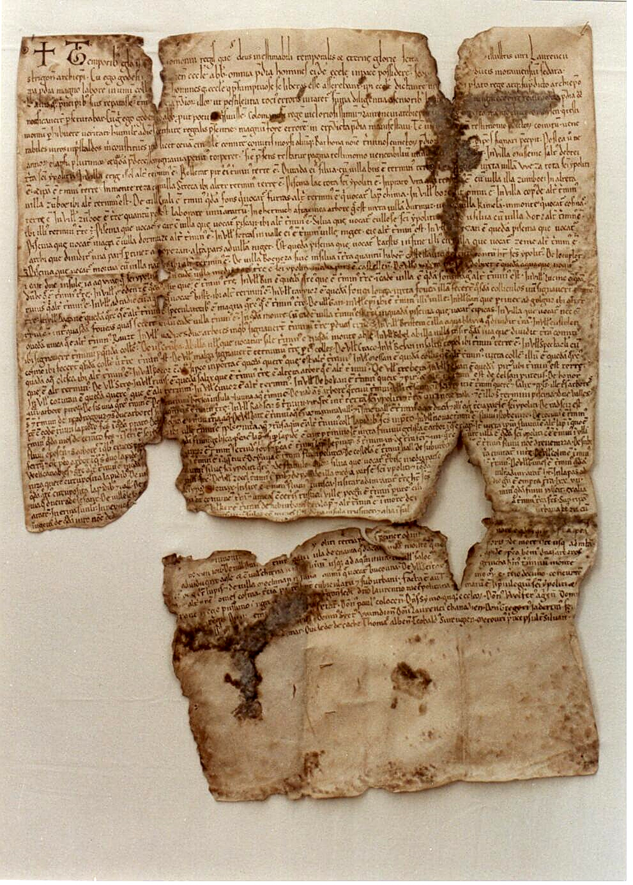
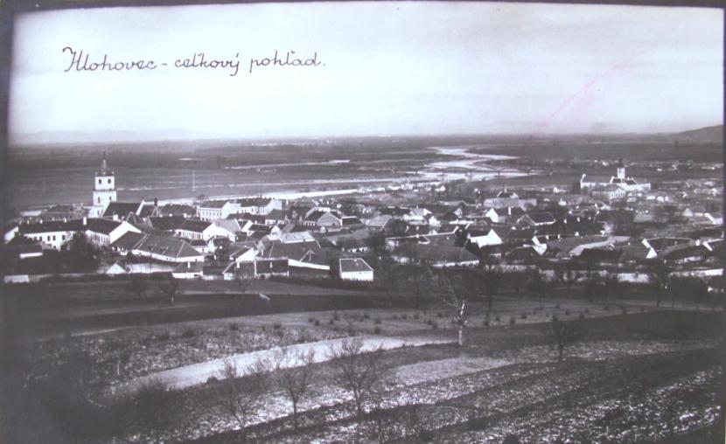
History
First citizens dated from older stone age (12 000 years before Christ)
In the years 5 000-3 500 BC there were three small villages in today´s territory of Hlohovec.
A significant change in history of Hlohovec meant the arrival of Slavs around the year 500. They built the old Slavic fortified settlement on the high slope just above the river Váh.
First record about Hlohovec is Zoborská listina from 1113, in which the first name of Hlohovec was Golguz.

Slide 4
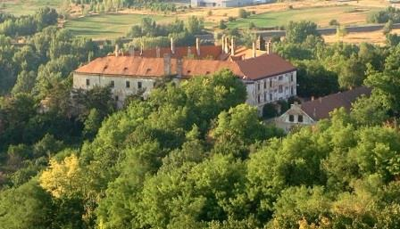
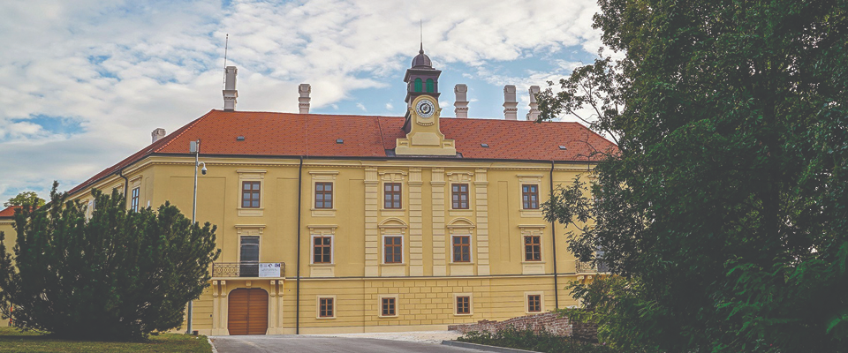
Castle
It is the dominant monument of the town
The last family in the castle was the Erdödy family
Nowadays it is used for exhibitions, weddings and cultural events.

Slide 5
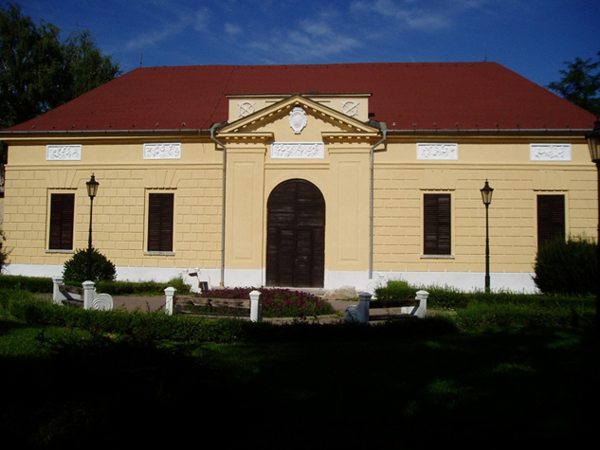
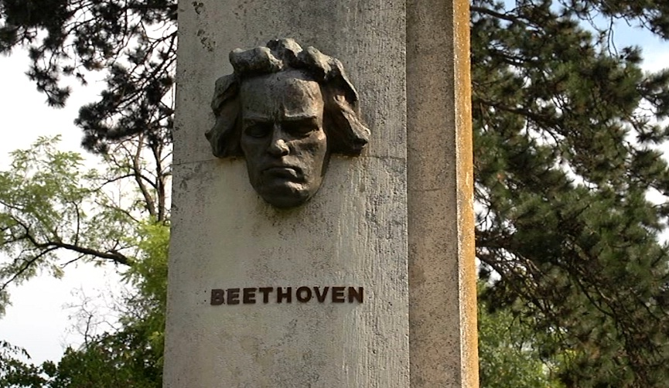
Empire theatre
Empire theatre in Hlohovec is the only preserved aristocratic theatre in Central Europe.
Jozef Erdödy financed its building in 1801.
It is famous by its perfect acoustics.
It hosted the Italian opera society, actors from Vienna and Budapest theatres in the past. Famous Ludwig van Beethoven also played there.

Slide 6
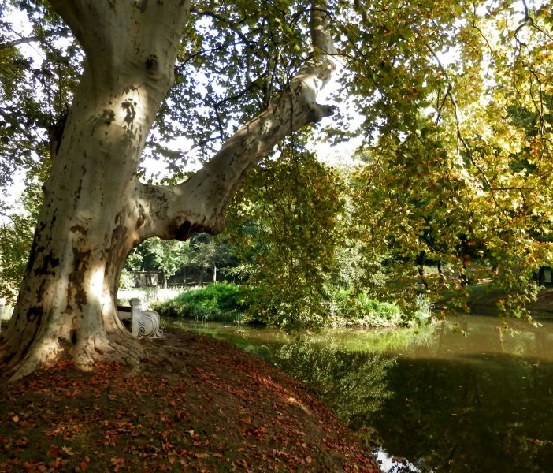
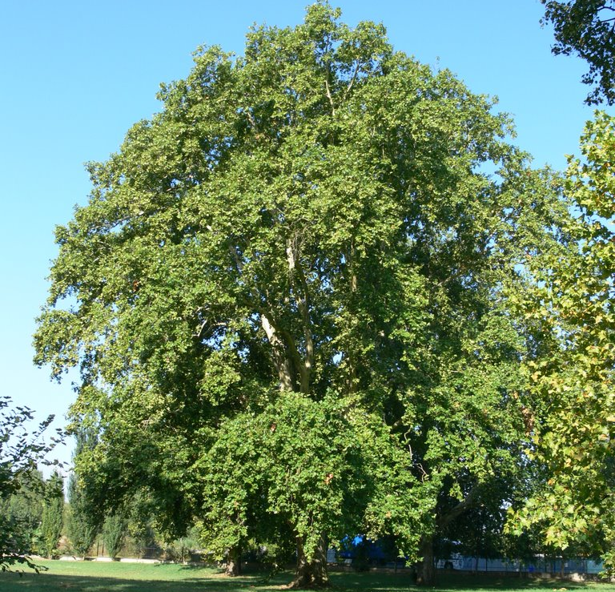
Pánska záhrada
Our "Castle Garden" where is the biggest sycamore (like maple trees) park in Central Europe.
The oldest one is over two hundred years old.
You can also find there the most massive tree in the region Hlohovec which is forty meters high and five and half metres thick.

Slide 7
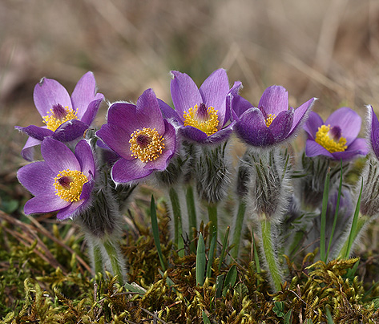
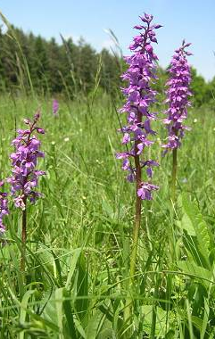
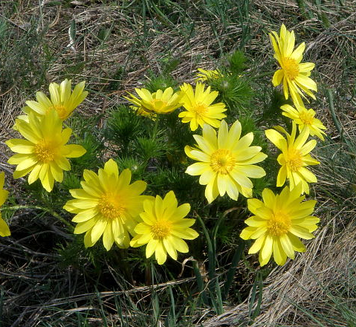
Nature reserve Sedliská
It is the most important and the oldest protected area in the region Hlohovec.
Many protected species of plants grow here, such as poniklec „pasqueflower“, hlaváčik jarný „spring pheasant's eye“
and other rare plants.

Slide 8
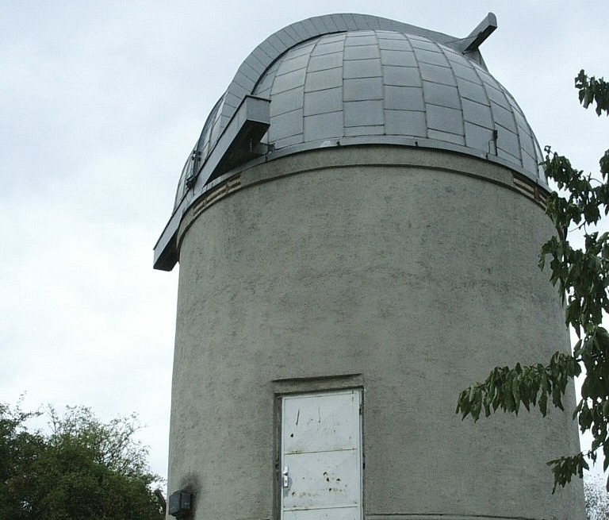
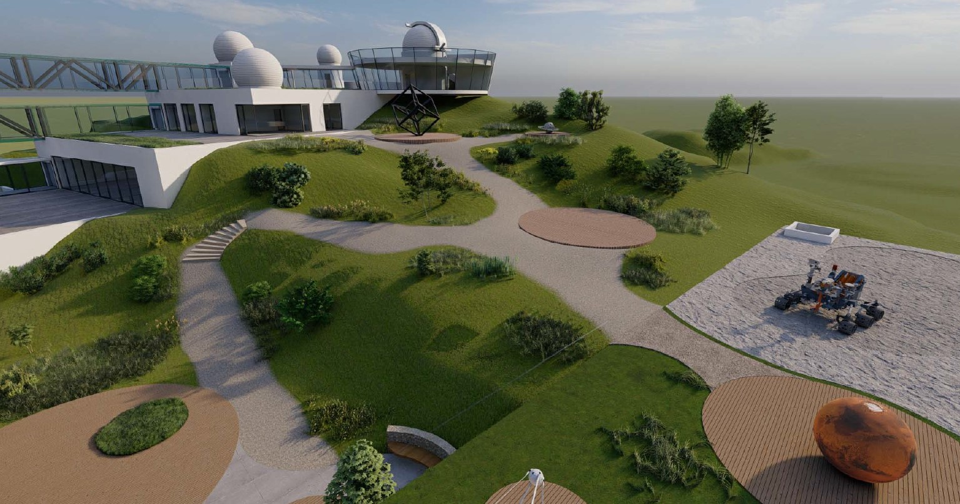
Observatory and planetarium
Hlohovec is one of the few places in Slovakia where a planetarium is located.
The observatory in the Planetarium has the second largest telescope in Slovakia.
There already is a project to change this place into the most modern astronomical centre in the middle Europe

Slide 9
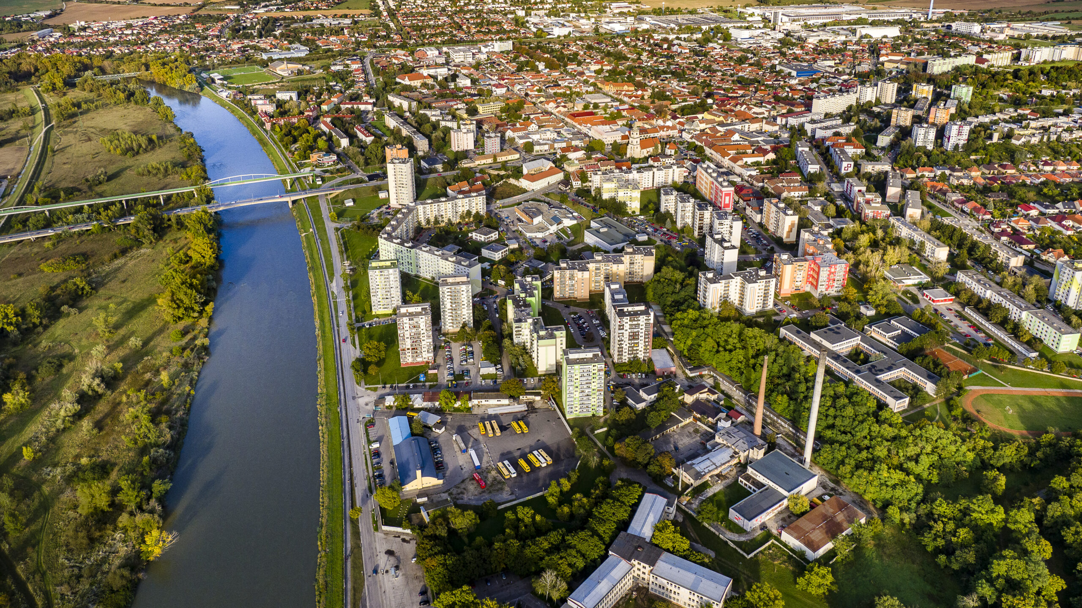
Thank you for your attention

