Slide 1
country English-speaking
Alicja Bednarczyk

Slide 2
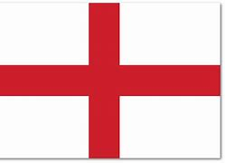
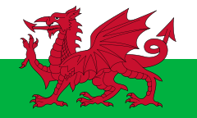
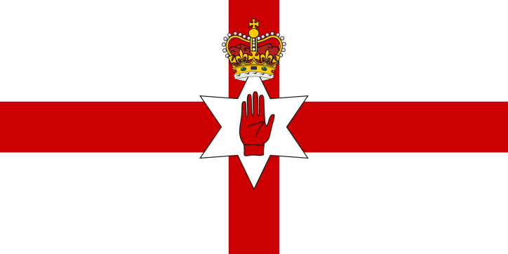
country English-speaking
These countries include: England, Scotland, Wales, Northern Ireland

Slide 3
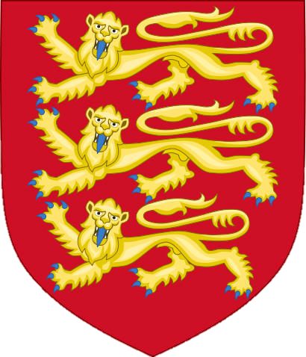
England country English-speaking
Flag:
Emblem:

Slide 4
England-map
Here

Slide 5
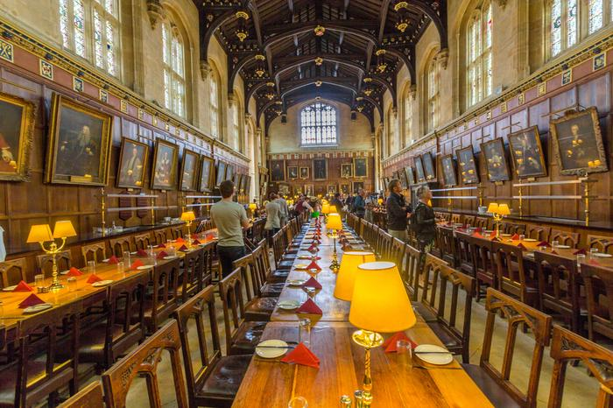
the most interesting places in England
One of the most interesting places in England is the town of York in Yorkshire, at the confluence of the Rivers Ouse and Foss, known mainly for its rich history. It was founded more than 2,000 years ago and has been the largest city in this part of the UK for a long time. In medieval buildings are intertwined traces of vikings and Romans.

Slide 6
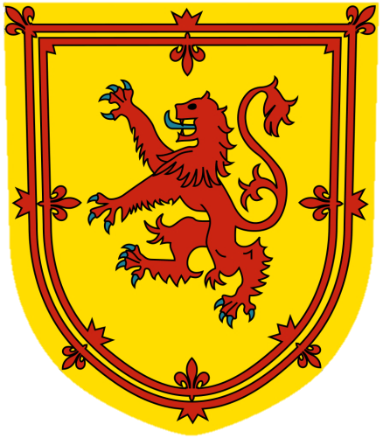
Scotland country English-speaking
Flag:
Emblem:

Slide 7
Scotland-map
- Scotland

Slide 8
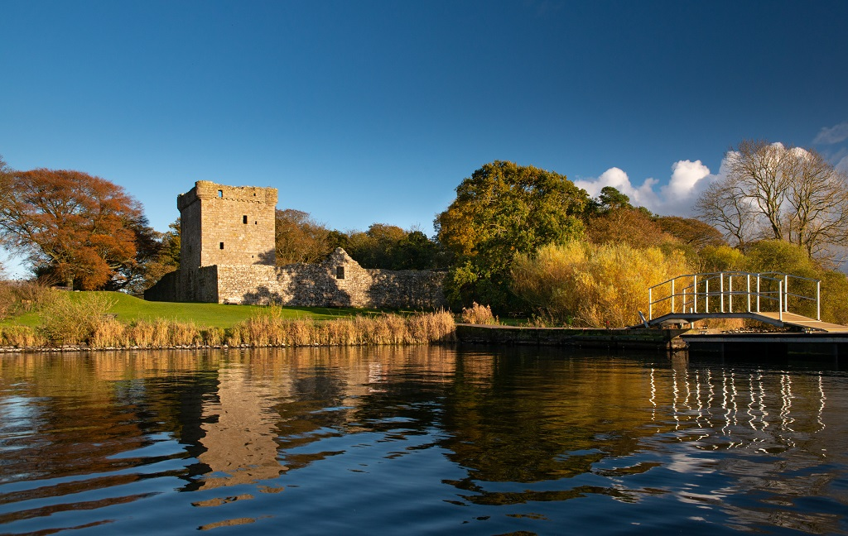
the most interesting places in Scotland
Among the castle's most famous ruins are Lochleven Castle - the place where Queen Mary of Scotland was imprisoned, Slains Castle - the ruins that inspired dracula's character, Dunottar Castle, where hamlet's film adaptation, Urquhart Castle on Loch Ness, was filmed.

Slide 9
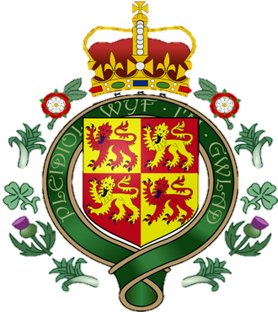
Wales country English-speaking
Flag:
Emblem:

Slide 10
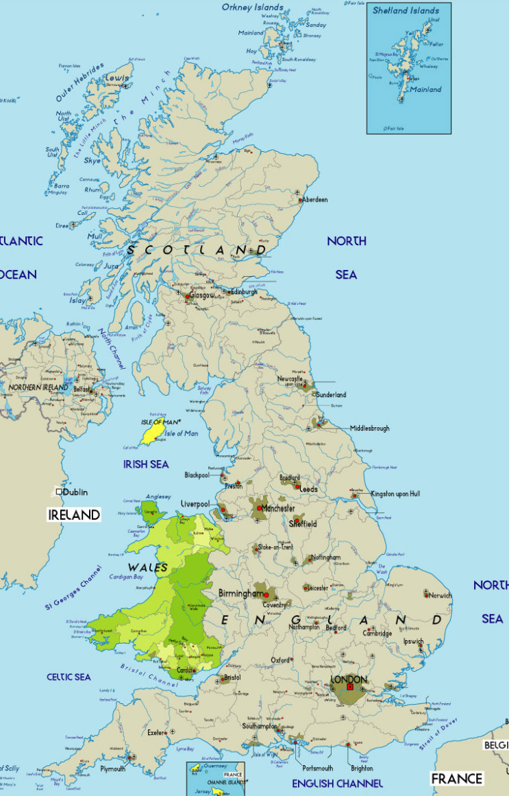
Wales-map

Slide 11
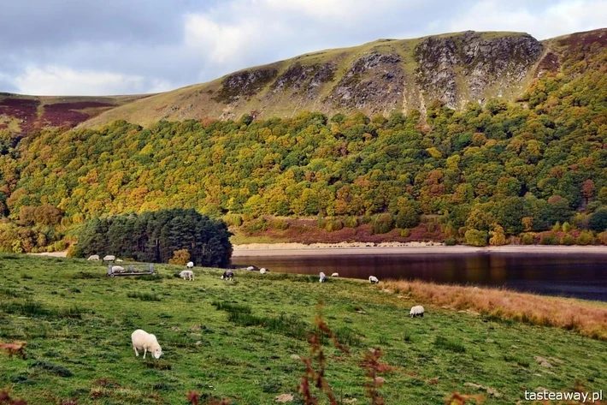
the most interesting places in Wales
Tasteaway / Press Release
Beautiful fairy-tale valley, perfect for long walks or bike rides. Elan Valley is located in the Powys region, west of Rhayader. The entire area of the valley is 180 km2, so you can partially explore it on foot or on bicycles (they can be rented on site, also with a children's trailer), and partly by car.

Slide 12
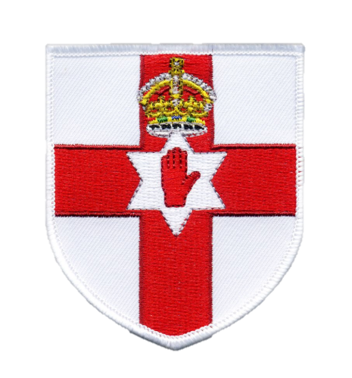
Northern Ireland country English-speaking
Flag:
Emblem:

Slide 13
Northern Ireland-map

Slide 14
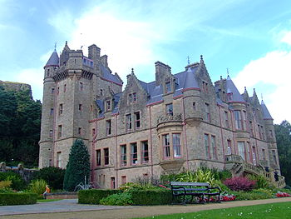
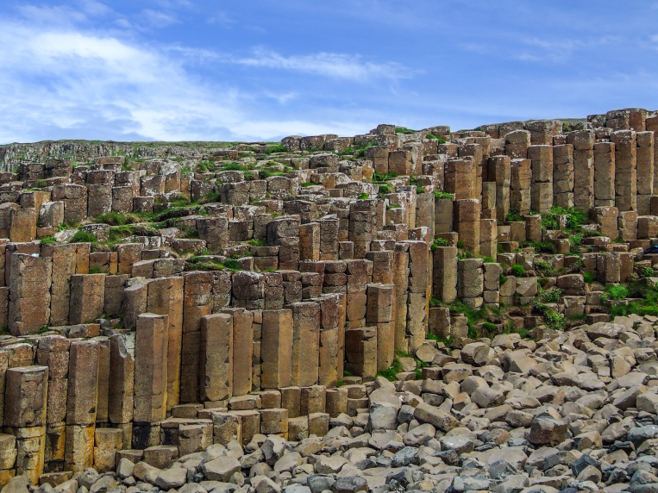
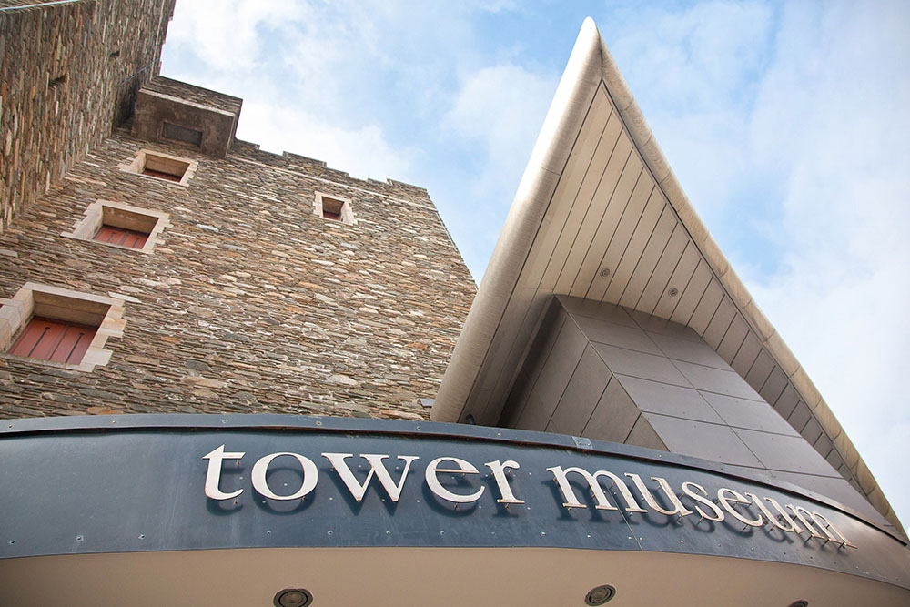
the most interesting places in Northern Ireland
Belfast: Laganside, Ulster Museum, Stormont, Cave Hill, West Belfast
Antrim Coast Road,
Rathlin Island,
Giant's Causeway - Giant's Causeway
Carrick-a-rede bridge
Bushmills Distillery
Portrush, New
Derry - Tower Museum, Derry, city walls and murals
Bellaghy Bawn
Ulster Folk and Transport Museum,
Portaffers,
Mourne Mountains,
Argory,
Armagh
Mount Slieve Gullion
Sperrin Mountains,
Beaghmore Stone Circles,
Lough Neagh Lake,
Castle Coole,
Devenish Island,
Marble Arch Caves

