Slide 1
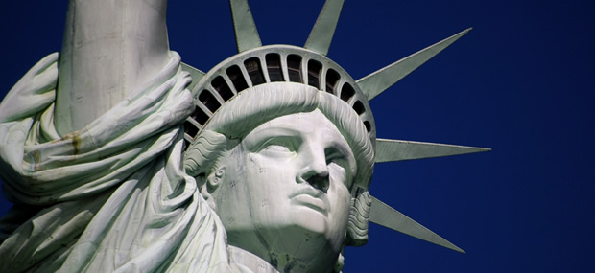
The Velvet Revolution
Czechoslovakia returns to democracy
Timotej Krajčovič, Martin Herceg

Slide 2
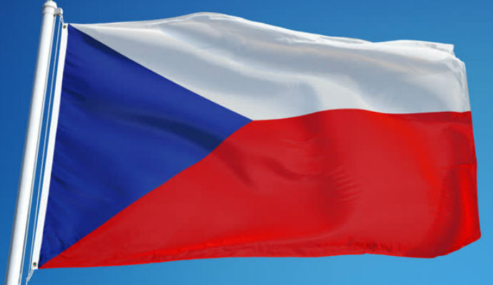
Basic information
The Velvet revolution was a peaceful end to communism in CZECHOSLOVAKIA.
It took place for over 6 weeks in the year 1989.
It was a non-violent transition of power. The communist regime fell and democracy was restored.

Slide 3
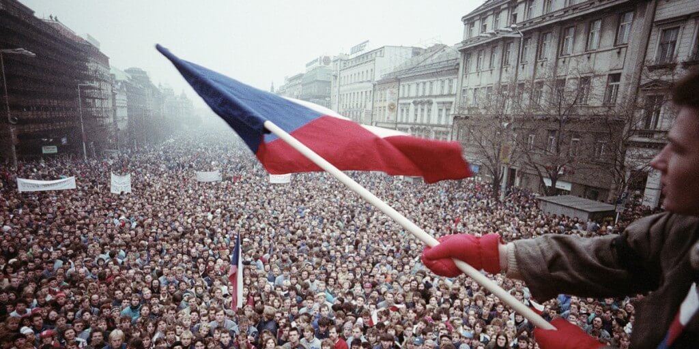
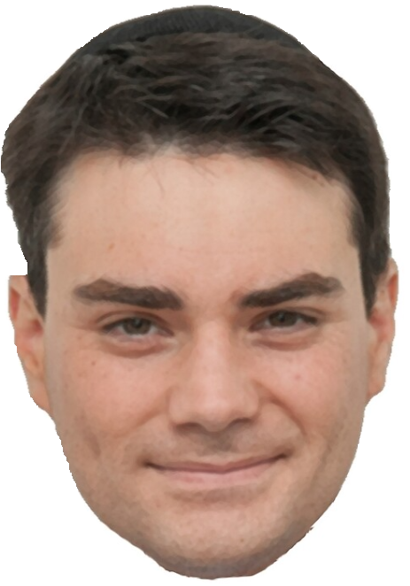
How the revolution went
The revolution started on November 17th, 1989. University students paid tribute to Jan Opletal. He was a student killed by Nazis on that day in 1939. In the evening hours, the students headed to Prague’s city center, calling for democracy.
As a result of this unplanned event, they were surrounded on Národní (National) street by communist police (VB). Following a brutal intervention against the students, mass demonstrations occurred in the following days.

Slide 4
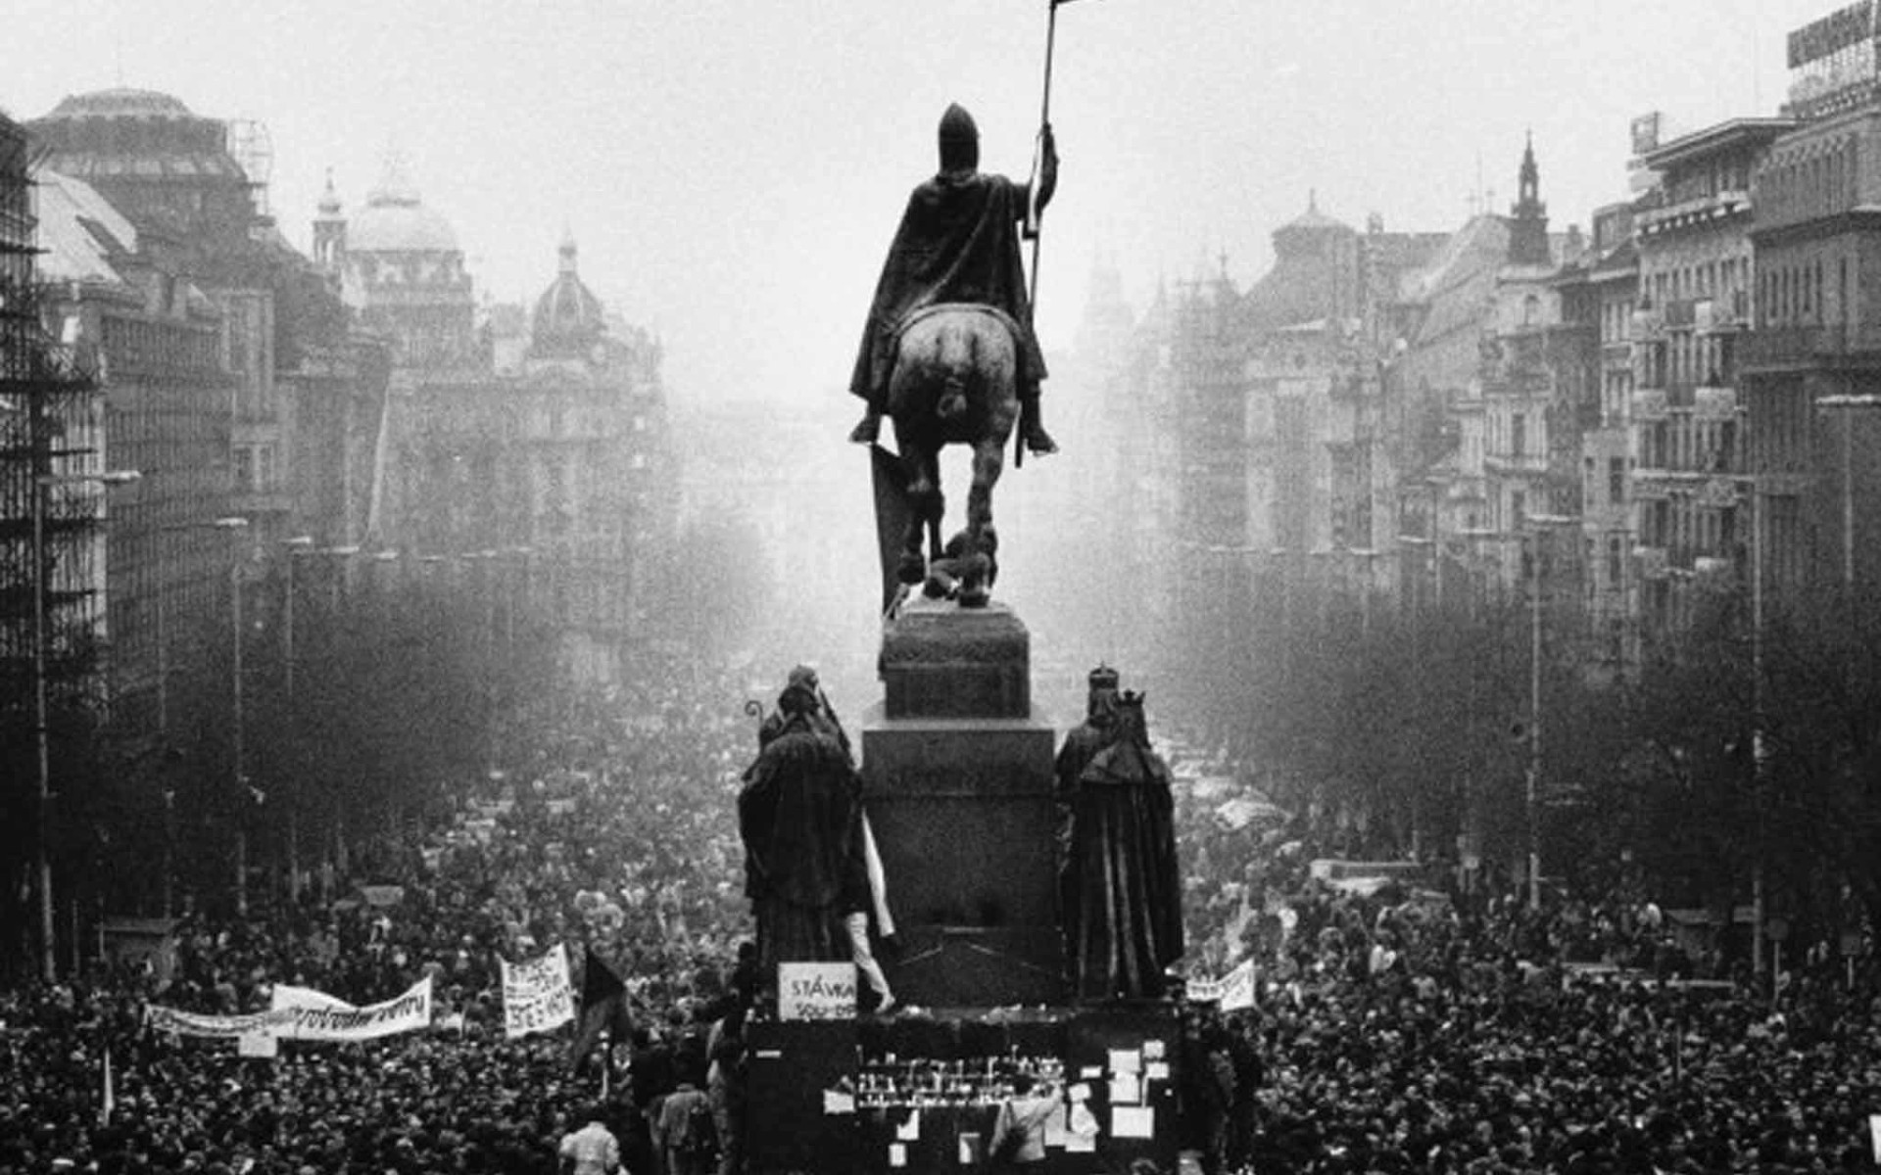
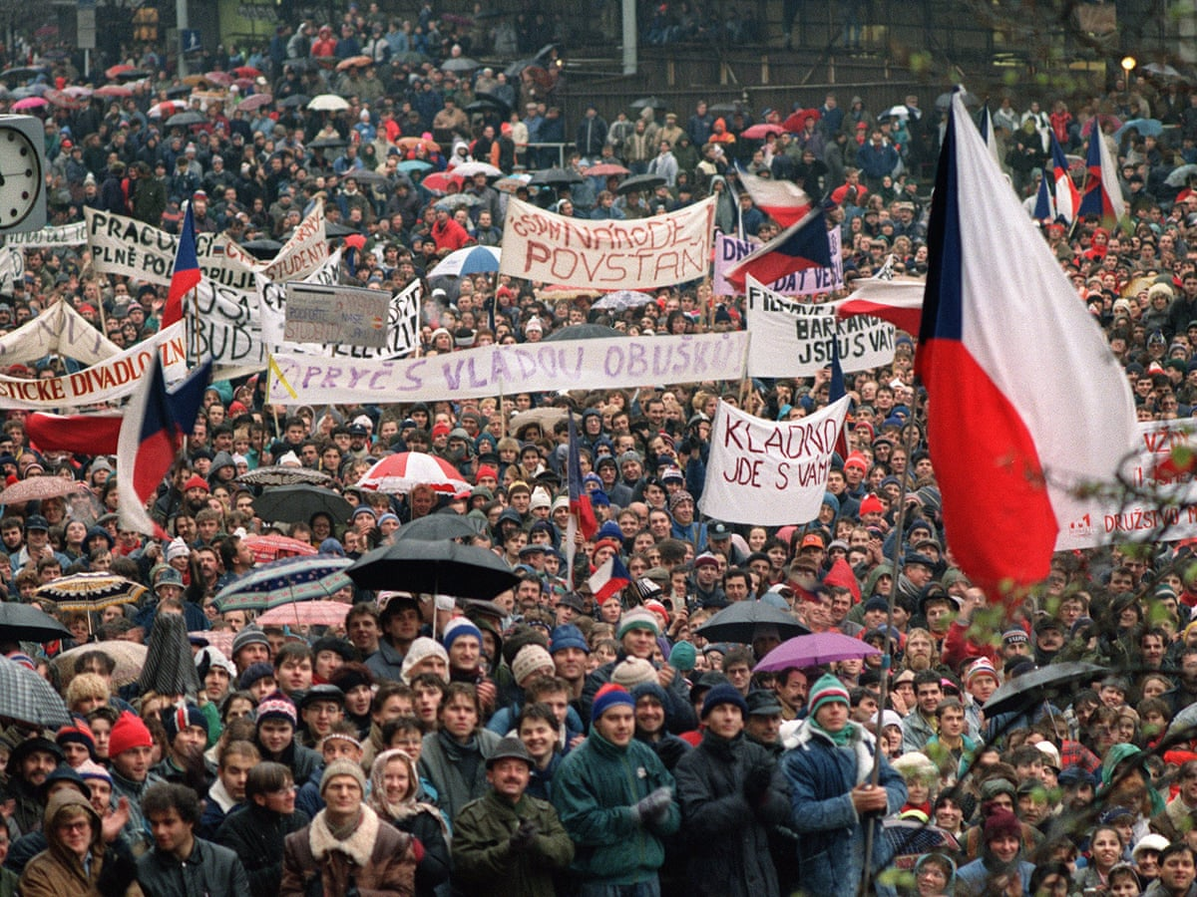
More information
On November 19th, the opposition led by Václav Havel formed the movement Civil Forum (Občanské forum). Furthermore, actors, students, and others planned a general strike.
Two days later, 200 000 people demonstrated against the communist regime. Further, the largest demonstration took place on November 25th, 1989. In fact, over half a million people participated.

Slide 5
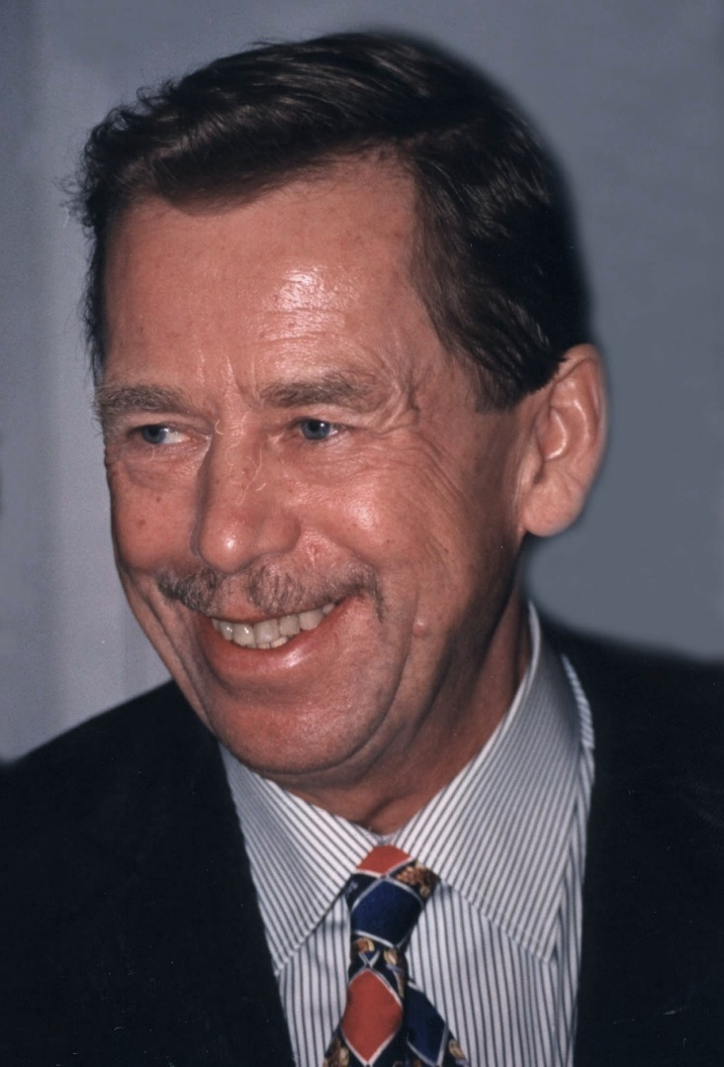
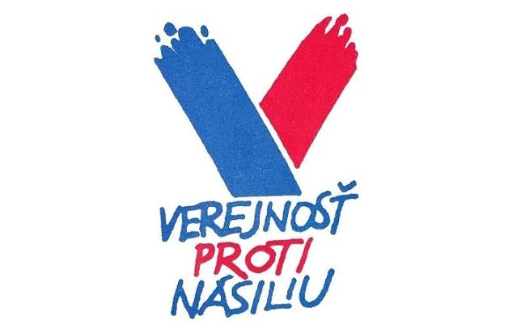
Political landscape after the revolution
On December 4th, 1989, the communist leaders opened borders to the west. A week later, the president of the Czechoslovak Socialist Republic, Gustav Husák, resigned. Václav Havel was elected as the new president on December 29th. That day marks the end of the revolution. Political oppression of the leading party broke down. Furthermore, the country became a parliamentary republic.
Václav Havel.
The first czechoslovak president after the revolution. The biggest Prague airport is named after him.

Slide 6
Democratic Czechoslovakia
The symbol of the Velvet Revolution was jingling keys.
It was a symbol to wave away the Communists.
Following the Velvet Revolution, elections took place in June 1990. They were the first democratic elections in the country since 1946. Civil forum won the vote. However, the movement dissolved a year later. President Václav Havel advocated for the withdrawal of the Soviet army from the state. Worldwide, people see him as one of the key figures of the civil rights movement. Moreover, Czechoslovakia transformed from a socialist centralized state-run economy to capitalism. November 17th became a major state holiday.

Slide 7
THE END
Thank you for your attention

