Slide 1
Velvet Revolution
1989

Slide 2
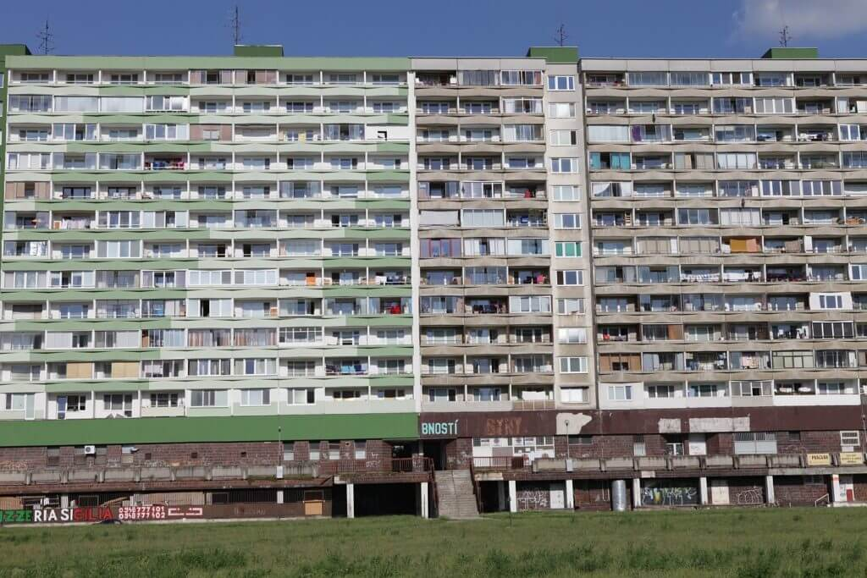
Life before Velvet Revolution
We can say that things which happened in November 1989 were the most important things for us.
Our generation is too young and we have never lived in regime as it was before, so it can be different for us to imagine it.
Our previous regime was called socialism and it was hard time for our citizens.
In this time nobody was free.
People could not travel wherever they wanted and they could not express their opinion.
In the county were strictly rules and everybody had to respect them.

Slide 3
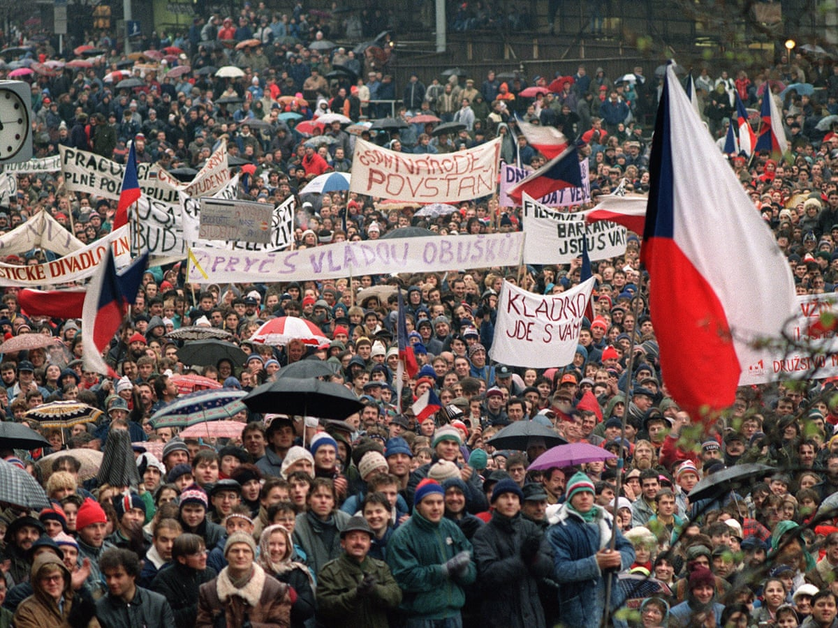
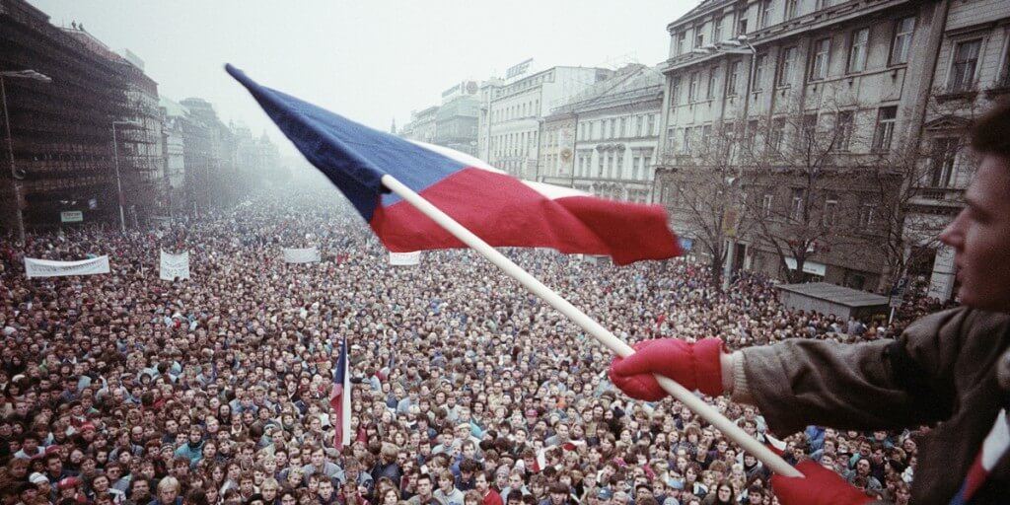
17th of November-29th of December 1989
It was the time when Czechoslovakia became independent country.
It means that Soviet Union did not have an influence in Czechoslovakia anymore.

Slide 4
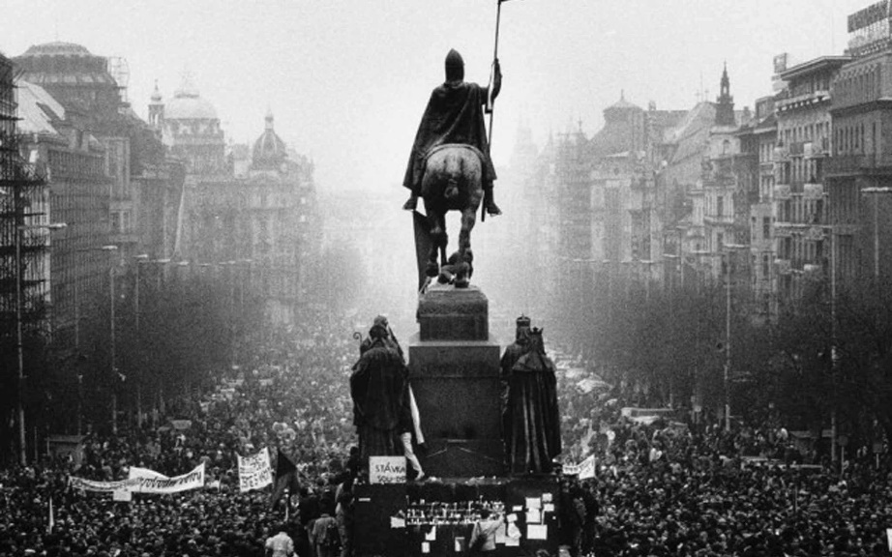
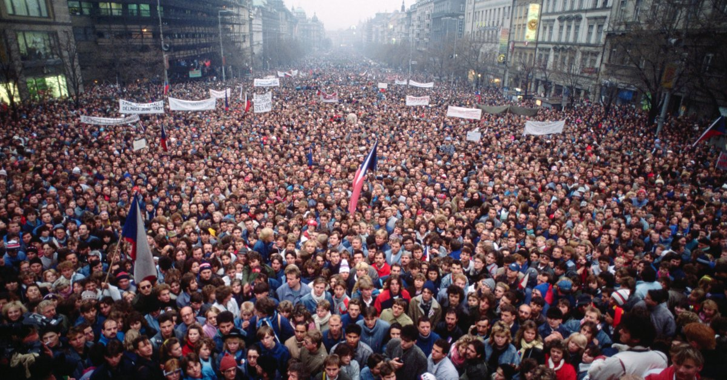
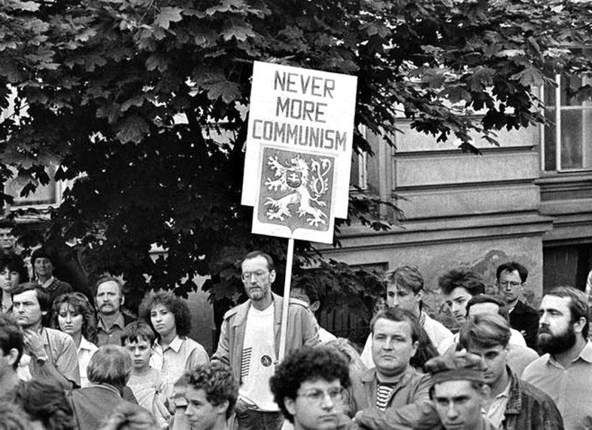
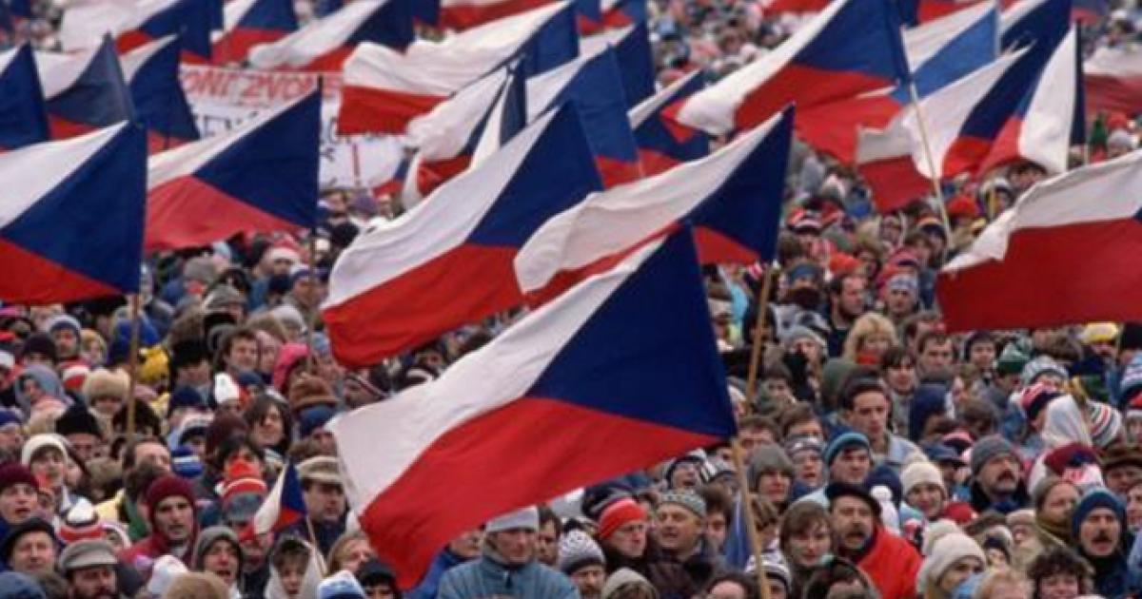
Organizators of demonstrations were mainly students and then actors, later all citizens.

Slide 5
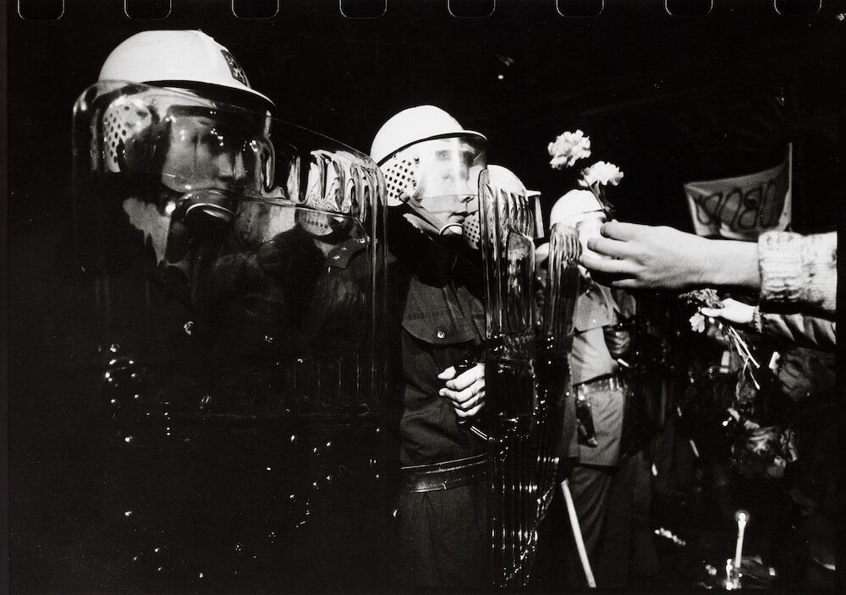
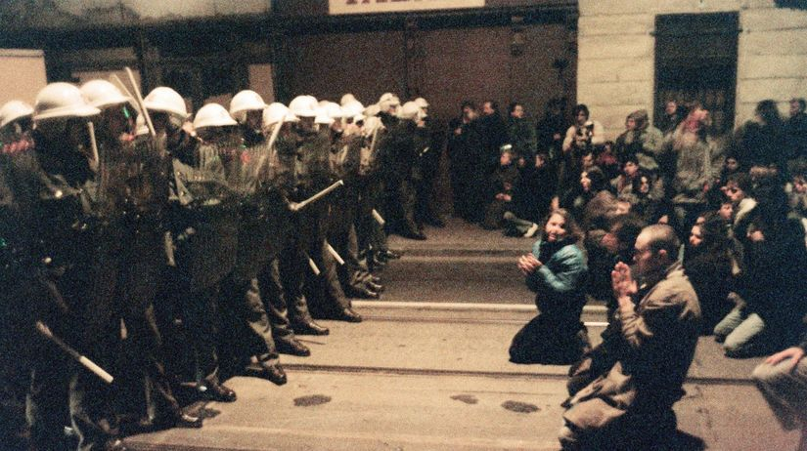
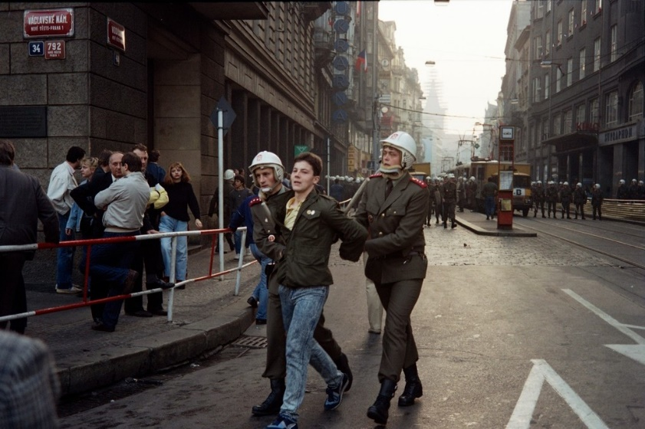
17th of November
Everything started 17th of November in Prague, where Slovak and Czech students were protesting against communism regime but they were stopped by brutal attack of police.
There were 600 injured and 35 hospitalized.

Slide 6
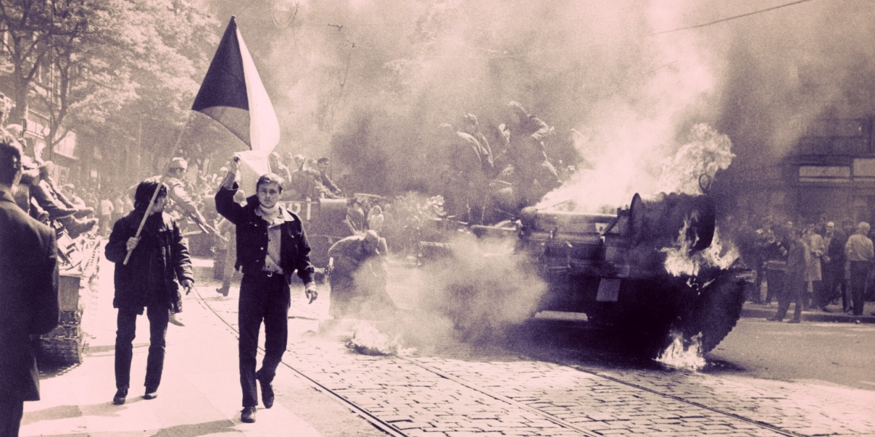
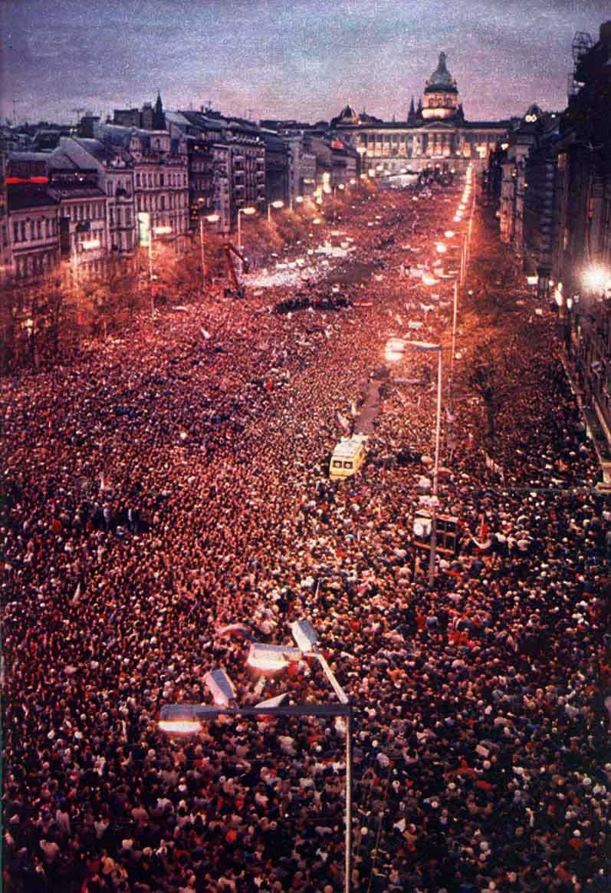
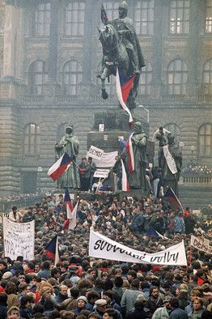
This police attack was the reason why students from whole Czechoslovakia started to protest.
In following days other citizens joined to these protests.
This process continued for several weeks.
This revolution had several symbols as lighting candles or jangling their keys.

Slide 7
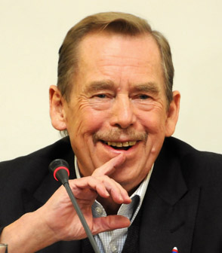
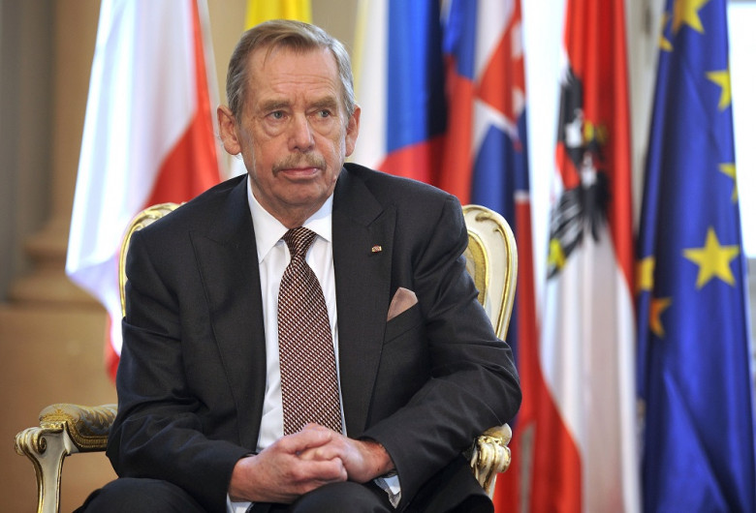
Pressure in the streets was still bigger and bigger.
After the agreement, Czechoslovak Communist Party resigned.
On December 12th, the first non-communist party was created.
The first president of Czechoslovakia was Václav Havel.

Slide 8
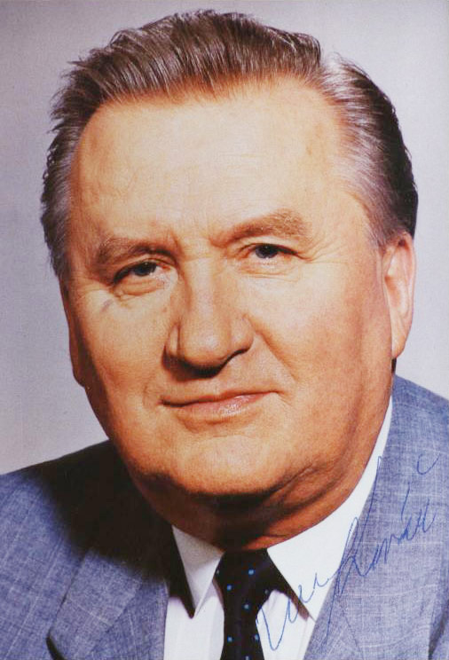
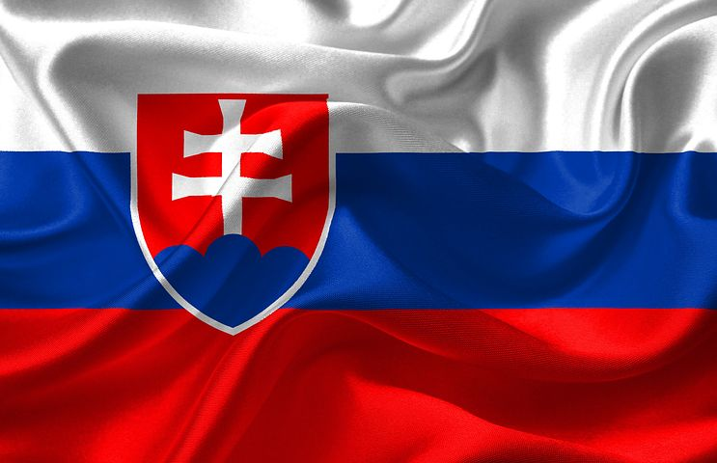
Division of Czech and Slovak republic
Czechoslovakia was divided into two countries on December 31st 1992.
Since the first of January 1993 Slovak republic has been created.
Our first president was Michal Kováč.

Slide 9
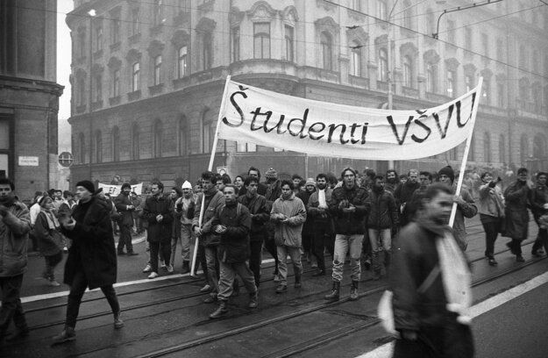
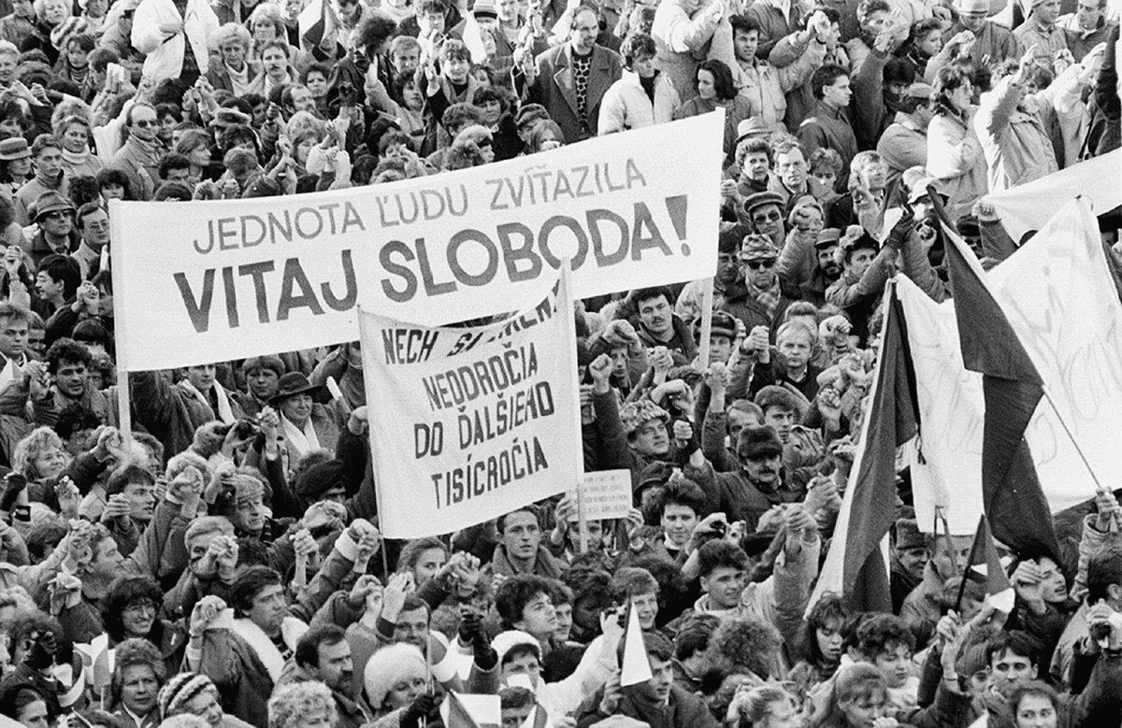
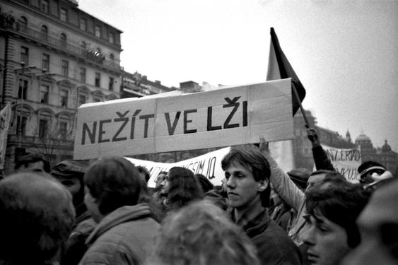
Thank you for your attention!

