Slide 1
THE HISTORY OF THE RELATIONSHIP OF MYTHOLOGY AND ASTRONOMY
Notes:
How is connected folklore and science?
It is in folklore that the basics of science lie. Most works of folklore raise the central question of knowledge: what? Where? When? Why? The answers to them reveal the desires and aspirations of people of ancient times to understand the world around them: the Universe, nature, people, plants, animals, etc.
Astronomy is the science of the Universe's structure, movement, and development. Ancient Lithuanians explained in the tales how the Earth appeared, who forged the sun, and why formed the Circles of Return were lit in the sky or formed a chandelier.
The first to apply astronomy knowledge systematically was merchants and sailors who needed to locate themselves. Knowledge of astronomy was also required by farmers, who determined the beginning of sowing, predicted floods or the time of harvest according to the location of certain constellations.

Slide 2
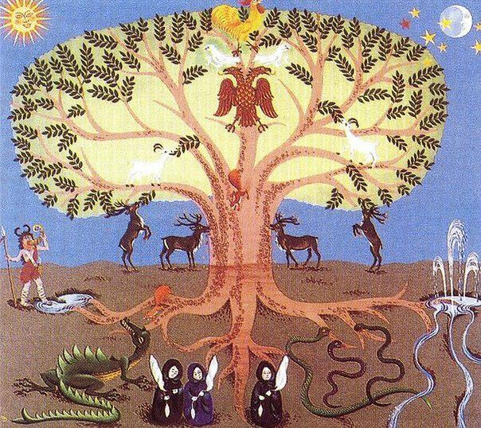
Pasaulio medis
Notes:
Our ancestors explained the origin of the Universe in their way. According to them, there was first continuous darkness and sludge - the land mixed with water. After this chaos, the wandering spirit with divine power is the Praamžis. He has begun to divide the Universe into elements - water, land, air and fire. First, the water separated from the sludge and formed a lagoon. Praamžis removed the seeds of the land from the lagoon's depths, and the land that had grown from them was taken. Many nations, including Lithuanians, have the concept of the World Tree. The world was depicted as a mighty broad-leaved tree with the top supporting the sky and the roots reaching the depths of the Earth. At the top of the tree are the lights of the sky and eagles, at the branches are other birds, under the tree are animals and people, and near the ground are snakes and other reptiles..

Slide 3
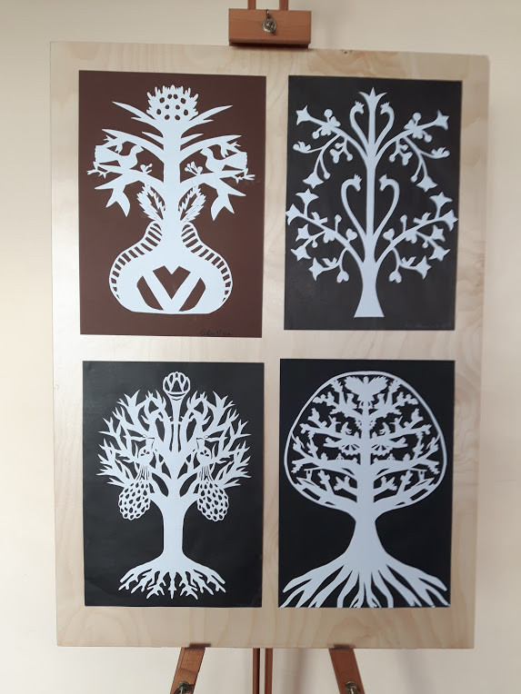
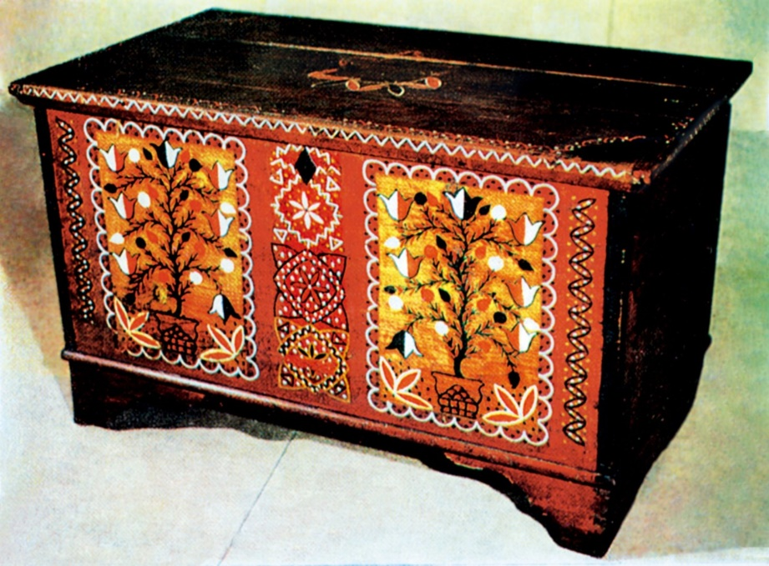
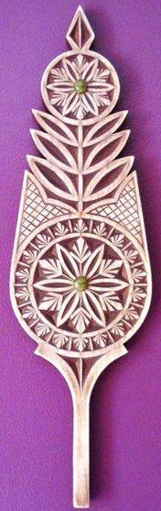
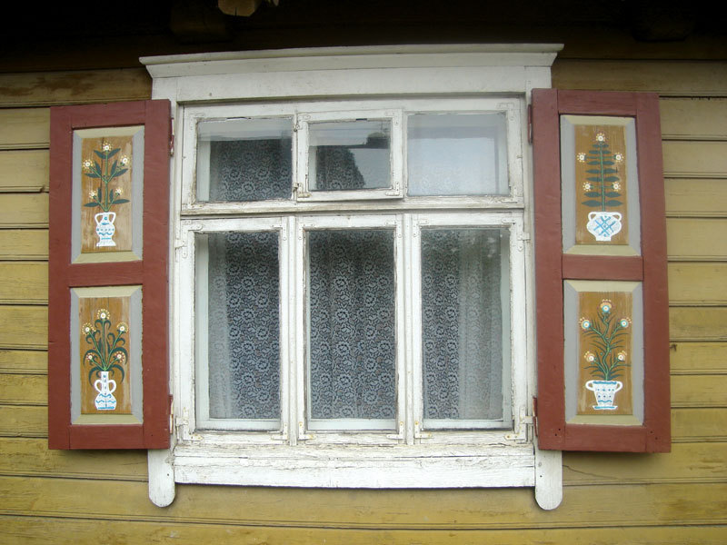
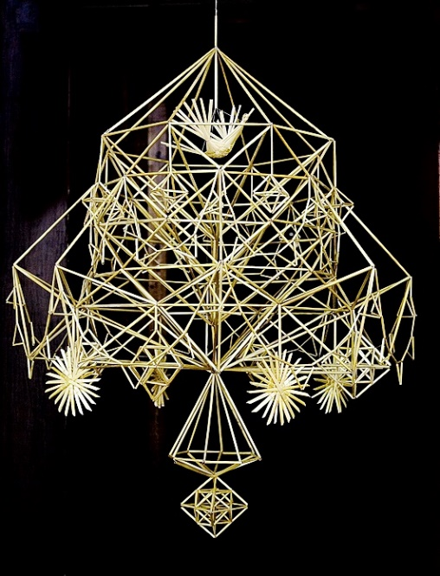
Notes:
The concept of the world's wood is also reflected in folk art (carvings, shelters, gardens, decoration of chests, shutters or other items).

Slide 4
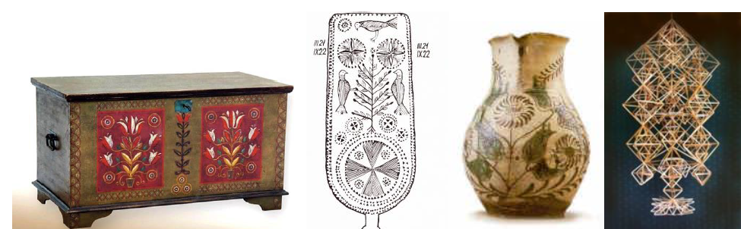
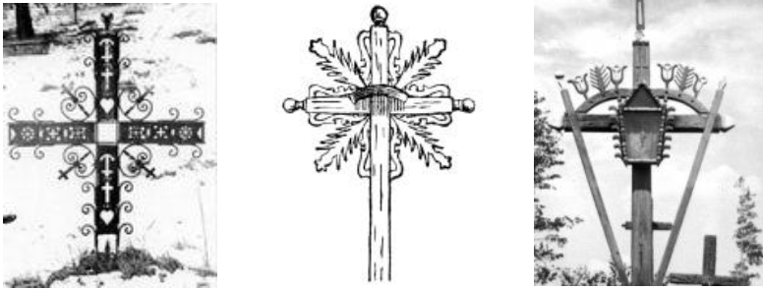
Pasaulio medis
Notes:
Since ancient times, the land has been sacred to Lithuanians because it is the breadwinner, the guardian of all living things. The bread loaf is offered to the deity of the Earth, buried in the Earth for a good harvest. The beer is poured out so that the Earth continues to provide bliss and prosperity. The worship of the earth cult in Lithuania has survived since the Baltic times. Trees occupy an important place. The most essential and most worshipped oak was considered the abode of the gods. In folk art, the tree of life is usually depicted as a faded tree or lily full of flowers or fruit and a bird perched on top of a tree (flower). Such motifs are common on chests of drawers, spindles, house doors or shutters and are abundant in weaving or embroidery patterns.

Slide 5
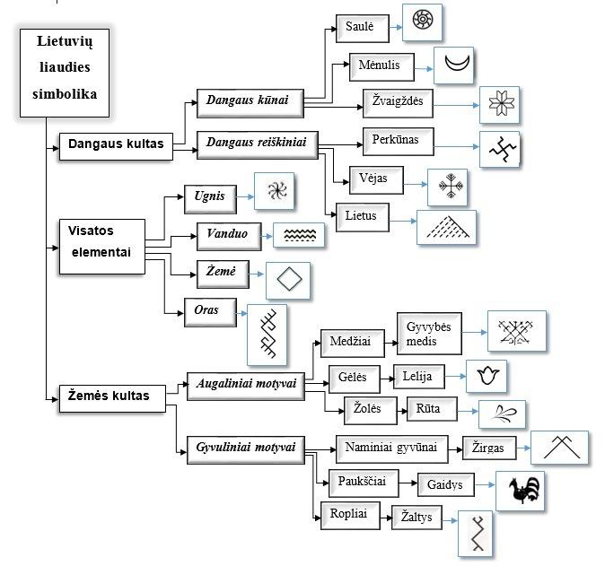
Notes:
Lithuanian folk symbols used in folk art grew out of specific content of life. The symbolism reflects what the people of that time lived like. In Lithuanian folk culture, the symbols of heaven and Earth are the main ones from which everything else follows. The sun is worshipped as the bearer of life, the moon is the celestial traveller, the night light is honoured as the man of the sun, and the stars are their daughters.

Slide 6

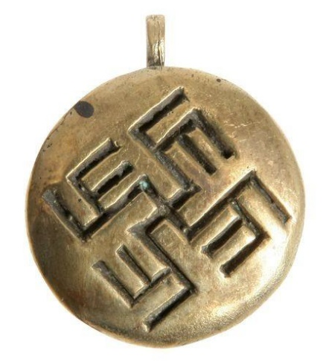
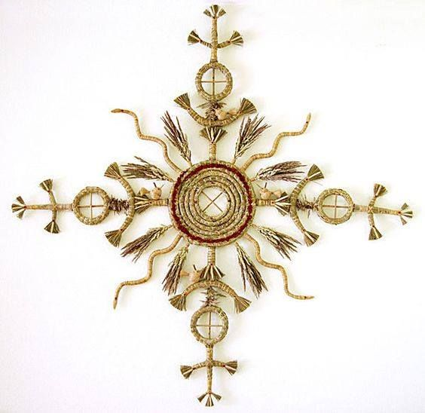
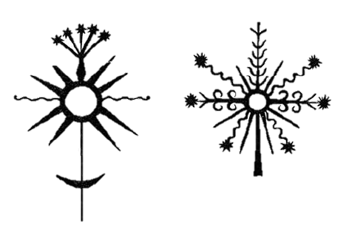
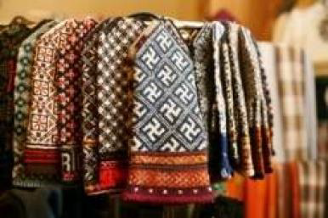
Saulė
Notes:
Perhaps the most worshipped of all time, and probably of all nations, is the sun. Sun is the essential source of life and energy. It was significant for agriculture. Since the Stone Age, the symbol of the sun has been expressed in a circle, circle, wreath, spiral, crosses in a process, or similar forms.

Slide 7
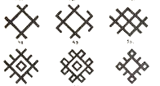
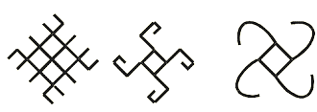
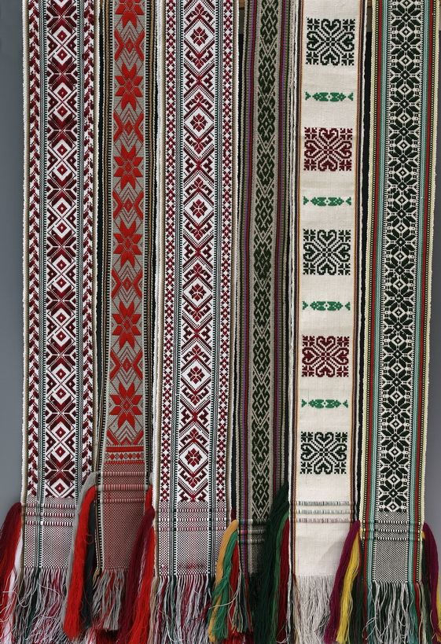
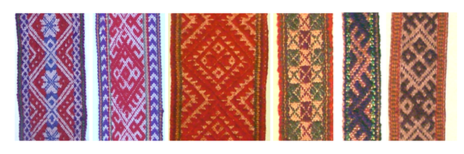
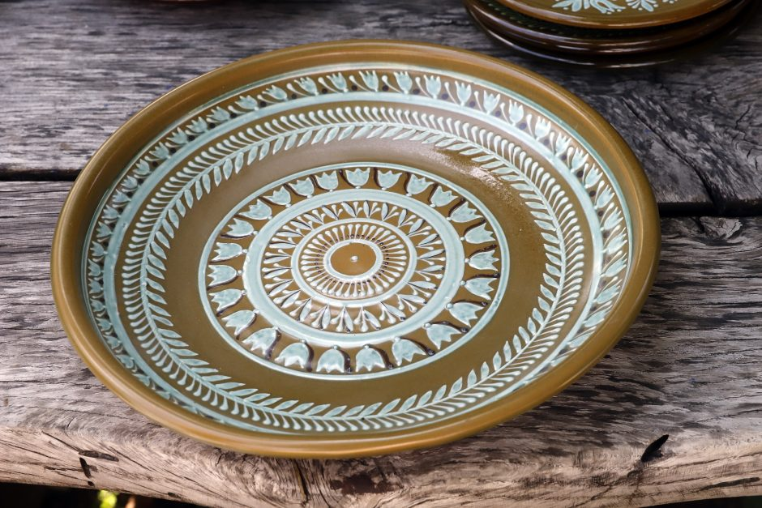

Slide 8
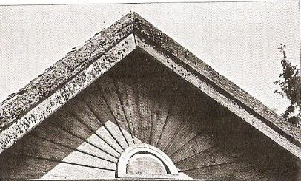
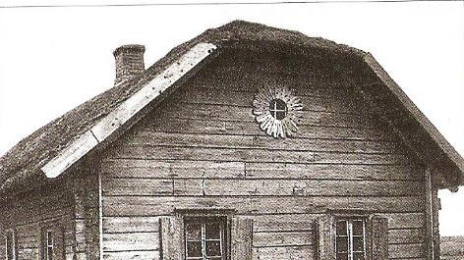
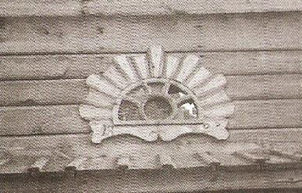
Saulės motyvų gausu ir lietuvių architektūroje
Notes:
The symbols of the sun were usually decorated on the dwelling house and barn. All the embellishments not only adorned but also protected the inhabitants from evil spirits.

Slide 9
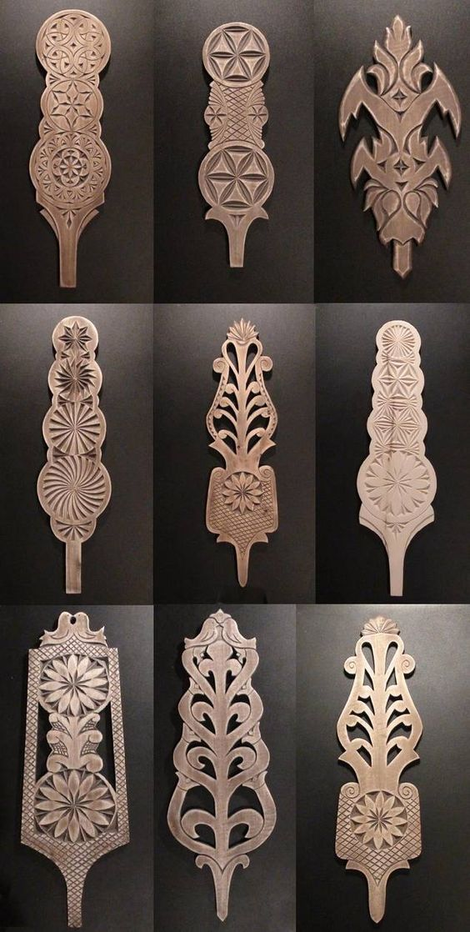
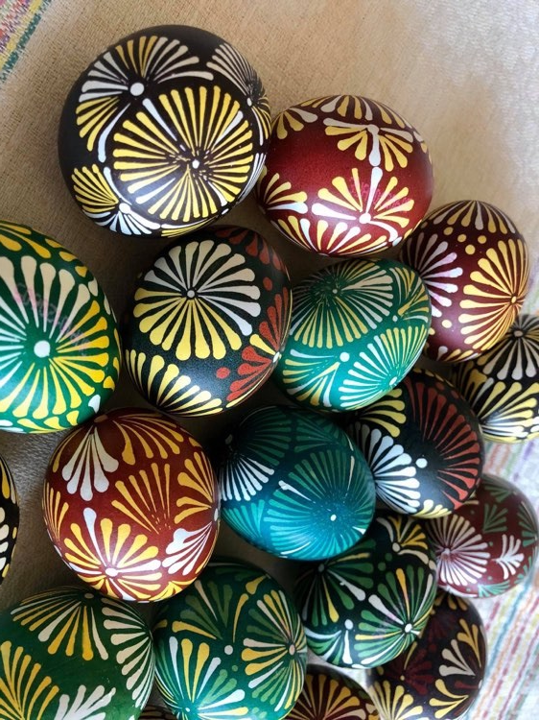
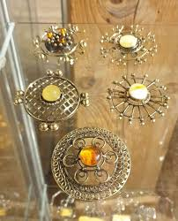
Saulės motyvai taikomojo pobūdžio dirbiniuose
Notes:
Sun motifs are abundant in fabrics, ornaments, wood carvings, furniture, crosses, eggs, and ceramics. There are many surviving outcrops with the symbol of the sun - a segmental star.

Slide 10
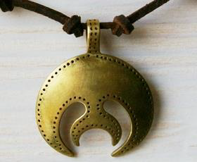

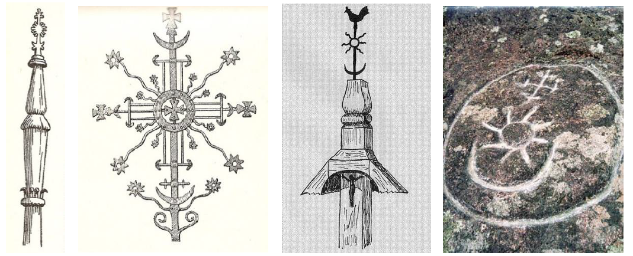
Mėnulis
Notes:
The sun was not alone in Lithuanian folk art and folklore. The moon and stars accompanied it. The moon's importance in folk art is excellent but not more significant than that of the sun, so the moon symbol is often depicted under or near the sun, usually smaller in size than the symbol of the sun. By following the moon's phases and knowing their effects on nature and man, people have adapted their work and lifestyle to them. The lunar calendar is widespread and is often planted by gardeners and farmers.

Slide 11

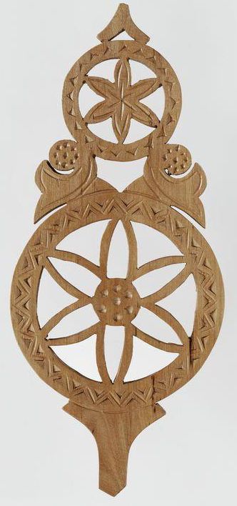
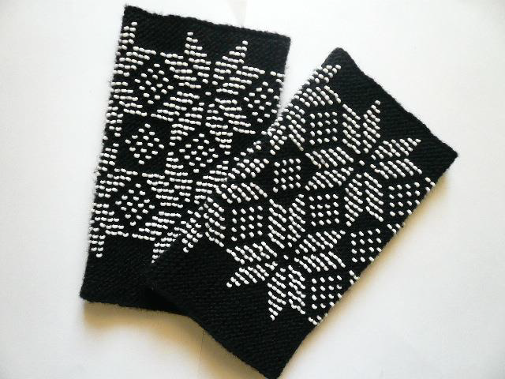
Žvaigždės
Notes:
Observing the stars has long been important for humans because we can use the stars to orientate in space and determine the time of sowing or harvesting and changes in the weather. Venus, called the Western or Dawn Star, is highly respected and loved. Its symbol is a pentagonal star typical in knitted patterns.

Slide 12
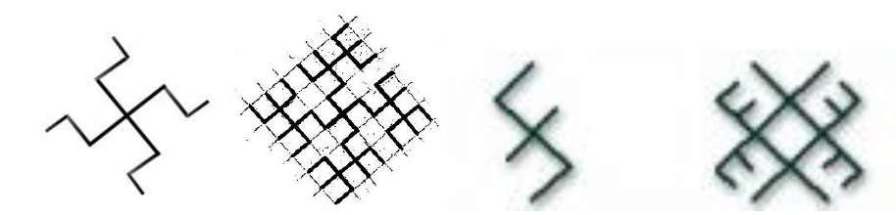
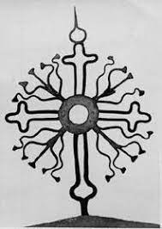
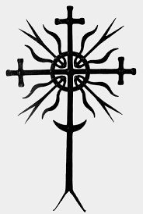
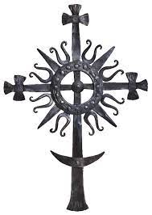
Perkūno simboliai
Notes:
Celestial phenomena such as thunder and lightning are called by one name - Perkūnas. It is a deity imagined in the old beard, which fights for justice and performs the functions of a life-bearer. Geometric shapes symbolize Perkūnas, often expressed as a cross or "axe."

Slide 13


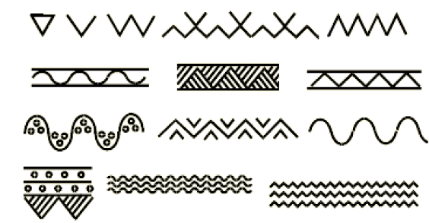
Vėjas, lietus, vanduo
Notes:
The wind is imagined as an armless, legless being who knows everything and sees everything, so he was thought to be the almighty creator of the Universe. The wind is usually represented by a plus sign, which symbolizes the four directions. The main symbol of the wind - the windmill also had four wings. Rain is associated with agriculture because the fate of the harvest depends on it. The symbolism of rain intertwines with watermarks, so rain is often depicted in a zigzag or triangle. An area filled with vertical or diagonal lines can also be considered a sign of rain.

Slide 14
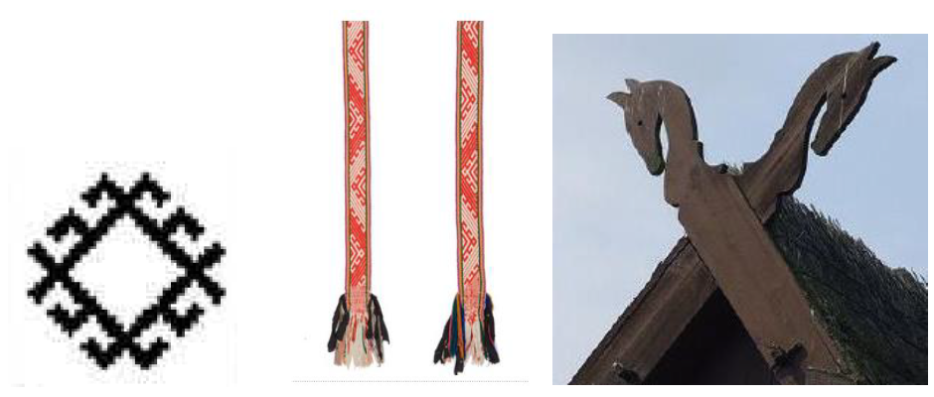
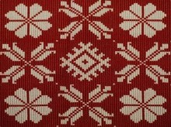
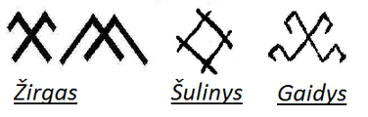
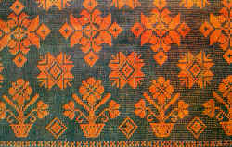
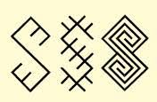
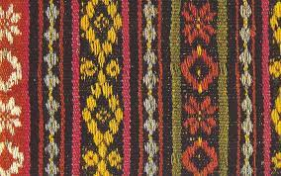
Augalų ir gyvūnų motyvai
Žaltys
Notes:
Motifs of plants and animals in folk art.

Slide 15
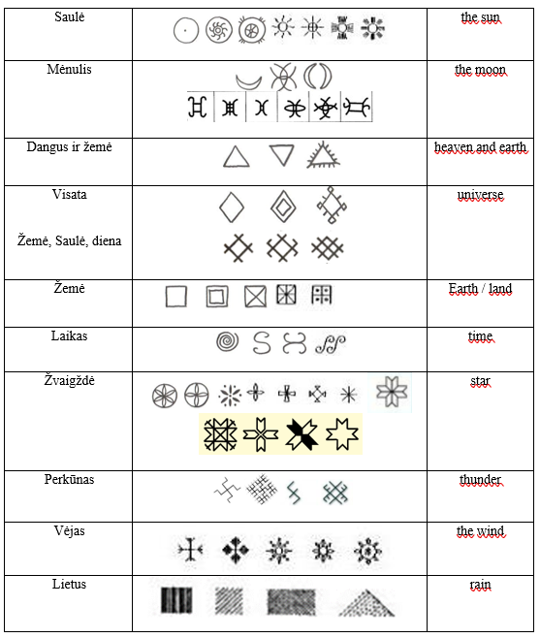
1 užduotis. Atpažinkite simbolius

Slide 16
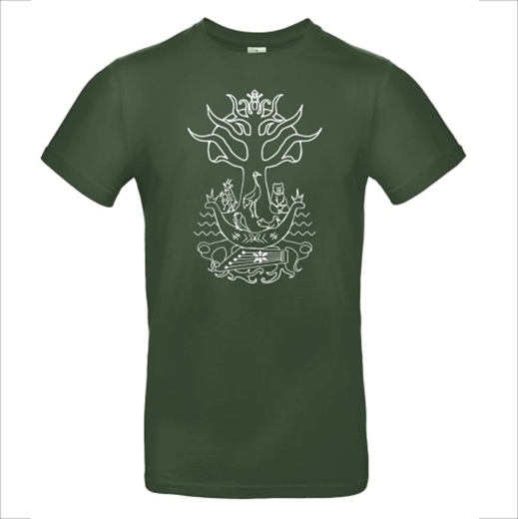
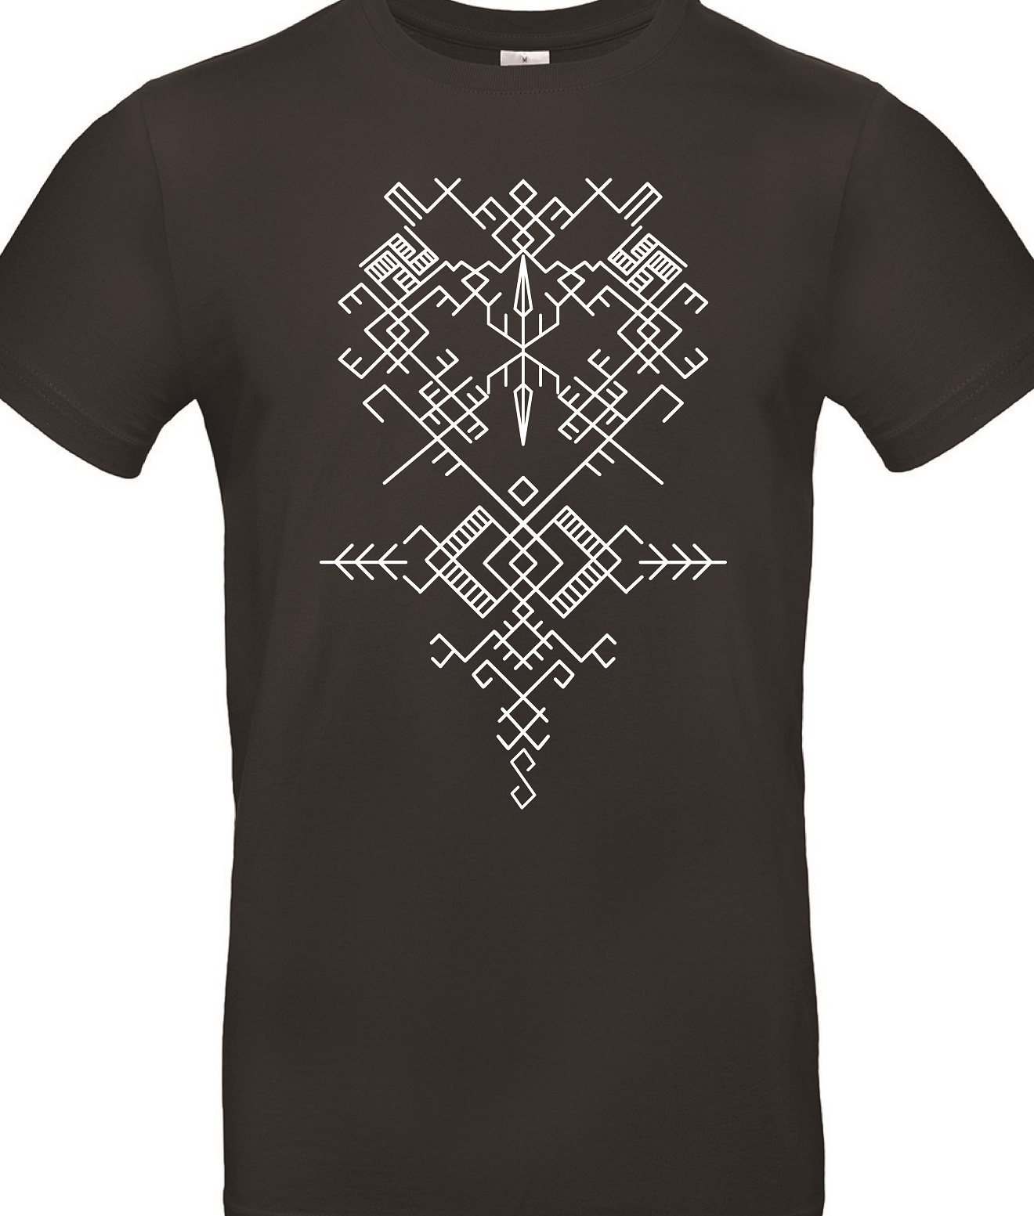
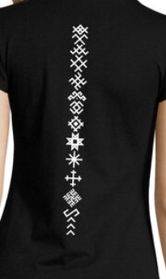
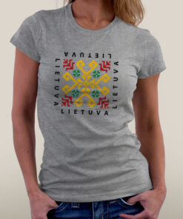
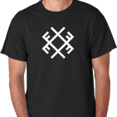
2 užduotis. Eskizas
Sukurkite piešinio ant palaidinės eskizą panaudodami dangaus kūnų simboliką.
Notes:
Create a sketch of the drawing on the blouse using the symbolism of celestial bodies.

