Slide 1
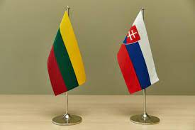
International lesson „How good do you know some of the EU countries.“
Live meeting of Slovakian
and Lithuanian students
19 05 2021

Slide 2
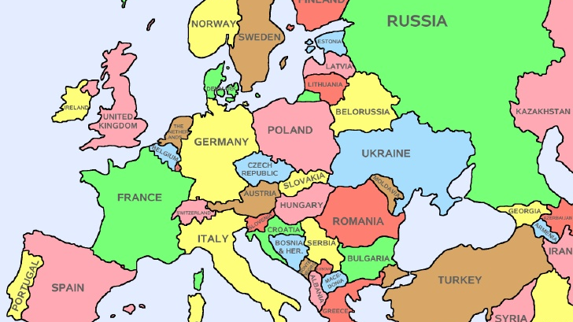

Slide 3
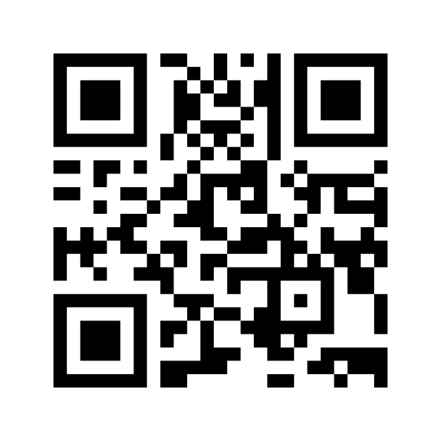
https://www.menti.com/vxys56f568

