Slide 1
Velvet Revolution 1989
Nina Baranovičová, Ernest Fázik, GIK HC, Slovakia

Slide 2
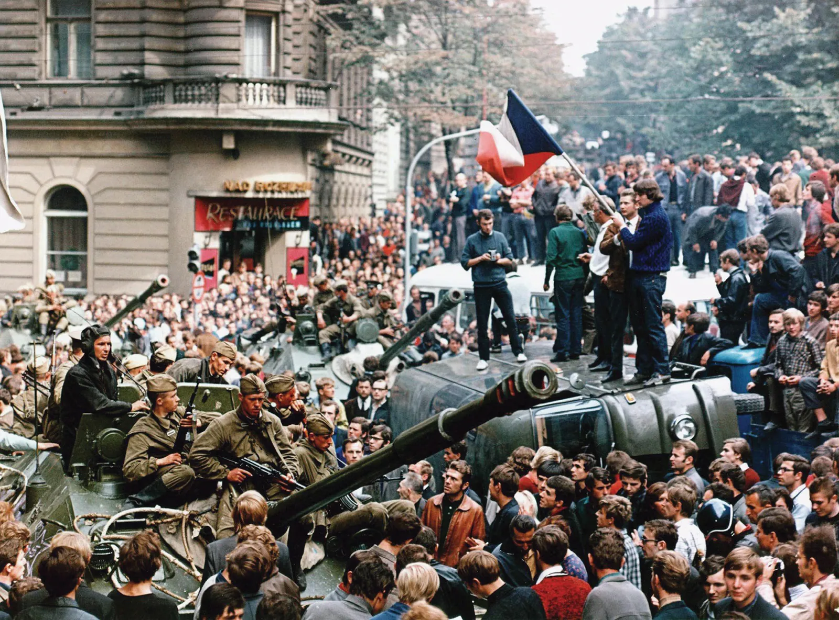
Background
In 1989, Czechoslovakia was in the 20-year long era of normalization
This started when Soviet troops invaded Czechoslovakia to keep control
During this time, the CSSR was not doing well economically and human freedoms were limited
The Communist party was leading the country for 40 years already

Slide 3
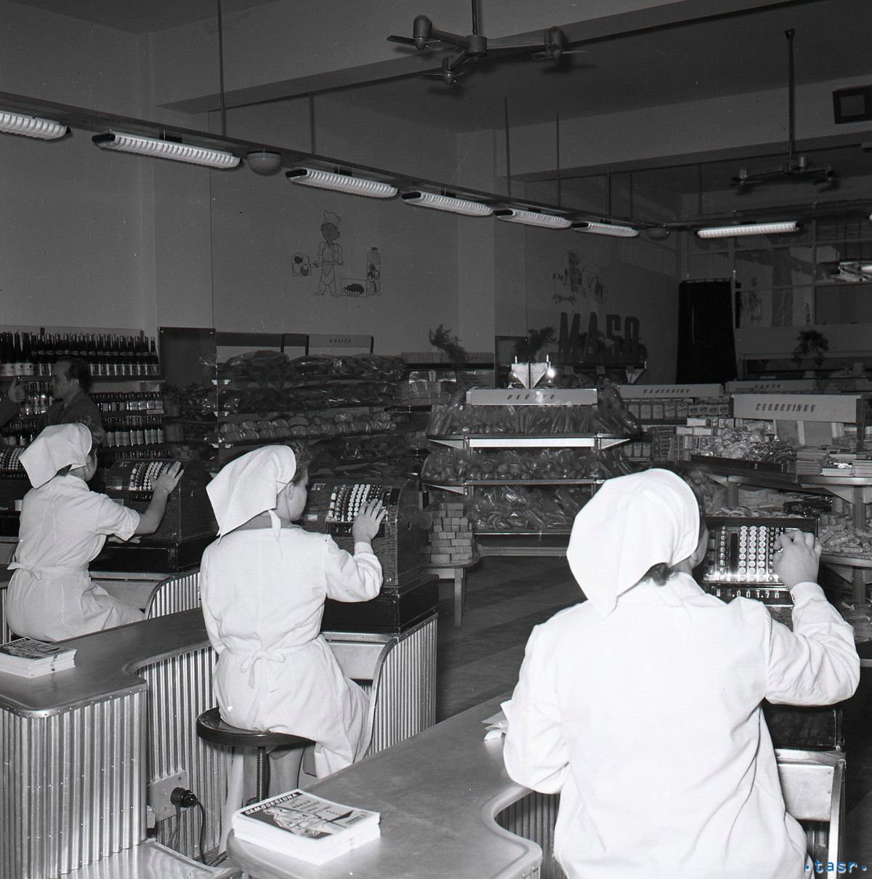
Czechoslovakia before November 1989
Travelling to free countries was banned
Art not supporting the government was censored
People couldn’t be openly religious
Schoolbooks were biased and censored
In order to get a better life people had to join the Communist Party
The state owned everything
Many products were hard to get

Slide 4
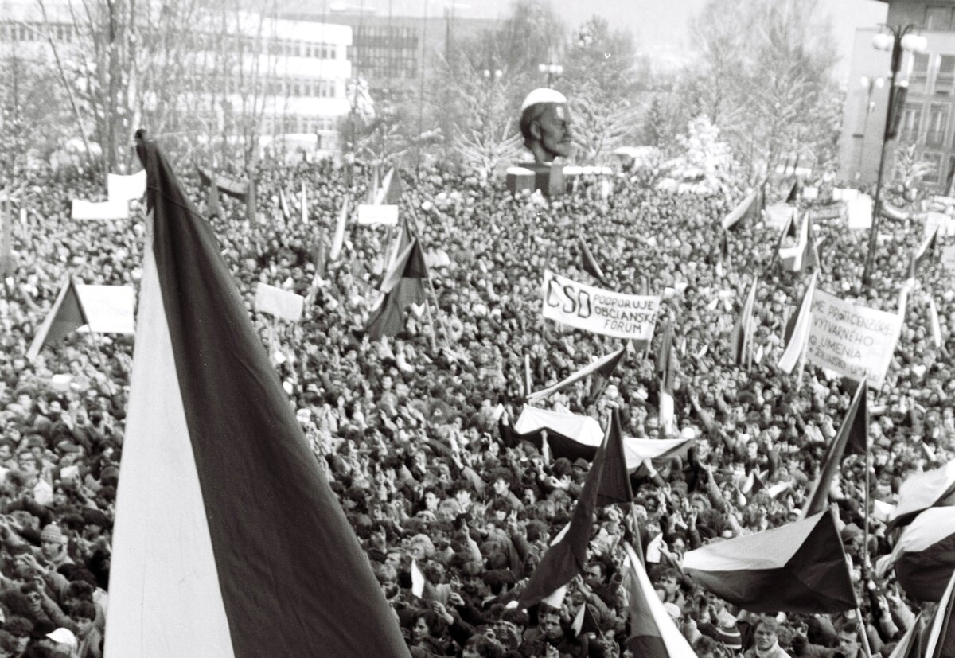
November 17th
On International Student´s Day, a protest was organized to commemorate it by the Communist Party in Prague
Students and 15 thousand others joined the protest to voice opposition to the government
This was effectively the start of a two week long series of protest in all the major cities of Czechoslovakia

Slide 5
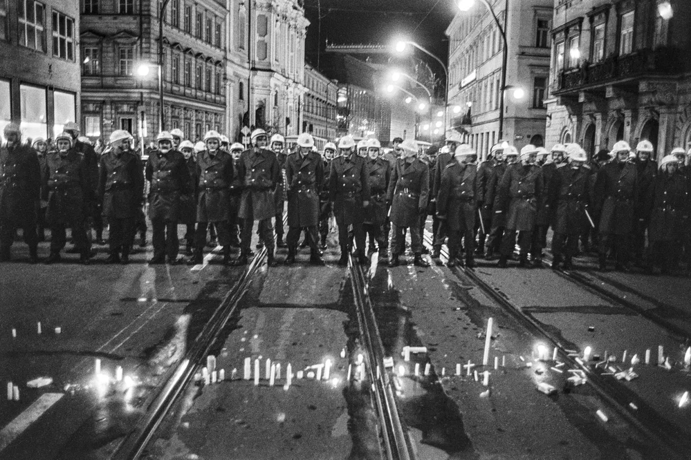
The Velvet Revolution
The protests were facing non-stop opposition by the riot and secret police
Among others, the government used water hoses to stop the protesters from continuing their non-violent protests
On 27th of November, a general strike supported by most of the country forced the government to effectively end censorship and the rule of the Communist Party

Slide 6
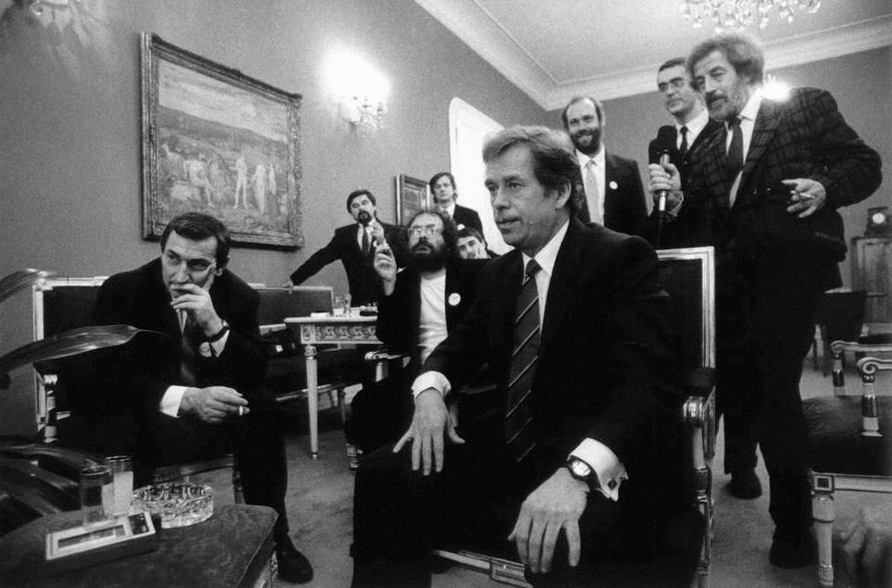
The Wind of Change
Thanks to the revolution, the first free presidential election was held on November 29th
Václav Havel, a human rights activist, became the first president of post-communist Czechoslovakia
After the elections, the economy privatised, Soviet troops left the country and the borders were opened

Slide 7
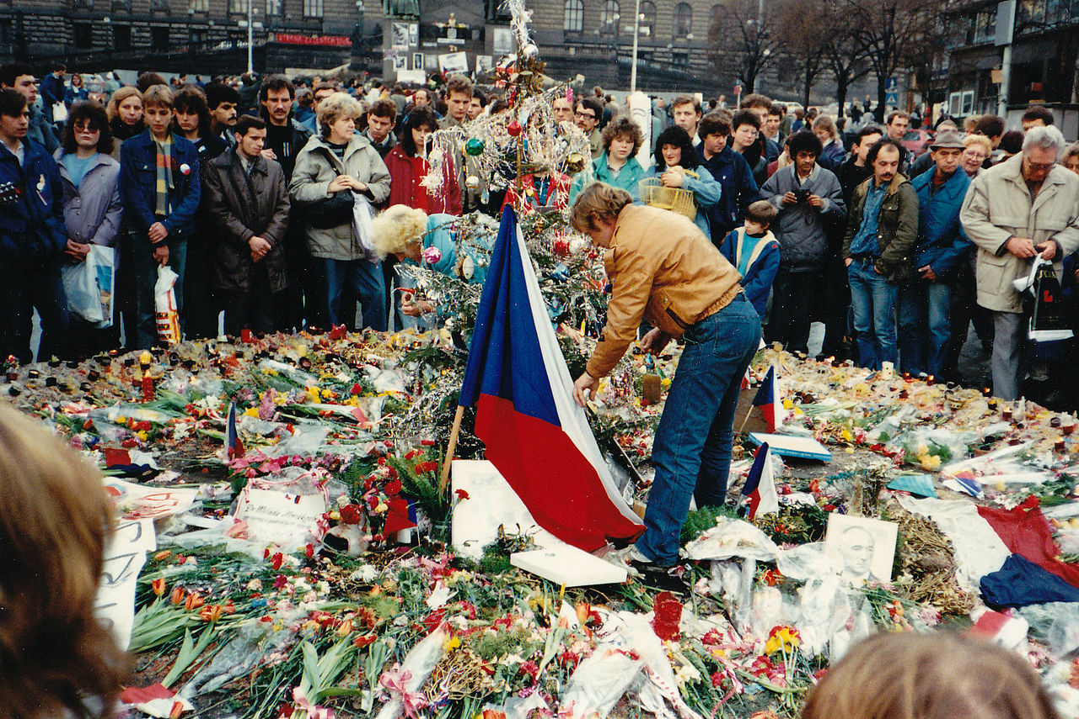
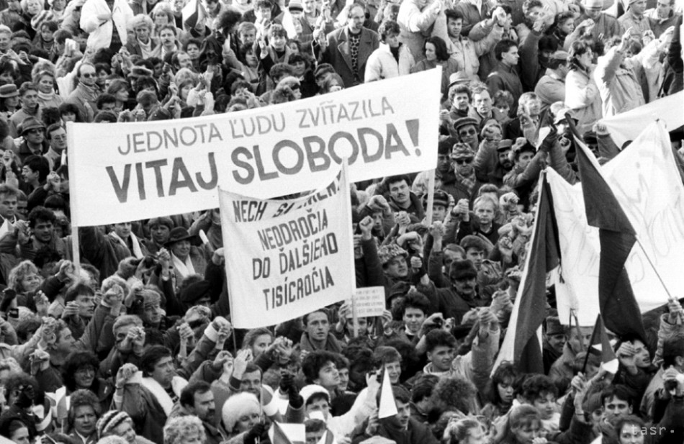
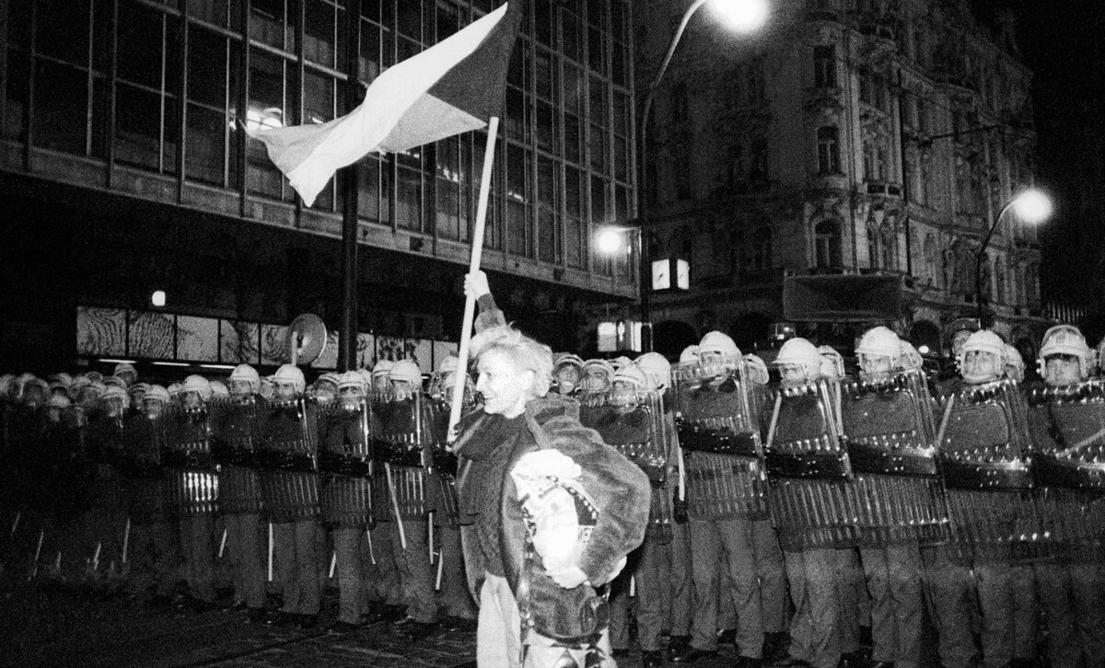
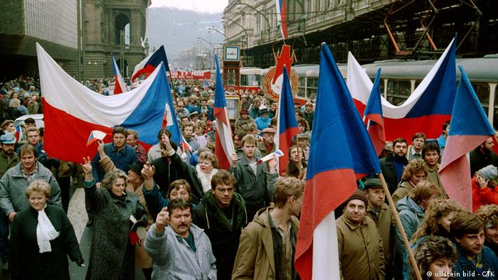

Slide 8
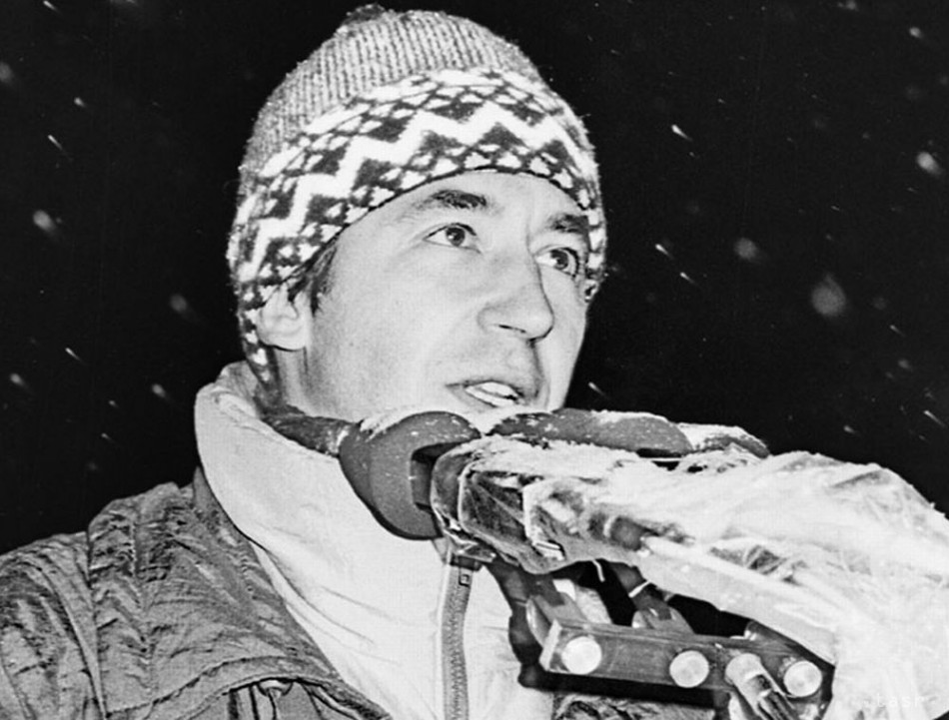
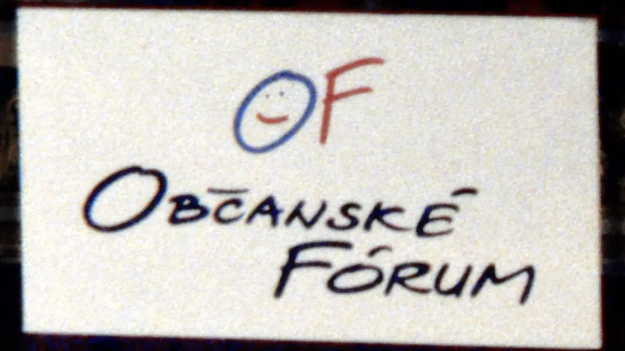
Symbols of the Revolution
Budajka (Budaj hat)
Občianske Fórum (Civic Forum)
Štrnganie kľúčmi (Keys Jingling)
Verejnosť proti násiliu (Public Against Violence)

