Slide 1
GERMANY

Slide 2
Germany is a federal country which has federal states. Each state has its constitution, parliament and government. Germany is located in western Europe and has breathtaking landscapes of forests, rivers, mountain ranges.

Slide 3
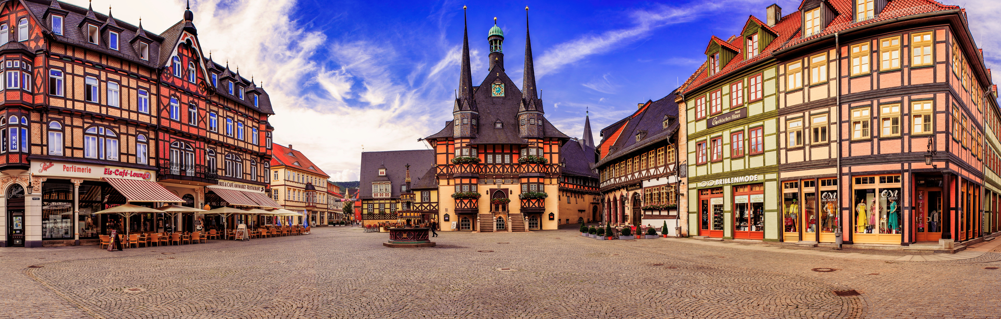
Germany is the country with the highest population in European union. There live about 82,5 million citizens.

Slide 4
Germany receives millions of tourists each year, many of them visit famous sightseeings of Germany and nature reserves.

Slide 5
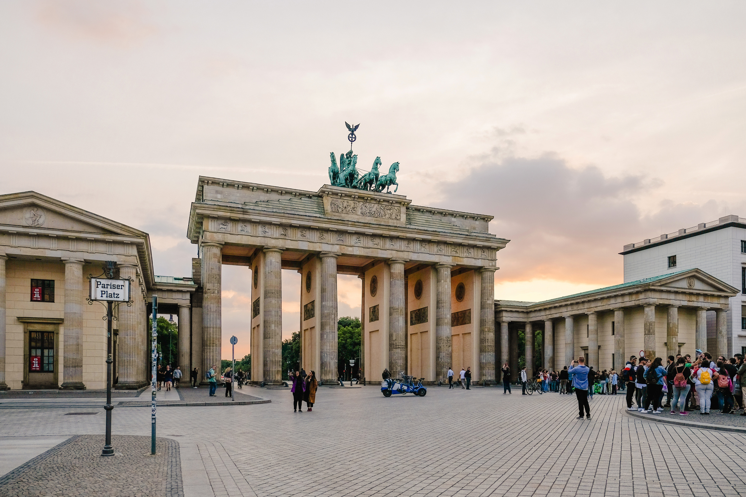
Brandenburg Gate is Berlin's most famous landmark. A symbol of Berlin and German division during the Cold War, it is now a national symbol of peace and unity.

Slide 6
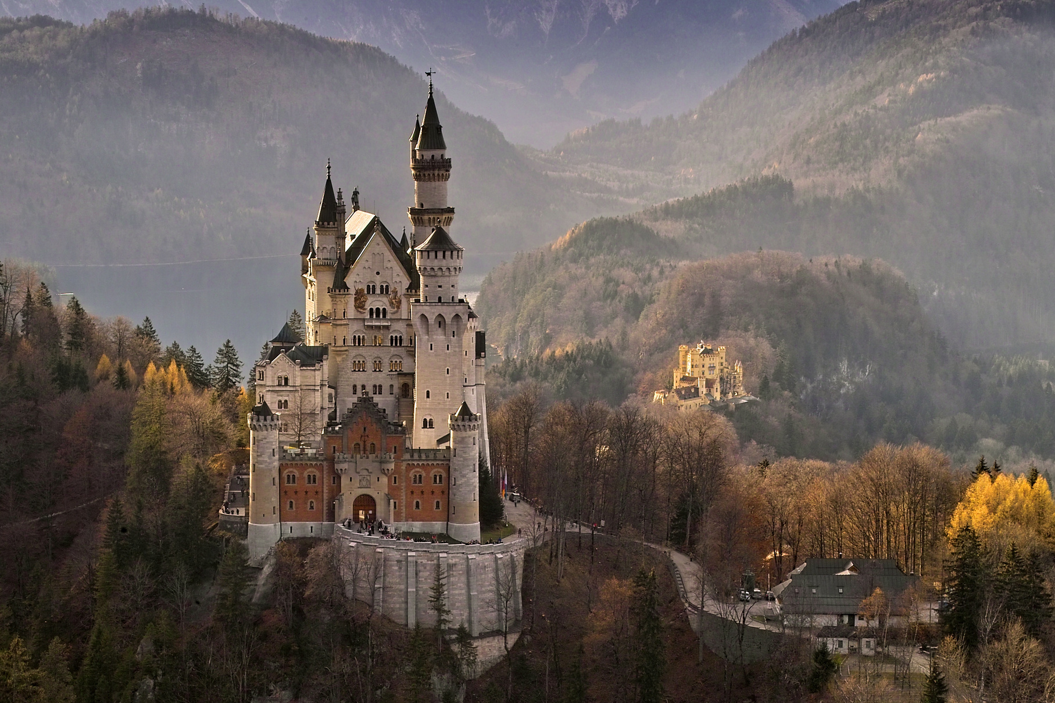
Neuschwanstein Castle is a 19th-century historicist palace on a rugged hill above the village of Hohenschwangau near Füssen in southwest Bavaria, Germany and it's one of the most significant part in Germany.

Slide 7
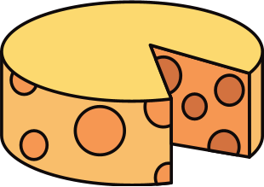
German people love cheese and beer

Slide 8
Currywurst is sold from stalls and fast-food eateries in many towns and cities, and if you want to know what food the capital city Berlin is famous for, you will quickly discover that it is Currywurst..

Slide 9
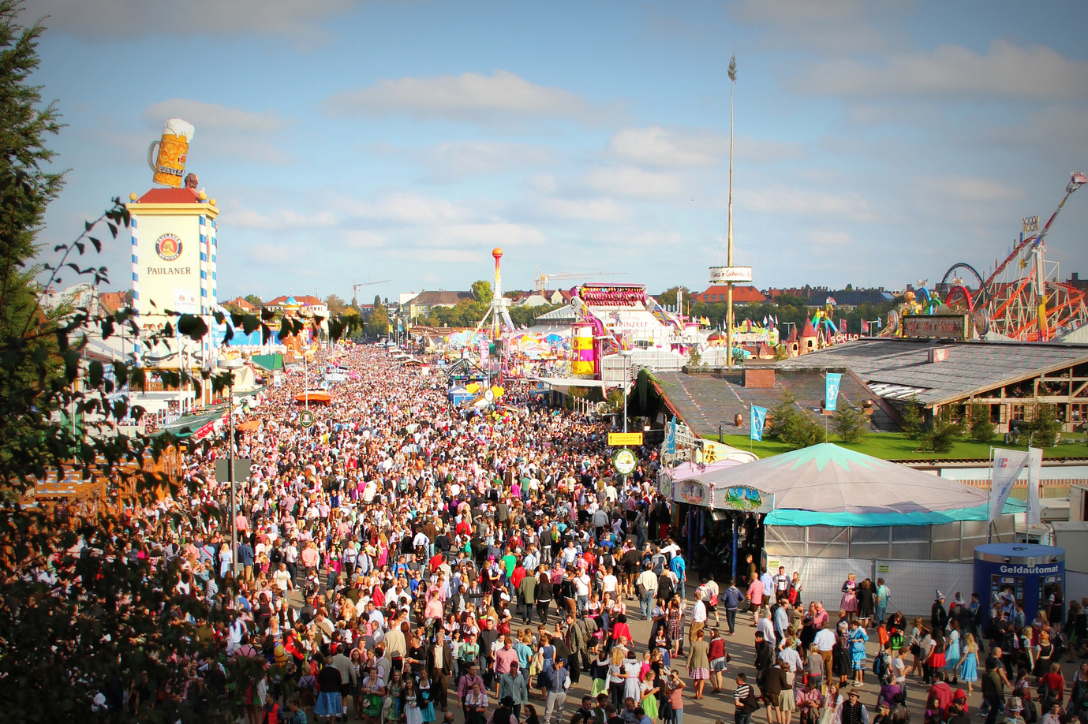
Oktoberfest is a festival held each year in Munich, in October. It's the world's largest fair. People drink beer and eat traditional German meals.

Slide 10
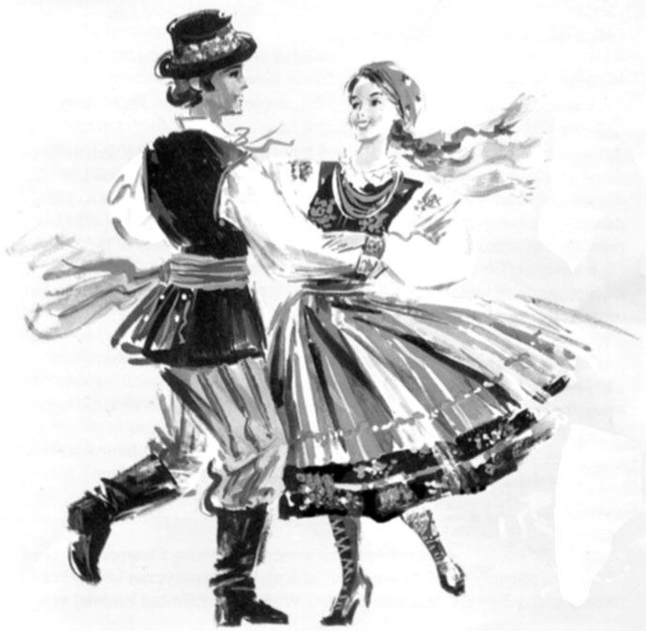
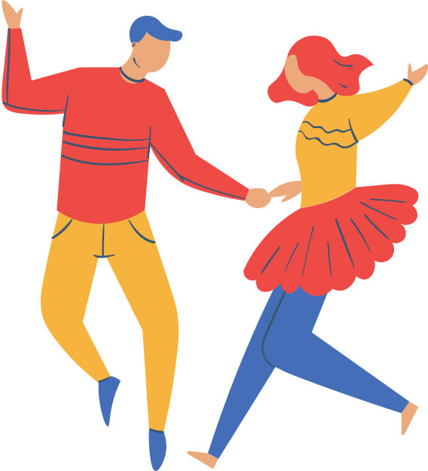
"Polka" is a traditional dance from Austria, but it's also very trendy in Bavaria. "Polka" is a fast dance which is danced by couples or groups.

Slide 11
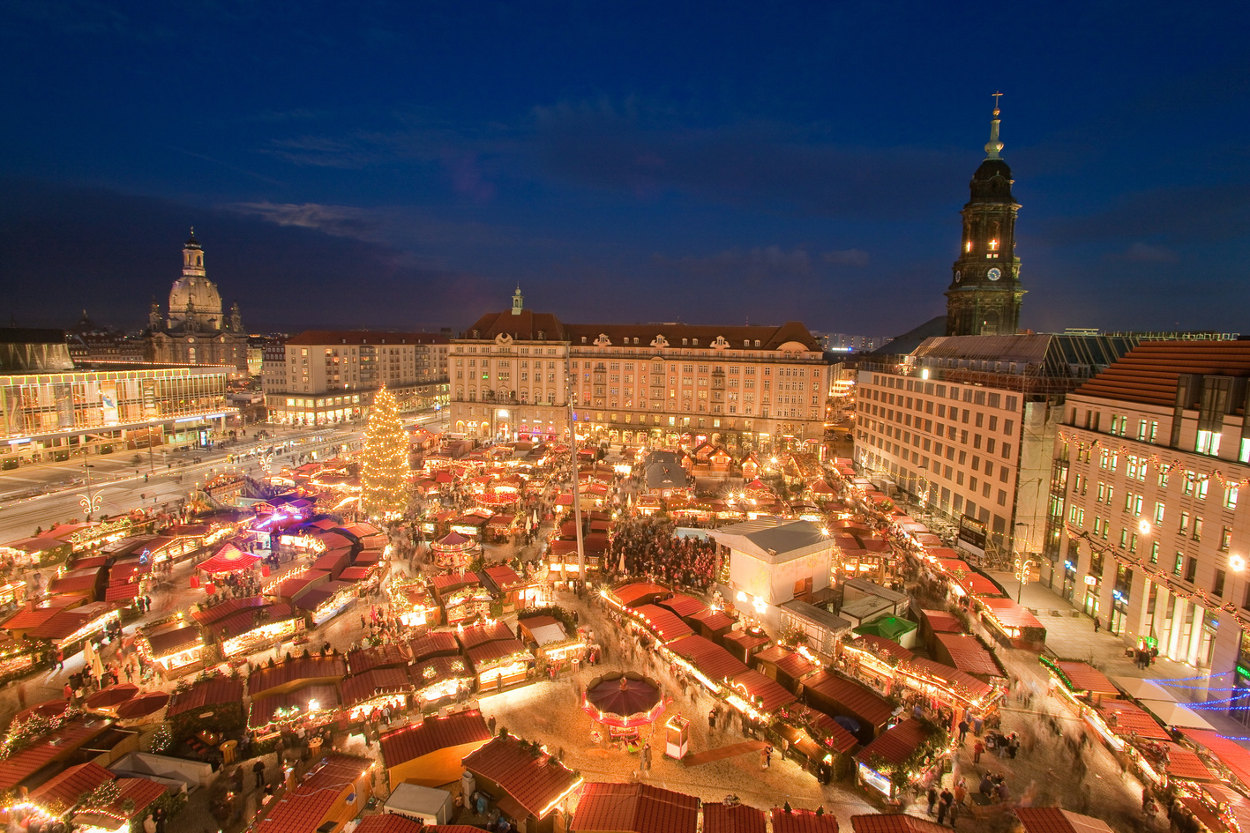
Germany is famous for its colourful and traditional Christmas markets, organised across the country during the festive season.

Slide 12
Germany was one of the founding members of the European Union in 1957.

Slide 13
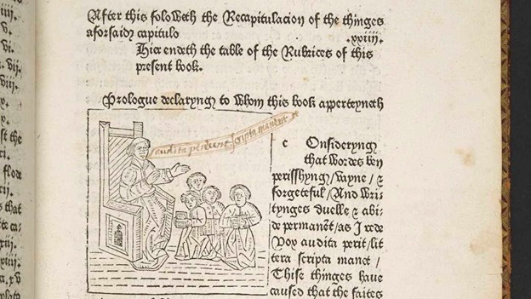
Did you know?
The first known printed book was printed in German, just as the first ever known printed magazine.

Slide 14
The official language of Germany is German, with over 95% of the population speaking German as their first language.

Slide 15
Did you know?
In Germany, education is free even for international students. This is the case not only in primary and secondary education, but also in higher education, public colleges and universities.

