Slide 1
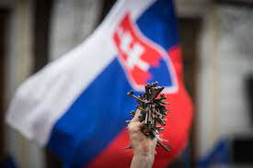
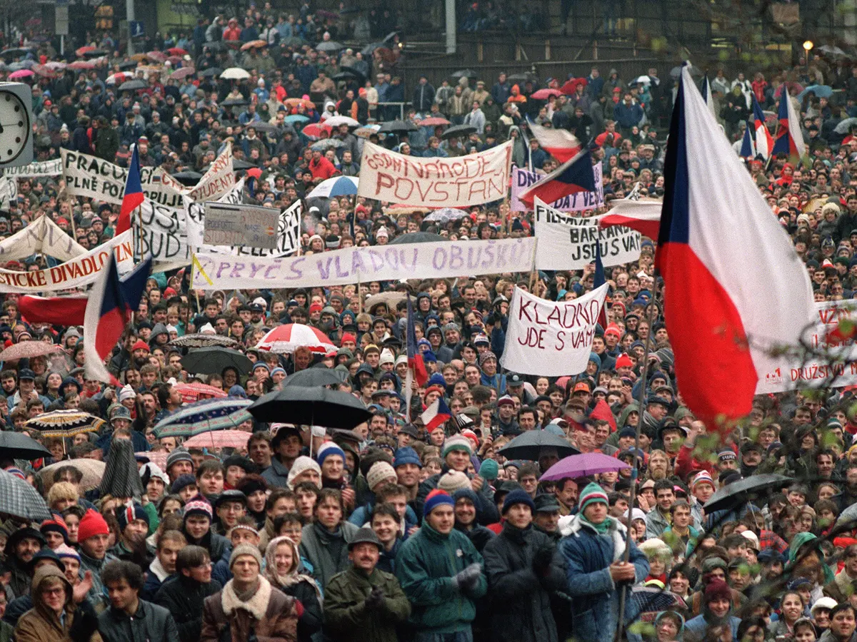
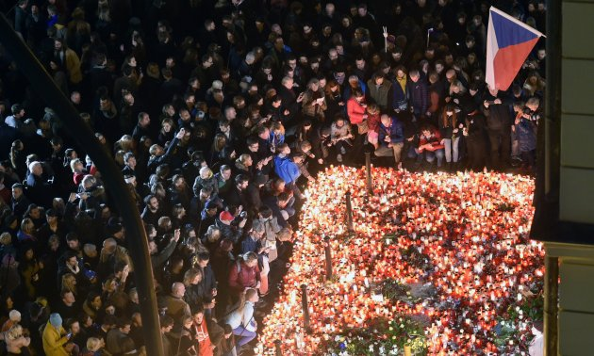
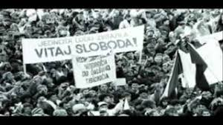
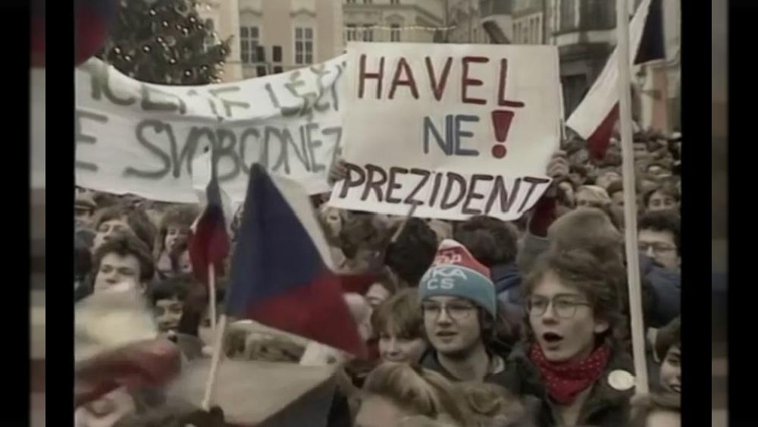
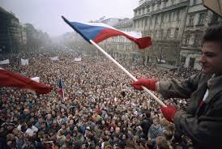
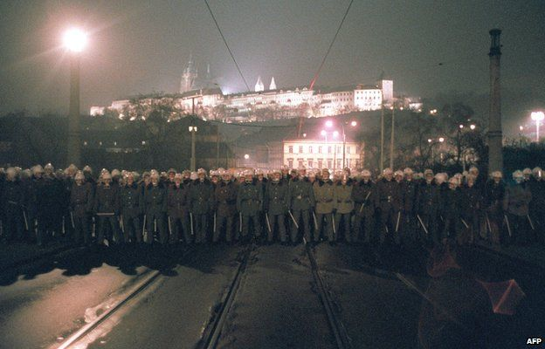
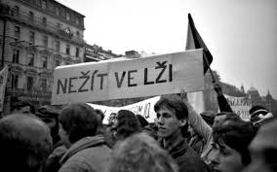
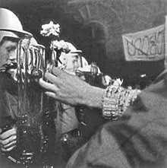
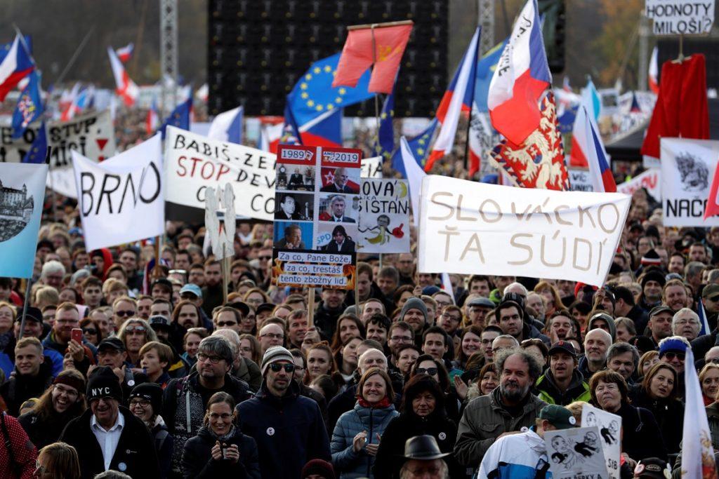
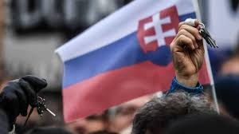
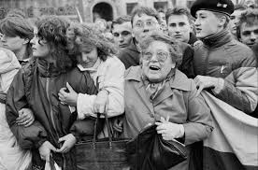
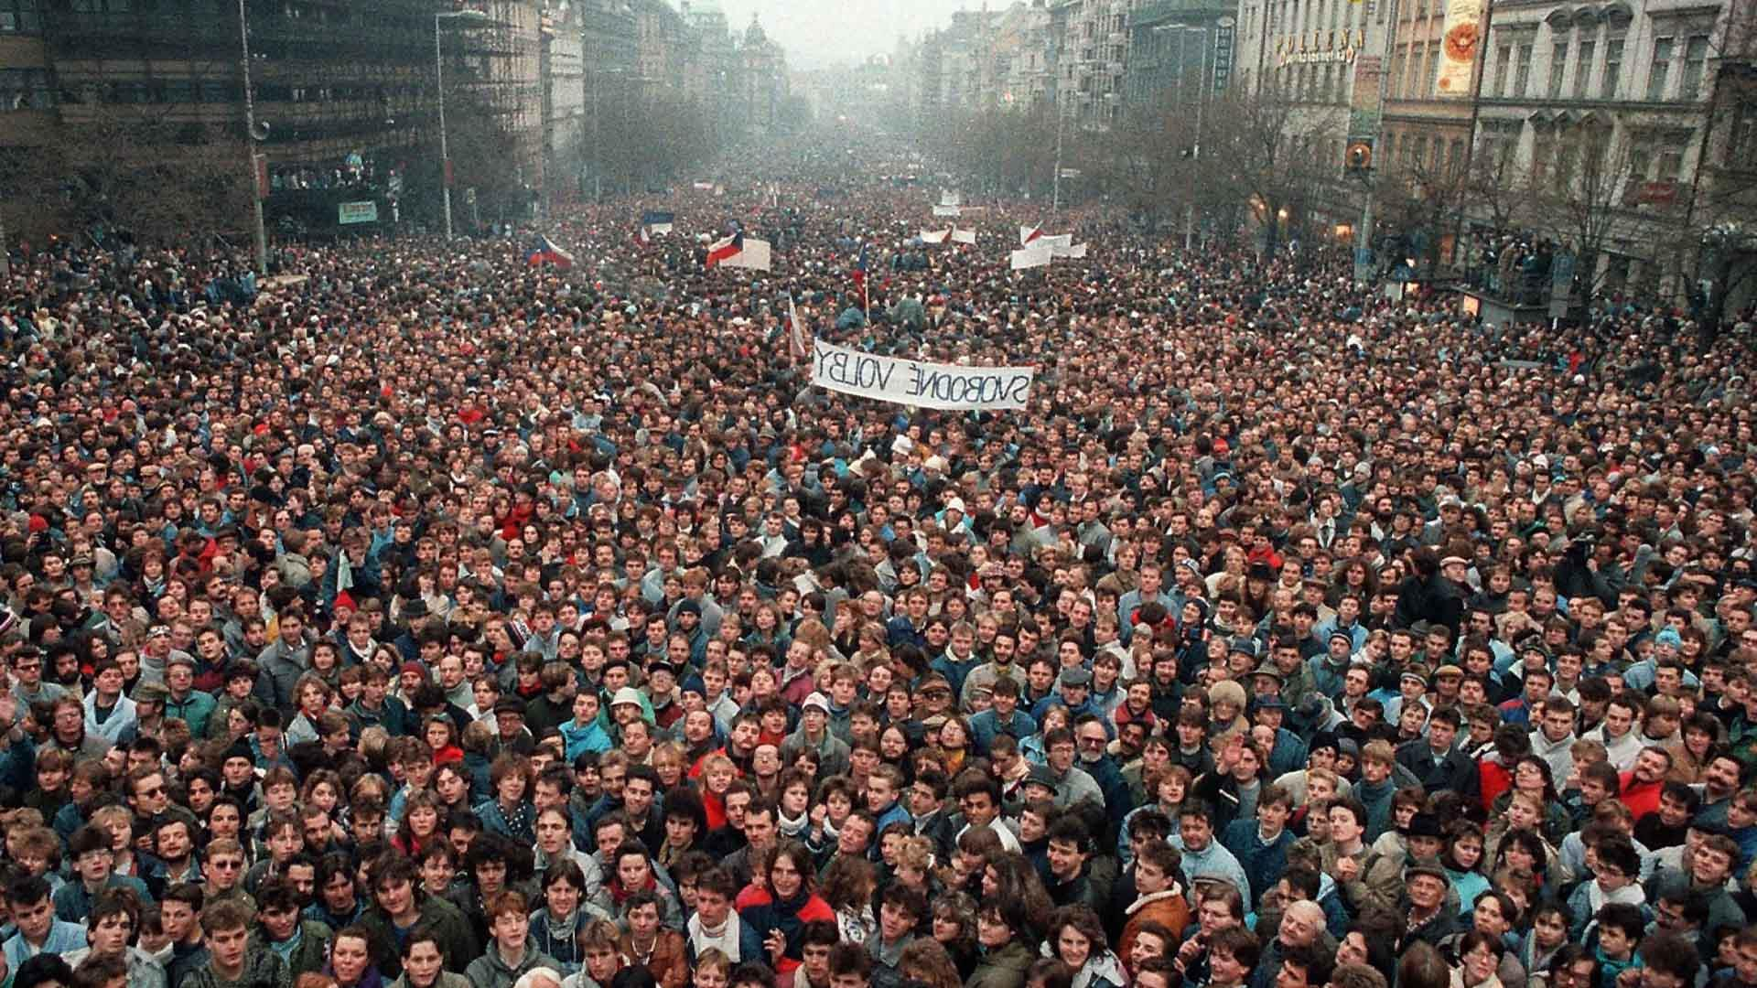
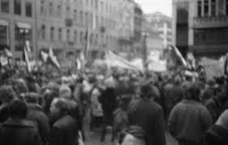
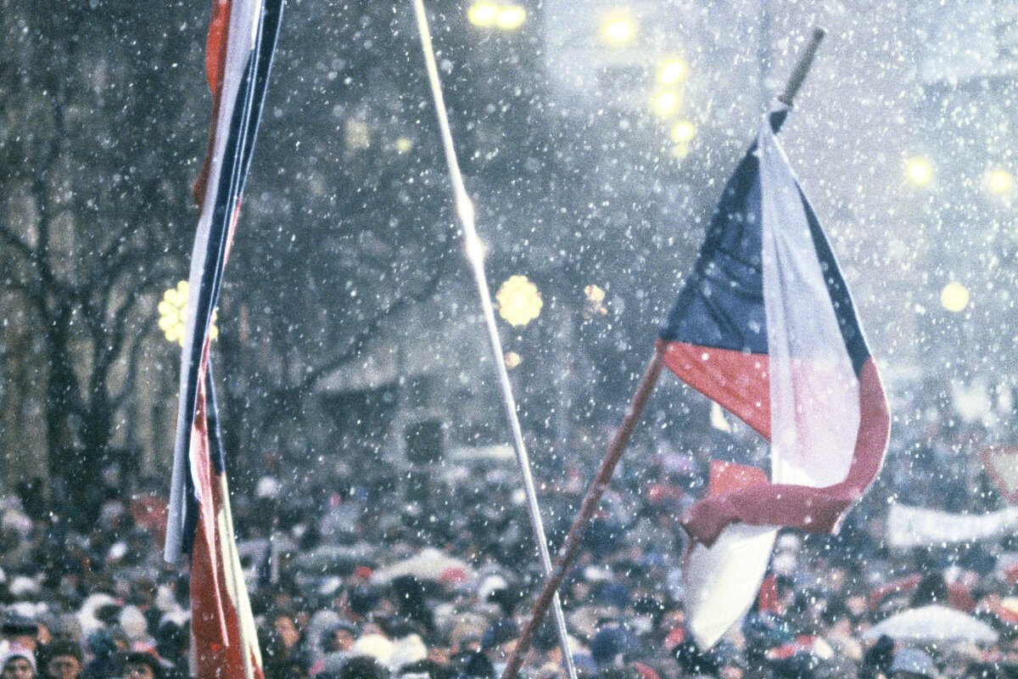
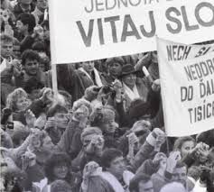
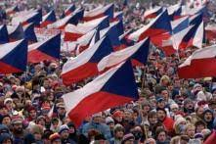
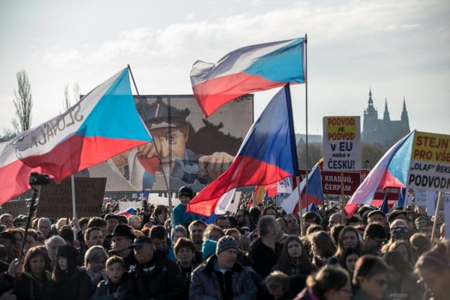
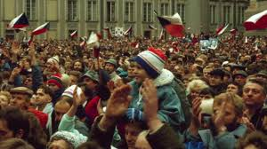
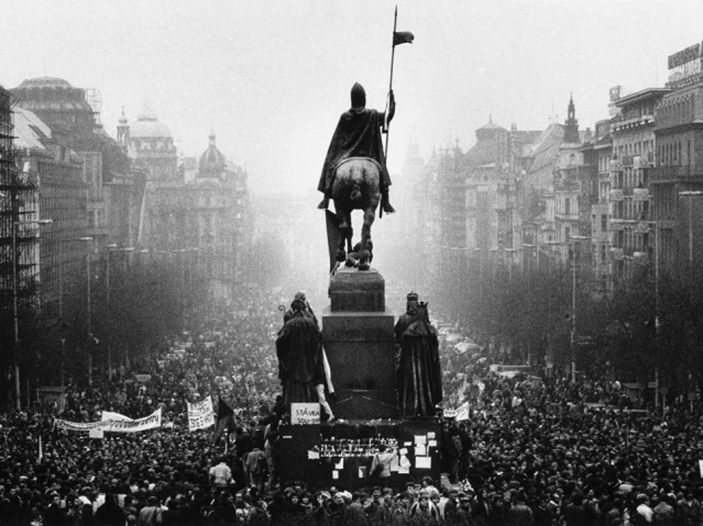
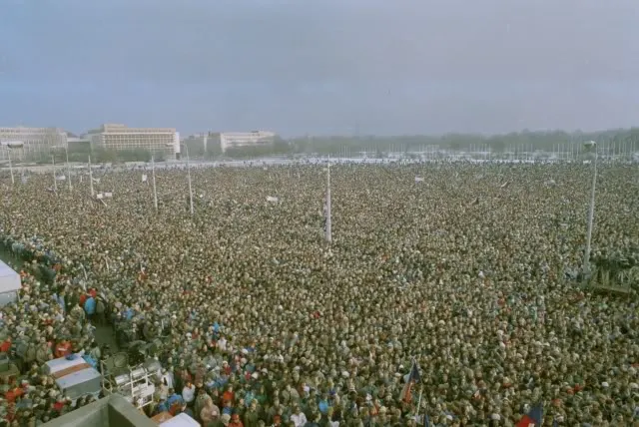
V e l v e t R e v o l u t i o n
Zuzana Kováčová
Sofia Kolevová

Slide 2
What was Velvet Revolution?
The Velvet Revolution was an event which result was removal of communist regime in Czecho - Slovakia.
Non-violent protests of students from Universities joined by well-known actors, artists and singers.

Slide 3
Protests:
17th of November:
Prostests started in the afternoon in areal of Charles University.
They held lit candles and chanted slogans for freedom.
This assembly was interrupted by special policemen called Červené Barety.

Slide 4
protests:
27th of November the two hour general strike took place .
The next day the Federal Assembly elected Alexander Dubček as its chairman.
On 29th of December was Václav Havel elected as the president of CSSR .

Slide 5
Results of velvet revolution:
The result was the end of 41 years of one-party rule in Czecho-slovakia, and the cancellation of the command economy and conversion to a parliamentary republic.

Slide 6
Life before and after:
Before:
Banned things:
Travelling abroad
Foreign music
Problems with studying on High Schools and Universities
Western television and radio
After:
People started their own businesses
Unbanned travelling
Freedom of speech
Newspapers could inform objectively

Slide 7
Symbols:
1. Ringing with keys.
2. Budajka - hat
3. Peace sign - fingers
4. Cloves flowers, candles
5. Create a corridor - Utvorte koridor

Slide 8
THANKS
FOR
PAYING ATTENTION!

