Slide 1
Slovakia

Slide 2
The basic information about Slovakia
Slovakia is a country that is part of Central Europe.
It is a landlocked country, which is bordered by Poland, Ukraine, Hungary, Austria and the Czech Republic.
In Slovakia live over of 5.4 million people and Slovak territory has 49 035 square kilometers.
The largest and also capital city of Slovakia is Bratislava.
The second largest city is Košice.
Our official language is Slovak.
This is a flag of Slovakia

Slide 3
Location of Slovakia on the map

Slide 4
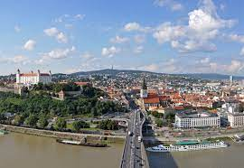
Bratislava
Bratislava is our capital and also the largest city.
The population of Bratislava is about 0.5 million.
In the picture is marked Bratislava and also our second largest city Košice.

Slide 5
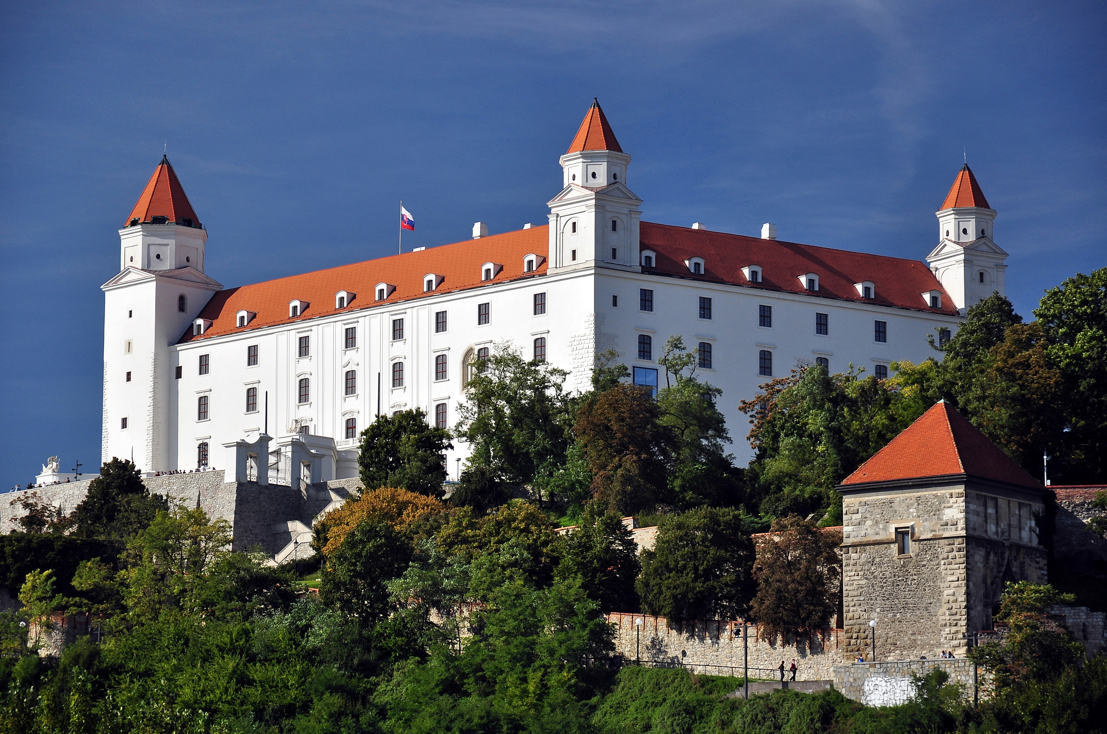
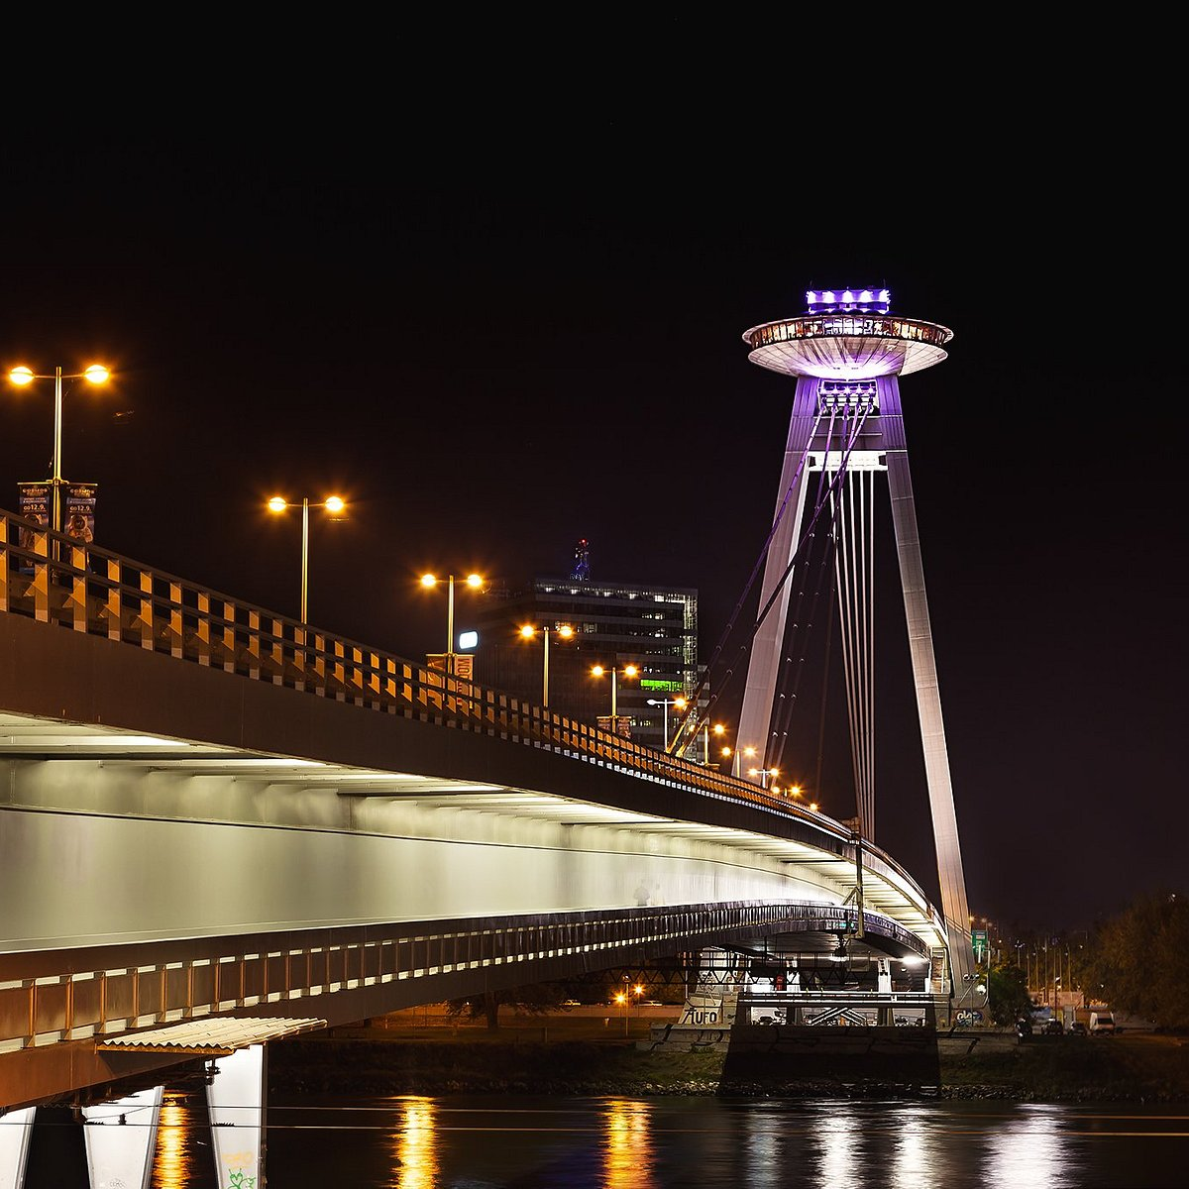
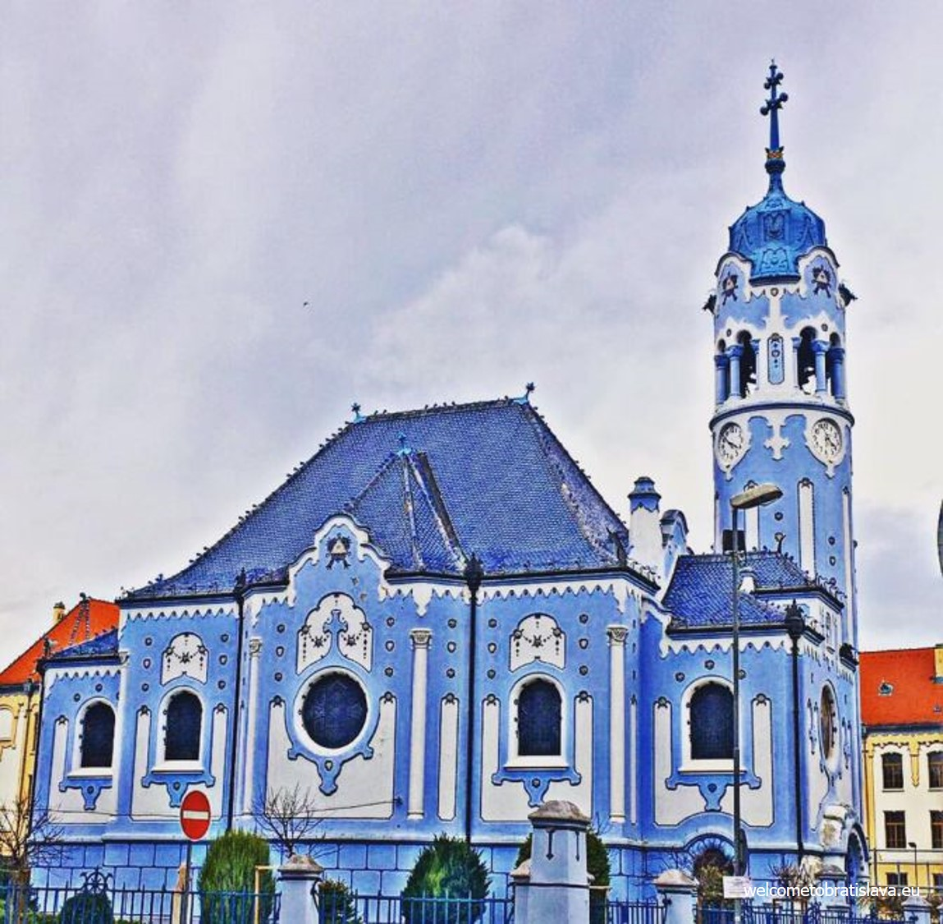
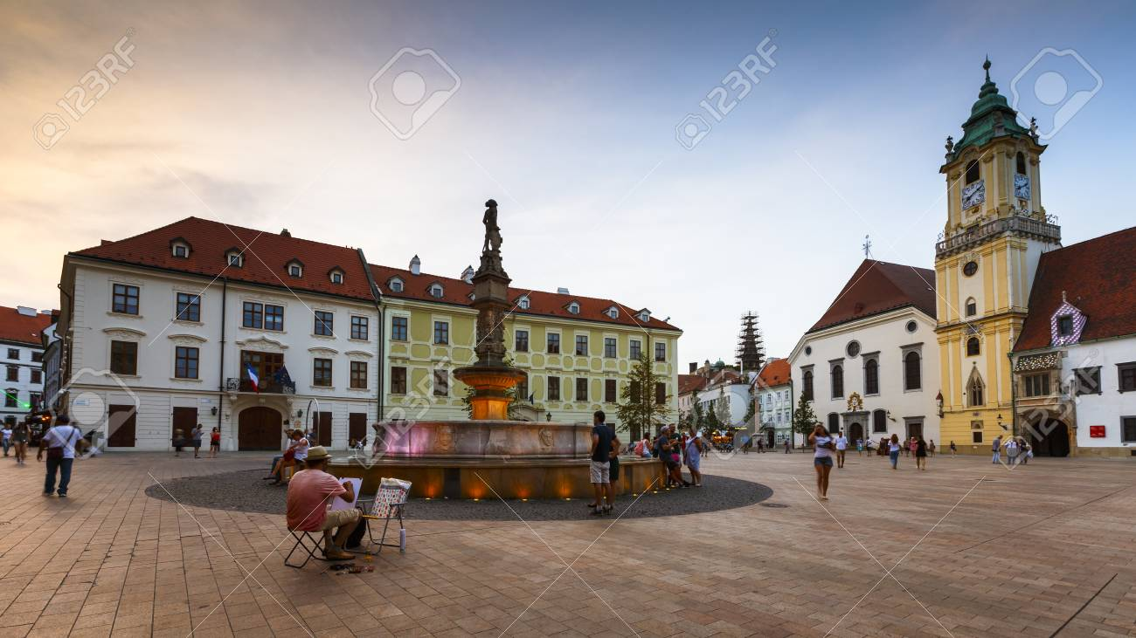
The most interesting things in Bratislava
UFO Tower
Bratislava Castle
Blue Church
The Main Square

Slide 6
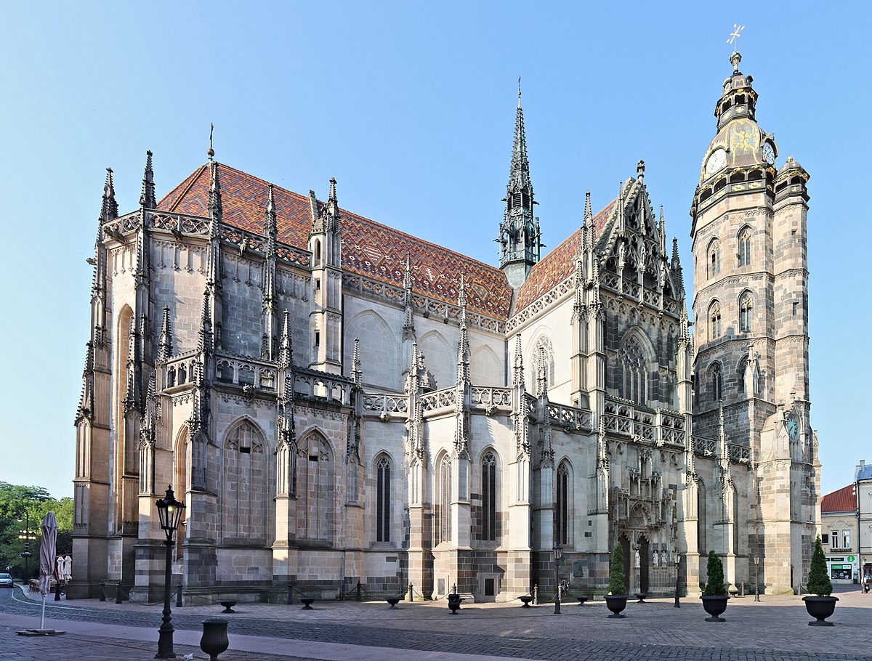
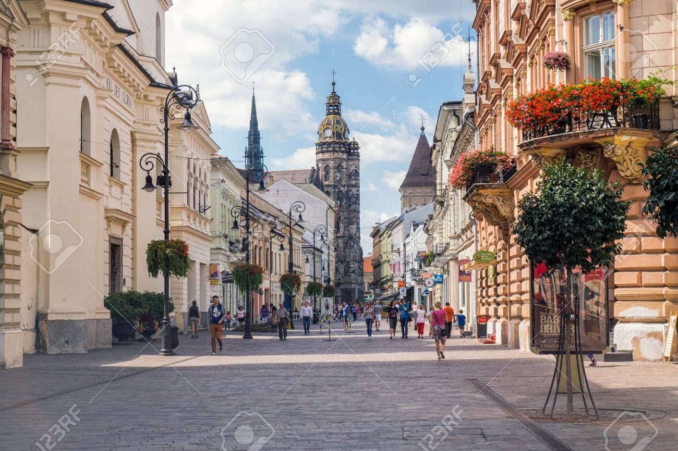
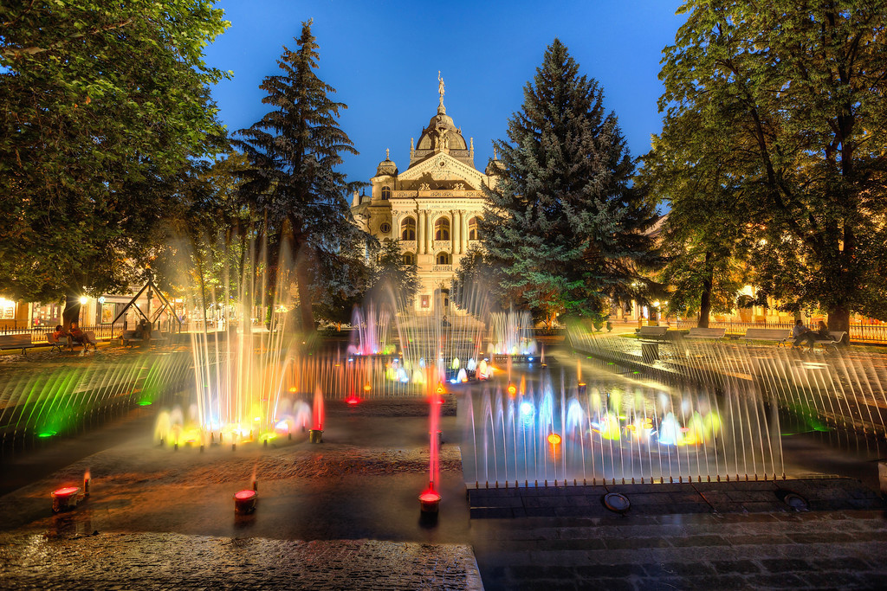
Košice
St Elisabeth Cathedral
Košice is the second largest city and the largest city in eastern Slovakia.
Population of Košice is about 0,3 million.
The Main Square
Singing Fountain

Slide 7
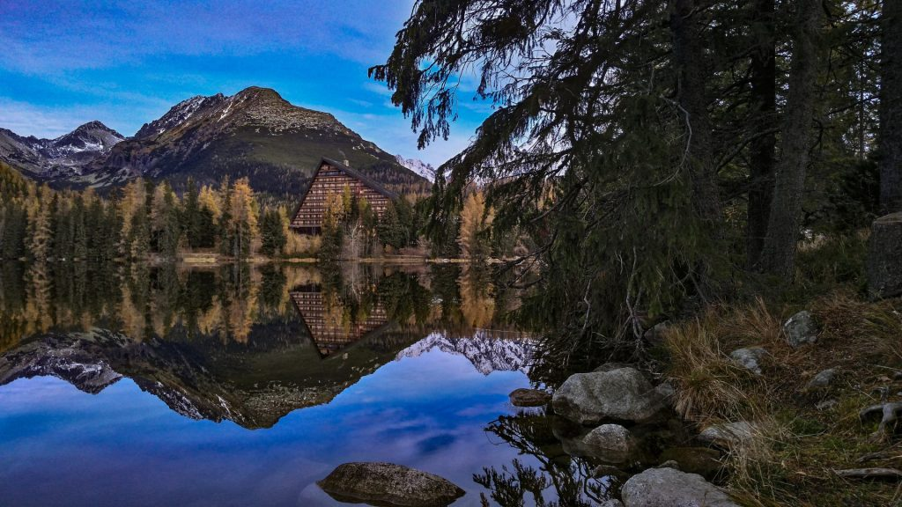
The High Tatras
The High Tatras are the highest mountains in Slovakia.
The highest peak of the High Tatras is Gerlachovský štít.
The High Tatras also belong to the Tatra National Park.
In the picture is Štrbské pleso – it is the most popular lake in the High Tatras.

Slide 8
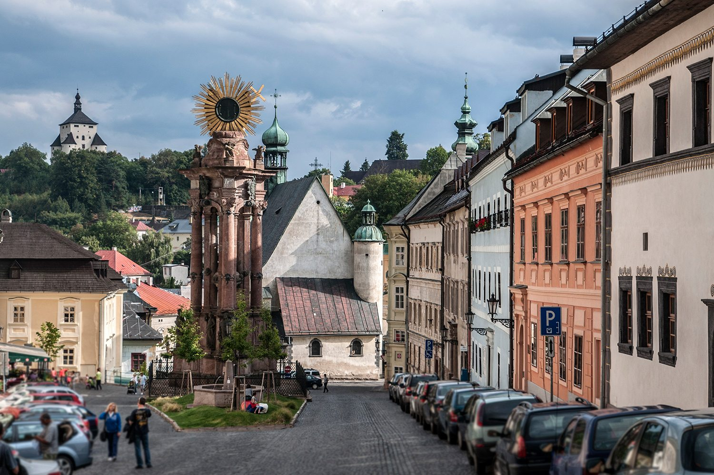
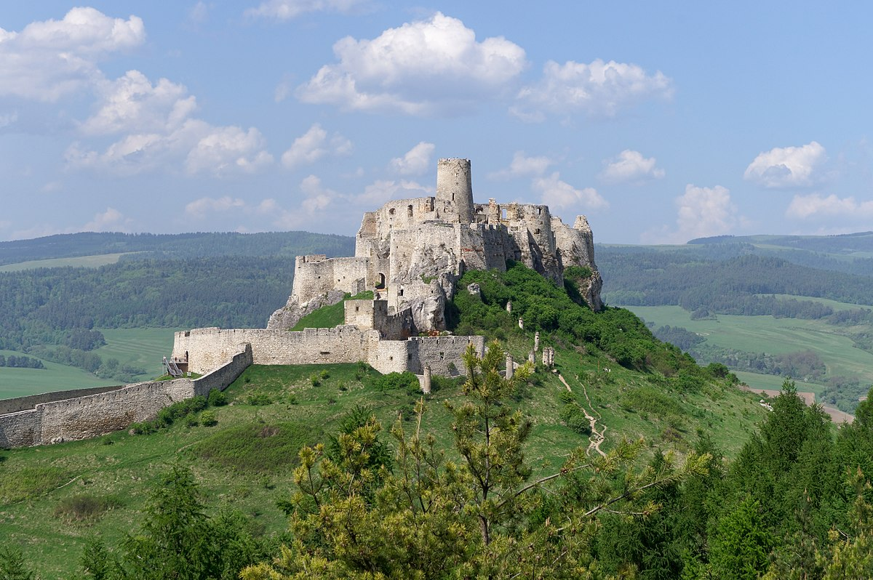
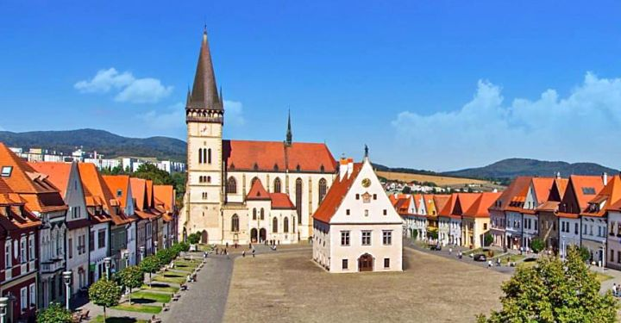
Slovakia in the UNESCO
In Slovakia, we have eight monuments that are in UNESCO.
Banská Štiavnica – a small mining town in central Slovakia
Spiš Castle which is also the largest castle in Central Europe
Bardejov – a town in the North-Eastern Slovakia

Slide 9
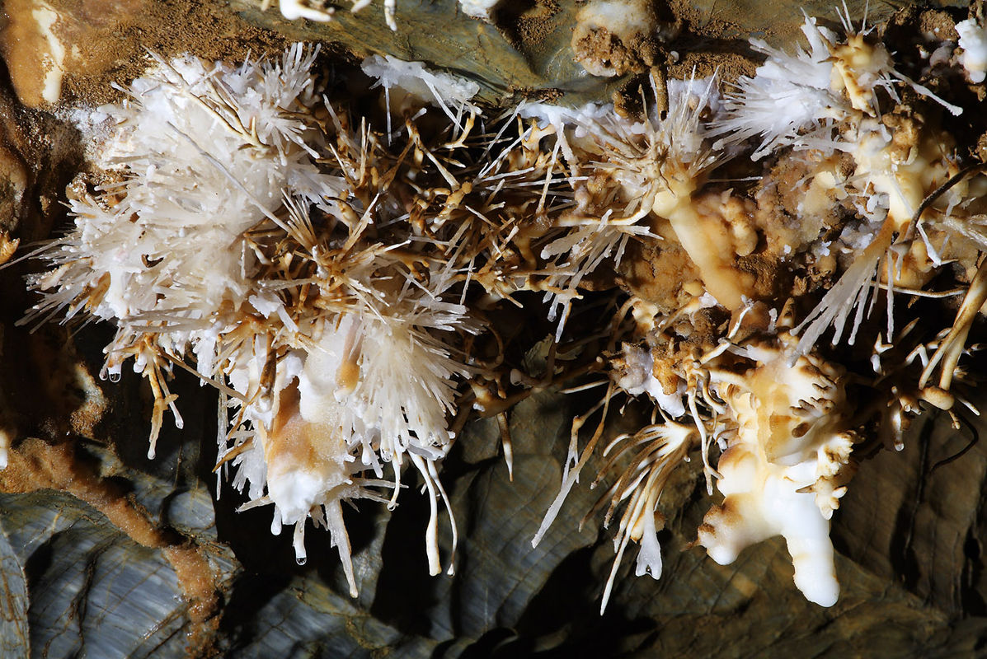
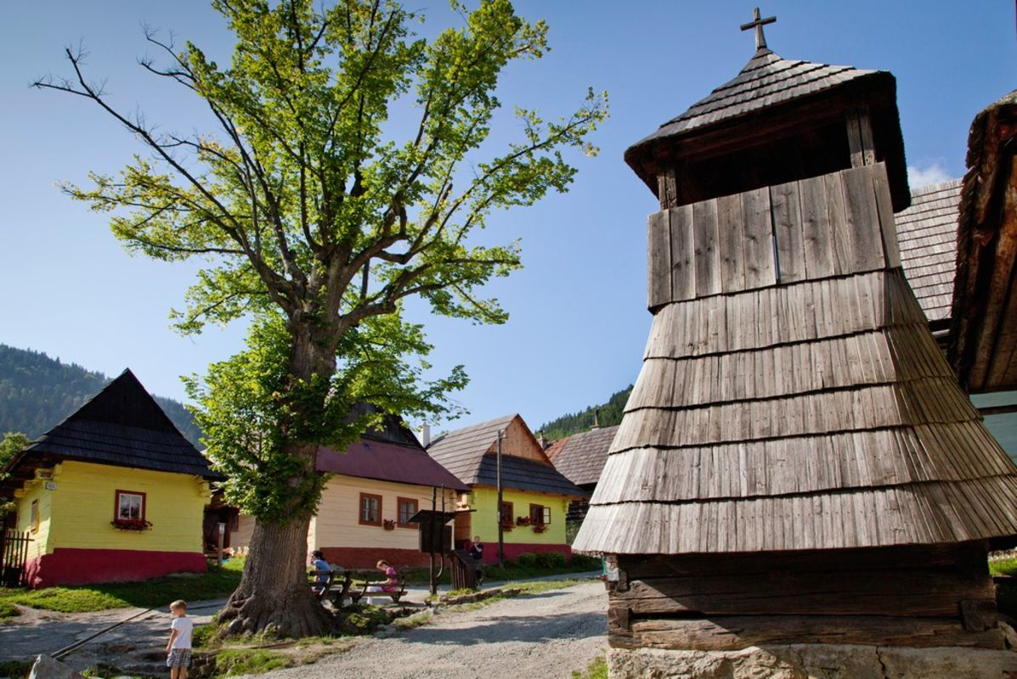
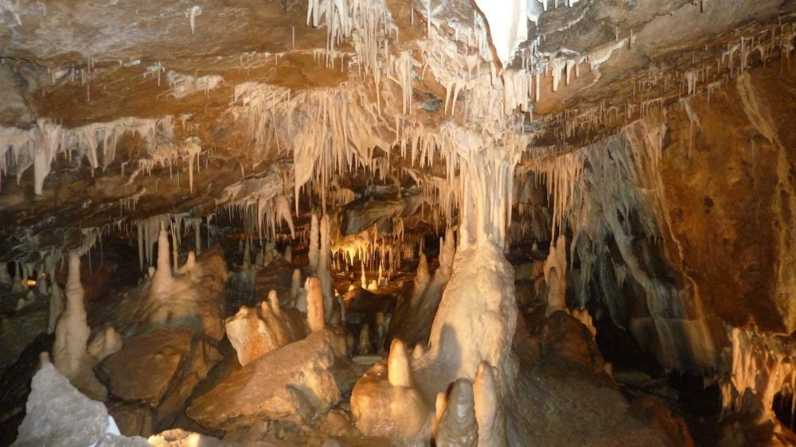
Caves
Vlkolínec – a very small historical village, which is part of Slovak town Ružomberok.
In these pictures are photos from Ochtinská Aragonite Cave.
There are only three caves of this type in the whole world – two are in America and one in Slovakia.

Slide 10
Thank you for your attention

